Slide 1

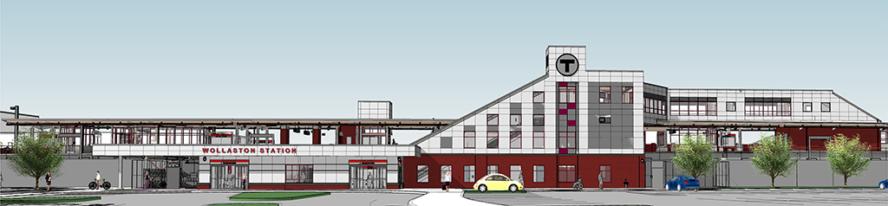
Wollaston Station Construction Presentation June 20, 2018
Get there
Getting around during Wollaston Station improvement work
Update during Wollaston Station
construction
June 20, 2018
Notes:
Katy Zazzera to present this slide.

Slide 2
Overview
A47CN01 – Wollaston Station Improvements and Quincy Center Garage Demolition
    Wollaston Construction Update
    Quincy Center Demolition
    Single Track Access
    South Shore Garages
    Bus Shuttle
    Parking Update
    Engagement/Communications Strategy
Notes:
Katy Zazzera to present this slide.

Slide 3
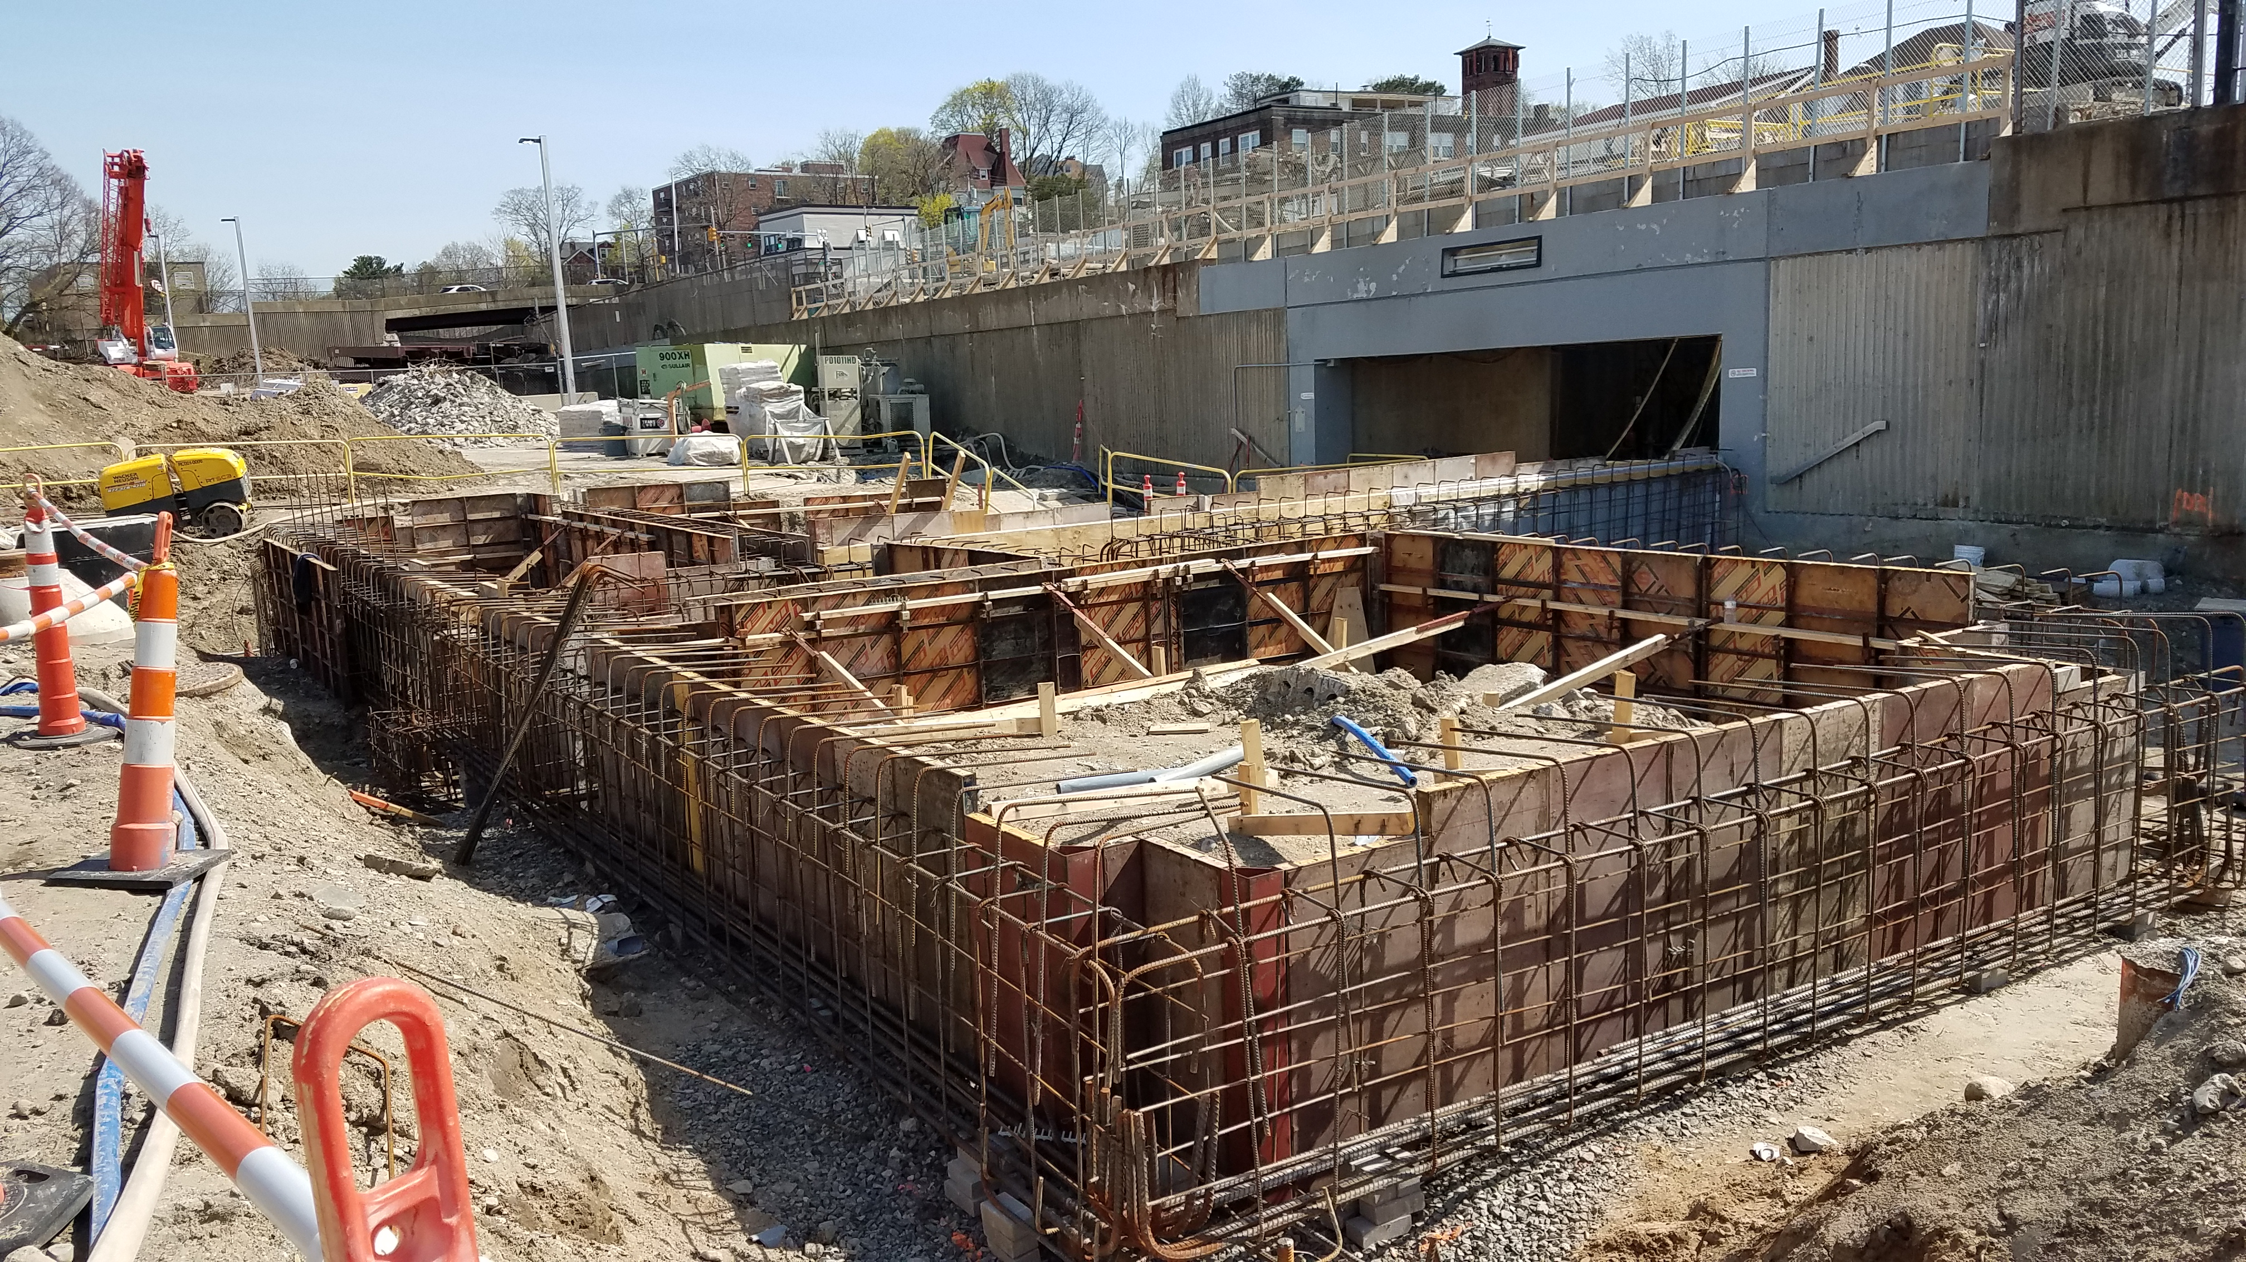
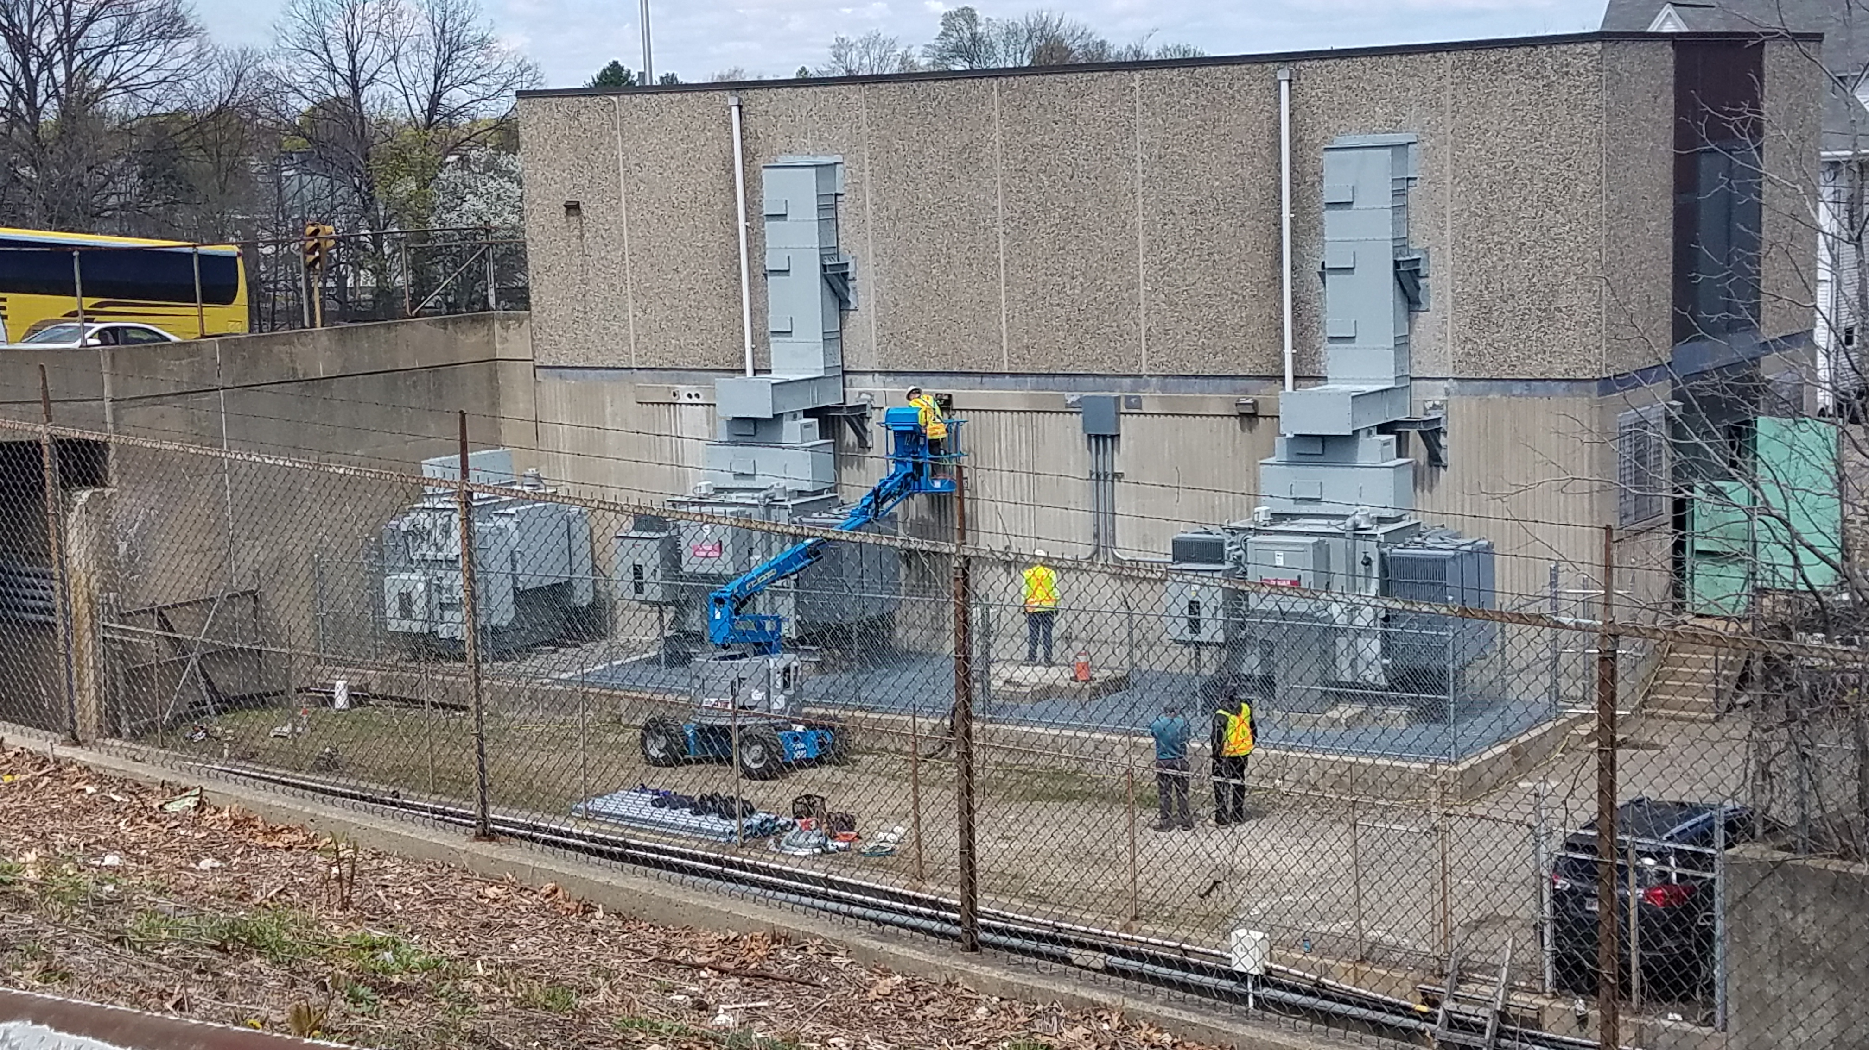
Wollaston Station Improvements Construction Status
A47CN01 – Wollaston Station Improvements and Quincy Center Garage Demolition
Parking Lot (East) Head House foundation work complete
Platform foundation work ongoing
New Stair 6 at platform being excavated
Site Utility work continues
Newport Ave. (West) entrance foundation work continues
Work at electrical substation continues
East Head House wall mock-up built
Newport Ave. will be reduced to 3 lanes beginning Monday June 25th and then for the remainder of the Summer.
Notes:
J. McCormack to present this slide

Slide 4
Wollaston Station Improvements Construction Status
Single Track Access
A47CN01 – Wollaston Station Improvements and Quincy Center Garage Demolition
Single Track Access is one of the contract’s options provided to the contractor to be able to perform critical work activities in the Right-of-Way (ROW) at Wollaston Station. The Red Line does not operate on one of the two tracks at Wollaston Station, either northbound or southbound, between North Quincy and Quincy Center during non-peak times of day. Currently, the contractor is utilizing this type of diversion to repair deteriorated concrete along the existing ROW.
Notes:
J. McCormack to present this slide

Slide 5
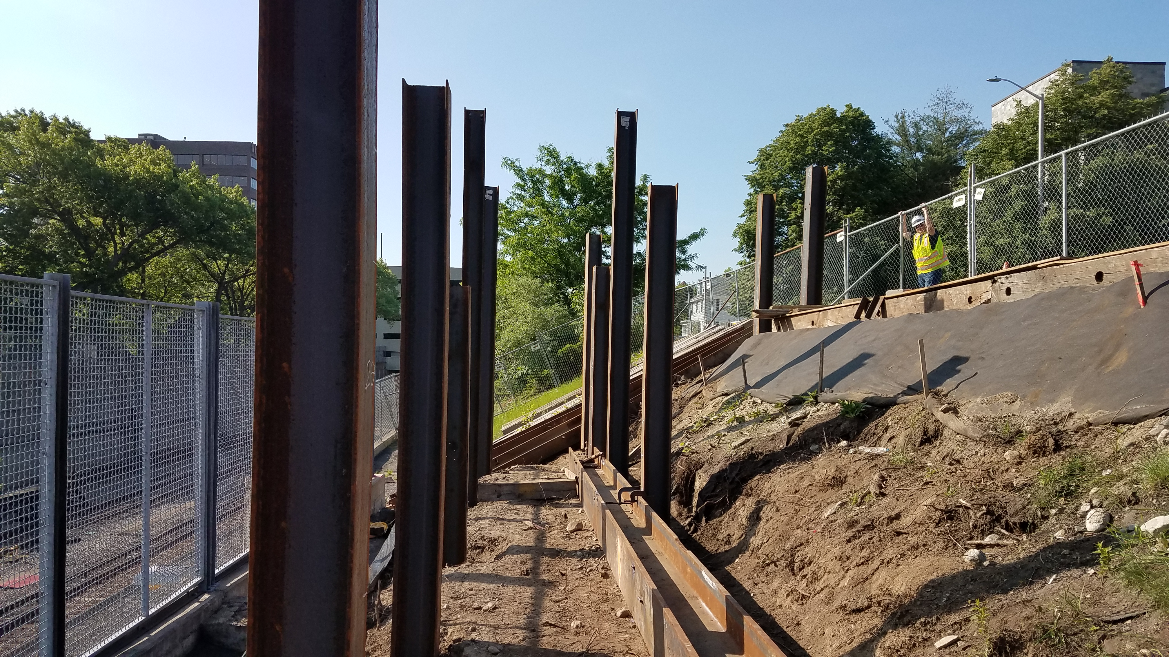
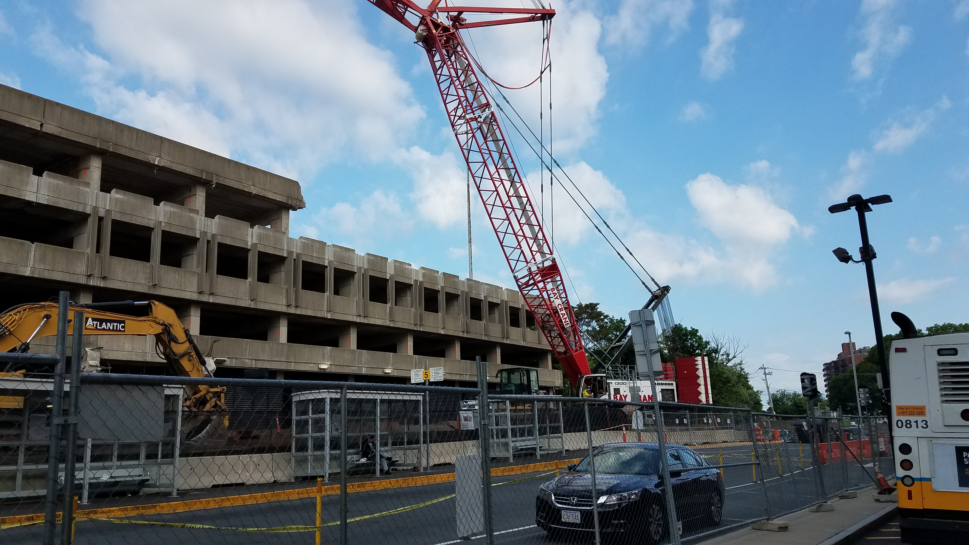
Quincy Center Garage Demolition and Improvements
Old Busway Canopy Removed
Burgin Pkwy. Accessible Walkway foundation work continues
Fifth Level of Garage continues to be removed.
Elevator work continues on platform level.
Elevator 810 will be shutdown from the 3rd week of July 2018 through to the Fall of 2018 to replace it with a new elevator cab and machinery.
Weekend Diversions will take place this fall to take down parts of the garage that remain over the tracks.
Notes:
J. McCormack to present this slide

Slide 6
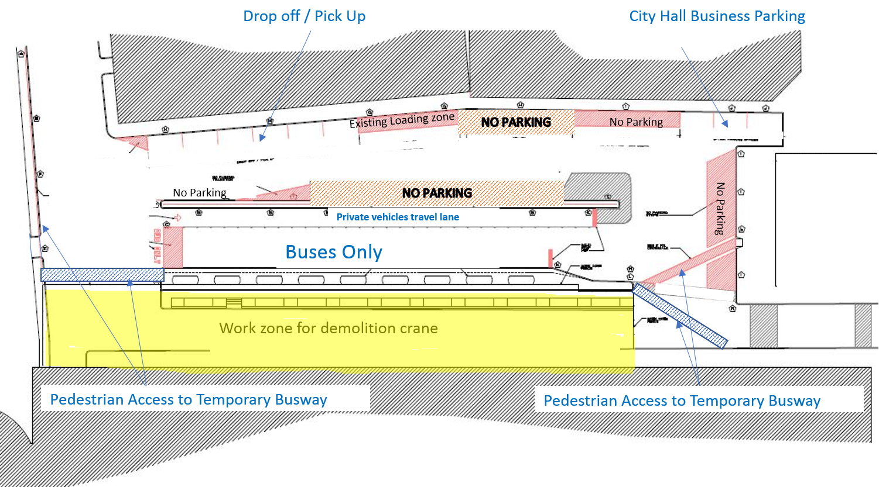
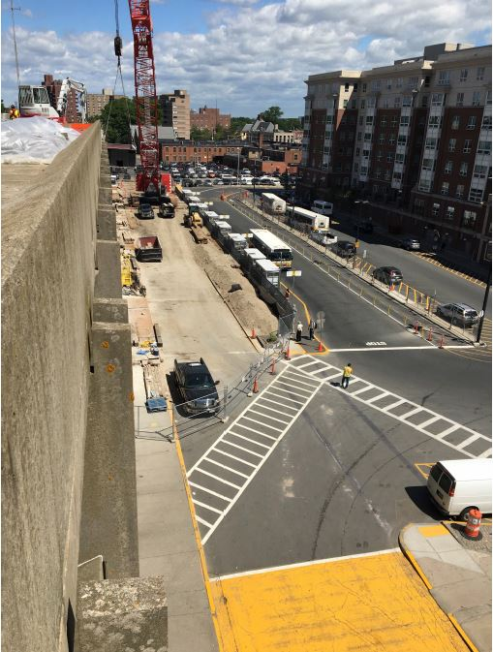
Quincy Center Garage Demo
Notes:
J. McCormack to present this slide

Slide 7
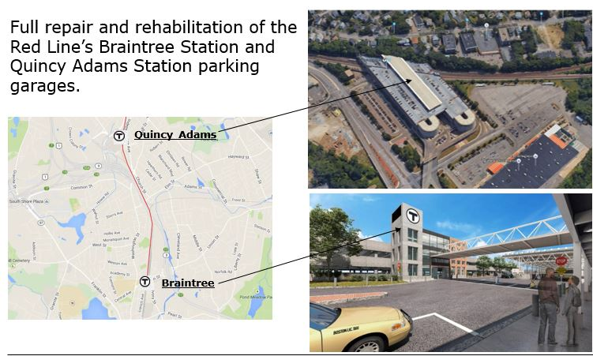
South Shore Parking Garage Repairs
MBTA Contract W46CN04
Contractor: McCourt/ Consigli JV
Notice To Proceed: 05/15/18
Substantial Completion: Fall 2021
Construction Budget: $64,300,290.00
Includes restoring two restrooms at North Quincy Station’s South Head House
On-site replacement parking provided
Notes:
J. McCormack to present this slide

Slide 8
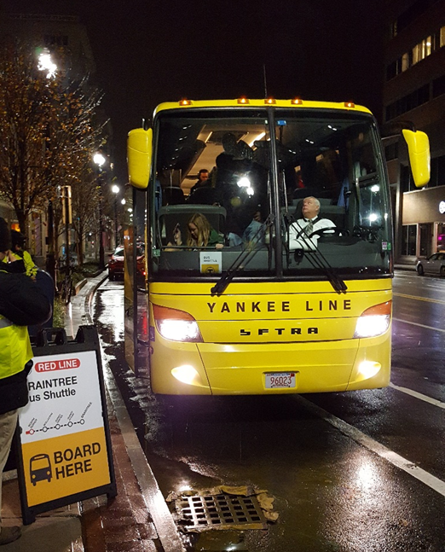
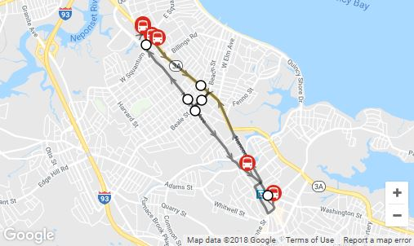
Bus Shuttle
A47CN01 – Wollaston Station Improvements and Quincy Center Garage Demolition
6 buses operate off-peak
10 buses operate at peak
1300 trips per rush hour on average
Map showing shuttle locations is live on mbta.com/Wollaston
Screenshot of live location map
Notes:
Dorsey Dugan to present this slide

Slide 9
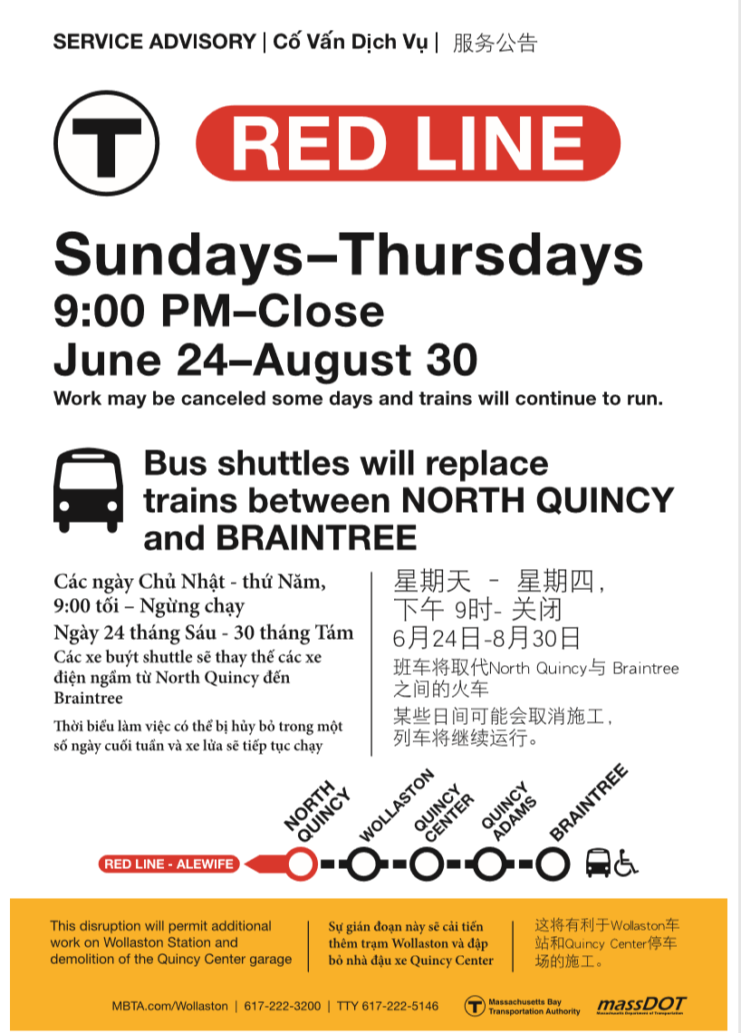
Upcoming Shuttle Calendar
A47CN01 – Wollaston Station Improvements and Quincy Center Garage Demolition
Weeknight Shuttles
  Red Line: North Quincy to Braintree
  Operating Hours: 9:00 PM through End of Service
  Operating Dates:
  Starting June 24th and lasting through the remainder of the summer
  Additional dates thereafter
Weekend Shuttles
  Red Line: North Quincy to Braintree
  Commuter Rail: Braintree to South Station
  Operating Weekends of:
  September 7^{th,} 2018
  September 14^{th,} 2018
  September 21st, 2018
  September 28th, 2018
  October 5th, 2018
  October 12th, 2018
  October 19th, 2018
  Additional Dates Thereafter
Please note: Schedules are subject change.
Notes:
J. McCormack to present this slide

Slide 10
Parking Observations
        There continues to be less than 50 cars parked at Wollaston Station during peak hours each day. Nearly 400 spaces still available.
        Prior North Quincy parking vacancy at Newport Avenue lot nearly eliminated during peak – consistently at 100% weekday occupancy.
        Commuters who once parked are choosing alternate modes of transportation.
Notes:
Evan Rowe/ Bruno Lopes to present this slide

Slide 11
North Quincy Station Transit Oriented Development (TOD)Parking Planning
    Construction for the TOD project is scheduled to begin Summer 2018
      Parking garage construction will be completed in Phase I of the project in recognition of existing parking demands.
      Given observations of commuter and parking patterns at Wollaston, vacancies at Wollaston will replace loss of spaces at North Quincy during the estimated 1 year construction period for the garage at North Quincy.
      Free shuttles between North Quincy, Quincy Center, and Wollaston
      Additional option to park at DCR’s Squantum Point to access Ferry Services

Slide 12
Engagement/Communication Strategy
A47CN01 – Wollaston Station Improvements and Quincy Center Garage Demolition
MBTA has created a tailored public outreach plan for the project.
Creation of Wollaston Community Advisory Committee (CAC)
Weekly update of activities listed for Wollaston & Quincy Center stations at: MBTA.com/Wollaston
Hand-delivery of Informational flyers to directly impacted neighborhoods in four languages: English, Traditional & Simplified Chinese and Vietnamese
  Shuttle bus route map
  Sewer work outside Wollaston Station
  Quincy Center Demolition
  Overnight Work
Individual meetings - Project Team has meet with individual abutters including homeowners and businesses

Slide 13
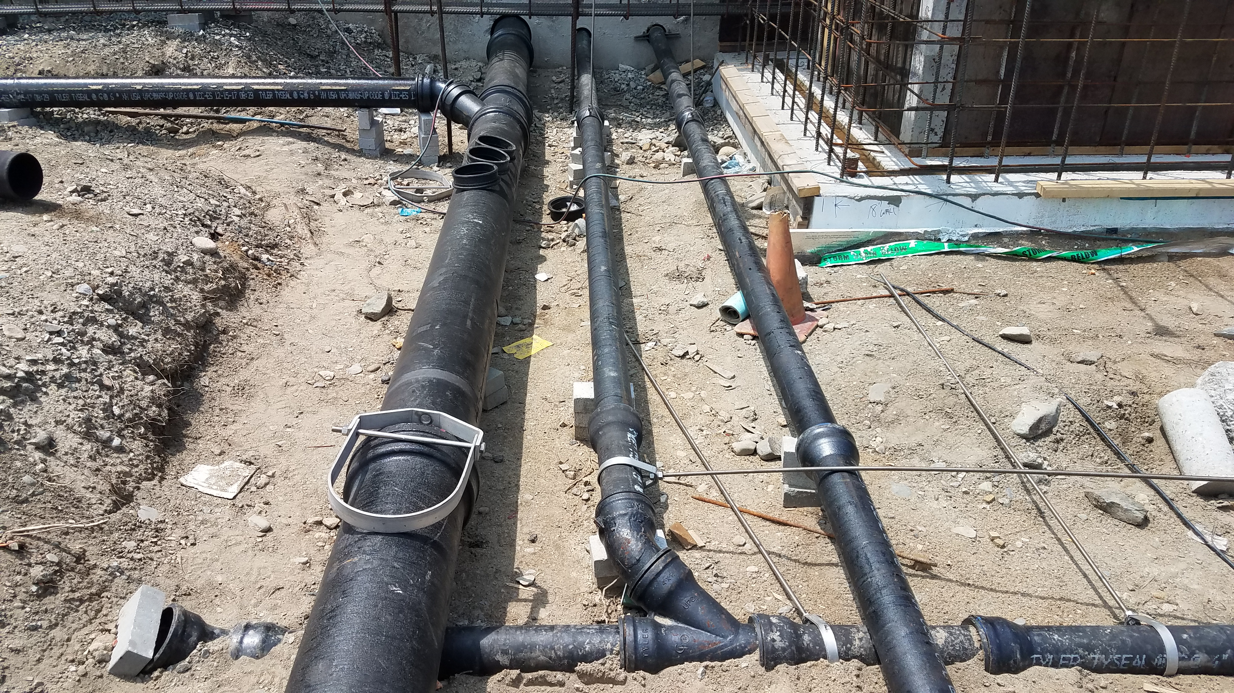
Engagement/Communication Strategy (cont.)
A47CN01 – Wollaston Station Improvements and Quincy Center Garage Demolition
Email blasts from Project Team - information sent to mailing list of over 360
Direct project email address - Wollaston@mbta.com - established by Project Team to respond directly to community concerns
  The three major categories of public interest thus far are:
      Shuttle Bus Service
      Construction
      Redline/Commuter Rail service issues
  Responded to over 140 requests for information
Public Meetings

Slide 14

Contact us
A47CN01 – Wollaston Station Improvements and Quincy Center Garage Demolition
617-222-3200
Call for questions, schedules, or trip planning.
For more information go to mbta.com/wollaston
Email the Project team: Wollaston@mbta.com
Thank you for your patience during construction!

Slide 15
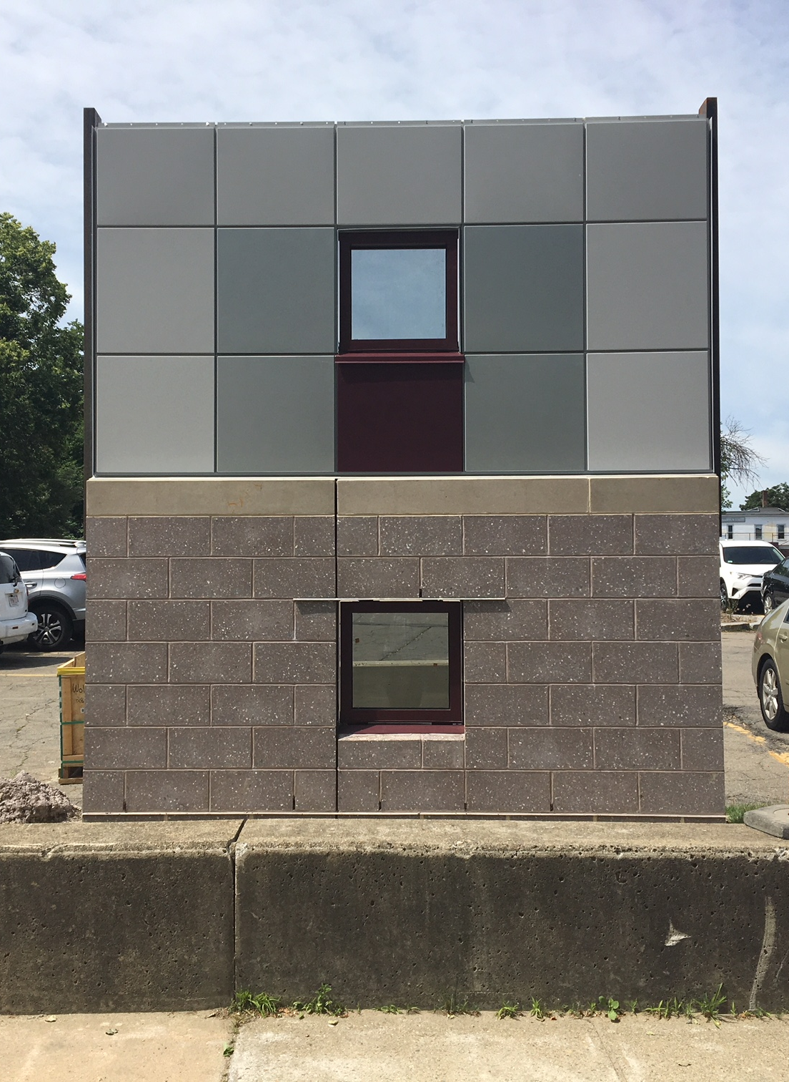
Thank you!
A47CN01 – Wollaston Station Improvements and Quincy Center Garage Demolition
Next CAC Meeting will be
September 19th, 2018

