Slide 1
Commuter Rail Positive Train Control (PTC)
Program Update
September 24, 2018

Slide 2
OVERVIEW
Commuter Rail PTC – Program Update
PTC is MBTA’s highest priority Capital Program.
MBTA has achieved its September 21, 2018 goal for meeting the requirements necessary to apply for and be granted an extension for a full PTC system deployment by 2020.
MBTA, together with the current team of Contractors and Consultants, will continue to execute PTC Program Plans in order to deploy PTC across the entire Commuter Rail System by August 31, 2020 in compliance with the FRA regulations, which require complete deployment by December 31, 2020.
MBTA received an additional $20 million grant from FRA for the implementation of PTC.

Slide 3
CURRENT PTC ACTIVITIES AND PROGRESS
Commuter Rail PTC – Program Update
Work required to Formally Request an Extension from FRA for MBTA’s PTC System Implementation to 12/31/2020 - Complete
Wayside Equipment Installation - Complete
Onboard Equipment Installation - Complete
Stoughton Pilot Line Formal Field Qualification Testing (FQT) - Complete
PTC Training of Keolis Staff for RSD - Complete
PTC Configuration Management System - Complete
Revenue Service Demonstration (RSD) Application submitted to FRA September 18,2108
Request for Extension submitted to the FRA on September 21, 2018

Slide 4
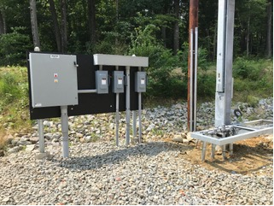
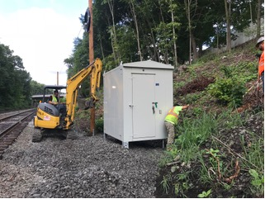
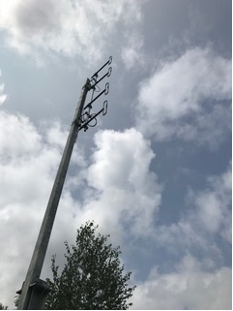
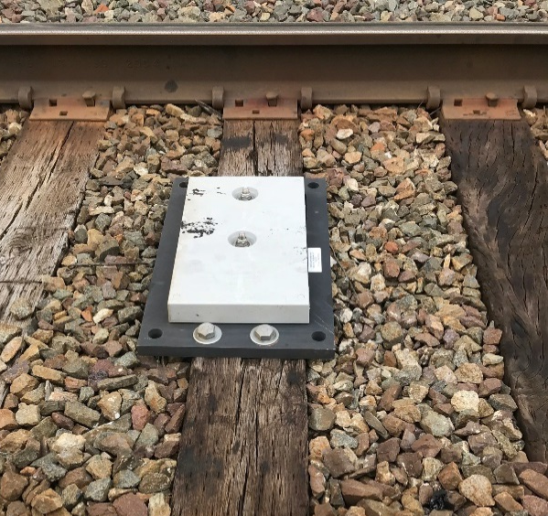
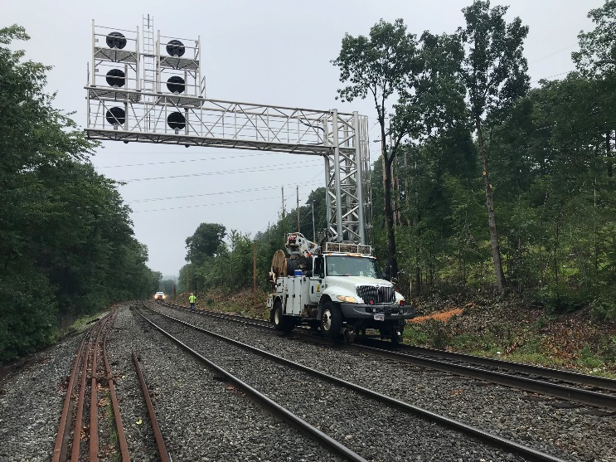
Commuter Rail PTC – Program Update
95 Locomotives - 84 Control Cars
194 Wayside Interface Units
(WIUs)
181 Wayside Radios
181 Antennas
3097 Transponders
223 Miles of Fiber optic cable

Slide 5
NEXT STEPS
Commuter Rail PTC – Program Update
Place Stoughton Line in RSD upon FRA Approval
Expected Late November
Complete testing and submit RSD application for Lowell Line by December 31, 2018. (Weekend shutdowns for testing to continue through 2018).
Complete testing of remaining lines and place in RSD
Fairmount Line Testing starts in October
Commissioning of remaining lines by August 31, 2020
Upgrade vehicle fleet to Rev 11 ACSES Software
Planned for October and November
Coordinate with Amtrak, CSX, & Pan Am for Interoperability Testing
Implement ATC on Worcester, Needham, and Franklin Lines by 2020

