Slide 1
Human Resources Update
Q4 FY 2018
September 24, 2018

Slide 2
Agenda
Key Leadership Hires
Hiring statistics & action plans
Organizational transformation
KPI Update
Compensation

Slide 3
Talent Acquisition

Slide 4
Critical Hire Update
Title | New Hire | Internal Promotion
Chief Greenline Transformation (repurposed from Policy, Innovation & Transformation) | Angel Pena
Senior Director of Infrastructure Engineering & Planning | Joseph Pavao*
Chief Customer Officer | Danny Levy*
Director of Warehouse & Logistics | Dan Barton
Deputy Chief Real Estate | Offer extended
Senior Director of Real Estate | Roger Mann*
Open Roles | Status
CFO | Candidates interviewing
Chief EHS Officer | Candidates interviewing – Hard to fill role
Senior Director of Engineering & Maintenance | Open and reviewing resumes
Executive Director of Commuter Rail | Finalizing
Chief Counsel | Candidates interviewing
Director of Ferry Services | Offer in progress
Program Manager for Red/Orange Line | Finalizing
* Transferred from another Commonwealth agency

Slide 5
Programmed Hiring Dashboard
Pivot Point
218 Part-Time Bus Operators Hired FY18
75 Part-Time Streetcar Motorpersons Hired FY18
In FY19 Staffing has exceeded the goal for Bus hiring and met the goal for Streetcar hiring
Targeting 50 hires again in November Bus class and maybe January, assessing future needs
2017
2018
Trending in right direction, team effort focused on hiring
Process improving with four month effort
More streamlining and efficiencies to come

Slide 6
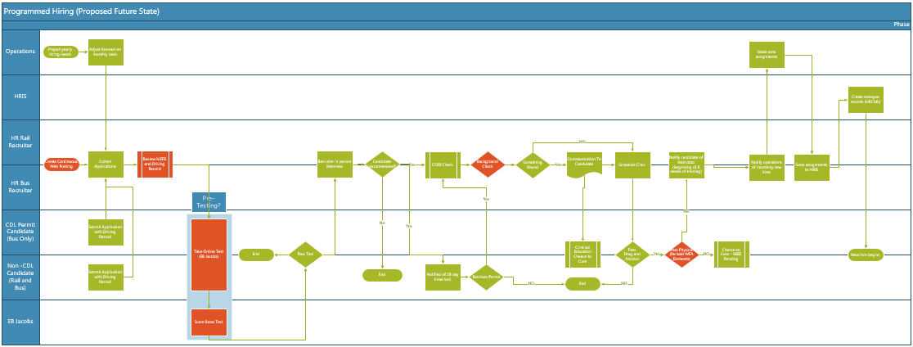
Our future state design eliminates 50% of the process steps… ….while ensuring compliance with FTA and other statutory requirements
Programmed Hiring - Leaning the process
Current: 62 steps
Proposed: 32 steps
Current State yields 2.3% hires
Automating Boss Testing with immediate results starting 10/5
Driving records review moved up in process to ensure qualified candidates are identified – 50% lost in the past - new process started 8/15
Calling candidates to begin process in time for classes vs. 4 x’s per year – lost 50% in the past to no shows

Slide 7
Time to Fill FY18 Posted Roles
58 days average Time to Fill
(not including programmed hiring or TPD)
378 Hires & Promotions
100+ days to fill include unique, niche roles difficult to find in market and constrained by compensation package – 13 @ 140+ days
37% (141) filled within 40 days - 55+% filled in 60
GOAL – 90 Days
GOAL – 45 Days

Slide 8
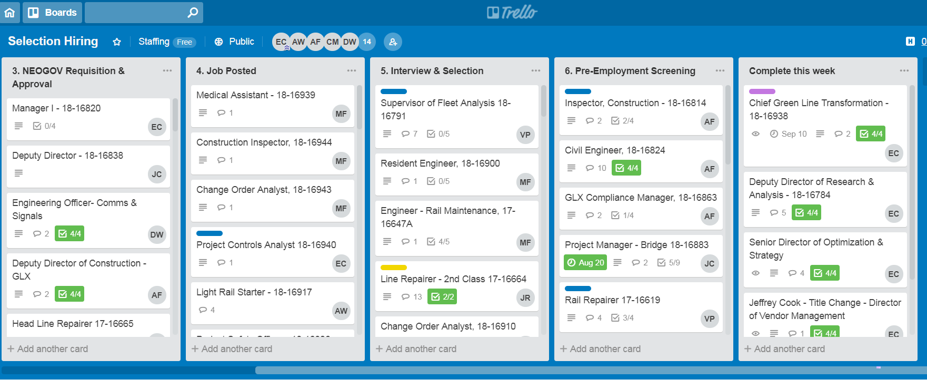
Trello
…using technology to improve visibility and accountability
Digital dashboard showing status of jobs in each phase
Interactive real time communication between manager and recruiter
Reviewed weekly with General Manager and HR staff
Implementing to leadership team for their review

Slide 9
Leave Management

Slide 10
FMLA Actions Taken since June 2018
Task force meet weekly to focus on dropped trips
Task force fully aligned on priorities and co-lead by DGM Gonneville and AGM Haase
Cohesive team making decisions as a team– OHS, Bus operations, LR, Legal, Analytics, Leave Mgmt.
Identified Performance Issues and developed a project plan
Certification Verification:
Nurse Case Manager Review
Clarification/authentication to validate initial certification
Medical Director Review Process
2. Frequency & Duration:
Developed enhanced analytics reporting – identify FMLA Pattern Use by day of week, schedule, holidays, school vacations, and sporting events
Implemented recertification process for any employee exceeding F & D
Create evaluation plan for impact of F & D recertification efforts

Slide 11
FMLA Actions Taken since June 2018 continued
3. FMLA Case Management (Workflows):
Updated FMLA and Frequency & Duration workflows to ensure compliance with FMLA regulations. Created Pattern Absence Workflow
Implemented a Return to Work status program in conjunction with OHS
Designate without Documentation- employees on approved workers comp
Statement of Family Relationship- form inserted into FMLA packets
Weekly meetings with Senior Staff and monthly meetings with WorkPartners CEO and President
As regulations change, continue to review & update process improvements
4. Outreach Initiatives:
Scheduling employee workshops focused on FMLA/dropped trips
Meetings with Local 589 and MBTA Leadership to address FMLA usage and dropped trips

Slide 12
Total Number of Employees Open FMLA & ADA
Average # of EE’s with Open FMLA
Average: 1820
822
728
664
96% Intermittent
97% Intermittent
97% Intermittent
95% Intermittent
27% Of Employees
28% Of Employees
27% Of Employees
31% Of Employees

Slide 13
Managing the FMLA Caseload- FY 2018
Top Three Reasons For Denials
#1: No documentation provided
#2: Ineligible
#3: Exhausted
Top Three Areas For Approvals
#1: Bus Maint & Transportation
#2: Light Rail
#3: Heavy Rail
Achieving Success
Improved Management of TPA
Monitored Usage
Enhanced Analytics
9% (545)
6% (390)
FMLA Approval Rate Trending Down
* Federal regulation mandating timeframe of required paperwork

Slide 14
Key Performance Indicators

Slide 15
Key Performance Indicators – Two months in
Management team KPI’s are showing to be on time & on target
Aligned to Authority’s and GM’s goals
Transparency of priorities down to the individual level to drive accountability

Slide 16
Compensation

Slide 17
Compensation
Mercer Bench-marking Study Completed June 2017
Transit & Mercer Benchmark data completed May 2018
New organization presented to the Board March 2018
Adjustment/ alignment of roles to org July 2018
New Band & employee impact analysis completed August 2018
1st group
of adjustments made August 2018
Sept - Oct 2018- completing alignment review
…Addressing titles, band structure and some necessary market adjustments
Reviewing the rollout with the Executive Leadership-September 2018
Re-evaluate when new Market data is available - March 2019
Will look to implement merit increase program for FY20
16

Slide 18
MACP

Slide 19
MACP Funding
Task force led by MBTA HR
Focus on the three key initiatives
1. Drive our ability to retain key talent thru providing development & management best practices training- Kicking off October 3
45 Participants, Bus Operations Managers from all bus garage locations
2. Expand our ability to source candidates for key assignments by engaging recruitment firms, one-time signing bonuses, relocation fees, e.g. Real Estate, CFO, EHS
3. Secondment Staffing to impact change with loaned leadership
Clearance from the State Ethics approved Sept 2018.
Next steps are to identify the key assignments
Delayed kick off, but back focused on program
Re-engagement with MACP in August/September

Slide 20
Appendix

Slide 21
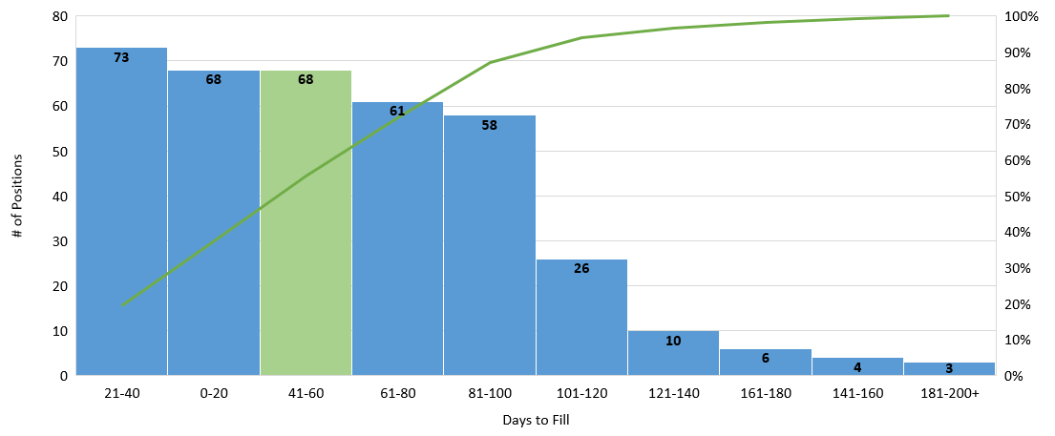
Time to Fill Pareto
Signals, Safety, R/O & AFC2.0 PMs, GLX

Slide 22
Time to Fill Pareto Details
Distribution for majority of roles is normal but executive and niche roles continue to prove challenging
0-20: Lottery (Track Laborers), Union Referrals, Appointments
21-40: Seniority positions (Track Persons, System Repairers), SPPs, Appointments, Selection Process – Easier to fill roles with strong applicant pool
41-60: Senior Project Managers, Staff Assistants, other support roles in Capital Delivery area
61-80: Project Managers, Chief Inspectors, Senior Budget Analysts, Forepersons
100+: Harder to fill roles within Safety, IT, Red/Orange Line PMs, Program Manager for AFC 2.0, AGM Transit Programs, Gen. Counsel, EHS,

Slide 23
Number of Employees Approved FMLA By Quarter

