Slide 1
General Manager’s Remarks
Fiscal and Management Control Board
September 24, 2018

Slide 2
Agenda
PTC overview
Rail Safety Week
Bus arrival, prediction improvements
Tufts Medical Center real-time information
UMass Lowell – Commuter Rail partnership

Slide 3
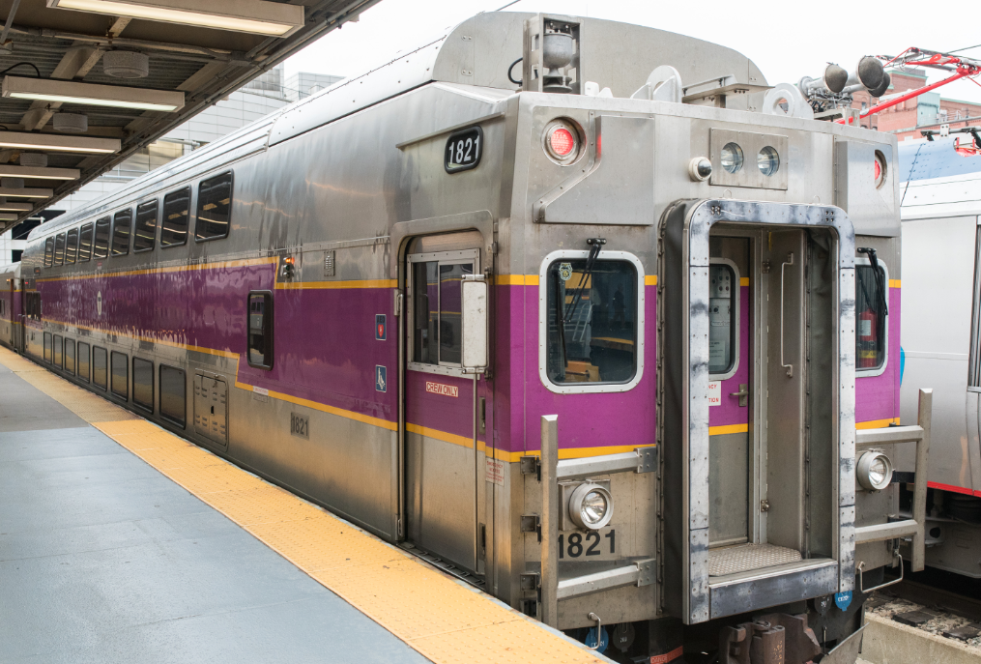
Positive Train Control overview
PTC is T’s highest priority capital program
MBTA now off FRA list of systems “at risk” of failing to meet deadline
Met necessary requirements to apply for extension for full PTC deployment by end of 2020
Efforts will continue to focus on deployment plan
Upon implementation PTC will provide major, modern safety enhancements

Slide 4
Operation Lifesaver (OLI) – Rail Safety Week – September 23rd - 29th
External Outreach for Commuters & Passengers:
Rail Safety messaging on 160 MassDOT Digital Billboards and RMV Display Ads statewide
OLI messaging on MBTA in-station digital displays and on the Commuter Rail mTicket App
Signs, posters, and audio announcements onboard subway and commuter rail trains
Internal Outreach for MBTA Employee’s:
Rail Safety Week posters at all Rail, Bus, and E&M facilities
Managers will conduct rail safety briefings with their employees
Personnel will receive safety reminder cards that they may keep on their person

Slide 5
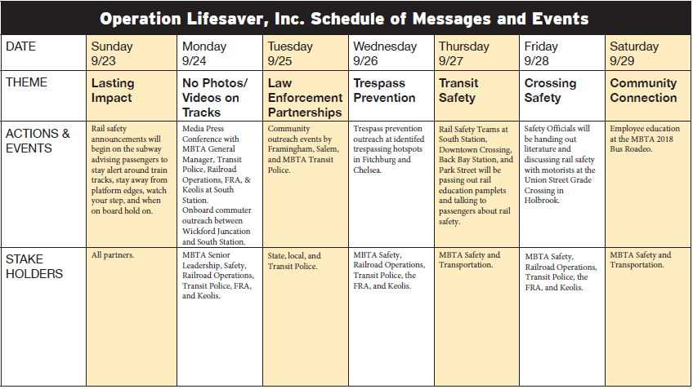
Operation Lifesaver (OLI) – Rail Safety Week – September 23rd - 29th

Slide 7
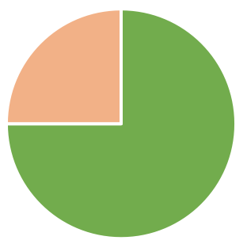
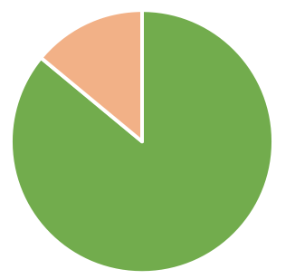
RTAPS: Real-Time Arrival Prediction System
Status: previous bus predictions required years of fine-tuning; prediction accuracy currently about 75 percent*
Action: selection process for new vendor included vendor-blind “bake-off,” comparing live predictions and actual live raw data
Result: winning bidder, Swiftly, will bring accuracy up to approximately 84 percent
Cutover to new vendor to be complete within next five weeks
75
%
accurate
%
84
accurate
*Based on predictions of 0-30 minutes, with stricter accuracy requirements for lower “closer” predictions.

Slide 8
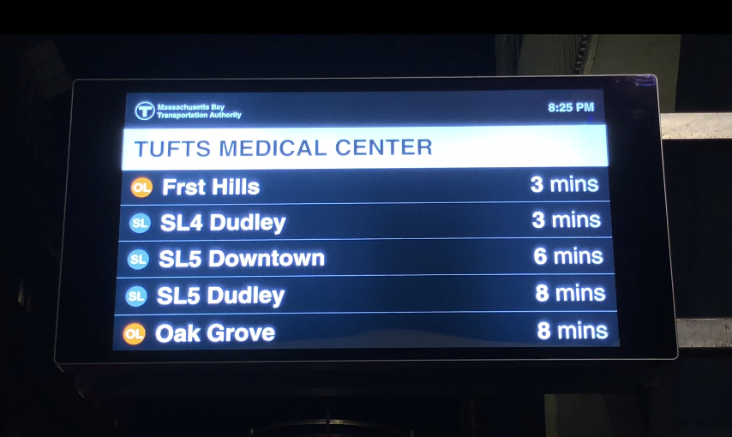
Real-Time Information: Tufts Medical Center
For the first-time ever, rapid transit and bus information together at street level
Major customer-facing improvement providing real-time info to our customers where and when it is helpful
Plans to expand real-time info into digital panels in the near future

Slide 9
MBTA-UMass Lowell Commuter Rail Pilot
First-of-its-kind-program allows members of UMass Lowell community to ride Commuter Rail at no cost
Launched on Sept. 17, saw 3,000 sign-ups in first week
Program connects students to internships, cultural and sporting events in Boston; has potential to reduce need to drive, reducing GHG
Appreciate UMass Lowell’s leadership to partner in this program

