Slide 1
Bus Network Redesign Update
September 24, 2018
Office of Transportation Planning

Slide 2
MBTA Bus Network Redesign Problem Statement
The FMCB wants to improve bus service for all riders, and has developed a problem statement to serve as a starting point:
Changes in land use and changing demographics across the Boston region have resulted in travel needs that the MBTA’s current network does not serve well or at all
The MBTA should have a route system that reliably and efficiently serves the largest number of existing and potential riders while also serving customers with significant equity and mobility access needs.
The deliverable of this effort will be:
Recommendations for an implementable new bus network that will better serve the region’s needs – including routes, frequency, span of service, and coverage.
Question for FMCB: Do we need to expand the problem statement to include more specificity on outcomes?

Slide 3
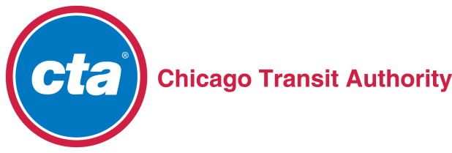
MBTA Bus Network is Different: 51 Cities and Towns
MBTA bus system decision-making is complicated by serving 51 municipalities whereas many peer systems (NYC MTA, CTA, MUNI for example) focus primarily on only one.
Question for FMCB: What role should cities and towns have given the unique nature of the network?

Slide 4
MBTA Bus Network is Different: Planning, Infrastructure, Productivity
MBTA is already pursuing the Better Bus Project, which is analyzing the gap between today’s bus service and the standards set by the January 2017 Service Delivery Policy
This planning process is a key element of many other network redesigns being conducted by other systems
Bus network is integrated with rail and rapid transit network
MBTA bus system is among the most productive in the nation (third highest passenger per revenue vehicle mile among large urban bus systems)

Slide 5
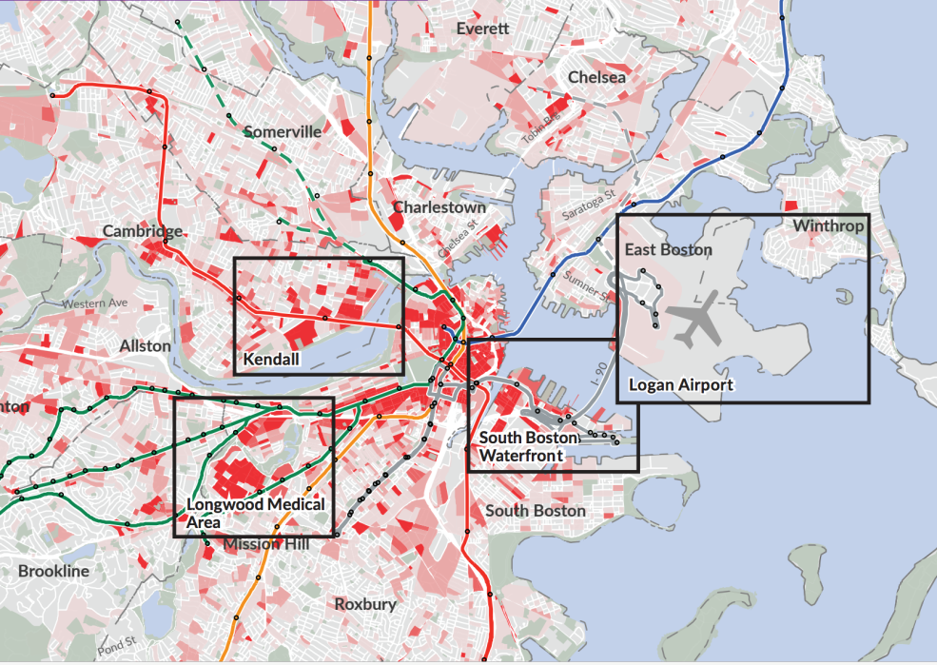
MBTA Bus Network Redesign Focus
The unique features of the MBTA system/Boston region and the problem statement identified by leadership argues for a focus on:
New routes to better serve identified corridors and Focus40 Priority Places
Analysis of low performing routes based on existing productivity
High Productivity Bus Route
Low Productivity Bus Route
Question for FMCB: Should this process consider redesigning the whole network or focus only on low productivity routes and new corridors?

Slide 6
Bus Network Redesign Process
2018
2019
2020
Phase 1: Development of Network Level Goals and Metrics
Phase 2: Corridor Analysis, Development/Evaluation of Concepts
Question for FMCB: RFI or RFP?
Phase 3: Incremental Implementation, Pilots of New Service
Question for FMCB: Incremental approach or comprehensive changes?

Slide 7
Phase 1: Development of Network Level Goals and Metrics
Convene internal and external working groups focused on process design and the development of network level metrics
Network level metrics will be used to explore tradeoffs, and evaluate both the current system and alternative bus network designs
Questions for FMCB:
Should the Network Redesign consider changes to the geographic scope of the MBTA bus network?
What should the Network Redesign assume for bus operating budget, fleet size, and management oversight?
How should the process take into account the uncertainty of municipal partnerships for on street transit accommodation?

