Slide 1
Bus Fleet and Facility Program
September 24, 2018

Slide 2
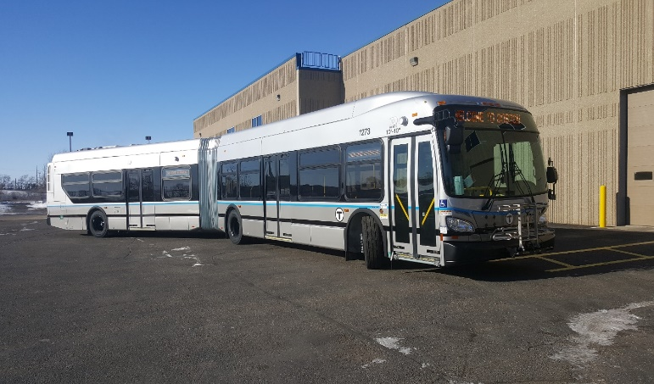
Problem Statement
Near-Term Bus Fleet and Facility Program
The MBTA bus fleet will expand over the next 25 years
1150 – 1400 of total bus maintenance and storage capacity will be needed
Ensure flexibility in new facilities to support fleet vehicle types
Expansion to new technologies that require new capability
Extended-Range Hybrid Buses
Electric Buses
Building for the future

Slide 3
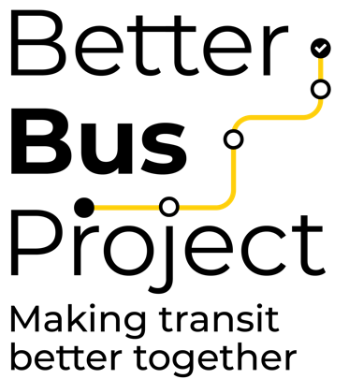
Program Plan
Near-Term Bus Fleet and Facility Program
The Fleet and Facility Plan will be initiated within Office of Chief Engineer
Coordination/Working group: Maintenance, Bus Operations, Capital Delivery, Capital Program Oversight, Engineering, Planning, Environmental, Real Estate
Develop action plan for Capital Program
Garages by Capital Delivery
Fleet by Vehicle Engineering
Informed by the Better Bus Project and the Bus Network Redesign
Expect action plan for facilities to be in place in 12 months
Bus procurements to begin according to 10/1 FMCB Action
Sequence Bus procurements and Facility improvements on a single timeline
Bus Network Redesign

Slide 4
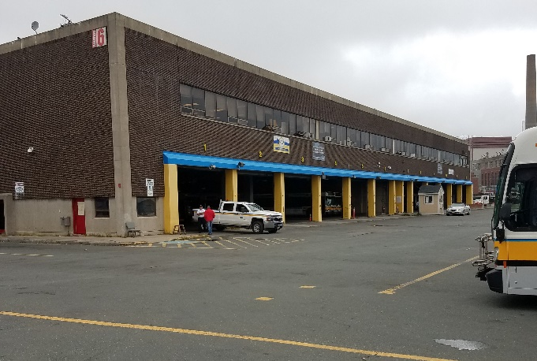
Near-Term Bus Fleet and Facility Program
MBTA Bus Garage Overview
MBTA’s Bus Garage Infrastructure consists of 10 Maintenance Garages, including Everett Heavy Maintenance
MBTA Garages have a bus capacity ranging from 28 to 254
Current Facilities Status
At or beyond capacity
Average age 54 years
Average TERM Condition Score: 2.75
Some functionally obsolete (e.g. capacity, ceiling heights, door heights)
Action: Develop an executable bus facility strategy for future need and technology
Locations/Permitting
Bus Propulsion
Battery Charging
Electric Utility
Bus Storage
etc.

Slide 5
Near-Term Bus Fleet and Facility Program
MBTA Bus Fleet Overview
MBTA’s bus fleet consists of 40-foot and 60-foot buses using multiple forms of propulsion including CNG, diesel, diesel-electric hybrid, and electric (overhead catenary lines)
Current fleet size – 1024 buses
Average fleet age – 7.3 years
MBTA bus service life is typically 12-15 years
FTA requires minimum of 12-year service life
MBTA typically conducts fleet overhauls after 6+ years
Evaluation of condition and required overhaul scope to improve vehicle reliability and passenger experience
Action: Develop an executable 10+ year fleet procurement plan
Fleet expansion
Propulsion technology advancement

Slide 6
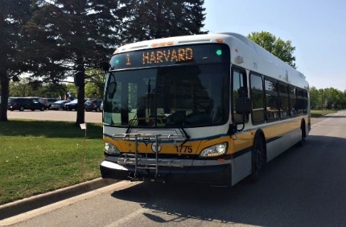
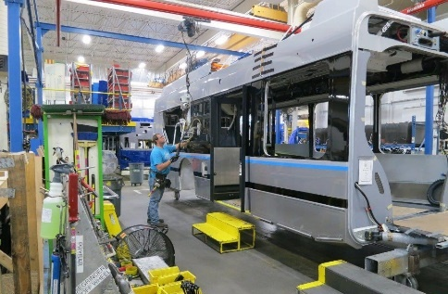
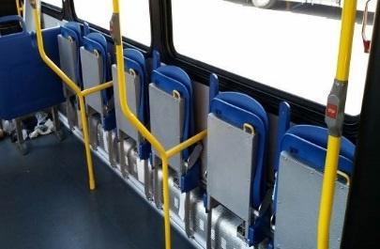
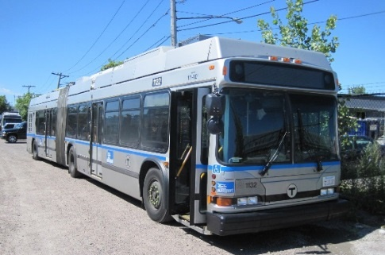
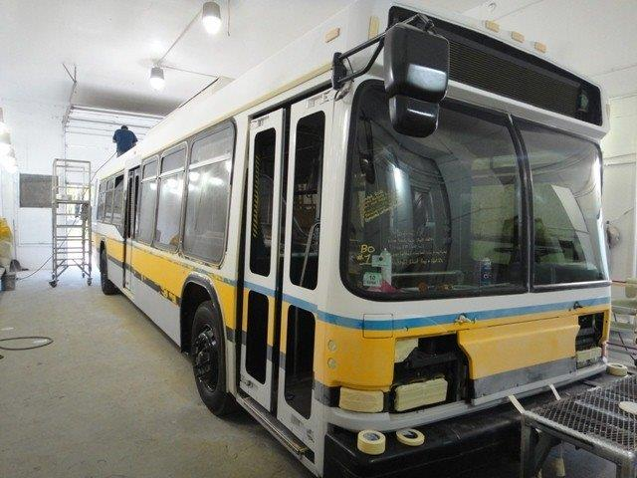
Recent and Ongoing Bus Programs
Near-Term Bus Fleet and Facility Program
New Bus Procurements:
325 + 6 New Flyer 40-foot CNG and Hybrid buses – last bus delivered July 2017
44 + 1 New Flyer 60-foot Hybrid buses – last bus delivered September 2018
5 New Flyer 60-foot battery electric buses (Low-No grant) – expected delivery Spring 2019
Bus Overhaul Programs:
32 Neoplan 60-foot DMA overhaul program – last bus delivered August 2018
155 New Flyer 40-foot ECD buses (option fleet) – overhaul underway (completion 2019)

Slide 7
Near-Term Bus Fleet and Facility Program
Bus Fuel Economy Advancements / Sustainability
New Flyer Diesel:
40-foot Low Floor Bus – 3.24 avg. mpg
60-foot Low Floor Bus – 3.19 avg. mpg
New Flyer Hybrid:
40-foot Xcelsior Bus – 5.34 avg. mpg
60-foot Xcelsior Bus – 4.09 avg. mpg
New Flyer Hybrid 60-foot extended range bus (45th Bus)
Configured with 120% more battery storage capacity with start/stop functionality and extended ranges with engine-off, zero-emissions operation.
New-improved battery chemistry supplying greater capacity and storage.
Capability to complete 2.2-mile Silver Line Transitway Tunnel in engine-off, zero-emissions EV mode.
Planned testing of this advanced hybrid bus will determine overall benefits and fuel economy.
194 New Flyer Advanced Hybrid 40-foot Low Floor Option Bus:
Configuration will increase battery capacity by 166% with start/stop functionality and engine-off, zero-emissions operation
Expected to reduce fleet fuel consumption and emissions as compared to traditional diesel fleet:
2.8 million gallons of fuel saved
Reduced greenhouse gas (GHG) emissions by 41,000 tons
Reduced nitrogen oxide (NOx) emissions by 28,000 tons
Reduced fleet idle time by 900,000 hours

Slide 8
Near-Term Bus Fleet and Facility Program
Planned New Procurements & Overhaul Programs
Next bus fleet replacements include:
193 Neoplan 40-foot Emission Control Diesel buses (ECD) [2003 – 2004]
32 Neoplan 60-foot Dual Mode Articulated buses (DMA) [2004 – 2006]
28 Neoplan 40-foot Electric Trolley Buses (ETB) [2004]
Next bus fleet overhauls include:
25 New Flyer 60-foot Hybrid buses – specification under development [2010]
60 New Flyer 40-foot Hybrid buses – overhaul anticipated 2020 [2014]
Next Procurements:
Exercise Option for 194 NFI 40-foot hybrid buses Board 10/2018 (Replaces 193 Neoplan ECD buses)
Professional Services Contract (New Bus Fleet and Technology) Board 11/2018 (Supports bus fleet replacement and expansion program + propulsion technology advancement)
Professional Services Contract (Bus Overhaul) Board 03/2019

Slide 9
Facility Program Development Plan
Near-Term Bus Fleet and Facility Program
Spring 2019
Summer 2019
Summer 2019
Fall 2019
Future
Validate Focus40 and IFFP service needs regionally
Confirm/revise fleet needs to address anticipated regional service demand
Overlay existing routes and contemplated Better Bus Project bus route changes
Current facility evaluation
Analyze feasibility of modifying and/or expanding current facilities
Identify real estate to for construction of new facilities (environmental, permitting)
Model facility Design (Procure Designer Support)
Small (100 busses or less)
Medium (100 to 200 busses)
Large (greater than 200 busses)
Investigate modern technology, building techniques and partnerships
Electric Bus Infrastructure
Vertical and TOD development
Separation of maintenance and layover
Sequence facility program to meet existing and future bus and network needs
Project Design and Construction
Incorporate into CIP

Slide 10
Next Steps
Near-Term Bus Fleet and Facility Program
October 2018:
194 Advanced Hybrid Bus Contract
November 2018:
New Bus Fleet Consultant Contract
Summer 2019:
Model Facility Conceptual Design
Fall 2019:
Facility Investment Program Plan

Slide 11
Back up
Near-Term Bus Fleet and Facility Program

Slide 12
Path Forward
Near-Term Bus Fleet and Facility Program
Execution Plan Development Process:
Identify vital and deficient facilities
Initial requirements for facility real estate search
Procure Facility Design Consultant
Future facility capacity and vehicle delivery schedule
Fleet makeup – quantity needed to provide service
Evaluate 60-foot battery and extended range hybrid buses
Execute battery bus program to replace North Cambridge ETB Fleet
Requirements and best practices for new, modern facilities
Conceptual Model Garage development
Execution strategy:
Determine appropriate staging and sequencing – which facilities to maintain, close, open
Considering potential impacts to operational costs and service
Filter, prioritize, and acquire available real estate
Optimize for most efficient bus network
Determine propulsion technology approach for procuring new bus fleets
Solicit design and construction services for new and/or expansion of facilities
Explore alternative procurement methods (Fleet and Facilities)

Slide 13
Near-Term Bus Fleet and Facility Program
Near-Term Bus Fleet and Facility Program
MBTA Bus Fleet Overview
Name | Year Purchased | Quantity | Status
Neoplan 40-foot ECD | 2003-04 | 193 | Completed Overhaul 2015
Neoplan 60-foot DMA | 2004-06 | 32 | Completed Overhaul 2018
Neoplan 40-foot ETB | 2004 | 28 | Completed In-House Overhaul
New Flyer 40-foot ECD 155 (base) | 2006-07 | 155 | Completed In-House Overhaul
New Flyer 40-foot ECD 155 (option) | 2008-09 | 155 | Overhaul Expected Completion 2019
New Flyer 60-foot Hybrid | 2010 | 25 | Specification Development
New Flyer 40-foot Hybrid (ConnDOT option) | 2014 | 60 | Overhaul Anticipated 2020
New Flyer 40-foot Hybrid | 2016-17 | 150 + 6 | Overhaul Anticipated 2023
New Flyer 40-foot CNG | 2016-17 | 175 | Overhaul Anticipated 2023
New Flyer 60-foot Hybrid | 2016-17 | 44 + 1* | Overhaul Anticipated 2023
New Flyer 40-foot Hybrid (option) | Anticipated 2019-20 | 194 | Execute Option FMCB Board 10/2018
* 45th extended 60’ hybrid option bus delivered September 2018

Slide 14
Bus Facility Summary Statistics
Near-Term Bus Fleet and Facility Program
Name | Year Built | Vehicle Capacity | Condition
Albany | 1941 | 116 | 2.7
Arborway | 2004 | 118 | 3.1
Cabot | 1975 | 180 | 2.8
Charlestown | 1975 | 254 | 2
Everett Heavy Maintenance | 1947 | - | 2.6
Fellsway | 1925 | 76 | 2.4
Lynn | 1936 | 90 | 2.7
North Cambridge | 1979 | 28 | 3.2
Quincy | 1930 | 86 | 2.4
Southampton | 2002 | 98 | 3.6
Note: Condition rating is based off of the FTA Scale Condition Rating

