Slide 1
Transit Asset Management Program Status Update
September 10, 2018
Version 2.0

Slide 2
MBTA Asset Management Program Goals - RECAP
Transit Asset Management
MBTA Asset Management Program provides policies, processes, and systems to:
Meet or exceed service delivery goals by achieving and maintaining a state of good repair for all MBTA assets
Effectively identify, prioritize, and manage safety, risk, reliability, and performance.
Enable transparent, consistent, and data-driven decision making for investment prioritization across asset classes
Continue and sustain the MBTA’s fiscal discipline by optimizing available resources through lifecycle management, reliability-centered maintenance, business process improvements, and other best practices
Achieve compliance with Federal and State requirements and serve as a leader among peer agencies

Slide 3
Transit Asset Management Plan/NTD Deliverables Overview
Transit Asset Management
Key Federal Deliverables
Transit Asset Management Plan - Due October 1st 2018 and updated when a major change occurs
Identify a framework for evaluating and improving performance
Identify Life Cycle Management needs by asset class
Assess needs and resources to support safe and reliable service delivery and bring assets into a State of Good Repair.
Document current key processes, organizational architecture, and tools for effective Asset Management
Establish action plans for improving asset management
Report information for all assets owned, contracted and/or managed by the MBTA and used in the provision of providing public transportation services - due October 31st with 25% of all facilities given condition ratings increasing to 100% of all facilities given condition ratings in 4 years
FY19 Performance Targets reported to the Boston Metropolitan Planning Organization and Federal Transit Administration via the National Transit Database – Due October 31st

Slide 4
Transit Asset Management
Federal Deliverables: Strategic Approach
FTA / NTD Asset Inventory Module
Two step approach to reporting the full inventory of MBTA Assets
FY19 NTD submission will report 60% of all assets (October 31, 2018)
FY20 NTD submission will report all remaining assets (October 31, 2019)
Consulting teams working with asset owners to inventory assets and assess current condition
FTA 1 year extension for remaining asset collection and validation
Aug
Apr
May
Jun
Jul
Sep
Oct
Oct
Nov
Dec
Jan
Feb
Mar
2017
2018
Phase 1 – Initial meetings with asset managers to determine scope, resources needed and budget (2 weeks)
Phase 2 – Asset Inventory Data Entry/Troubleshooting (16 weeks)
Phase 3 – Data Validation/Condition Assessment/FY19 Performance Targets (16 weeks)
Phase 4 – QA/QC & Final Review (8 weeks)
Phase 5 – Data Entry into the National Transit Database (3 weeks) due October 31st

Slide 5
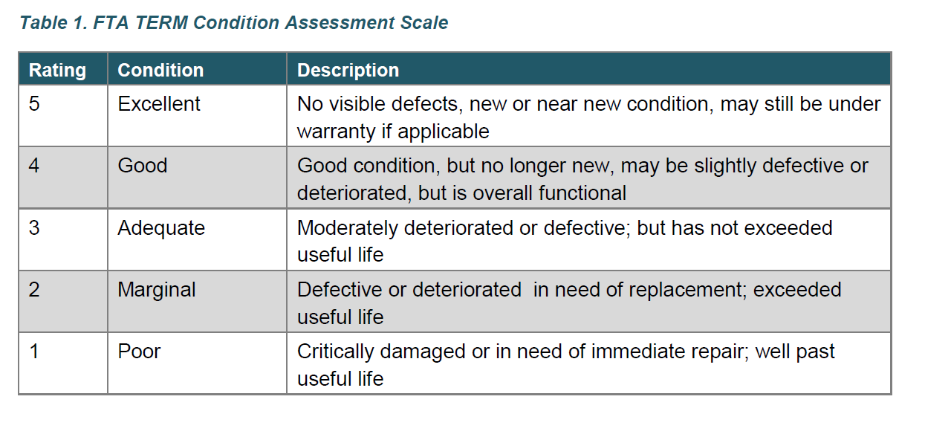
Transit Asset Management
Federal Deliverables: NTD Asset Inventory Facilities Condition Scoring
Facilities are assessed/graded for overall condition and reported to the NTD with a single overall condition rating per facility.
Agencies are not required to use the FTA TERM Model but must report facility condition assessment as a term rating score.
Year 1, (FY19) submission requires 25% of all facilities to be given condition ratings increasing to 100% of all facilities within 4 years.

Slide 6
NTD Asset Inventory Data Collection (1 of 2)
Asset Inventory Module
NTD Form Number | Reporting Category | FY18 NTD Reporting | FY19 NTD Reporting (FY19)
A-15 | Administrative and Maintenance Facilities | Count (quantity) of maintenance facilities, grouped by capacity | Individual facility inventory: type, location, square footage and condition rating*
A-15 | Passenger Stations and Parking | Count (quantity) of passenger stations, Only | Individual facility inventory: type, location, square footage, condition rating* and capital responsibility
A-20 | Rail Track | Current reporting mixes track and guideway | Track mileage by type (e.g. tangent or curved). Must also report major track elements e.g. crossovers
A-20 | Fixed Guideway | N/A Did not require reporting | Guideway by construction type (e.g. elevated, tunnel, etc.), each divided into 10-year age buckets
A-20 | Substations | N/A Did not require reporting | Count of substation structures and substation equipment, each divided into 10-year age buckets
* Note: Facilities condition assessments must be updated every four years at minimum. Beginning in Report Year 2018 (Year 1), agencies must report at least 25% of their facility condition assessments. Agencies must report all condition assessment by Report Year 2021.

Slide 7
NTD Asset Inventory Data Collection (2 of 2)
Asset Inventory Module
NTD Form Number | Reporting Category | FY18 NTD Reporting | FY19 NTD Reporting
A-20 | Signals | N/A Did not require reporting | Percentage of signal assets total value divided into 10-year age buckets
A-20 | Power | N/A Did not require reporting | Percentage of total value of third rail or catenary in 10-year age buckets
A-30 | Revenue Vehicles | Detailed count of vehicles by type, capacity, age, etc. | Detailed count of vehicles by type, capacity, age, etc. useful life benchmark
A-35 | Service Vehicles | xxxxx | Detailed count of vehicles by type, age, etc. A useful life benchmark for each vehicle type
Ongoing reporting requirements:
Projected performance targets for next fiscal year – entered with annual report
Facilities Condition and Performance Assessments
Performance Restrictions (slow zone measure)
Narrative Report describing change in condition and progress toward targets

Slide 8
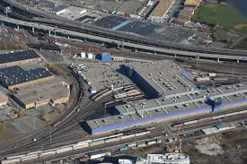
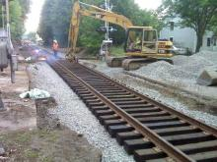
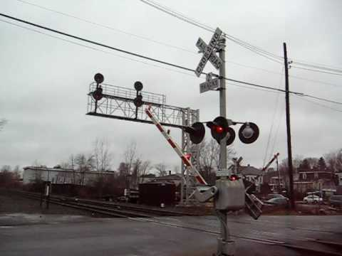
Transit Asset Management
Federal Deliverables: NTD Asset Inventory Reporting Categories
Commuter Rail Maintenance Facility
location,
square footage and
condition rating*
Rail Track
Track mileage by type (e.g. tangent or curved).
Must also report major track elements e.g. crossovers
Signals
Percentage of signal assets total value divided into 10-year age buckets

Slide 9
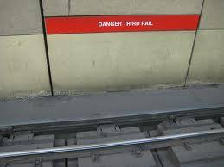
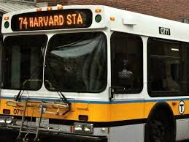
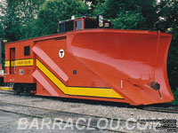
Transit Asset Management
Federal Deliverables: NTD Asset Inventory Reporting Categories
Power
Percentage of total value of third rail or catenary in 10-year age buckets
Revenue Vehicles
Detailed count of vehicles by type, capacity, age, etc.
Useful life benchmark
Non- Revenue Vehicles
Detailed count of vehicles by type, capacity, age, etc.
Useful life benchmark

Slide 10
Transit Asset Management
Federal Deliverables: Progress from February 2018
Transit Asset Management Plan and Improvement Plan
MBTA Asset Management maturity level benchmarked against global standard
155+ participants, 23+ departments
50+ meetings, workshops, Subject Matter Expert interviews
Identify existing and proposed levels of service to be achieved
Identify Life Cycle Management needs by asset class
Assess financial needs and resources required to support safe and reliable service delivery and bring assets into a State of Good Repair.
Document current key processes, organizational architecture, and tools for effective Asset Management
Establish action plans for improving the approach to asset management activities
2019 Performance Targets
Led by Capital Program Oversight
Initial targets established FY18
Workshops with asset owners to validate Useful Life Benchmarks (ULB)

Slide 11
Transit Asset Management
MBTA Asset Management Initiatives: FY19 Performance Targets
FY19 - Performance Targets
Sep
Oct
Jun
Jul
Aug
06/10/18
FY19 CIP Approved
10/1/18
Targets due for NTD entry
Led by Capital Program Oversight
Aligned to CIP
Rolling Stock Completed
Asset Category | Measure | Measure Type
Equipment | Percentage of vehicles that have met or exceeded their Useful Life Benchmark | Age-based
Rolling Stock | Percentage of revenue vehicles that have met or exceeded their Useful Life Benchmark | Age-based
Facilities | Percentage of assets with condition rating below 3.0 on FTA TERM scale | Condition-based
Infrastructure [Fixed Guideway] | Percentage of track segments with performance [speed] restrictions, by mode | Performance-based

Slide 12
Next Steps
Transit Asset Management
Transit Asset Management Plan (TAMP):
Provide draft TAMP to Asset Management Governance Board for review and comment, and update
Provide draft TAMP to FMCB for review, comment and update
Certify and submit TAMP
Asset Inventory Module (AIM):
Phase 1 data inventory and condition submitted August 31st to the MBTA
Submit to National Transit Database (NTD) and update Enterprise Asset Management Systems (EAMS) and State of Good Repair Database (SGR Database) from September to end of October
Commence 2019 data collection and validation phase 2 task order process August/September
Performance Targets:
Complete Track, Vehicles and Facilities metrics
Update MassDOT Tracker and PAMAC reports with data and progress

Slide 13
Transit Asset Management
APPENDIX

Slide 14
Transit Asset Management
NTD Reportable items – Fixed Guideway
Guideway Elements | 2018 |  | 2019
 | Transit | Comm Rail | Transit | Comm Rail
1. At-Grade/Ballast (including expressway) | x | x
2. At-Grade/In-Street/Embedded | x | x
3. Elevated/Retained Fill | x | x
4. Elevated/Concrete | x | x
5. Elevated/Steel Viaduct or Bridge | x | x
6. Below-Grade/Retained Cut | x | x
7. Below-Grade/Cut-and-Cover Tunnel | x | x
8. Below-Grade/Bored or Blasted Tunnel | x | x
9. Below-Grade/Submerged Tube | x | x
10. Substation Building | x | x | x | x
11. Substation Equipment | x | x | x | x
12. Third Rail/Power Distribution |  | x | x | x
13. Overhead Contact System/Power Distribution |  |  | x | x
14. Train Control & Signaling | x | x | x | x
15. Tangent – Revenue Service | x | x
16. Curve – Revenue Service | x | x
17. Non-Revenue Service | x | x
18. Revenue Track – No Capital Replacement Responsibility | x | x
19. Double Diamond Crossover | x | x
20. Single Crossover | x | x
21. Half Grand Union | x | x
22. Single Turnout | x | x
23. Grade Crossings | x | x

Slide 15
Transit Asset Management
NTD Reportable items – Facilities
Facilities | 2018 |  | 2019
 | Transit | Comm Rail | Transit | Comm Rail
Administrative Office / Sales Office | x | x
At-Grade Fixed Guideway Station |  | x | x
Bus Transfer Center |  | x | x
Combined Administrative and Maintenance Facility (describe in Notes) | x | x
Elevated Fixed Guideway Station |  | x | x
Exclusive Grade-Separated Platform Station | x | x
General Purpose Maintenance Facility/Depot | x | x
Heavy Maintenance & Overhaul (Backshop) | x | x
Maintenance Facility (Service and Inspection) | x | x | x
Other, Administrative & Maintenance (describe in Notes) | x | x
Other, Passenger or Parking (describe in Notes) |  |  | x | x
Parking Structure |  |  | x | x
Revenue Collection Facility |  | x | x
Simple At-Grade Platform Station |  | x | x
Surface Parking Lot |  |  | x | x
Underground Fixed Guideway Station |  | x | x | x
Vehicle Blow-Down Facility | x | x
Vehicle Fueling Facility | x | x
Vehicle Testing Facility | x | x
Vehicle Washing Facility | x | x

Slide 16
Transit Asset Management
NTD Reportable items – Revenue Vehicles
Revenue Vehicles | 2018 |  | 2019
 | Transit | Comm Rail | Transit | Comm Rail
Articulated Bus (AB) | x |  | x
Automated Guideway Vehicle (AG)
Automobile (AO) | x |  | x
Over-the-road Bus (BR) | x |  | x
Bus (BU) | x |  | x
Cable Car (CC)
Cutaway (CU)
Double Decker Bus (DB)
Ferryboat (FB) |  | x |  | x
Heavy Rail Passenger Car (HR) | x |  | x
Inclined Plane Vehicle (IP)
Light Rail Vehicle (LR) | x |  | x
Monorail Vehicle (MO)
Minivan (MV) | x |  | x
Other (OR) | x |  | x
Commuter Rail Locomotive (RL) |  | x |  | x
Commuter Rail Passenger Coach (RP) |  | x |  | x
Commuter Rail Self-Propelled Passenger Car (RS)
School Bus (SB)
Streetcar Rail (SR)
Sports Utility Vehicle (SV) | x |  | x
Trolleybus (TB) | x |  | x
Aerial Tramway (TR)
Van (VN) | x |  | x
Vintage Trolley (VT) | x |  | x

Slide 17
Transit Asset Management
NTD Reportable items – Service Vehicles
Service Vehicles | 2018 |  | 2018
 | Transit | Comm Rail | Transit | Comm Rail
Automobiles | x | x | x | x
Trucks and other Rubber Tire Vehicles | x | x | x | x
Steel Wheel Vehicles | x | x | x | x

