Slide 1
Lean at the MBTA
Quarterly update
9/10/18

Slide 2
Recap: Lean at the MBTA
Lean Update
What is Lean? Lean is a systematic approach to continuous improvement by applying principles and tools to eliminate waste
Why are we here? MBTA has high level of broken processes and inefficiencies
What is our opportunity? By providing collaboration tools and establishing approaches for employees to solve problems together, we can create lean and efficient processes that generate productivity - creating bandwidth to invest in other critical needs for the MBTA
For FY19, goal is to achieve operationalized 5% ($30M) productivity targets including in operating budgets
Established departmental-level KPIs to maintain or improve operational outcomes; KPIs reviewed on monthly basis
How are we doing? With only 1 month of financial and operational data, it is too soon to confirm potential FY19 trends; first quarter results will provide clearer basis to confirm progress

Slide 3
Executive summary
Lean Update
Organization is managing to FY19 budget and operational expectations
Organization committed to operating budget stability; Operational KPIs either held constant or improving
First quarter results to provide clearer basis for FY19 forecast
Renewed focus on driving accountability and transparency across organization: Modified processes to measure and track success
Simplified, standardized, and clarified monthly departmental reviews to better focus on key business performance measures, risks and opportunities
Built monthly leadership dashboard to track monthly operating performance vs. , risks and opportunities
Deep dives on process redesign and Lean support in most critical departments: Four key projects kicked off, with early results
Rail Maintenance: Workplace organization (5S) at Riverside Car House
Bus Maintenance: Quick wins and launched partnership with Greater Boston Manufacturing Partnership
Everett: Developing Standard Repair Times; and analyzing future demand and impact of new Red & Orange Line vehicles on workflow
Systems Maintenance: Developing prioritization tools for critical assets
Lean organizational promotion, training, and adoption:
First Lean White Belt training scheduled for late September, targeting Operations management first (to be cascaded down) (in coordination with MassDOT University)
Additional 7 projects completed and ~80 people trained and/or directly involved in Lean projects

Slide 4
Over last 12 months, Bus Maintenance has reduced the Cost Per Mile by ~15%, driven by increased focus on accountability and transparency
Lean Update
Estimated ~$13M saved from reducing cost per mile over last 12 months
OVER LAST 12 MONTHS:
Monthly KPI & budget accountability reviews
SRT creation and focus
Integration with Mancon
Lean projects at Charlestown, Everett Bus, Cabot
PLAN FOR FY19:
Lean project at Southampton with Greater Boston Manufacturing Partnership
Improve parts flow process
Capital investments in facilities
Notes: Cost per mile include Everett Bus shop, exclude Non-Revenue Shop and North Cambridge, and exclude fuel and cleaning contract; fully loaded fringe costs include pension costs if funded at 5% discount rate instead of 7.75% and retire health (OPEB) costs if fully funded; Bus CPM is unweighted across bus garages

Slide 5
Over last 12 months, Rail Maintenance has reduced the Heavy Rail cost per mile by ~20%, while Green Line increased by ~10%
Lean Update
Estimated ~$5-6M saved from reducing cost per mile over last 12 months
OVER LAST 12 MONTHS:
Monthly KPI & budget accountability reviews
#7 Mid-life overhaul for Green Line
Improved incident management system and trend analysis
PLAN FOR FY19:
Develop SRTs in Rail
Lean project at Riverside
Improve parts flow process
Capital investments in facilities
Notes: Cost per mile include Everett Rail shop; fully loaded fringe costs include pension costs if funded at 5% discount rate instead of 7.75% and retire health (OPEB) costs if fully funded; Mattapan not shown; Heavy Rail CPM is unweighted across car houses

Slide 6
Targeted Lean efforts continue, areas of focus represent some of greatest challenges for Bus and Rail Maintenance
Lean Update
Focus | Q4 FY18 Average |  |  | FY19 Target |  |  | Actions
 | Cost per mile | MMBF | SRT com-pliance | Cost per mile | MMBF | SRT com-pliance
Bus Maintenance: Southampton | $6.12 | 13K | 48% | <$4.60* | >12. 5K | >75% | Root cause analysis on Standard Repair Times Workplace organization Standard work Material management
Rail Maintenance: Riverside | $7.56 | 7K | No SRTs | <$7.00* | >5K | >50% | Develop Standard Repair Times Workplace organization Material management
Everett: Rail | $0.79 | N/A | No SRTs | $0.80* | N/A | >50% | Develop Standard Repair Times Identify changes to Everett workflow due to new vehicles Improve parts flow between Everett and Car-houses
Note: *Mileage based on FY18 average mileage with adjustment only for expected SL3; targets to re-estimated after multiple months of new mileage observed from SL3, and additional early access and night service, and any changes to Rail; Total cost per mile includes fully-loaded fringe costs and Everett Allocation, Bus Maintenance costs also exclude Non-Revenue Shops and Fuel costs; Reservoir costs included in CPM listed for Riverside

Slide 7
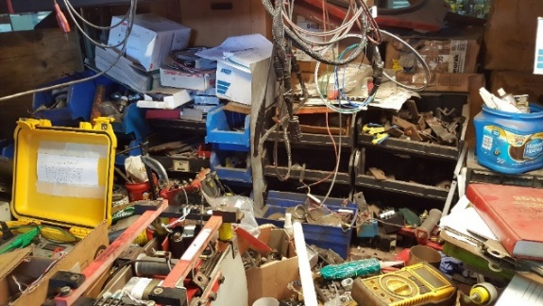
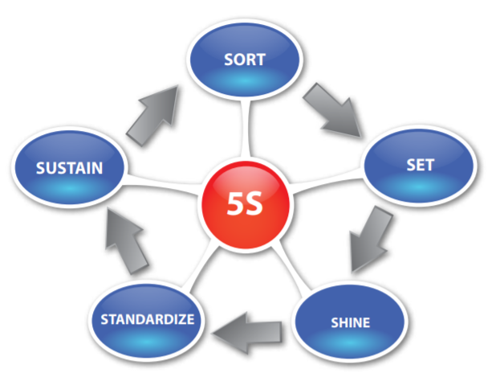
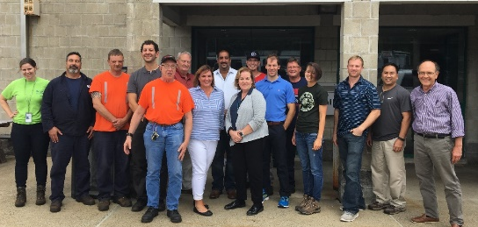
Lean Case Study – Riverside Car House: First 5S event
Lean Update
Problem & Root cause
Solution
Impact
Safety risk: Tripping hazards, clutter
Space shortages: Not enough room to store Type 9 Capital Spares
Unknown inventory levels: Obsolete mixed with active parts, unclear if shortages or excess of parts
Root cause ➔ Unstructured & cluttered workspaces
33% more storage space in areas
Organize for efficiency and effectiveness
Remove and recycle obsolete parts
Organize tools and parts based on frequency of use
Set standard system in place to maintain clean and organized workplace
Removed/Recycled 10 dumpsters of wood & 4 dumpsters of metal
First major Lean event at Car House

Slide 8
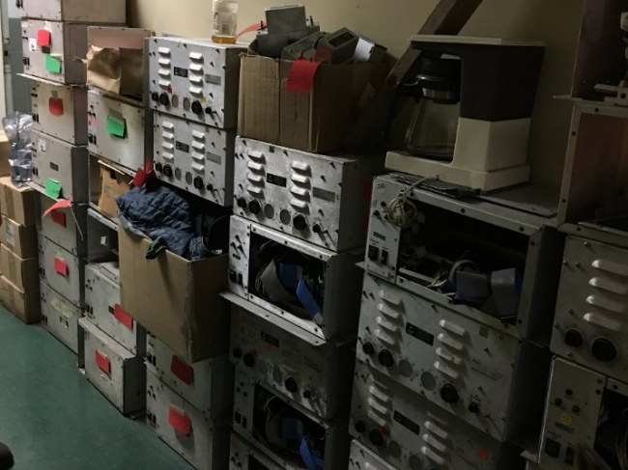
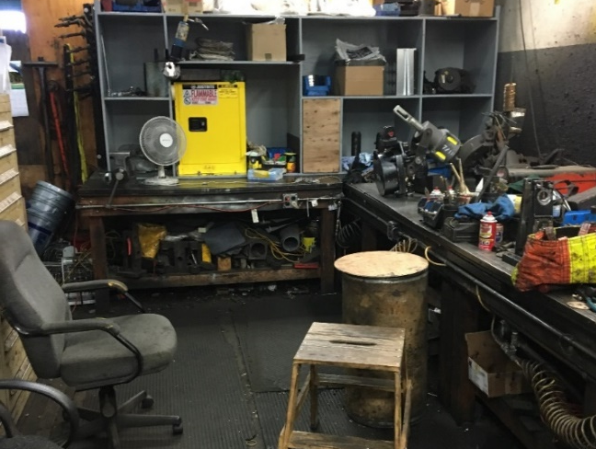
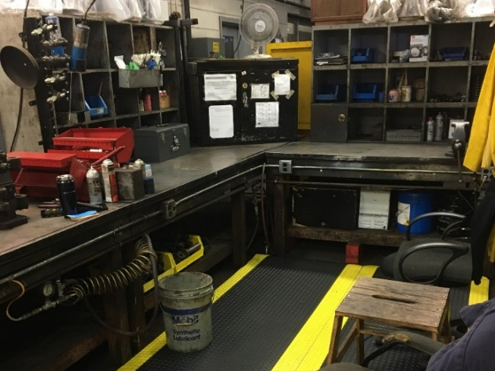
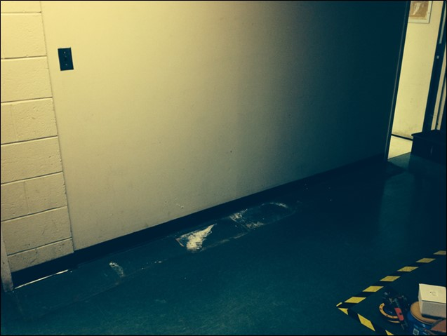
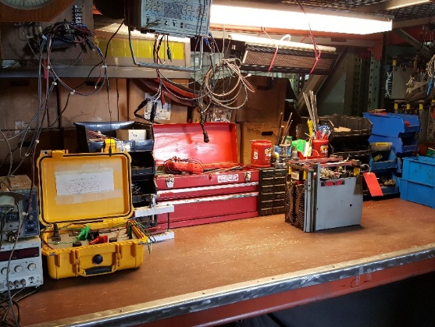
Lean Case Study – Riverside Car House: First 5S event
Lean Update

Slide 9
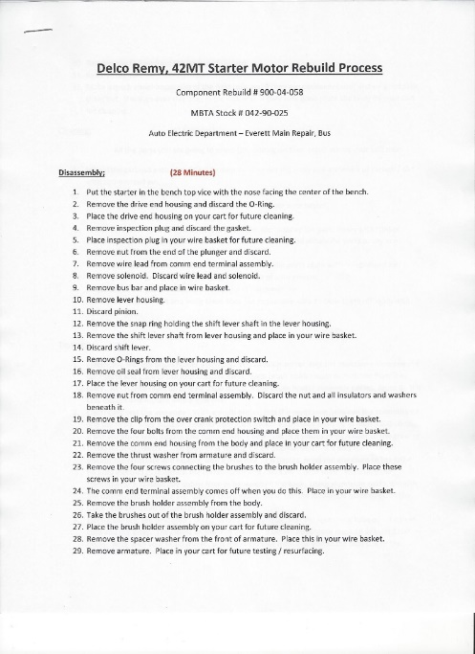
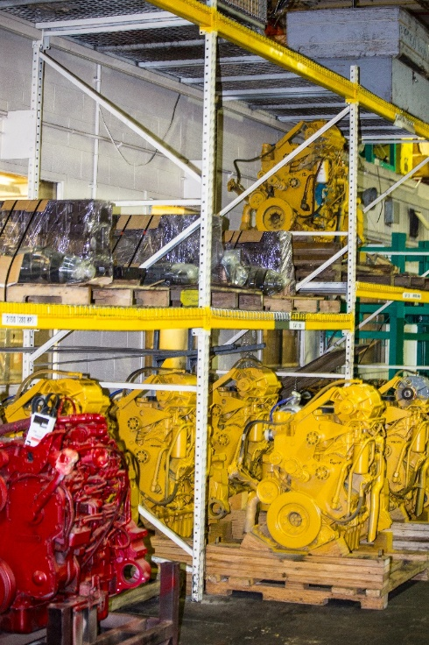
Lean Case Study – Everett Bus: Continuing efforts driven by front line
Lean Update
Lean Council meets on weekly basis
Developing Standard Repair Times which allows for standardized work and better identifying where training is necessary
Investing in capital equipment to improve productivity and replace broken assets
Continuing 5S (workplace organization) efforts
Broader impact on organization and culture, with increased focus on customer service

Slide 10
APPENDIX: Summary of organizational targets and key productivity initiatives for FY19
Lean Update
Dept./ Function | FY18 Actuals ($M) | FY19 Budget ($M) | Delta between FY18A vs. FY19B | Key actions underway (not exhaustive)
General & Administrative | $189 | $187 | ($2) | Multiple, incl. Business Process Redesign
Bus Transportation | $143 | $144 | $1 | HASTUS electronic roster-picking
Rail Transportation | $95 | $93 | ($2) | HASTUS electronic roster-picking
System Maintenance | $129 | $129 | $0 | (TRAPEZE) Maintenance system upgrade Lean project
Bus Maintenance | $75 | $73 | ($2) | Parts and inventory management Lean project at Southampton
Everett Main Repair | $28 | $30 | $1 | Development of Standard Repair Times
Rail Maintenance | $55 | $53 | ($2) | Development of Standard Repair Times Lean project at Riverside
Other Operations | $25 | $27 | $1 | Multiple
Contracted Transit Services | $527 | $549 | $21 | System and process upgrades
Other expenses | $277 | $281 | $4
Total Operating Expenses | $1,543 | $1,564 | $21
Notes: All costs in $M unless noted otherwise; Numbers may not tie due to rounding; Other expenses includes benefits and financial service charges

Slide 11
APPENDIX: New projects completed or in implementation in Q1 FY19 (not exhaustive of productivity-related work by organization)
Lean Update
Dept. | Project | Impact | Est. cost avoided or savings
System-Wide Accessibility | Simplify vendor timesheet invoice receiving process | 90% reduction in cycle time, saving 34 hours/year (observed) | ~$3K
Riverside Car House | 5S in 4 key areas (engineering & administration, Thyristor bench, Brake bench, and Electrical repair room) | Removed/recycled 14 dumpsters over 2 week period Estimated 33% additional storage space in 5S areas (observed) | N/A
Budget / Finance | Monthly Reporting Package 2.0 and leadership dashboard | Increased transparency and accountability Standardized expectations and timelines Decrease in unnecessary meetings | ~$5K
Vehicle Maintenance & OPMI | Semi-automated Monthly Cost Sheets | Increased standardization and better availability of Bus and Rail key performance indicators Increased time available (~15 hours / month) (predicted) | ~$15K
Bus Maintenance | New process to prioritize Standard Repair Times | 25% increase in hours covered by Standard Repair Times at Southampton (predicted) | N/A
Transit Facilities Maintenance | HVAC preventative maintenance | Identified a root cause of missed preventative maintenance (PM) Increased vendor accountability for PM compliance | ~$9K
Everett Bus | Small capital investments to increase productivity of key groups (e.g. vehicle sign shop) as part of Lean Council | $500K in increased productivity, with 1 year projected payback (predicted) | ~$500K
Note: Financial impact estimates average hourly wage of $40/hour with a fully-loaded fringe costs

Slide 12
APPENDIX: Costs Per Mile at Charlestown and Cabot Bus Garages over last twelve months
Lean Update
OVER LAST 12 MONTHS:
Monthly KPI & budget accountability reviews
Cabot buses coming off warranty
Implementing series of capital and productivity enhancements
PLAN FOR FY19:
Continue to implement productivity initiatives at Charlestown
Additional investments in facilities (e.g. hoists)
Notes: Cost per mile includes Everett and administration overhead costs; fully loaded fringe costs include pension costs if funded at 5% discount rate instead of 7.75% and retire health (OPEB) costs if fully funded

Slide 13
APPENDIX: In Bus Maintenance, the plan for FY19 will build on the work done to date to decrease costs and increase productivity
Lean Update
Bus Maintenance costs
From Q4 FY2018 update
Note: Costs include Everett Bus shop, exclude Non-Revenue Shop, and exclude fuel; fully loaded fringe costs include pension costs if funded at 5% discount rate instead of 7.75% and retire health (OPEB) costs if fully funded; FY18P is 11 months of actuals and 1 month of avg. run-rate; FY19 fringe assumes FY18 fringe rate; No accruals for FY18 included

Slide 14
APPENDIX: Glossary
Lean Update
APT: Assets Planning & Training
CEX: Customer Experience
HR: Heavy Rail
Kanban card: A physical card used to visually signal when inventory should be replenished or other actions should be taken
KPI: Key Performance Indicator
LR: Light Rail
MMBF: Mean Miles Between Failure
PSM: Power Systems Maintenance
SCM: Signals & Communication Maintenance
SOP: Standard Operating Procedure
SRT: Standard Repair Time
SWA: System-wide Accessibility
TFM: Transit Facilities Maintenance

