Slide 1
General Manager’s Remarks
Fiscal and Management Control Board
September 10, 2018

Slide 2
Agenda
Late Night Pilot
Special $10 Weekend Commuter Rail Fare Pilot
Parking Rate Changes
Alewife Garage Update
Asset Management Update

Slide 3
Late Night Pilot
Beginning Sept. 2, bus service expanded between 10 PM and 3 AM on a number of routes
Later, more frequent service on some existing late night routes from 10 PM and 2 AM
Service available after 2 AM in Dorchester, Roxbury, Charlestown, Everett, East Boston, and Lynn
More bus trips to and from Boston, the surrounding neighborhoods, and Logan Airport
Because when you work at night, you need transit that stays up with you.
www.mbta.com/LatePM

Slide 4
Special $10 Weekend Commuter Rail Fare Pilot
Summer pilot extended to December 9
Initial results are highly promising
Most productive weekend, July 28-29, sold over 8,100 passes
Extending the pilot to more thoroughly gauge ridership demand and the pilot’s overall impact

Slide 5
Parking Rate Changes
New rates became effective Sept. 1
Seeks to balance lots that are overused and underused
Measured approach resulting in a mix of price increases and decreases
Investments in parking facilities, necessary maintenance and rehabilitation, including:
$64 million full-scale rehabilitation of Quincy Adams and Braintree garages
$10+ million in pavement, lighting, and security improvements at MBTA surface lots; and more.
For full information, visit www.mbta.com/ParkingPrices.

Slide 6
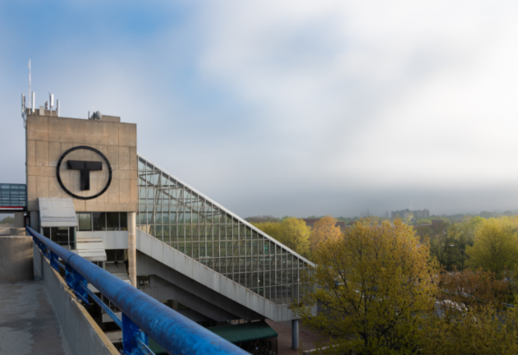
Alewife Garage Update
Continued advancement of long-term plan for the facility
$5.7 million contract that was advertised in July was awarded Aug. 9
Contractor’s work schedule has been received and crews are mobilizing equipment at the Garage beginning today
Overnight parking allowed; no weekend closures needed

Slide 7
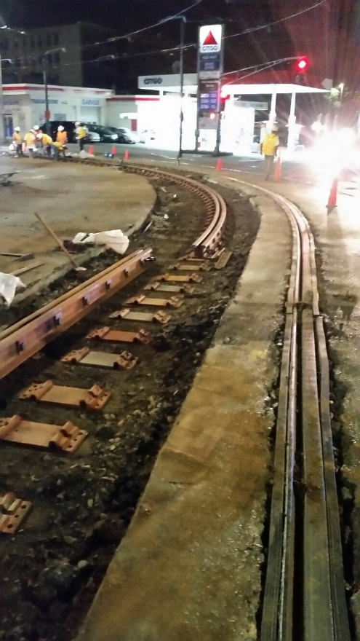
Asset Management / State of Good Repair
Ended FY18 with balanced operating budget and approx. $500 million in pay go capital
Developed $8 billion CIP for next five years with intense investment focused on core infrastructure
Building out Asset Management Program, ushering in shift toward data-driven decisions on investments and maintenance

