Slide 1
DGM Remarks
Fiscal & Management Control Board
September 10, 2018

Slide 2
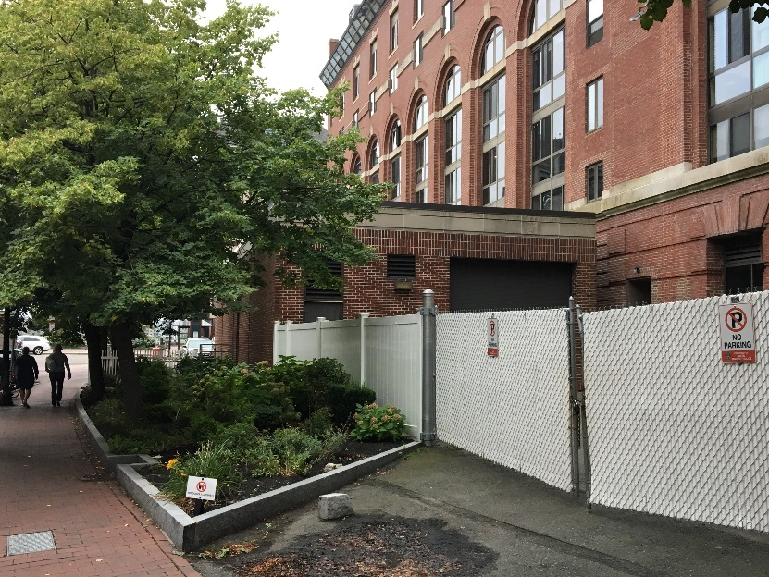
Power Outage
DGM Remarks 9/10/2018
August 29, 2018 a major power outage affecting the Green, Orange and Blue Lines
Including:
Station Lighting
Fare Equipment
Elevators/Escalators
Trains operated with delays
Issue caused by fault in A/C supply cable from Lincoln Switching Station

Slide 3
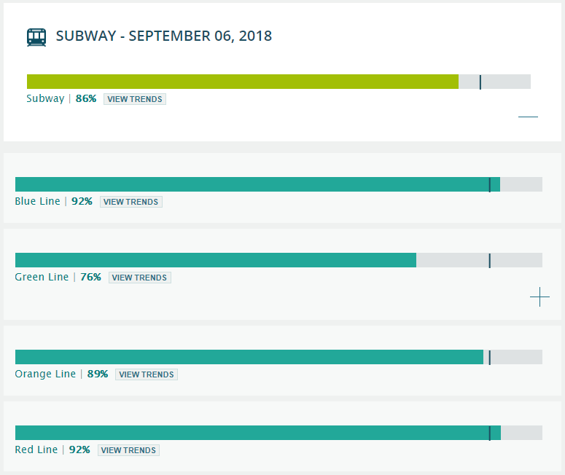
Updates to MBTAbackontrack reliability data
DGM Remarks 9/10/2018
On September 12th, 2018, data feed will be updated to reflect improved data quality
New Real-time Data for Heavy Rail
Resulting decrease in reliability metrics for Red, Orange, and Blue Lines of 0 – 2% due to the inclusion of wait times for passengers traveling to the terminal stations
New Data Fusion Engine for Real-time Feeds
Improves update frequency of real-time information by up to 30 seconds
Results in more accurate arrival and departure times
Resulting increase in reliability metrics for Green Line between 2-7%
Update to Passenger Arrival Rates based on Origin-Destination-Transfer (ODX) model from Fall 2017
Allocates passengers previously boarding at Wollaston
No change to reliability metrics

