Slide 1
MBTA Construction Contract No. C14CN01: Iron Horse Park Operations Control Center
October 15, 2018

Slide 2
OVERVIEW
MBTA Contract No. C14CN01: Iron Horse Park Operational Control Center
Today’s board action will provide approval for construction of the Iron Horse Park Operations Control Center that will house dispatching operations for MBTA Commuter Rail North (CRN) and Pan Am freight in the same space. It will also house the back-up PTC data center.
The IHPOCC project includes construction of a new building, designed to accommodate future growth of the signal system and future regional dispatch capability, parking lot, and site utilities.
The construction duration is 24 months.

Slide 3
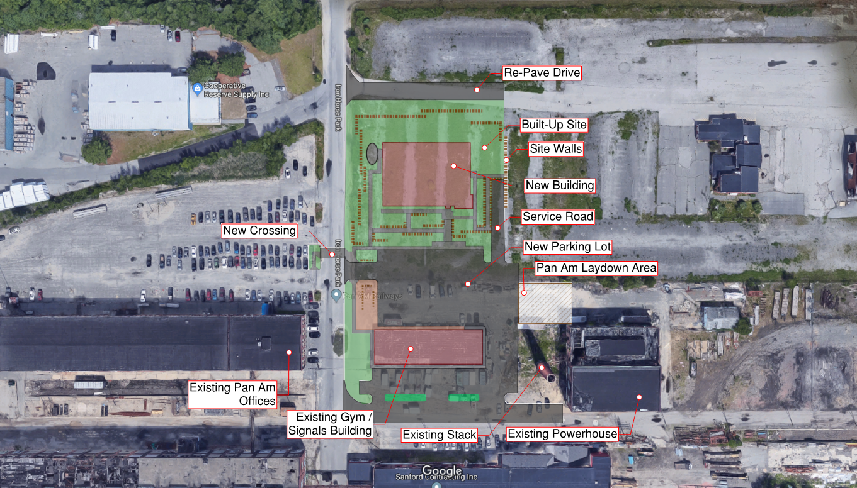
Construction Project Overview – Site Plan
MBTA Contract No. C14CN01: Iron Horse Park Operational Control Center
N

Slide 4
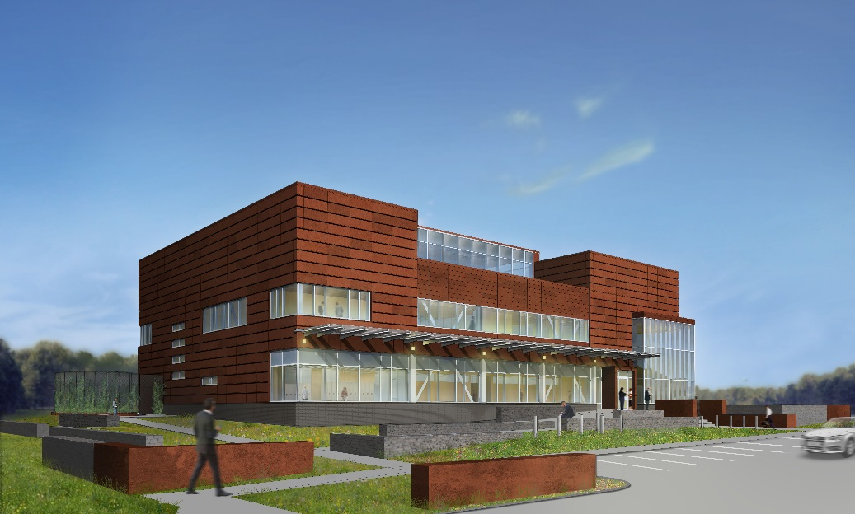
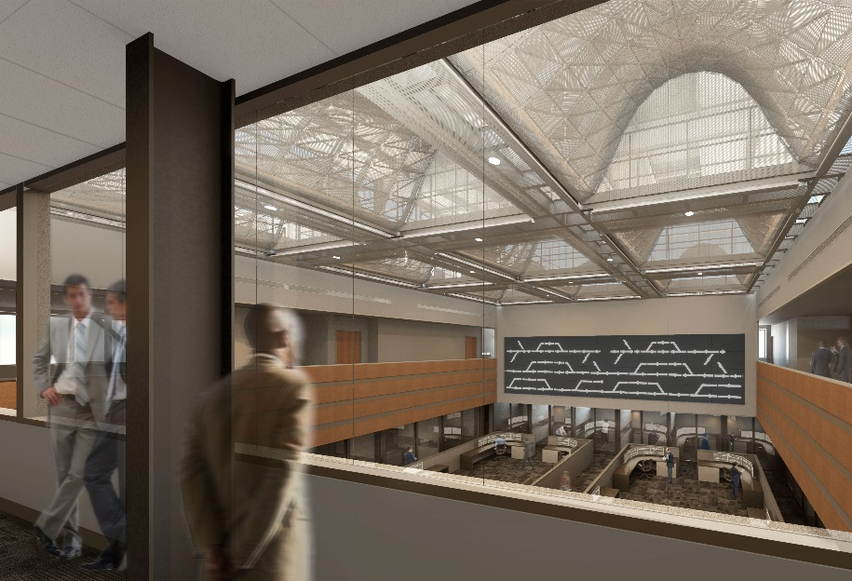
Construction Scope
MBTA Contract No. C14CN01: Iron Horse Park Operational Control Center
New Building Construction: foundations, structure, enclosure, redundant mechanical and electrical systems, low voltage systems, IT and dispatch equipment, plumbing, fire protection, interior partitions, fixtures and furnishings.
Site Work: Site utilities, parking lot, retaining walls, landscaping, site security and lighting

Slide 5
Project Benefits
MBTA Contract No. C14CN01: Iron Horse Park Operational Control Center
Provides fully redundant and state-of-the-art Operations Control Center (OCC) in which MBTA Commuter Rail and Pan Am will conduct north side train operations in the same location using the same systems for real time coordination
Provides back-up for the existing Commuter Rail OCC
Provides remote location for Positive Train Control (PTC) backup system
Room for expansion of the signal system or other dispatch capabilities
New building will have a 100 year life span
New building is resilient and above the flood plain

Slide 6
Construction Procurement
MBTA Contract No. C14CN01: Iron Horse Park Operational Control Center
Project was advertised on July 3, 2018
Engineer’s Estimate was $28,315,535
Bid Opening was on August 14, 2018
Four (4) Bids were received
$32,730,706 W.T. Rich Company, Inc. (Low Bidder)
$33,530,212 Tocci Building Corporation
$34,955,000 Barletta Heavy Division, Inc.
$35,739,000 Daniel O’Connell’s Sons, Inc.
Bid analysis has been completed

Slide 7
Request of the Fiscal and Management Control Board
MBTA Contract No. C14CN01: Iron Horse Park Operational Control Center
Staff request that the Fiscal and Management Control Board authorize the MBTA General Manager to award and execute MBTA Construction Contract No. C14CN0: Iron Horse Park Operations Control Center with W.T. Rich Company, Inc. for an amount not to exceed $32,730,706.00.

