Slide 1
Early Morning and Late Night Pilot Update
October 1, 2018

Slide 2
Overview
Update on Early Morning pilot ridership
Update on Late Night marketing efforts
Next Steps

Slide 3
Early Morning Pilot
Early Morning pilot started April 1, 2018
Service was added to 10 routes: 16, 19, 31, 32, 65, 70, 104, 109, 117, 455
Goal was to provide new mobility, especially for work trips, and to reduce over-crowding during a time when resources could be added.
Added new earlier trips if former first trip was crowded—10 new trips on weekdays, 2 on Saturdays, and 5 on Sundays.
Extended 5 short trips: 2 trips on weekdays, 2 on Saturdays, and 1 on Sunday.

Slide 4
Early Morning Ridership Observations
Passengers are using earlier trips—and crowding is decreasing on previously overcrowded first trips.
907 new riders per week—153 on weekdays, 47 on Saturdays, and 98 on Sundays. (Source: APC: Spring/Summer 2017 vs Spring/Summer 2018)

Slide 5
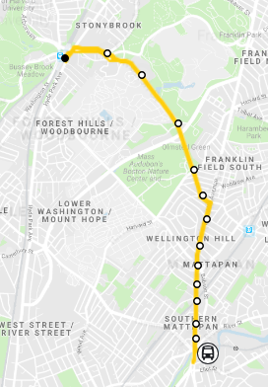
Early Morning Ridership Observations: New Route 31 Sunday Trips Added
Before:
First inbound trip: 6:00am Mattapan – Forest Hills, 51 passengers, and 12 standees.
After:
New 5:25am inbound trip (was out-of-service bus) – 26 passengers
New inbound 5:45am trip – 22 passengers
6:00am inbound trip – 34 passengers
Net change—30 new inbound riders, [1 new outbound]
More productive time in schedule
More riders comfortable.
Forest Hills
31
Mattapan

Slide 6
Early Morning Ridership Observations: New Route 455 Weekday trip added
Before:
First trip: 5:00am Lynn – Wonderland, 51 passengers, and 12 standees.
After:
New 4:45am trip Lynn – Wonderland, 34 passengers, everyone seated, with 5 empty seats
5:00am Lynn – Wonderland trip, 45 passengers, and 6 standees
Net change—28 new riders
More riders comfortable.
Lynn
455
Wonderland

Slide 7
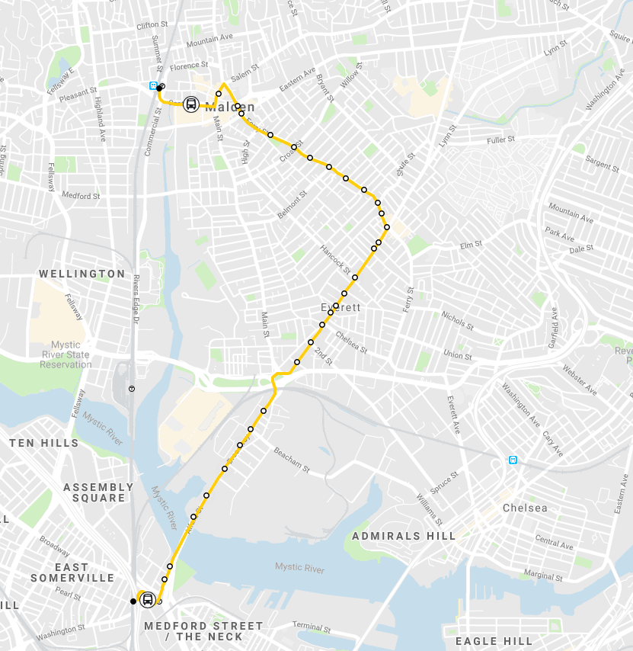
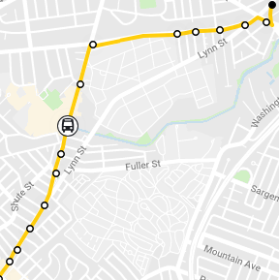
Early Morning Ridership Observations:
Example: Route 104/109 short trips extended
Before:
First trips of the morning were:
4:43 am Glendale Sq short trip, 21 passengers
4:57 am Route 109, 48 passengers
5:00 am Glendale Sq short trip, 52 passengers
5:11am Route 104, 63 passengers
180 total passengers on 4 trips
After:
4:35 am, Route 109, 47 passengers
4:57 am, Route 109, 59 passengers
4:50 am, Route 104, 67 passengers
5:11am, Route 104, 63 passengers
235 total passengers on 4 trips
Net change: 55 new riders on same trips, with two trips extended
Suggests need for additional early service
Malden
109
Linden Sq
104
Glendale Sq
Sullivan

Slide 8
Late Night Pilot
New Service started Sept 2, 2018
Three types of additional service added in Phase 1
New service in the 1-2am timeframe, create late night spine with SL1/SL4
Later last trip where high ridership on current last trips (after 12:30am)
Increase frequency from 10pm-12:30am on routes with crowding/high ridership
Opportunity to make adjustments in Phase 2 (Spring 2019) along with changes to Early Morning service

Slide 9
Customer Awareness of Early Morning and Late Night
Largest increase in awareness from July 2018 to September 2018 was for late night bus service
Most customers initially found out about late night bus service from posters/flyers, news media, or in-station announcements
MBTA Customer Opinion Monthly Panel Survey – July 2018 through September 2018

Slide 10
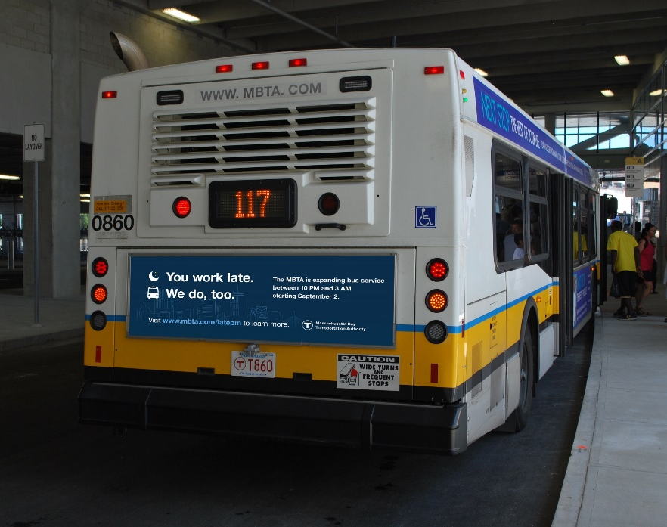
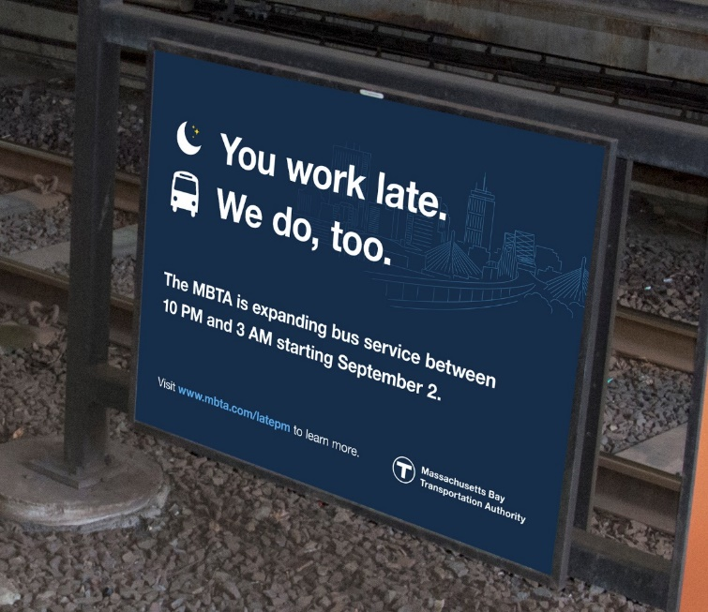
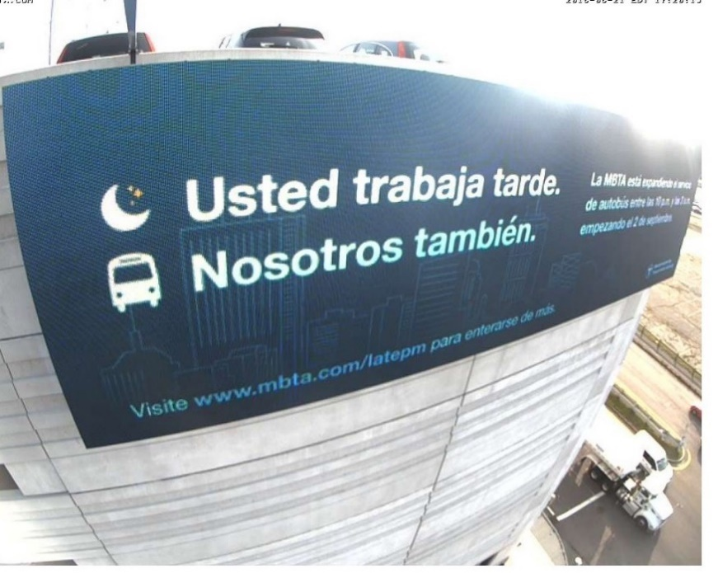
Marketing
Campaign Objective: To build awareness and increase ridership of the new late night bus service.
Bus Tails
Car Cards
Station Signage
Station Monitors
Website
www.mbta.com/projects/latepm

Slide 11
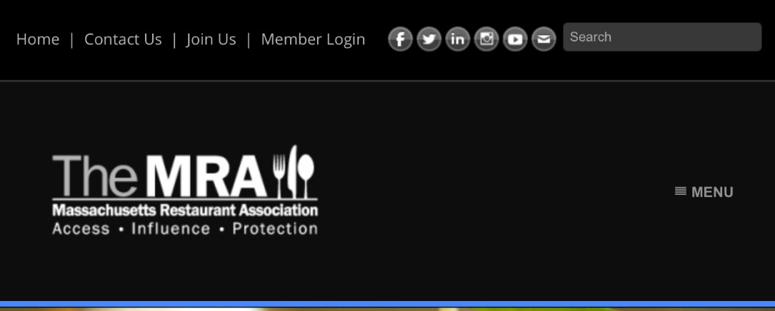
Partnerships and Outreach

Slide 12
Paid Media Opportunities

Slide 13
Next Steps
Increase Late Night marketing efforts
Continue to evaluate Early Morning ridership patterns to suggest adjustments for Spring 2019
Start monitoring Late Night ridership

Slide 14
Additional survey data
Successful marketing to customers who service is relevant to
Customers who used bus service for their most recent trip were more likely to know about early morning and late night bus service than other customers, despite not generally being more aware of MBTA initiatives
MBTA Customer Opinion Monthly Panel Survey –September 2018

