Slide 1
General Manager’s Remarks
Fiscal & Management Control Board
November 26, 2018

Slide 2
Agenda
East Street Bridge replacement
MBTA Police Patrolmen’s Association Collective Bargaining Agreement

Slide 3
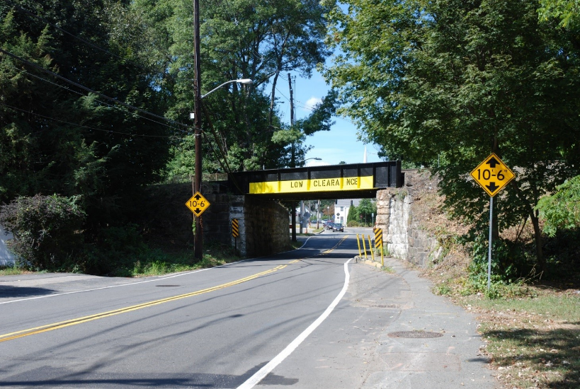
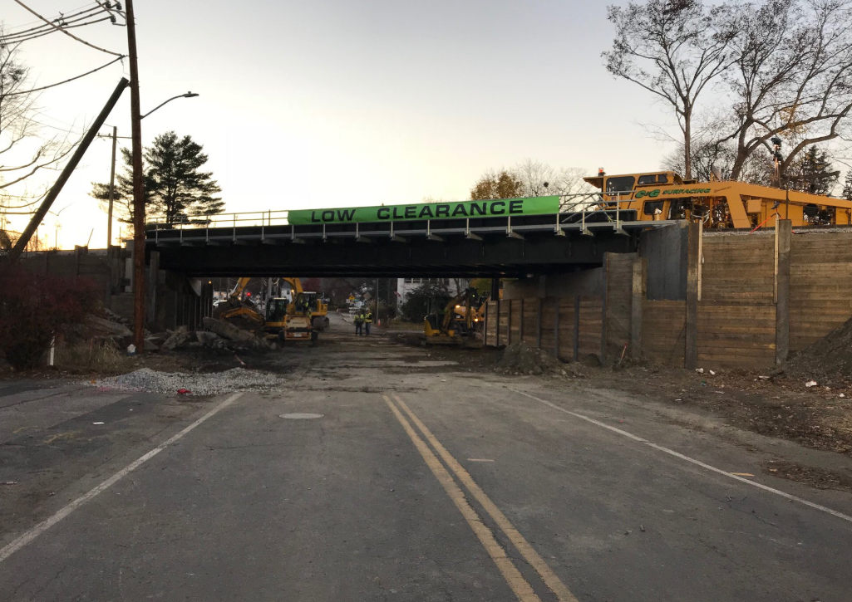
East Street Bridge Replacement
Old bridge:
Originally built in 1911
Low vertical clearance; narrow roadway width
Notorious for vehicle strikes
Bridge/road closure lasted from 11/9-11/11:
Track removal, bridge demo, 10 p.m. Friday
New bridge rolled into place
New track installation and alignment
Roadway below restored

Slide 4
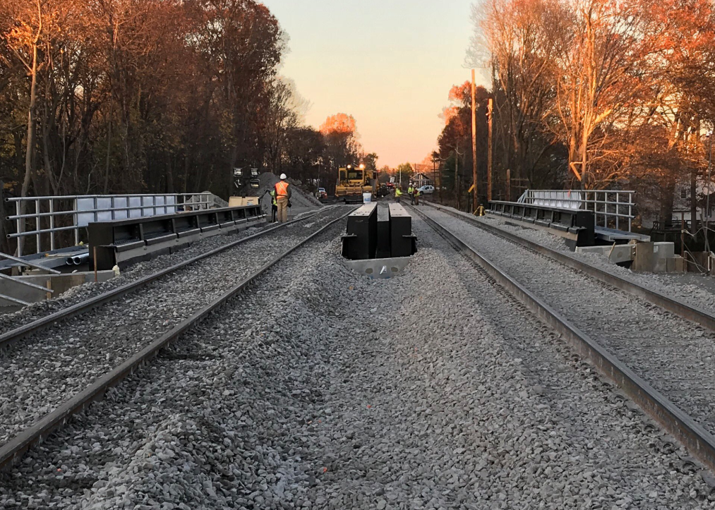
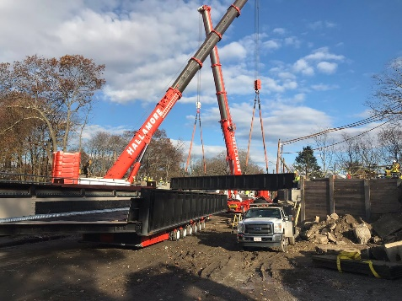
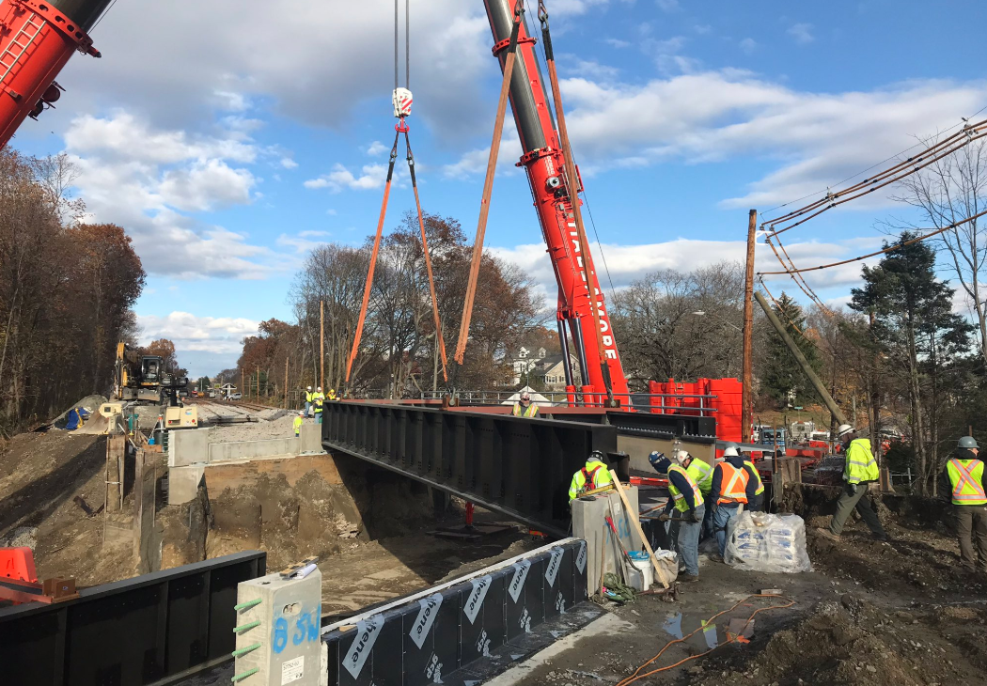
East Street Bridge Replacement
Entire effort took 51 hours – completed three hours ahead of schedule
New bridge built to higher vertical clearance, reducing a frequent hazard to trucks
Wider horizontal clearance will allow for sidewalks along roadway
Once complete, bridge will be brought up to SGR, reducing maintenance costs going forward

Slide 5
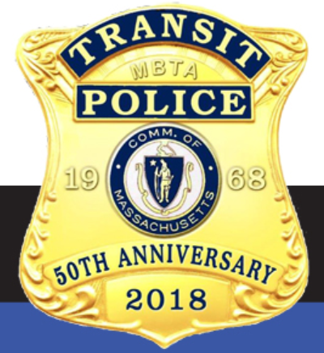
MBTA Police Patrolmen’s Association
T and Police Patrolmen’s Association reached agreement for successor CBA
Agreement provides wage adjustments, work-rule adjustments
Agreement will allow TPD and Patrolmen’s Association to move forward in partnership and continue Department’s great work

