Slide 1
DGM Remarks
Fiscal & Management Control Board
November 26, 2018

Slide 2
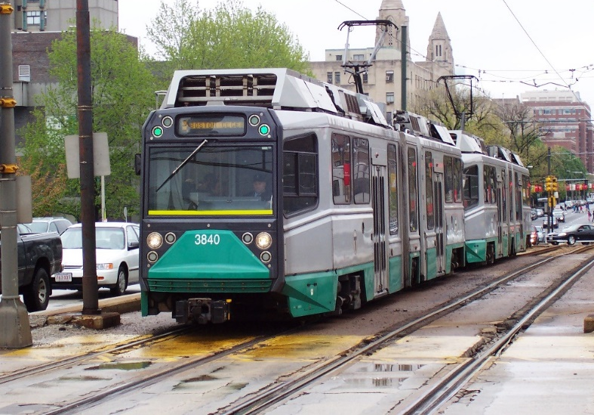
DGM Remarks 11/26/18
Green Line Traffic Signal Priority (TSP)
Continued focus on implementation of TSP in partnership with the City of Boston
Modeling of TSP benefits on B & E Line completed
Phased implementation underway on B & E Line
This week “go-live” on three additional intersections along E Line
BTD & MBTA continue to
refine system and develop
a complete roll-out strategy

Slide 3
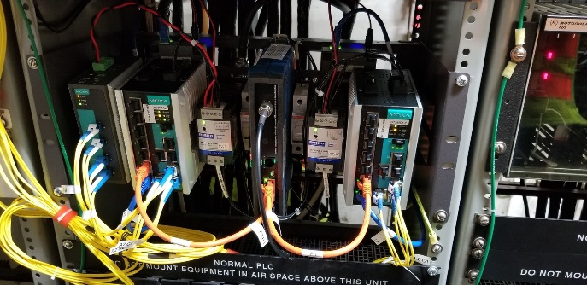
DGM Remarks 11/26/18
Red and Orange Line Signal Communication Upgrade
75 locations throughout the network utilized leased communication technology
Obsolete and unreliable infrastructure caused periodic and prolonged service delays
Full transition to internal
fiber optic network completed
last week
Project Benefits:
Reduce service delays
Robust network with system redundancy
Capacity to support signal technology upgrades
Independent control of system by MBTA personnel
Key step in upgrade of our signal system

