Slide 1
Operating Budget Stability
FY18 Year-End Projection
Report to Fiscal and Management Control Board

Slide 2

MBTA transitioned Commercial Banking accounts to Citizens Bank
Commercial Bank Transition
MBTA’s bank transition increases interest income and improves efficiency, security and workflows
New contract to generate $3,000 more interest income per day than prior contract
Interest rate automatically adjusts with Fed Funds Rate, which is expected to increase
Competitive RFP with 10 responses, all from well qualified banks
Citizens to waive all service fees, simplifying the contract management function
Allows for checks to be produced by a third party – MBTA out of the check writing business
Citizens has a strong CRA Rating, demonstrating its commitment to low and moderate-income neighborhoods (92 Massachusetts locations)
Increased security through antifraud and cybersecurity controls such as ACH Block, cybersecurity audits, reporting and verification.
Enhanced services and technological capabilities to accommodate AFC 2.0

Slide 3
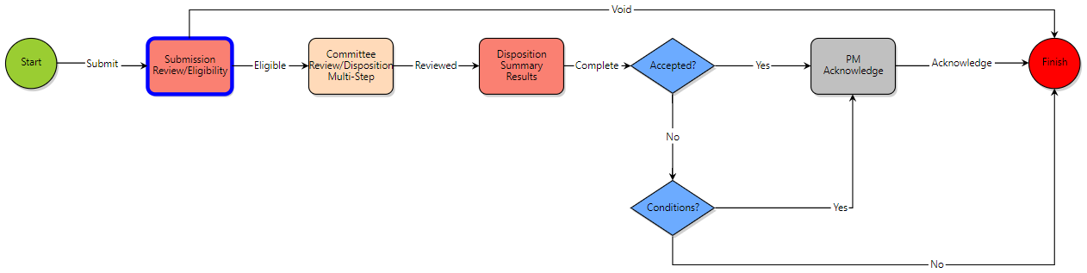
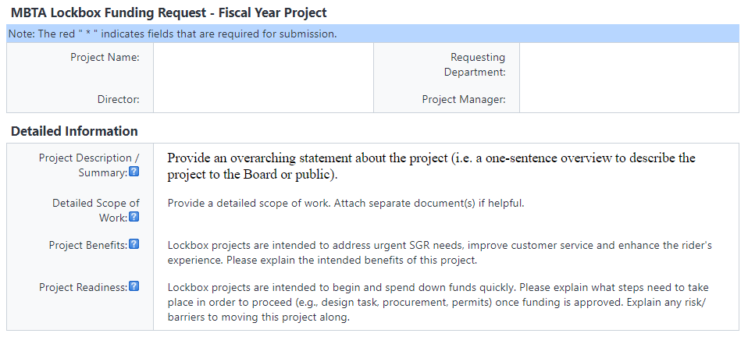
Pay-Go capital project intake process and project management are now active in eBuilder
PMIS Implementation
Pay-go project proposal intake process is now live in eBuilder, allowing committee members to review and approve requests electronically
Once approved, Pay-go capital projects will be managed in eBuilder, including document management and collaboration, scheduling, and meeting minutes
First Pay-go project active in eBuilder is Rail Vehicle Regulatory Signage Standardization & Improvement – a cross-functional team coordinating and standardizing safety, Title VI, and priority seating signage in rail transit vehicles
Pay-go project intake eBuilder process flow:
Submission form:

Slide 4
RECAP: FY18 deficit $307M below projections; $600M of cumulative savings since creation of FMCB
FY19 Preliminary Operating Budget
MBTA management in process of recasting FY18-FY20.
Operating Deficit does not include Additional State Assistance received in FY16 ($155M), FY17 ($140.25M) or FY18 Projections ($127M)

Slide 5
Financial Update Agenda
Executive Summary
FY17 Full Year Actuals vs. FY18 Full Year Projection
FY18 Full Year Budget vs. FY18 Full Year Projection
Recap: FY19 Budget Risks
Appendix

Slide 6
EXECUTIVE SUMMARY:
Structural deficit stable from last year, expense growth remains controlled
  COMPARED TO PRIOR YEAR: Projected structural deficit of $28M is down 6% ($2M) from FY17
    Projected non-debt operating expense has grown less than 1% year-over-year
    Revenue growth in FY18, led by own-source and sales tax categories, has offset increased debt service & slightly higher non-debt operating expenses
  COMPARED TO BUDGET: Projected structural deficit 8% below budget ($2M) in FY18
    Both higher than budgeted revenues and lower expenses have offset increased debt service
  FY19 BUDGET RISKS REMAIN:
    Growth in labor operating costs from growing pension expenses and proposed capital employee transfer
    Proposed growth restrictions for advertising limit own-source revenue growth

Slide 7
Financial Update Agenda
Executive Summary
FY17 Full Year Actuals vs. FY18 Full Year Projection
FY18 Full Year Budget vs. FY18 Full Year Projection
Recap: FY19 Budget Risks
Appendix

Slide 8
Projected structural deficit down 6% ($1.8M) compared to FY17
FY17 Full Year Actuals vs. FY18 Full Year Projection
 |  | FY17 Full Year Actuals vs. FY18 Full Year Projection
 | ($M) | FY17 ACTUALS |  | FY18 PROJECTION |  | $ VARIANCE |  | NOTES
REVENUES | Operating Revenues | $715.6 |  | $752.6 |  | $37.0 |  | New advertising & parking contracts proved favorable in FY18
 | Non-Operating Revenues | $1,209.5 |  | $1,230.3 |  | $20.7 |  | One-time real estate transactions
 | Total Revenues | $1,925.2 |  | $1,982.9 |  | $57.7
EXPENSES | Wages, Benefits and Payroll Taxes | $771.8 |  | $761.4 |  | ($10.4) |  | Active headcount management and favorable CBA terms
 | Non-Wage | $755.3 |  | $780.1 |  | $24.8 |  | Increases in CRail fixed price, RIDE call center expense, cleaning contract, & fuel prices
 | Operating Expenses | $1,527.1 |  | $1,541.5 |  | $14.4
 | Debt Service | $427.9 |  | $469.4 |  | $41.5 |  | Consistent with debt policy requiring increased service payments
 | Total Expenses | $1,955.1 |  | $2,011.0 |  | $55.9
 | Structural Deficit | ($29.9) |  | ($28.0) |  | $1.8
 | Fare Recovery Ratio | 43.2% |  | 43.1%
 | Revenue Recovery Ratio | 50.4% |  | 52.5%

Slide 9
Projected non debt operating expense slightly higher compared with FY17
FY17 Full Year Actuals vs. FY18 Full Year Projection
Source: MBTA Internal Data

Slide 10
Higher revenues offset increased debt service & operating expenses
FY17 Full Year Actuals vs. FY18 Full Year Projection
Source: MBTA Internal Data

Slide 11
Agenda
Executive Summary
FY17 Full Year Actuals vs. FY18 Full Year Projection
FY18 Full Year Budget vs. FY18 Full Year Projection
Recap: FY19 Budget Risks
Appendix

Slide 12
Projected structural deficit 8% below budget ($2.4M) in FY18
FY18 Full Year Budget vs. FY18 Full Year Projection
 |  | FY18 Full Year Budget vs. FY18 Full Year Projection
 | ($M) | FY18 BUDGET |  | FY18 PROJECTION |  | $ VARIANCE |  | NOTES
REVENUES | Operating Revenues | $766.2 |  | $752.6 |  | ($13.6) |  | Fare revenue below budget but own source rev growth expected to continue
 | Non-Operating Revenues | $1,201.0 |  | $1,230.3 |  | $29.3 |  | Result of various one-time revenues
 | Total Revenues | $1,967.2 |  | $1,982.9 |  | $15.7
EXPENSES | Wages, Benefits and Payroll Taxes | $762.7 |  | $761.4 |  | ($1.3) |  | Streamlined workforce- as a result, pension costs flat
 | Non-Wage | $783.6 |  | $780.1 |  | ($3.5) |  | LEAN initiatives have been beneficial
 | Operating Expenses | $1,546.3 |  | $1,541.5 |  | ($4.7) |  | Improved cost controls authority wide
 | Debt Service | $451.4 |  | $469.4 |  | $18.1 |  | In line with FMCB approved debt policy; expected to moderate
 | Total Expenses | $1,997.6 |  | $2,011.0 |  | $13.3
 | Structural Deficit | ($30.5) |  | ($28.0) |  | ($2.4)
 | Fare Recovery Ratio | 43.8% |  | 43.1%
 | Revenue Recovery Ratio | 51.3% |  | 52.5%

Slide 13
Lower operating expenses, higher revenues offset increased debt service
FY18 Full Year Budget vs. FY18 Full Year Projection
Source: MBTA Internal Data.

Slide 14
Agenda
Executive Summary
FY18 Full Year Budget vs. FY18 Full Year Projection
FY17 Full Year Actuals vs. FY18 Full Year Projection
Recap: FY19 Budget Risks
Appendix

Slide 15
RECAP: FY19 Summarized Operating Budget
FY19 Itemized Operating Budget
 |  |  | ($M) |  |  | FY18 PROJECTION |  | FY19 BUDGET |  | $ VARIANCE |  | % VARIANCE
REVENUES |  |  | Operating Revenues |  |  | $752.6 |  | $773.0 |  | $20.4 |  | 2.7%
 |  |  | Non-Operating Revenues |  |  | $1,230.3 |  | $1,247.8 |  | $17.5 |  | 1.4%
 |  |  | Total Revenues |  |  | $1,982.9 |  | $2,020.8 |  | $37.9 |  | 1.9%
EXPENSES |  |  | Wages, Benefits and Payroll Taxes |  |  | $761.4 |  | $762.4 |  | ($1.0) |  | -0.1%
 |  |  | Non-Wage |  |  | $780.1 |  | $802.0 |  | ($21.9) |  | -2.8%
 |  |  | Operating Expenses |  |  | $1,541.5 |  | $1,564.4 |  | ($22.9) |  | -1.5%
 |  |  | Debt Service |  |  | $469.4 |  | $492.8 |  | ($23.4) |  | -5.0%
 |  |  | Total Expenses |  |  | $2,011.0 |  | $2,057.3 |  | ($46.3) |  | -2.3%
 |  |  | Structural Deficit |  |  | ($28.0) |  | ($36.5) |  | ($8.5) |  | -30.4%
*Due to rounding, numbers presented throughout this and other documents may not add up precisely to the totals provided and percentages may not precisely reflect the absolute figures

Slide 16
RECAP: Potential Risks to FY19 Operating Budget
FY19 Itemized Operating Budget
  Capital Employee Transfer
  Should the MBTA not receive legislative relief, capital employees will be transferred to operating budget
  Pension Costs
  Reduction in the assumed rate of return increases the MBTA required contribution
  Investment returns less than the assumed rate of return also increase the MBTA required contribution
  Advertising
  House Proposal to restrict MBTA outdoor communications limits ability to grow advertising in FY19; Could cost hundreds of millions in future years, and impacts rider-facing communications & service delivery
  Weather
  Prolonged inclement weather translates to increased spending across wages (overtime), materials and services
  A more significant weather event could lead to higher insurance premiums
  Financial Market Variables
  While the MBTA has hedges in place, a material increase in interest rates, higher energy prices and widening credit spreads impact the operating budget

Slide 17
Agenda
Executive Summary
FY18 Full Year Budget vs. FY18 Full Year Projection
FY17 Full Year Actuals vs. FY18 Full Year Projection
Recap: FY19 Budget Risks
Appendix

Slide 18
15-Year Pro Forma Shows Potential Loss of $600 Million in Non-Fare Advertising Revenues Under House Budget Plan
IMPACTS OF HOUSE BUDGET PLAN
Bus Shelter Contract (Expires 2019): fewer bus amenities, less shelters for communities where most needed
MBTA inability to remove old billboards due to asset freeze
Customer communications (for service, parking capacity, traffic data etc.) and real-time information programs left unsustainable, devoid of the assets to reach customers
$600M cumulative
KEY ASSUMPTIONS:
Annual rate of growth (current state): 7% Annual asset renewal: 10%

Slide 19
Capital Employee Transfer: Outside Section
HOUSE BUDGET (April 26, 2018)
Transfer capital employees to Operating Budget – Increase Additional Assistance
    Increase FY19 appropriated Additional Assistance by $27M from $127M to $154M
    Transfer remaining capital employees to Operating Budget
      Increases Operating Budget deficit; increases reliance on state assistance
      Limits MBTA workforce available for capital project delivery to current budgeted headcount
      Encourages use of consultants/contractors vs. MBTA employees to lead/drive capital projects
SENATE WAYS AND MEANS BUDGET PROPOSAL (May 10, 2018)
Keep capital employees on MBTA Capital Budget, consistent with GAAP and Federal guidance
    Allows capital employees to remain on the capital budget, with FMCB-adopted policy that:
      Defines employee positions eligible for classification on capital budget
      Specify that no bond funds shall be used to fund an employee’s salary
      Require an annual review by a third party auditor
    Requires annual reporting on number, salaries, titles and departments of capital employees and total expenditures tied to capital employee salaries

Slide 20
Total Expenses (Including Debt Service) up $56M, largely driven by increasing debt service compared to FY17
FY17 Full Year Actuals vs. FY18 Full Year Projection
Total
Source: MBTA Internal Data

Slide 21
Revenues projected to exceed FY17 by $58M, mostly driven by increases in own-source revenues compared to FY17
FY17 Full Year Actuals vs. FY18 Full Year Projection
Total
Source: MBTA Internal Data

Slide 22
Total Expenses (Including Debt Service) up $13.3M compared to FY18 budget
FY18 Full Year Budget vs. FY18 Full Year Projection
Total
Source: MBTA Internal Data

Slide 23
Revenue projection over budget by $16M compared to FY18 budget
Fare revenue shortfall offset by higher other income
FY18 Full Year Budget vs. FY18 Full Year Projection
Total
Source: MBTA Internal Data

Slide 24
ASSETS & LIABILITIES:
MBTA Retirement Fund liability is 58% funded
MBTA Retirement Fund Update
MBTARF Net Returns
YTD 2018 | 0.4%
1 Year (TTM) | 11.2%
5 Years | 7.6%
10 Years | 5.7%
*Estimate provided to MBTA by Conduent Consulting Actuaries on 1/19/2018 using 7.75% assumed rate of return. Rate has since been
revised to 7.50%.

Slide 25
NET CASH FLOWS:
In Jan-Mar of 2018, MBTA RF net cash flow was -$22M
MBTA Retirement Fund Update

