Slide 1
Lean at the MBTA
Quarterly update
6/25/18

Slide 2
Executive summary
Lean Update
Completed first wave of employee training and engagement
30 high-potential employees trained as Lean Liaisons (Jan-Feb ’18)
~200 additional employees involved in Lean workshops and process training
Lean Liaisons leading 30+ projects, 7 already completed (ongoing)
For FY19, goal is to achieve operationalized 5% ($30M) productivity targets including in operating budgets
Established departmental-level KPIs to maintain or improve operational outcomes; KPIs reviewed on monthly basis (Apr-May ’18)
Engaged with Operational departments to identify 1-3 potential initiatives to achieve budget goals, and/or maintain performance with cost targets (ongoing)
Continuing and expanding groundwork to redesign processes and focus on most critical departments
First wave of Lean: Systems Maintenance, Rail Car Houses (May-Jun ’18)
Second wave of Lean: Bus Maintenance, Everett (May-Jun ’18)
Next steps:
Developing enterprise-wide training and tools (in collaboration with MassDOT U) (by Oct ’18)
Onboarding Lean Resources (Completed Jun ’18)

Slide 3
Recap: What is Lean
Lean update
What is Lean? Lean is a systematic approach to continuous improvement by applying principles and tools to eliminate waste
Why are we here? MBTA has high level of broken processes and inefficiencies
What is our opportunity? By providing collaboration tools and establishing approaches for employees to solve problems together, we can create lean and efficient processes that generate productivity - creating bandwidth to invest in other critical needs for the MBTA

Slide 4
Recap: Our Lean framework
Lean Update
Lean coordination and internal resources
Co-identification of projects, facilitation, analysis, results aggregation
1
2
3
Promotion
First wave of lean tools, bootcamps, and identification of high-potential ‘Lean Liaisons’
Model
Deeper support in key departments to create ‘model’ examples
Unify
Track and celebrate results, best practice / experience sharing across existing efforts
4
Sustain
Support from third parties (secondments, training, specialized consultants etc.), but with a goal to build internal skill sets and capabilities

Slide 5
Promotion: First wave of Lean Liaisons trained, with ~10 projects completed and ~20 additional underway
Lean Update
~200+ trained & introduced to Lean
30 Lean Liaison projects
>$500K annualized cost avoidance / savings to date
PEOPLE
PROJECTS
$ IMPACT
+ ~100 additional people trained in process roll-outs

Slide 6
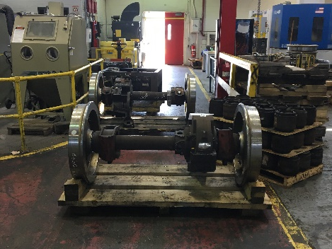
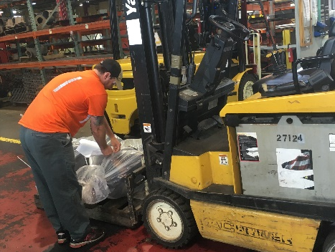
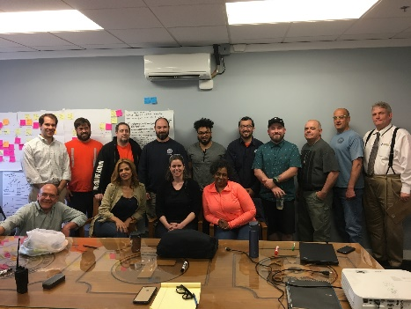
Lean Case Study - Everett Subway: Non-standard process for handling inbound & outbound components, negatively impacting Car Houses
Lean Update
Problem & Root cause
Solution
Impact
Safety risk: Inbound/ outbound components stored in aisles
Slower truck turnaround times: Lack of clarity about which components ready for Car Houses
Delays on shipments: Components ready to be shipped delayed by up to 1 day
Root cause ➔ Lack of SOP
Redesigned & standardized process with Kanban cards
All inbound & outbound components have designated staging areas
Clear roles & responsibilities
Simulated new process and trained all foremen within 1 week
20% reduction in truck turnaround Lead Time
20% reduction in touchpoints
Improved safety for employees
Everett Subway just 1 example - Efforts in TFM have produced >$350K of cost avoidance

Slide 7
Recap: $30M target set across entire organization for FY19 budget
Lean Update
 | DEPARTMENT | FY18 PROJECTION* | FY19 SAVINGS TARGET | FY19 Prelim Budget
1) | Bus Operations (Operators & Maintenance) | $222.0M | ($10.6M) | $211.4M
2) | Commuter Rail Supervision | $4.0M | ($0.2M) | $3.8M
3) | Everett Main Repair | $31.0M | ($1.5M) | $29.5M
4) | Rail Operations & Maintenance | $258.0M | ($12.3M) | $245.7M
5) | Transit Facilities Maintenance | $41.0M | ($2.0M) | $39.0M
6) | Administrative/Support** | $71.0M | ($3.4M) | $67.6M
 | Total | $627.0M | ($30M) | $597.0M
Note: FY18 Projection comprised of 7 months (Jul17 – Jan18) actual results and 5 months (Feb18 – Jun18) projected results
** FY18 Projection for Administrative/Support increasing due to expiration of Jet Fuel credits

Slide 8
For FY19, $30M target has been operationalized across 25 departments, but 65% concentrated in 2 key areas
Lean Update
~65% ($19M) across Vehicle & System Repair and Maintenance
Note: Does not include $400K Financial Service Charge saving; Ops Plan & Scheduling department included in Other Operations
Numbers may not tie due to rounding

Slide 9
For FY19, top down and bottom-up support for continuous improvement and budget adherence
Lean Update
Functional & Departmental goals, objectives & budgets
Key Performance Indicators (connected to Performance Management KPIs)
Strategic Initiatives
Lean Tools & Approaches

Slide 10
To hit targets, greatest focus is on key garages and car houses to develop new processes
Lean Update
Bus Maintenance
Southampton
Rail Maintenance
Riverside
Everett
Rail
KPI | Apr 2018 | FY19 target
Cost per mile | $6.45 | <$5.90*
MMBF | 8K | >12.25K
SRT com-pliance | 54% | >65%
KPI | Apr 2018 | FY19 target
Cost per mile | $8.76 | <$7.95
MMBF | 8.5K | >5K
SRT com-pliance | TBD | >65%
KPI | Apr 2018 | FY19 target
Shipment adherence | TBD | TBD
SRT compliance | TBD | >65%
Second wave: Increase standard work, and decrease waste and defects
First wave:
Establish baseline, identify opportunities and quick wins
Second wave: Develop rebuild model for vehicle & component demand
Note: Bus garages and car houses will also be measured on meeting daily Car Count and PM compliance; *Excludes the addition of SL3 miles, target to be re-estimated once multiple months of observed data available; Total cost per mile includes fully-loaded fringe costs and Everett Allocation, Bus Maintenance costs also exclude Non-Revenue Shops and Fuel costs

Slide 11
In Bus Maintenance, the plan for FY19 will build on the work done to date to decrease costs and increase productivity
Lean Update
Bus Maintenance costs
Note: Costs include Everett Bus shop, exclude Non-Revenue Shop, and exclude fuel; fully loaded fringe costs include pension costs if funded at 5% discount rate instead of 7.75% and retire health (OPEB) costs if fully funded; FY18P is 11 months of actuals and 1 month of avg. run-rate; FY19 fringe assumes FY18 fringe rate; No accruals for FY18 included

Slide 12
APPENDIX: Example list of Lean projects completed to date or in implementation (not exhaustive)
Lean Update
Dept. | Project | Impact | Estimated cost avoided
Railroad Operations | Reduce Lead Time and Cycle Time for producing daily coach fleet status report | 70% reduction in lead time, saving 930 hours/year (observed) | ~$85K
Everett Rail | Redesign in how finished components are stored and shipped to the Car Houses | 20% reduction in touchpoints, 20% reduction in truck turnaround lead time, and finished comp. no longer stored in aisles (obsv’d) | ~$3K
HR / Bus Operations | Redesign how bus workforce assessments are conducted to increase instructor utilization | 25% increase in workforce assessments by instructors, increases throughput of candidates by ~100/yr with zero cost (observed) | ~$7K
Red Line Operations | Identify opportunities to improve headway adherence and OTP without structural investments | Expected improvement due to improved coordination between Planning & Scheduling, OCC, and Red Line Operations | N/A
Safety | Reduce lead time for creation and submission of DPU Incident Investigation reports | Projected reduction of 15% of cycle times, saving ~130 hours/year | ~$12K
HR Compliance / IT | Decrease manual nature of tracking compliance with State Ethics Test | Projected reduction of at least 100 hours of filing time, access to all new data set on employee communication vectors | ~$9K
SWA | Improve process for design review comments and 5S in office space | Increased visibility and management of bottlenecks and lead times; better functioning workspace (observed) | N/A
TFM | Standardize daily work forms and process for dispatching & closing work orders | Reduction in ~10 hours/wk of administrative work and 10% productivity increase (observed) | ~$385K
Capital Delivery | Redesign Task Order Approval process for both GECs and project-specific contracts | Projected reduction of >50% lead time, from 9 months to less than 4 months | N/A
Note: Financial impact estimates average hourly wage of $45/hour with a fully-loaded fringe costs

Slide 13
APPENDIX: Glossary
Lean Update
APT: Assets Planning & Training
CEX: Customer Experience
HR: Heavy Rail
Kanban card: A physical card used to visually signal when inventory should be replenished or other actions should be taken
KPI: Key Performance Indicator
LR: Light Rail
MMBF: Mean Miles Between Failure
PSM: Power Systems Maintenance
SCM: Signals & Communication Maintenance
SOP: Standard Operating Procedure
SRT: Standard Repair Time
SWA: System-wide Accessibility
TFM: Transit Facilities Maintenance

