Slide 1
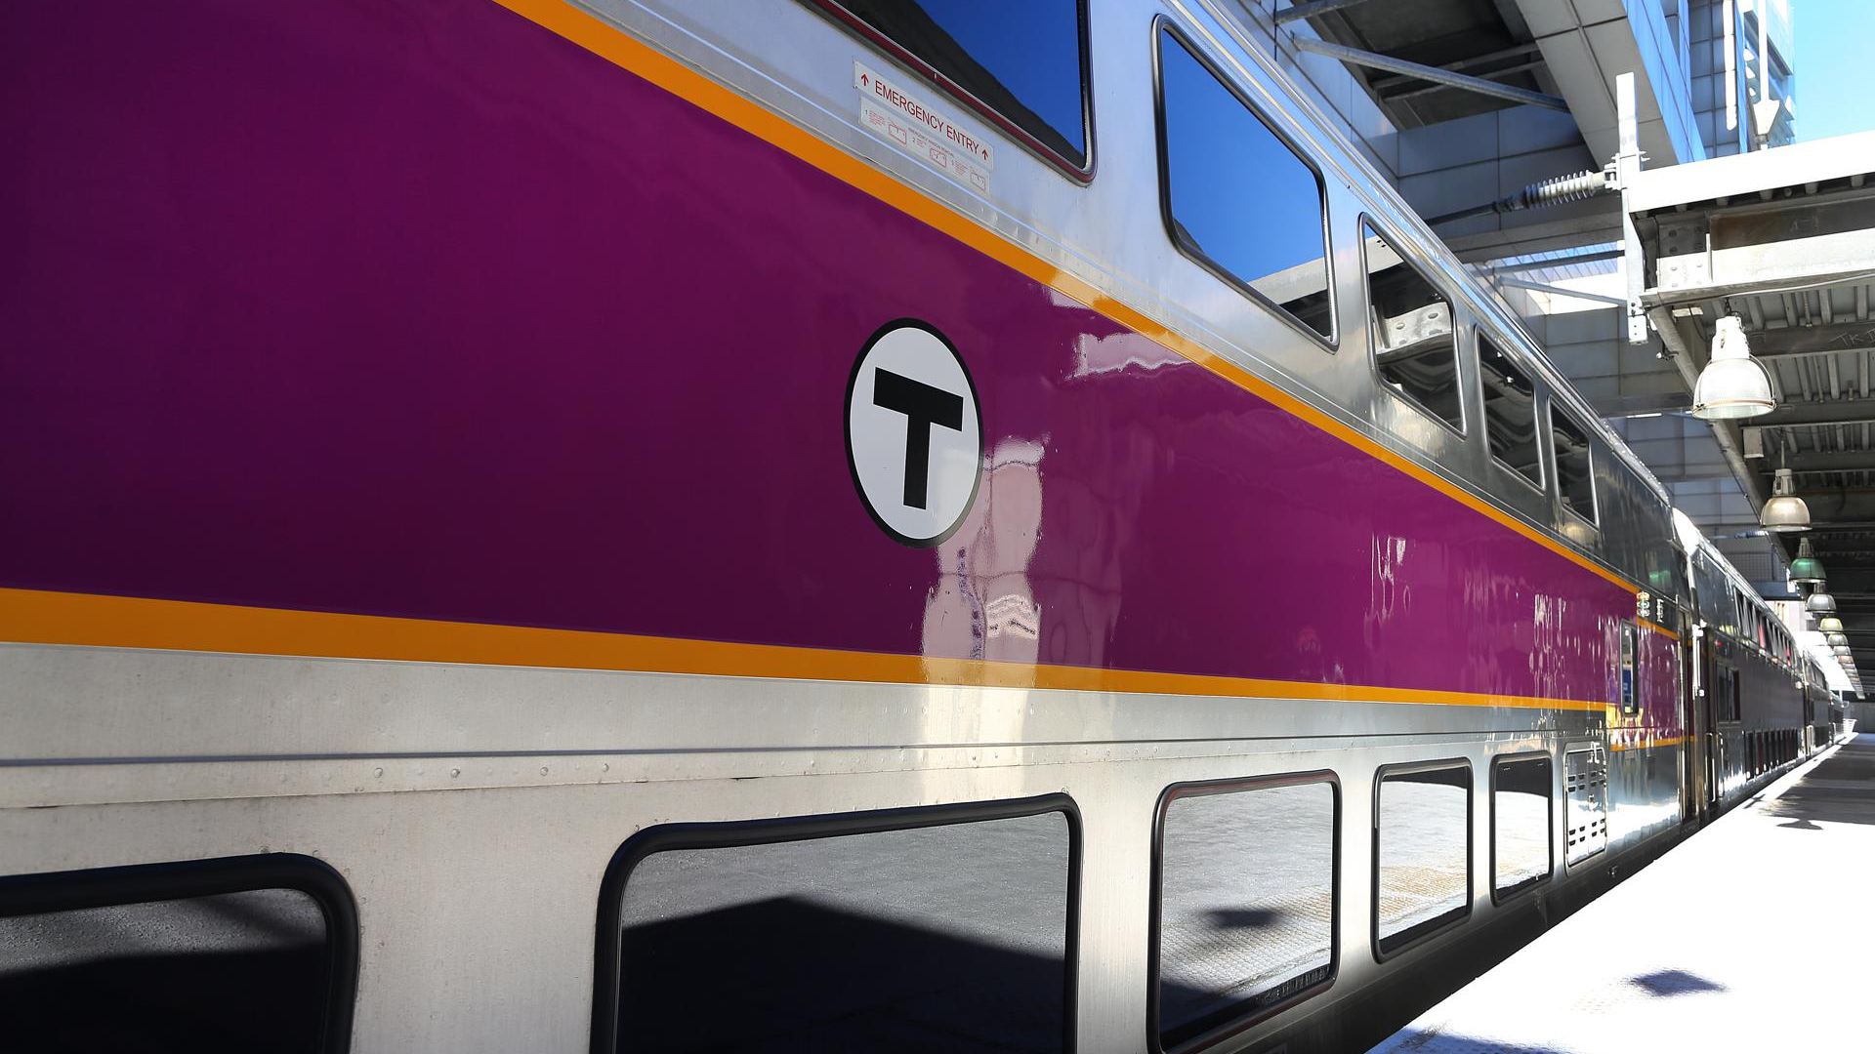
Revenue & Ridership Project Update

Slide 2
Approach
First six months focus on recruitment and setup:
  Recruited four marketing, revenue and retail specialists within Keolis and externally
  Recruited 40 strong ticket verification team
  Developed internal governance processes established overall project team has ~30 managers involved
Leveraging expertise and support from across the overall Keolis group including:
  France (gate line modeling)
  UK (retail systems and ticketless travel analysis)
  Canada (social media)
  US (data analysis)
Driving the importance of revenue management across KCS teams, changing KCS organizational culture and emphasis on revenue
Using best practice marketing techniques from other industries or other transit systems
Moving with pace and flexibility; emphasis on testing an evolving as we deploy the initiative

Slide 3
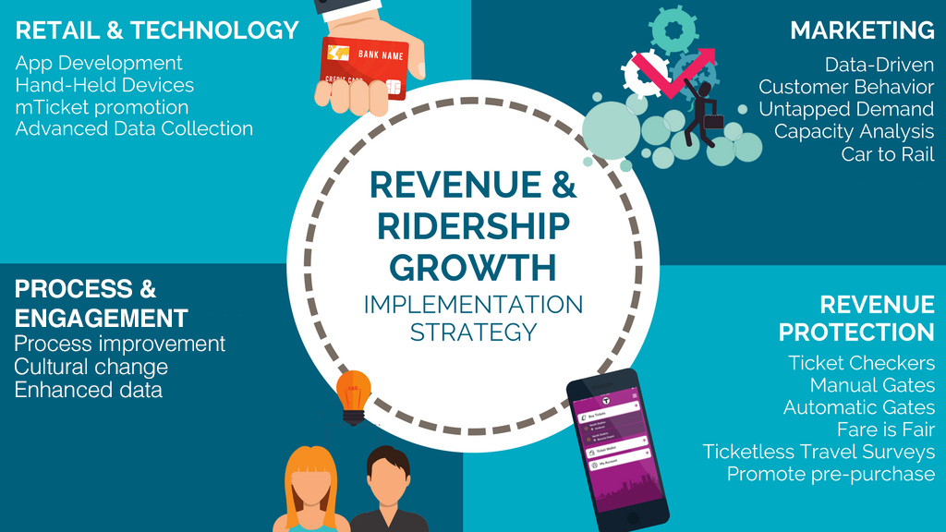

Slide 4
Commuter Rail Marketing
Context
Limited marketing CR outside of core commuter market
Limited data to support segmentation and targeting
Relatively low awareness of CR outside core commuter markets
Objectives
Identifying markets with high potential / low risk / high lifetime value and achieving buy in from stakeholders
Delivering new creative concepts, using best practice techniques to accurately target potential riders
Building market intelligence to improve targeting
Initial activities
Leisure campaign launch late March with media continuing through the year
Reverse commuter activity phased in through May and June and then continuing as a rolling campaign
Developed additional Summer $10 Weekends concept as part of joint promotion between MBTA/Keolis

Slide 5
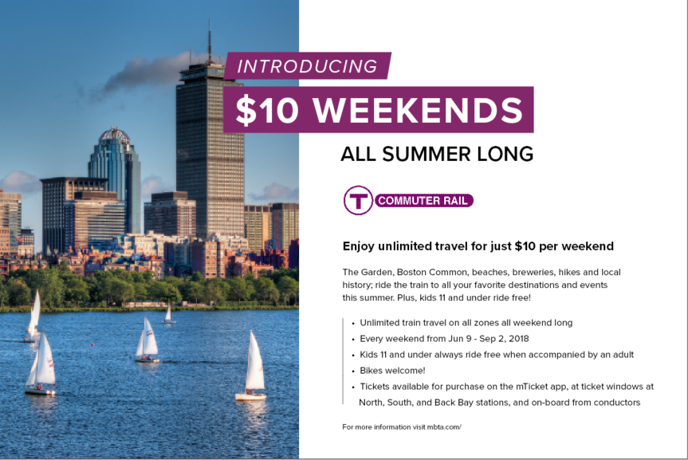

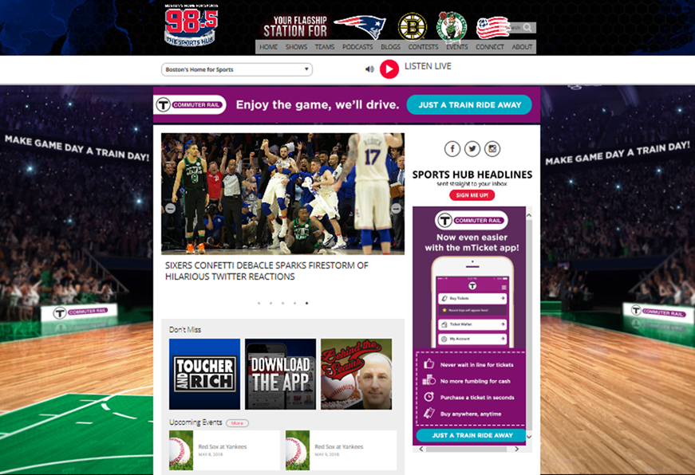

Current creative

Slide 6




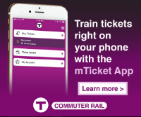
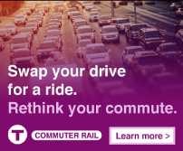

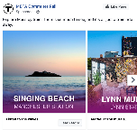
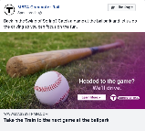

Current creative

Slide 7
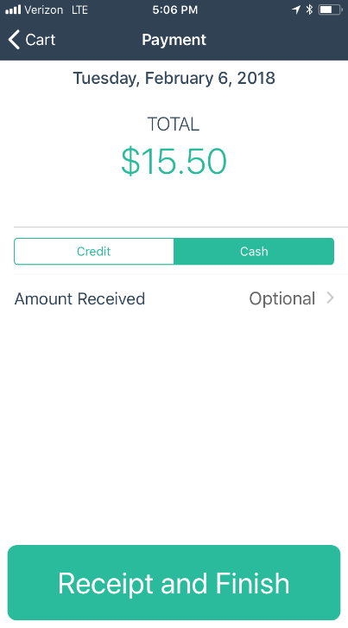
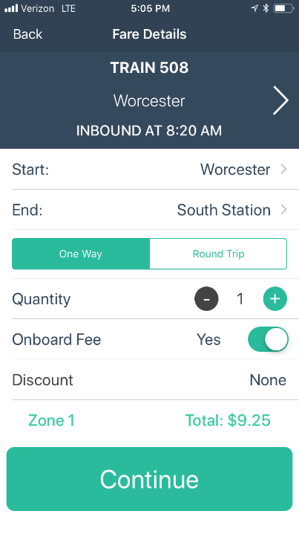
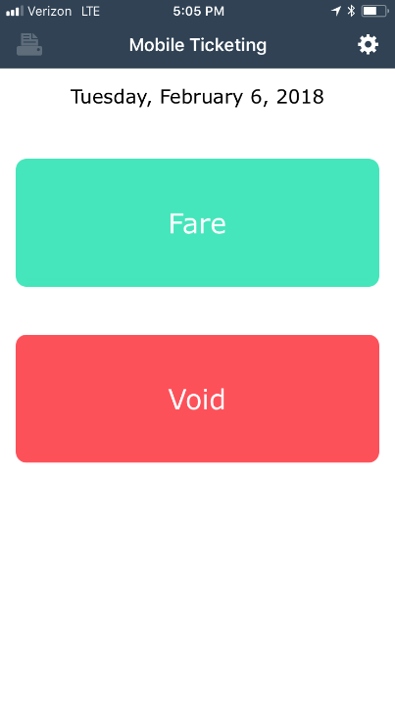
Hand Held Conductor Ticketing Device
Keolis has developed a new hand held ticketing device during early 2018
Allows on board convenient credit card and debit card purchase
Conductors started using live from February 2018 onwards
46 conductors are now using the hand held device
Planned roll out is around ~450 devices in use by end of August 2018
New conductors are only being issued RailSales as we phase out rebates

Slide 8
On Board Commuter Rail Ticket Sales
On board sales have historically been cash only using clipped tickets
On board volumes account for 125,000 tickets a month
The RailSales hand held device allows both cash payment and card payments to be taken
21,000 tickets have been sold by the pilot conductor group so far
MBTA/Keolis get much better data on origin/destination, number of passengers, time or purchase etc

Slide 9
Fare is Fair Checks
Checks involve Ticket Verification Assistants checking tickets before a passenger boards, M-Tickets have to be activated before passengers can board
Passengers with invalid tickets or no ticket are asked to purchase before boarding
Passengers also have to show a ticket to the conductor on board - checking before boarding and during a journey dramatically reduces potential for certain types of evasion
Strong emphasis on communicating before and during deployment of checks – extensive staff training on ticketing, ADA, customer service, minimizing confrontation
Station and on-train announcements at stations for 2 weeks before checks start, leafleting in the week before checks highlighting purpose and process and extra staff and managers in place
Follow up meet the manager events at Back Bay, South Station, North Station
Regular follow up by HQ managers to check the process is working as planned – weekly reports back from TVA team on progress

Slide 10
Fare is Fair and Ticketless Travel contacts
Whenever ticket checks start at a new station there is an initial spike in customer complaints
That spike subsides within 6-8 weeks of the start of checks as most customers become used to the checks
There is a steady volume of customer contacts around ticketless travel - these normally reflect complaints about other passengers, perceived opportunities for evasion etc
Every complaint is reviewed to determine whether process changes are needed resulting in some changes to checks at North Station and Back Bay

Slide 11
M-Ticket Purchases Back Bay and North Station
Fare is Fair checks expected to result in customers without tickets purchasing from M-Ticket, Ticket Offices and FVMs
M-Ticket data captures the origin station a customer selects giving an indication of where they started
Fare is Fair checks are PM peak only so would expect to see more purchases from Back Bay and North Station
Important to understand ticketless travel is hard to track exactly and there are many potential indicators of success, but so far the checks are working as expected

Slide 12
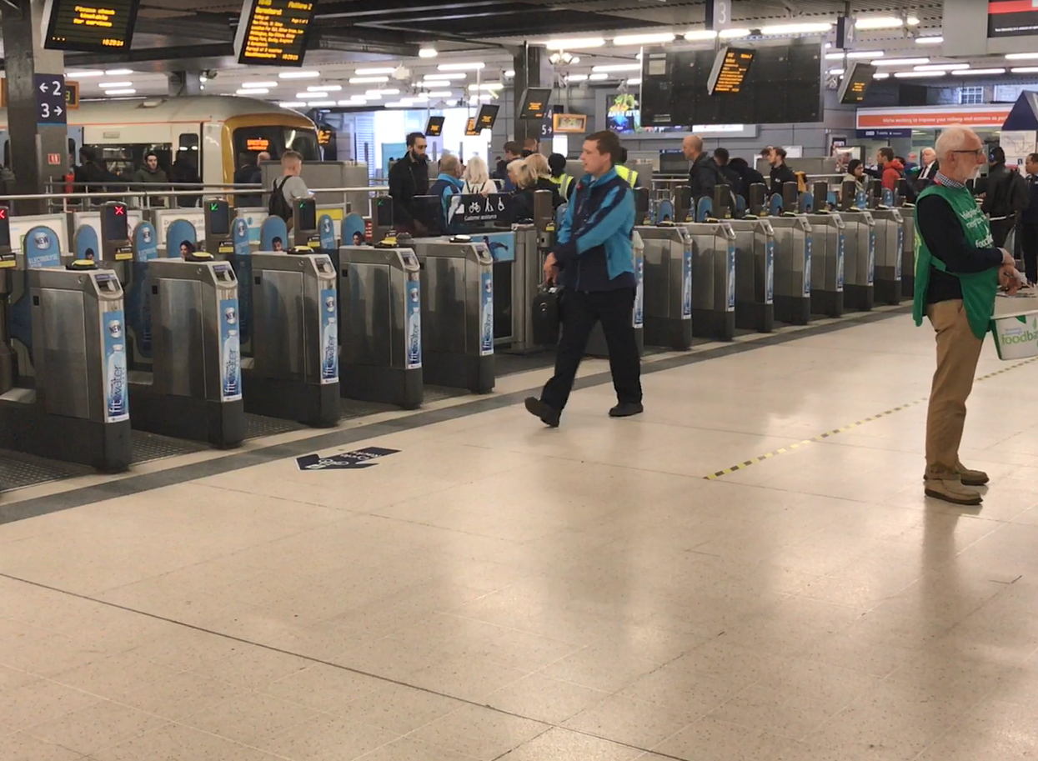
Next Steps: Planning & Installing Automatic Gates
  Initial scoping and option selection for gate locations:
    Multiple configurations reviewed for buildability, efficiency, overall experience
    Engaged internal CS, ADA, Safety and Engineering teams to review options
  Pedestrian flow modelling
    emphasis on getting the best options for customers and finding the most efficient configuration
  Code analysis
  Stakeholder engagement and approval|
  Follow up presentation July on next steps for initiative

