Slide 1
MBTA Contract No. R44PS04 Amendment No. 3 Red Line Cabot Carhouse Improvements
Red Line/Orange Line Improvements Program
June 25, 2018

Slide 2
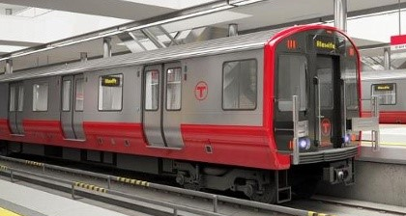
OVERVIEW
R44PS04 AM 3: Red Line Cabot Carhouse Improvements
Today’s board action will allow for Construction Phase Services to be provided by the Engineer of Record for the Red Line Cabot Carhouse Improvements project. This is in support of the Cabot Yard and Maintenance Facility Improvements Construction Contract under the Red Line/Orange Line Improvements Program to support the acceptance of new Red Line Vehicles.

Slide 3
Red Line/Orange Line Improvements Program
R44PS04 AM 3: Red Line Cabot Carhouse Improvements
Red Line
Orange Line
Total $1,982.03M
$1,009.00M
$470.36M
$350.95M
$151.72M
NEW VEHICLE PROCUREMENT PROGRAM
INFRASTRUCTURE IMPROVEMENTS PROGRAM
SIGNALS UPGRADE PROJECTS
STATE OF GOOD REPAIR PROJECTS

Slide 4
Funding
R44PS04 AM 3: Red Line Cabot Carhouse Improvements
 | Infrastructure Program
 | Orange Line Test Track | $7.80 M
 | Wellington Yard Expansion - Tracks 33 to 38 | $22.37 M
 | Wellington Maintenance Facility | $86.89 M
 | Wellington Yard Rebuild & Signal Upgrades | $148.92 M
 | Red Line Test Track | $25.40 M
 | Cabot Yard & Maintenance Facility Improvements | $290.52 M
 | Signal Systems RL Enhancements | $3.40 M
 | RL/OL Program Level (PM/CM, OR & Project Admin.) | $71.34 M
 | Unallocated Contingency | $48.76 M
 | Subtotal | $705.40 M
Anticipated Construction Advertisement Date
Mar. 2017
Oct. 2016
Mar. 2017
Feb. 2018
Aug. 2017
Apr. 2018
Dec. 2017
Red Line Orange Line Infrastructure Improvement Projects
(Cost in Millions)
✔
✔
✔
✔
✔
✔
✔
 | Signals Program
 | Orange Line Signaling and Train Control Systems Upgrade | $72.70 M
 | Southwest Corridor Wayside Signal Replacement | $39.34 M
 | Red Line Signaling and Train Control Systems Upgrade | $77.15 M
 | Columbia Junction Phase II | $28.94 M
 | RL/OL Program Level (PM/CM, OR & Project Admin.) | $36.74 M
 | Unallocated Contingency | $12.76 M
 | Subtotal | $267.63M
 | Total | $973.03M

Slide 5
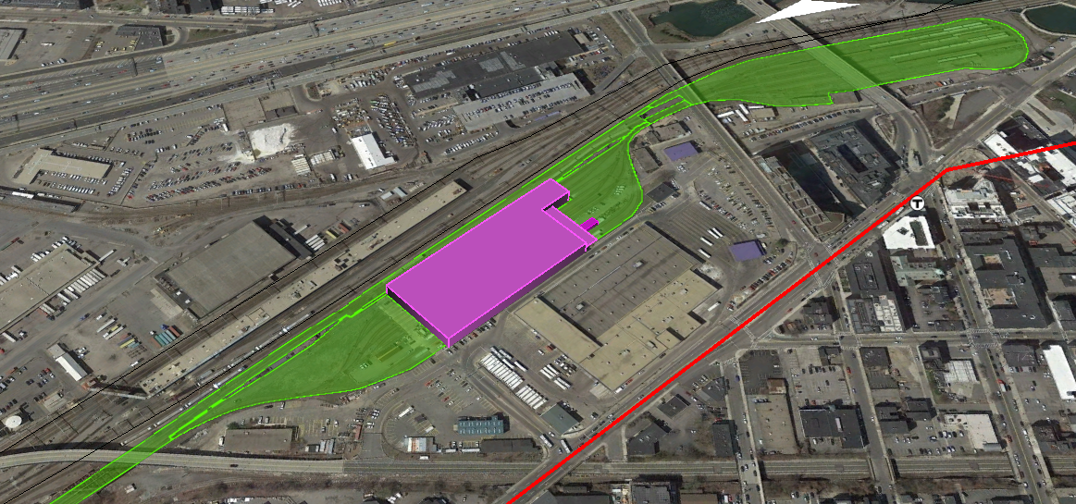
Construction Project Overview
R44PS04 AM 3: Red Line Cabot Carhouse Improvements
Cabot Yard & Maintenance Facility Improvements

Slide 6
Amendment No. 3 Scope
R44PS04 AM 3: Red Line Cabot Carhouse Improvements
The project is to rehabilitate the Cabot Carhouse in South Boston, improving the reliability of the new Red Line fleet by providing an updated maintenance facility.
Tasks for Construction Phase Services generally include:
Review and resolve Contractor Submittals.
Review, respond to, and resolve Contractor RFI’s.
Attendance at job meetings
Review of contractor change requests
Periodic site visits
Observe and witness factory/field testing of various scope items.
Assist in construction closeout through commissioning, installation inspections, certificate compliance at completion, final safety certification, and review of as-builts.
Coordinating with the Cabot Yard Rebuild & Signals Upgrades Engineer of Record.

Slide 7
Request of the Fiscal and Management Control Board
R44PS04 AM 3: Red Line Cabot Carhouse Improvements
Staff request that the Fiscal and Management Control Board authorize the MBTA General Manager and CEO, or his designee, to execute Amendment No. 3 to MBTA Contract R44PS04: Red Line Cabot Carhouse Improvements for the Red Line/Orange Line Improvements Program with Jacobs Engineering for an amount not to exceed $3,678,038.

