Slide 1
Better Bus Project - Update
June 25, 2018

Slide 2
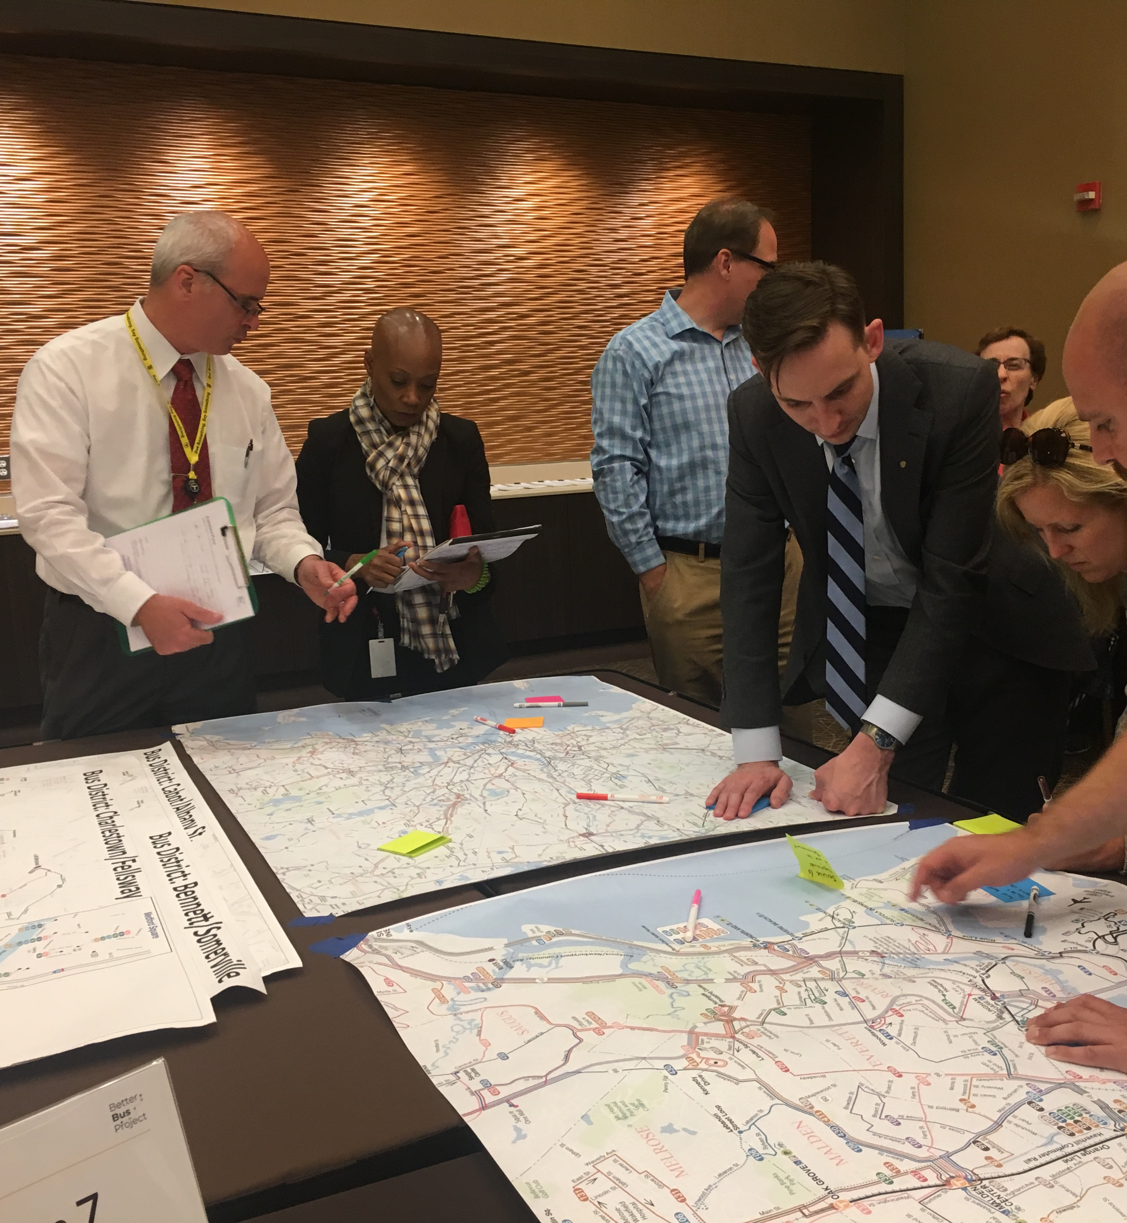
Overview
The Better Bus Project – Goals & Standards
Improving the Bus Network – The last 90 days
General Update on the Better Bus Project
Data
Outreach
Next Steps

Slide 3
The Better Bus Project – Goals and Standards
The goal of the Better Bus Project is to measure and close the gap between current bus service delivery and the service delivery standards, passed in January 2017. Closing the gap will depend on partnerships and optimization, as well as resource allocation and the modernization of planning and scheduling.
Comfort
Passengers should have a reasonable amount of personal space during their trips
Reliability
Passengers should be able to expect service to arrive when scheduled
Frequency
Passengers should be able to access transit within a reasonable waiting time
Span
Passengers should have confidence that service will operate during expected hours
Coverage
The geographic area where service is provided

Slide 4
Improving the Bus Network – The last 90 days
Early Morning Bus Service kickoff
Begin aggressive wave of operator hiring
Full and completed transition of revenue and non revenue employees to HASTUS Bid/Roster
Start of Phase II Washington Dedicated Bus Lane Pilot
April 1, 2018
May 7, 2018
June 1, 2018
June 6, 2018
Washington Dedicated Bus Lane becomes Permanent
Dropped Trip Task Force Created
SL3 kickoff
Late Night Bus Service Approved
April 21, 2018
May 15, 2018
June 4, 2018
June 19, 2018

Slide 5
General Update on The Better Bus Project
Data 75% Route Profiles completed 80% State of the System completed Market Analysis completed | Tools and Resources ODX Tool completed Advanced agreement for Transit Signal Priority Gap analysis tool (BRIT) completed $1.5M lockbox commitment in support of dedicated bus lanes, FY19 to FY21
Partnerships Met with 60+ municipal staff in 10+ communities Furthered relationships built with Liveable Streets and the Barr Foundation Dedicated bus lane discussions with five communities | Outreach 100% (15) Street Teams held 100% (6) Regional Meetings held 100% (14) Transit Talks held Feedback: 1,550 newsletter subscribers; 1,172 online responses; 846 Street Team surveys completed; 165 attendees at Open Houses; 250 attendees at Transit Talks

Slide 6
Data Update: Service Delivery comparison Standard
Performance Measure | Target | Performance
Bus reliability - Key Bus routes | 80% | 77% YTD
Bus reliability - Other routes | 75% | 63% YTD
Bus service operated | 99.5% | 97.7% YTD
Bus passenger comfort | 96% | 95% YTD
Frequency | 90%* | 84% Fall 2017
Span | 98%* | 97% Fall 2017
Base Coverage | none (75% minimum) | 79% Fall 2017
Frequent Service in Dense Areas Coverage | 70* | 59% Fall 2017
Low-income Households Coverage | 85% | 86% Fall 2017
*Updated target from Service Delivery Policy based on improved methodology

Slide 7
Data Update: Route level analysis, by Standard
 | Key Bus Routes/Silver Line (18 Total) | Other Routes (141 Total)
Reliability | 15 below target | 130 below target
Frequency | 4 below target | 68 below target
Span of Service | 2 below target | 55 below target
Comfort | 13 below target | 45 below target

Slide 8
Data Update: Analysis & Measurement of each Standard
Standards based on operated service
Analysis to identify key causes of performance below standards
Standard | Analysis in Better Bus Project
Reliability | Run times, segment level travel times
Service Operated | Dropped trip taskforce, FMLA usage analysis
Comfort | Causes of crowding analysis, segment level crowding analysis
Standards based on schedules
For Coverage, Span, and Frequency proposed service changes will be evaluated for their impact on the standards.

Slide 9
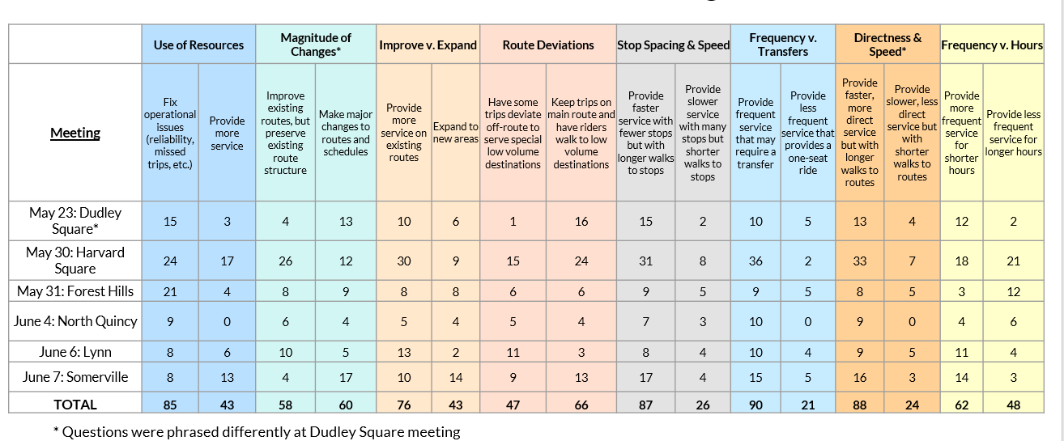
Outreach Update: Regional Meeting Public Feedback
Frequency v. Transfer – Frequent service
Directness & Speed – Faster, more direct service
Stop Spacing & Speed – Fewer stops, greater distance
Use of Resources – Fix operational issues

Slide 10
The Better Bus Project - Next Steps
Identifying Priorities and Trade Off Discussions
July 2018
Initial Tier Development and Discussion
September 2018
Title VI Analysis, based on Priorities and Tier Development
Fall 2018
Municipal Meetings to Identify Bus Optimization Opportunities
Fall 2018/Winter 2019
Public Outreach and Feedback -- Tier Recommendations
Winter 2019
Tier Development Discussions and Board Vote
Winter/Spring 2019
Implementation of The Better Bus Project Recommendations, based on rating/pick schedule timeline
2019 Summer/Fall Rating/Schedules

