Slide 1
MBTA Contract No. J66PS02
Winchester Center Commuter Rail Station Rehabilitation
Final Design and Construction Phase Services
June 18, 2018

Slide 2
OVERVIEW
Contract No. J66PS02: Winchester Center Commuter Rail Station Final Design and CPS
Today’s board action will provide for final design, bid phase and construction phase services for the Winchester Center Commuter Rail Station Rehabilitation Project in Winchester, MA on the MBTA Lowell Line.

Slide 3
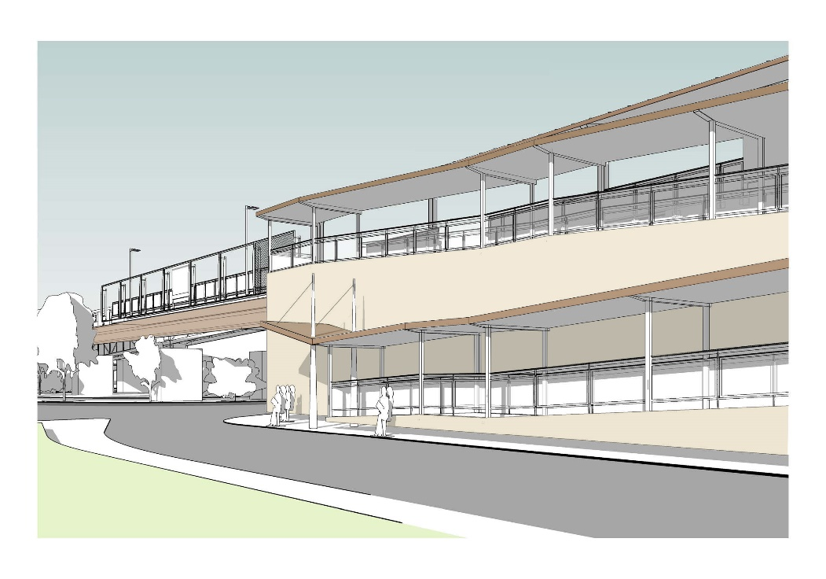
Construction Project Overview
Contract No. J66PS02: Winchester Center Commuter Rail Station Final Design and CPS
The project is a full reconstruction of the existing station and includes construction of new high-level accessible platforms, elevators and replacement of all walkways, ramps, canopies, signage, lighting and communication systems.
Existing Pedestrian Ramp
Proposed New Ramp System

Slide 4
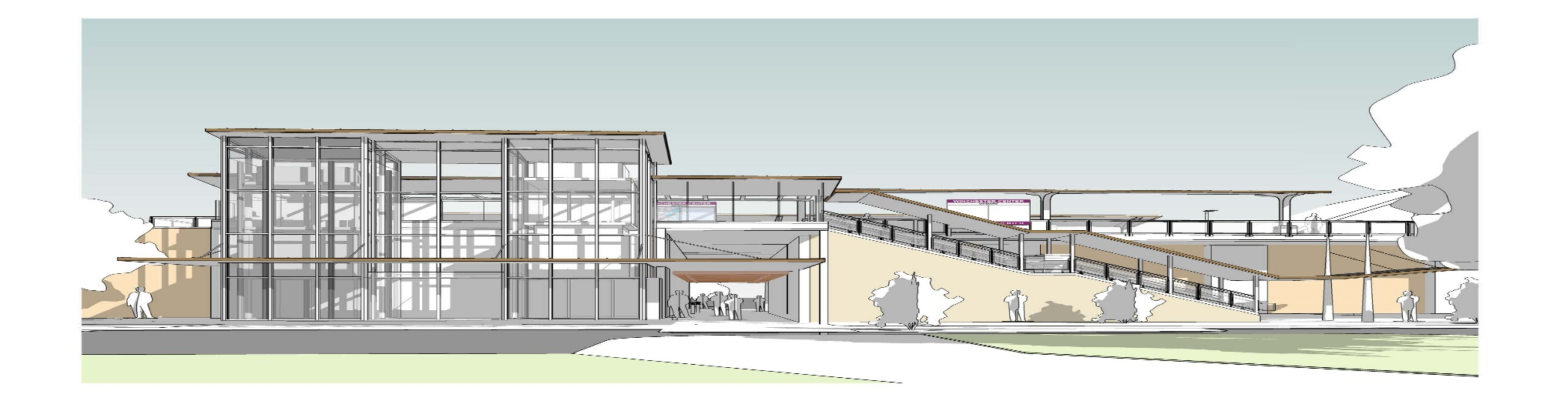
Project Benefits
Contract No. J66PS02: Winchester Center Commuter Rail Station Final Design and CPS
The reconstruction of the Winchester Station Center will provide ADA compliant full length high level platforms for level boarding, accessible ramps and elevators.
Useful life of the new station will be approximately 60 years and will bring the asset to a state of good repair.
The relocation of the ramp at Thompson Street to cross the Quill rotary will provide greater access to the station

Slide 5
Background
Contract No. J66PS02: Winchester Center Commuter Rail Station Final Design and CPS
The original Station was designed in 1956. The Ashlar faced concrete viaduct retaining walls support the elevated sections of platform and track throughout most of the station.
The existing station platforms are located just south of Main Street and pass over Waterfield Street. Access to the elevated passenger platforms is via four (4) ramps, two at each end of platform. At present, the station is severely deteriorated and the overall condition of the station is consistently reviewed.
Under an earlier contract Jacobs Engineering Group (Jacobs) was scoped to perform design phase services from 15% to 100% with the intent of authorizing Construction Phase Services (CPS). The scope of services under that contract included low level boarding platforms, ramps and mini high platforms with removable edges for wide freight train movement.

Slide 6
Background
Contract No. J66PS02: Winchester Center Commuter Rail Station Final Design and CPS
Under the prior contract Jacobs developed the design to a 30% level of completion reflecting scope changes resulting from changes in Federal Regulations and railroad operations and systemwide accessibility requirements.
The scope of services for this proposed follow-on contract is to advance the approved 30% design through final design, and provide construction phase services.
To maintain continuity in professional technical services, avoid substantial duplication of costs, and avoid an unacceptable delay, the MBTA seeks to contract with Jacobs to provide the final design and construction phase services.
Jacobs holds unique knowledge and project specific experience and brings considerable value to the Project. The negotiated cost is fair and reasonable and award of the contract to Jacobs is in the best interest of the MBTA.

Slide 7
Scope of Services
Contract No. J66PS02: Winchester Center Commuter Rail Station Final Design and CPS
This contract for Final Design, Bid Phase and Construction Phase Services includes:
Complete design services including architectural, civil, site, track, structural, mechanical, electrical, communication and signal design
Construction cost and schedule estimates
Environmental permitting
Prepare bid advertising documents, respond to bid questions
Review, response and resolution of contractor submittals and RFIs
Attendance at weekly project job meetings and special meetings
Periodic site visits and associated reporting
Review of authorized changes to the plans and specifications
Semi-final and final inspections and preparation of punch-lists
Preparation of final documentation for project closeout

Slide 8
Request of the Fiscal and Management Control Board
Contract No. J66PS02: Winchester Center Commuter Rail Station Final Design and CPS
Staff request that the Fiscal and Management Control Board authorize the MBTA General Manager and CEO, or his designee, to execute MBTA Contract No. J66PS02: Winchester Center Commuter Rail Station Rehabilitation Final Design and Construction Phase Services, with Jacobs Engineering Group for an amount not to exceed $3,937,875.

