Slide 1
Green Line Transformation Program: Green Line Train Protection System (GLTPS) Engineering and Project Management Services
June 18, 2018

Slide 2
Green Line Train Protection System - Engineering and Project Management Services
Background
As a result of accidents on the Green Line in 2008 and 2009 the NTSB issued a Safety Recommendation to the MBTA to implement a positive train protection control system.
The initial conceived solutions envisioned the implementation of a Communication Based Train Control (CBTC) system and all the time and cost associated with systems of this type.
In December of 2015 the focus shifted towards evaluation of alternative technologies that improve safety but are less costly, easier to implement without compromising service reliability and passenger capacity.
GLTPS Concept was developed with the primary purpose to:
Reduce the risk of red signal violations
Reduce the risk of train-to-train collisions
GLTPS Approach was developed
Overlay system desired – integration of the GLTPS onto legacy trains and wayside signaling equipment.
Modular components –combination of service-proven concepts and innovative application.
Risk mitigation based procurement – Three step procurement with physical demonstration and evaluation prior to award.
September 2016: Briefing with the NTSB & DPU.
October 2016: System Procurement RFP24-16 Released.
January 7, 2017 Last update presentation to the FMCB.

Slide 3
Green Line Train Protection System (GLTPS) Purpose
Green Line Train Protection System - Engineering and Project Management Services
Improve the Safety on the Green Line
Reduce the risk of red signal violations
Reduce the risk of train-to-train collisions

Slide 4
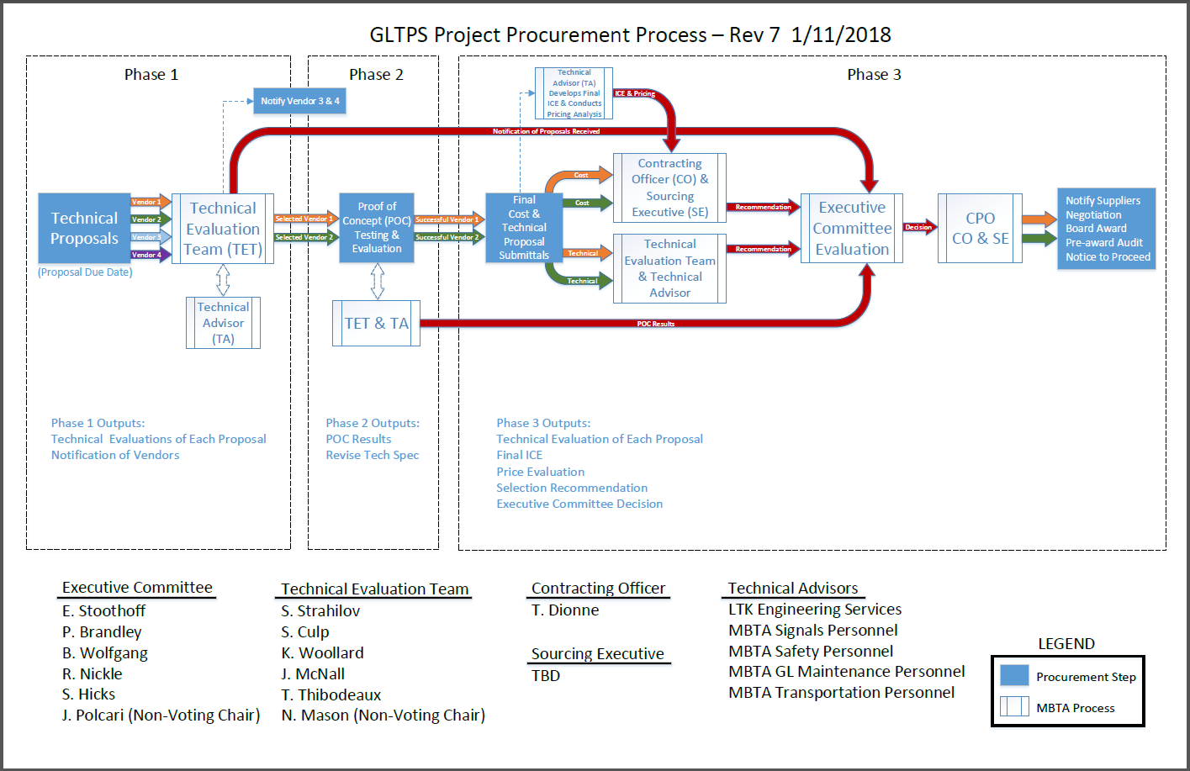
GLTP System Procurement Process (RFP No. 24-16)
Green Line Train Protection System - Engineering and Project Management Services
✓
✓
We are here
Oct ’16 ----------- Jun’17 ------ Dec ’17 --------- Mar ’18 -------------------Jun’18 ------------------------------- Sep’18

Slide 5
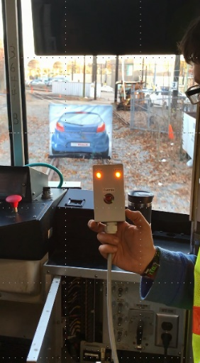
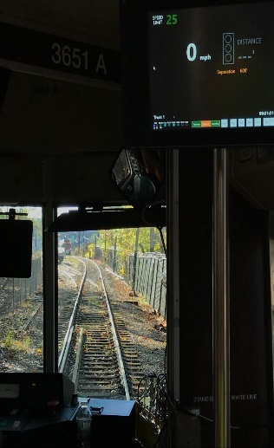
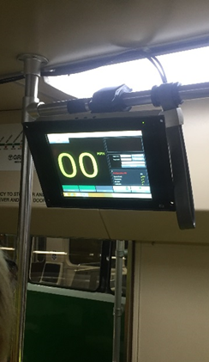
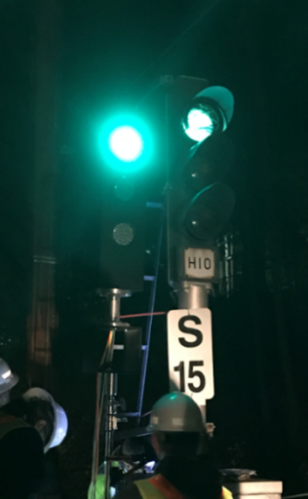
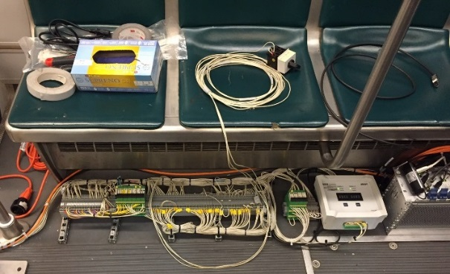
Project Progress since January 7, 2017
Green Line Train Protection System - Engineering and Project Management Services
Progress
Technical Solicitation Phase Oct 2016 – Jun 2017
Multiple Technical Proposals were submitted with two chosen to for Proof of Concept
Proof of Concept Testing Aug 2017 - Dec 2017
Two technical proposal solutions were tested and evaluated on the Green Line
GLTP Engineering and Project Management Team Selected Dec 2017
Final Technical Proposals and Evaluations Mar - June 2018

Slide 6
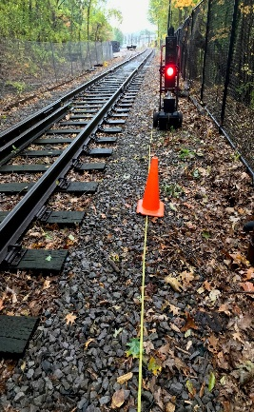
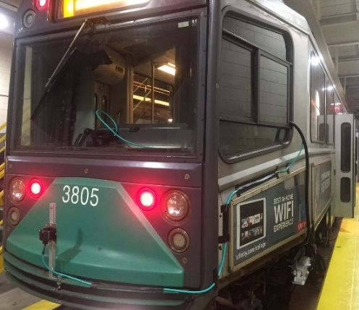
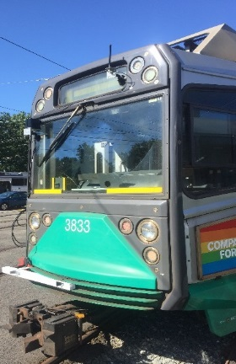
Project Outlook
Green Line Train Protection System - Engineering and Project Management Services
Next Steps
Board Award Engineering and Project Management Team (X20PS01) Jun 2018 (Today)
GLTP Contractor Final Selection (RFP 24-16) Jul 2018 (Ongoing)
Board Award GLTP Contractor (RFP 24-16) Aug 2018
NTP to GLTPS System Integration Contractor Sep 2018
Wayside Installation Contractor RFP 2020
System Wide Operational Integration 2023 - 2024

Slide 7
Engineering Contract Overview
Green Line Train Protection System - Engineering and Project Management Services
May 7, 2018 Green Line Transformation presentation noted the GLTPS as one of the future transformational projects.
Key Elements of Scope: Provide comprehensive engineering and project management support from Contractor selection through design, installation, operational integration and extended warranty:
Augment MBTA staff with subject matter expertise in train control, signaling, vehicle performance, commissioning, testing and operational integration.
Engineering support during the Design, Qualification, Implementation and Management of the Green Line Train Protection System (GLTPS).
Industrialization planning, oversight and commissioning for GLTPS equipment installations on all Green Line Vehicles Type 7, 8 & 9.
Industrialization planning, oversight and commissioning for GLTPS equipment installations at every Signal on the Green Line passenger service network (300+ locations).
Duration: 6 Years (72 Months from NTP)
Advantages & Opportunities:
The selected team has supported the MBTA since GLTPS concept development and can start tomorrow.
The team is ready to work holistically with the Green Line Transformation Program to delivery an integrated system to improve safety on the Green Line.

Slide 8
Request of the Fiscal Management and Control Board
Green Line Train Protection System - Engineering and Project Management Services
Staff request that the Fiscal and Management Control Board authorize the General Manager & CEO , or his designee, to award and execute MBTA Contract No. X20PS01 Green Line Train Protection System Engineering and Program Management Services with a team led by LTK Engineering Services (LTK, VHB & VPE) for an amount not to exceed $18,370,472 with a six year period or performance.

