Slide 1
Final CIP Update SFY 2019-2023 Joint Boards presentation
June 11, 2018

Slide 2
Overview
Since last meeting:
Held public meetings and completed comment period
Finished equity analysis
Updated sources
Updated projects / spending
Today:
Need vote on final CIP by Joint Board

Slide 3
Follow-up from June 5th CPC meeting
Public engagement – a future process improvement
Conduct an after action review of engagement efforts
Develop action plan and present proposed plan to CPC for discussion
Implement action plan during next year’s CIP update to broaden base of under represented groups and achieve more participation
Chapter 90 – a future update
Identify and report on whether and how much municipalities contribute to match state Chapter 90 allotments for eligible capital projects

Slide 4
Public engagement
Phase 1:
Focus on stakeholders – both established and newly identified, across all Divisions and modes
Direct outreach and meetings - in person and electronically
Outreach was focused on educating public about the CIP and process
Contacted stakeholder groups identified by the Divisions and other stakeholder groups
Phase 2:
10 public meetings across the Commonwealth
Two meetings held jointly with MPOs (Central Massachusetts and Berkshire)
Modest turnout at each meeting; approximately 16 participants/meeting
Additional Meetings
Legislative Briefing - 42 participants
I-495 Partnership Meeting - 17 participants
Community of Built Environment Meeting (DPH) – 12 participants
Massachusetts Municipal Association – 11 participants
Boston MPO - 27 participants
Two comment tools – online maps and participate tab in the CIP document
Letters and emails
221 comments received through close of the comment period (meetings, letters, emails, online CIP document)
Phase 3:
All comments logged and analyzed using qualitative data analysis software
Relevant comments were distributed to appropriate Divisions for input/response
Letters and comments will be responded to directly, as appropriate
Changes, where appropriate, are incorporated and published as part of the final CIP

Slide 5
Social Equity Analysis: Conclusions
2019-2023 CIP Social Equity Analysis:
This year’s analysis represents an incremental evolution of the process, including:
The incorporation of additional demographic categories (adding disability to minority, low-income, and limited English proficiency)
Analysis performed at Census Tract level rather then municipal level, for more localized understanding of impacts
Investments analyzed not only in the aggregate but also by mode and by investment category
The totality of investments appear to distribute funding in a manner that effectively benefits the diverse populations of the Commonwealth
At the modal and project category levels of analysis, there are examples of investments that benefit Title VI and EJ communities as well as those that benefit non-Title VI and non-EJ communities, suggesting overall equity in the capital investment strategy
Process Improvements for Future CIP Social Equity Analyses:
Variable Buffering
Currently - projects are given a 1-mile buffer from which to draw local demographic data for understanding impacted populations
Future - projects will be given a variable buffer due to the nature of the project (mode, type of infrastructure), the location of the project (rural, urban), and other such factors to more accurately describe the areas impacted by CIP investments.
Linking Project Scoring and Equity Analysis
Individual project scores reflect the benefit they bring to Title VI and EJ communities
This is not necessarily captured when identifying the local population during the equity analysis process.
By linking these two processes more closely together, the equity analysis will become stronger

Slide 6
Social Equity Analysis: Summary
Minority communities*
Low-income*
Communities with 24% minority or more
Total MassDOT investments in minority communities are approximately 12% less per capita than non-minority communities
Transit investments (only) in minority communities for MBTA Reliability and Modernization investments were 35% and 93%, respectively more per capita than non-minority communities
Median income at or below $44,100**
Non low-income communities receive about 23% more of total MassDOT investments per capita than low-income communities;
**65% of statewide median income (most recent median income is $67,846)
Limited English Proficiency*
Disability communities*
Communities with 6.25% or more of population that are LEP
High LEP communities receive 20% more MassDOT funding per capita than non-LEP communities
When only MBTA funding is included LEP communities receive over 75% more funding per capita
Communities with 11% or more of individuals with disabilities
Disability communities receive about 29% less in MassDOT funding per capita than non-disability communities
* Population data for any particular track assumed a one mile radius buffer around each project

Slide 7
Geographic Equity Analysis: Per Capita Spending by Census Tract
Note: dotted lines represent municipal boundaries

Slide 8
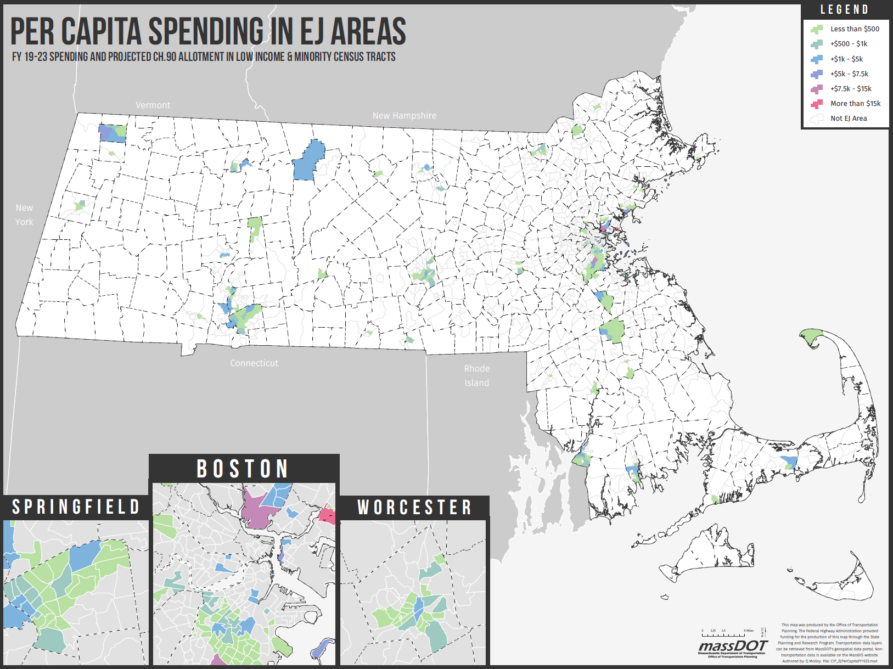
Social Equity: Per Capita Spending in Environmental Justice Areas
Note: dotted lines represent municipal boundaries

Slide 9
Sources update
Other state funds
Commonwealth (DEP) is eligible to receive funds from settlement of the lawsuit against Volkswagen for falsification of emissions data
While the Commonwealth has not yet submitted its proposed plan for spending settlement funds, DEP/ANF have agreed that MassDOT will receive $10.9 million in FY 19 for clean transit vehicles
Additional pass-through funds ($20 million) from the Executive Office of Housing and Economic Development to support transportation improvements related to Seaport Square development
Additional pay-go capital
$140 million in toll fund reserves has been identified through the development of the FY 19 operating budget
Reserves will be drawn as needed for eligible highway projects

Slide 10
Plan update: investments by priority
millions | SFY 2018- 22 | SFY 2019- 23 | Differences
Reliability* | $9,647.0 | $8,404.4 | -$1,242.5
Modernization | $3,247.1 | $5,103.2 | $1,856.2
Expansion | $2,148.1 | $1,921.5 | -$226.6
Chapter 90 | $1,000.0 | $1,000.0 | -
Planning, Enterprises Services, & Other | $902.1 | $842.5 | -$59.6
Five-year total | $16,944.2 | $17,271.6 | $327.4
Adjustment highlights:
Additional funding ($6.2 million) for electric bus procurement (PVTA) in other state funds
More pay-go capital for MassDOT
Additional $140 million available over 2019-2023 through identification of available reserve funds (tied to final FY 19 operating budget for MassDOT)
Final CIP will incorporate some draws on the reserve funds available
*MBTA investments in R/O Line shifted from Reliability to Modernization

Slide 11
Spending updates
Aeronautics Division – no changes
Highway Division
MPOs have endorsed all TIPs and they are reflected in the final draft CIP update
STIP/CIP realigned which results in some project shifts
Additional pay-go capital available (FY 18 year end reserves) in coordination with operating budget to be programmed for capital projects on tolled facilities
IT – no changes
MBTA
Additional federal funds for discretionary ferry grant awarded in May ($6 million) and higher than anticipated FFY18 FTA formula funds ($25 million)
Rail and Transit Division
Transit – $10.9 million made available from funds received by DEP from VW emissions lawsuit settlement
VW funds to be used on eligible investments that reduce emissions (e.g. electric buses)
Funds will be used to cover additional costs to procure electric buses and supporting facilities for PVTA and replace bond cap programmed by VTA for purchase of electric buses
RMV
$3 million of bond cap spending associated with ATLAS to occur in FY 18
Reduces bond cap needed in FY 19 for ATLAS

Slide 12
MassDOT spending by source (Draft vs. Final)
Projected sources (in millions) | Draft FY19 | Final FY 19 | Delta | Draft 5-year Total | Final 5-year Total | Delta
Federal sources of funds
Federal Highway (FHWA) reimbursements | $611.8 | $643.7 | $31.9 | $3,782.1 | $3,810.1 | $28.0
Federal Transit (FTA) reimbursements** | $4.7 | $4.6 | ($0.1) | $24.1 | $24.1 | $ -
Federal Aviation (FAA) reimbursements and grant draws | $37.0 | $37.0 | $ - | $209.6 | $209.6 | $ -
Federal Rail (FRA) reimbursements and grant draws | $3.5 | $3.5 | $ - | $4.6 | $4.6 | $ -
Subtotal federal sources* | $657.1 | $688.9 | $31.8 | $4,020.4 | $4,048.3 | $28.0
Bond cap | $898.2 | $890.4 | ($7.8) | $4,214.0 | $4,206.2 | ($7.8)
Accelerated Bridge bonds | $76.5 | $67.5 | ($9.0) | $92.1 | $81.8 | ($10.3)
Rail enhancement bonds | $59.8 | $61.5 | $1.7 | $149.2 | $150.9 | $1.7
CARM | $24.2 | $30.5 | $6.3 | $190.1 | $169.5 | ($20.6)
Metropolitan Highway system (MHS) pay-go | $77.7 | $71.6 | ($6.1) | $175.3 | $223.3 | $48.0
Gaming | $ - | $ - | $ - | $ - | $ - | $ -
Western Turnpike (WT) pay-go | $40.9 | $43.9 | $3.0 | $232.1 | $251.6 | $19.5
Tobin Bridge (Tobin) pay-go | $30.2 | $21.5 | ($8.7) | $105.0 | $105.6 | $0.6
Reimbursable and 3rd parties | $0.4 | $0.4 | $ - | $20.0 | $20.0 | $ -
Municipal and local funds | $3.3 | $3.3 | $ - | $14.3 | $14.3 | $ -
Public private partnerships | $ - | $ - | $ - | $ - | $ - | $ -
Other State Funds*** | $ - | $30.9 | $30.9 | $ - | $30.9 | $30.9
Subtotal of non-federal sources* | $1,211.2 | $1,221.4 | $10.3 | $5,192.1 | $ 5,254.2 | $62.1
Total sources* | $1,868.3 | $1,910.3 | $42.1 | $9,212.5 | $ 9,302.6 | $90.1
* Totals may not add due to rounding | ** FTA reimbursements for MassDOT projects only; RTA federal funds are not included | *** New funding source made available to MassDOT

Slide 13
MBTA spending by source (Draft vs. Final)
Projected sources *(in millions) | Draft FY19 | Final FY 19 | Delta | Draft 5-year Total | Final 5-year Total | Delta
Federal sources of funds
Federal Highway (FHWA) reimbursements | $49.0 | $49.0 | $ - | $109.9 | $109.9 | $ -
Existing FTA reimbursements and grant draws | $402.9 | $399.1 | $ (3.8) | $2,721.0 | $2,752.2 | $31.2
FTA Full funding grant agreement (GLX FFGA) | $92.6 | $92.6 | $ - | $827.7 | $827.7 | $ -
Other federal funds | $4.3 | $4.3 | $ - | $5.9 | $5.9 | $ -
Subtotal federal sources* | $548.8 | $545.0 | $ (3.8) | $3,664.6 | $3,695.8 | $ 31.2
Bond cap (including lockbox) | $60.9 | $60.9 | $ - | $301.0 | $301.0 | $ -
Accelerated Bridge bonds | $0.4 | $0.4 | $ - | $0.4 | $0.4 | $ -
Rail enhancement bonds | $185.3 | $185.3 | $ - | $1,097.0 | $1,097.0 | $ -
MBTA Revenue bonds | $207.0 | $206.1 | $ (0.9) | $1,854.5 | $1,854.9 | $ 0.4
Metropolitan Highway system (MHS) pay-go | $0.7 | $0.7 | $ - | $1.3 | $1.3 | $ -
Gaming funds | $0.0 | $0.0 | $ - | $0.0 | $0.0 | $ -
Municipal and local funds (GLX) | $0.0 | $0.0 | $ - | $75.0 | $75.0 | $ -
Reimbursable and 3rd parties | $14.4 | $14.4 | $ - | $84.0 | $84.0 | $ -
Positive Train Control (PTC) financing | $97.9 | $97.9 | $ - | $336.7 | $336.7 | $ -
Pay-Go lockbox (MBTA) | $159.6 | $162.6 | $3.0 | $551.2 | $550.6 | $ (0.6)
Capital maintenance fund | $4.6 | $4.6 | $ - | $5.4 | $5.4 | $ -
Other State Funds** | $ - | $ - | $ - | $ - | $ - | $ -
Subtotal of non-federal sources* | $730.8 | $732.8 | $ 2.0 | $4,306.5 | $4,306.3 | -$0.2
Total Sources* | $1,279.6 | $1,277.8 | $(1.8) | $7,971.0 | $8,002.2 | $31.0
* Totals may not add due to rounding | ** New funding source made available to MassDOT and MBTA

Slide 14
Project updates
Aeronautics Division – no changes
IT – no changes
Highway
STIP/CIP realigned which results in some project shifts
MBTA – Additional projects
Hingham ferry dock modifications (draft CIP only funded design) - $12.1 million
Customer technology program - $10 million
Design standards and guidelines - $8.8 million
Rail and Transit Division – no changes
RMV – Additional (potential) project
To better serve the needs of Cape Cod residents and in response to numerous public comments, RMV and Cape Cod Regional Transit Authority (CCRTA) are exploring options for RMV services at the CCRTA facility in Hyannis. Two potential options are being explored:
Option 1: Full service RMV facility
Option 2: Limited service facility (e.g. providing only renewal services). A limited service location would be in addition to, not instead of, South Yarmouth
Pending the outcome of further analysis, a potential project could be included in the CIP update for FY 2020-FY2024

Slide 15
Next steps and discussion
Incorporate any input from Joint Boards
Finalize CIP content for final publication

Slide 16
FY2019-2023 CIP update: Appendix Program sizes
June 11, 2018

Slide 17
Reliability investments by program
Aeronautics / Airport pavement management system
Aeronautics / Airport capital improvement
Highway / All-electronic tolling
Highway / Bridge
Highway / Equipment
Highway / Facilities
Highway / Interstate pavement
Highway / Municipal bridge
Highway / Non-interstate pavement
Highway / Roadway improvements
Highway / Safety improvements
Highway / Tunnels
OTP/ Pre-apprenticeship
Information Technology / Desktop experience
Information Technology / Digital infrastructure
Information Technology / Cyber/information security
Information Technology / Asset management
MBTA / Bridges and tunnels
MBTA / Revenue vehicles
MBTA / Facilities
MBTA / Stations
MBTA / System upgrades
MBTA / Track, signals, and power
Rail / Bridges
Rail / Facility reliability
Rail / Grade crossings
Rail / Vehicle reliability
Rail / Track and right-of-way reliability
RMV / Operations Management
Transit / Mobility assistance program
Transit / RTA facility and vehicle maintenance
Transit / Technical assistance
Transit / RTA vehicle replacement
Five-year program budget in millions
Aeronautics | Highway | IT | MBTA | Rail | RMV | Transit | Total SFY19-23
$269.3(millions) | $4,411.6 | $59.5 | $3,775.4 | $252.4 | $1.1 | $169.9 | $8,943.7

Slide 18
Modernization investments by program
Aeronautics / Airport administration buildings
Highway / ADA retrofits
Highway / Complete streets
Highway / Intelligent transportation systems
Highway / Intersection improvements
Highway / Roadway reconstruction
Highway / Allston multi-modal
Information Technology / Customer digital experience
Information Technology / Enterprise/BRP/automation
Information Technology / Workforce productivity
MBTA / Accessibility
MBTA / Risk Management and Mitigation
MBTA / Commuter Rail Safety and Resiliency
MBTA / Red Line/Orange Line Improvements
MBTA / AFC 2.0
MBTA / Customer Experience and Technology
MBTA / Process Improvements and Innovation
Rail / Facility modernization
Rail / Industrial rail access program
Rail / Track and right-of-way modernization
Registry / ATLAS
Registry / Customer service modernization
Registry / Kiosks
Transit / RTA facility and system modernization
Transit / RTA fleet upgrades
Transit / RTA replacement facilities
Five-year program budget in millions
Aeronautics | Highway | IT | MBTA | Rail | RMV | Transit | Total SFY19-23
$25.0 (millions) | $1,768.8 | $43.7 | $2,934.3 | $59.4 | $67.5 | $42.7 | $4,941.4

Slide 19
Expansion investments by program
OTP / Bicycle and Pedestrian Modal Implementation
Highway / Bicycle and pedestrian
Highway / Capacity
MBTA / Green Line Extension
MBTA / Expansion projects
Rail / South Coast Rail
Rail / Track and right-of-way expansion
Rail / Vehicle expansion
Five-year program budget in millions
Highway | MBTA | Rail | OTP | Total SFY19-23
$488.7 (millions) | $1,422.5 | $139.0 | $60.0 | $2,110.2

