Slide 2
Human Resources Update
Update on Strategic Plan
New HR Service Delivery Model
Organizational Results: Highway and RMV
Continuous Improvement - Looking Forward

Slide 3
Shift in Focus: 2015-2017
2015
Legacy
Practices
Current Status
Industry Standard HR Processes
Industry
Standard
HR
Processes
Legacy
Practices

Slide 4
Workforce Strategy – Key Initiatives
Human Resources is committed to attracting, retaining, and developing a diverse and qualified workforce while advancing and implementing solutions that lead to business improvements.
Branding
Succession
Planning
Learning and Development
Talent
Acquisition
Process
Simplification
This strategic plan lays out five key initiatives designed to help HR better support the business needs of MassDOT & MBTA.

Slide 5
Learning and Development
72%
of managers surveyed responded that they were not adequately trained for their new role.
Key Initiative: Develop training programs that provide managers and supervisors with the tools needed to successfully perform and deliver on business priorities.
NEW TRAINING
On Going Training
Manager and Supervisor Certificate Program
LEAD (MBTA Leadership and Development Program – Eastern United States and Canada)
College for America (Online undergraduate degree programs with Southern New Hampshire University)
AutoCAD 2016 / Civil 3D Essentials and Advanced
Northeast Transportation Technician Certification
National Transit Institute QA / QC Course
Highway Construction Management Certificate w/Wentworth (9/2018)
Lean 6Sigma (7/2018)
White belt (In House)
Green belt (Contracted)
Bus Garage Leadership program (sponsored by MACP) in conjunction with Mass Community Colleges (7/2018)
Legal Interviewing Online course (just released)
‘Hiring the Best People’ Online Course (8/2018)
VIDEO and eLEARNING INITIATIVE - Conversion of classroom trainings to video based and eLearning delivery to support increased compliance and accessibility to training.

Slide 6
Talent Acquisition
Only
62%
of managers surveyed responded positively to the statement “qualified candidates accept positions.”
Recruiters will now work with Hiring Managers to
deliver high quality talent through:
Posting – Strategic use of job boards and other services beyond MassCareers
Sourcing – Reaching out to passive candidates
Networking - Building relationships with groups like professional associations and educational institutions
New Applicants in Pipeline for CSR
1174
Total CSR Referrals from DOL
156
Former Interns Hired
18
Interns Hired
147
6

Slide 7
Talent Acquisition: Enhanced Internship Program
Key Initiative:
Recruit top talent for MassDOT/MBTA Internships and retain the best performers for entry level positions.
Northeastern University
Mass Maritime Academy
UMass Amherst
Harvard University
Key Partner Colleges/Universities
Total Summer Interns Across MBTA/MassDOT 2018
18
Interns Hired Full Time
147

Slide 8
Shift in Focus: Looking Forward
THE GAP
Transactional
HR
Deliverables
THE IDEAL
Strategic Business
Impact
Strategic
Business
Impact
Transactional
HR
Deliverables

Slide 9
HR Service Delivery Model (Why?)
TO EXPAND HR CURRENT CAPABILITIES
Improving and Streamlining Operational Efficiencies
Greater HR Focus on Strategy
Improving the Employee Experience
Increased HR Capacity to Focus on Business and Talent Issues

Slide 10
HR Service Delivery Model
HR
Business Partner
Centers
Of
Expertise
HR Business Partners
“HR Business Partners Help Companies Turn Aspirations into Action.”
—Dave Ulrich
Drive New Thinking
Provide Deep Content Expertise in Chosen Area
Design Specific Business Solutions
HR
Service
Center
Integration
SHARED SERVICES
Policy Development
MassDOT University
Occupational
Health Services
Perfecting the Delivery of HR Basics
Focus on Employee Experience

Slide 12
Highway HR Partnership - Results
Highway FY 18 Hiring
162 new hire and promotional opportunities filled
Critical Hire Positions Filled
18 - Laborer/Motor Equip. Operator/Hwy Foreman
28 - Civil Engineer I – 50% former Highway Interns
61 - Civil Engineer II-VI (including 2 Tunnel Engineers, and 1 Deputy Chief Engineer)
7 - Electrician I, II and High-Voltage
6 - Motor Equipment Mechanics
10 - General Construction Coordinators and Inspectors
7 - Environmental Analyst [II-V]
4 - Bridge Inspectors
Highway Human Resources Business Partner (HRBP) working directly with Headquarters and Districts to prioritize remaining vacancies at newly establish weekly hire meeting.
Highway Business Priorities
Snow and Ice
Reduce Overtime
Construction and Capital Programs
Maintenance

Slide 13
Highway Snapshot
HR Strategic Partnership Approach
HR instituted a rotational program for regular district office visits to bring 10 Park Plaza to the field operations. The program has participation from Labor Relations, Employee Relations, Talent Acquisition and the HR Business Partner. This effort fosters heightened collaboration and cooperation from both sides.
HR is exploring an electrician apprentice program with a Boston trade high school for a pilot program with District 6. HR is also attempting to develop a mechanics mentoring program.
Policy: drafted Overtime Policy and related template for standard operating procedures (SOPs); Provided revisions to Workplace Violence Policy and Weapons-free Workplace Policy.
Identifying and preparing candidates for promotional opportunities
Learning and Development: multiple initiatives with internal and external providers to develop skills for current role and prepare for succession.
Highway is addressing lack of required licenses in MEO and MEM positions by hiring on a nine-month provisional basis and providing training for CDL and hoisting licenses. Employee must pass tests within nine month period.

Slide 14
RMV HR Partnership - Results
RMV FY 18 Hiring Plan
Hiring of temporary resources to achieve 100% workstation utilization within the service centers
To date, HR has on-boarded a total of 85 temporary resources to support the ATLAS Stabilization and Workstation Utilization Initiative
31 temporary resources were converted to full time Customer Service Representative I as of May 27th
Conducting assessment of needs for an agile workforce
Partnering with Workforce Labor and Development in order to enhance our Customer Service Representative I pipeline
RMV Business Priorities
Atlas Implementation
Real ID
Reduction in Wait Times
Service center optimization

Slide 15
RMV Snapshot
RMV HR Strategic Partnership approach
Collaborative efforts with Labor Relations, Office of Diversity and Civil Rights and the RMV in the development and implementation of performance standards for union employees
Developing formal management training tailored to service center manager job responsibilities
Policy: Provided Criminal History Records Information (CHRI) Policy for Real ID and CDL background check requirements and related internal guidelines for the CHRI Review Committee.
Talent Acquisition: brought on 33 interns, 8 returning to learn about RMV operations – goal to hire for full time.
Learning and Development: MassDOTU to assist in developing additional Training to address knowledge gaps with ATLAS software

Slide 16
MassDOT Human Resources
Centers of Expertise
March 19, 2018

Slide 17
What is a Center of Expertise (CoE)?
Leverage expert knowledge to deliver best in class service
Payroll
Employee Relations
Total Rewards
Human Resources Business Intelligence
Project Management & Continuous Improvement
Talent Acquisition

Slide 18
Human Resources Business Intelligence
Predictive HR Analytics
&
Workforce Forecasting and Real-Time Metrics.
Reactive Data Reporting

Slide 19
Human Resources Service Center
One Stop Shop
Minimize Redundancy
Track Trends

Slide 20
HR Service Center Objectives
Consistent experience
Customer Service
Interview
Scheduling
Performance Management - Support/ Tracking
General HR Policy Inquiries
Benefits -
Transactions/Support
Leave of Absence Support
On-boarding/
Off-boarding
Uniform Processes
Improved Service Delivery

Slide 21
How it Works: HR Model in Action
Inquiry
TIER 1
TIER 2
Employee or Manager
HR Support Specialist
HR Business Partner or Center of Expertise
95 % of inquiries resolved
5 % of inquiries resolved
TIER 1:
Inquiries and service requests by telephone / email.
TIER 2:
More complex or specific questions / issues.

Slide 22
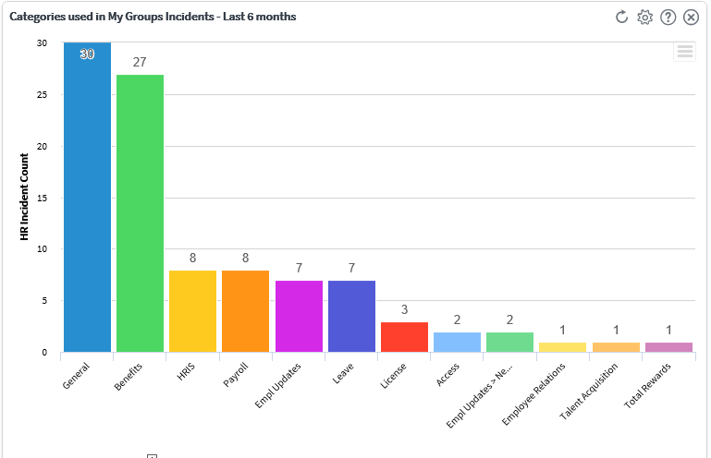
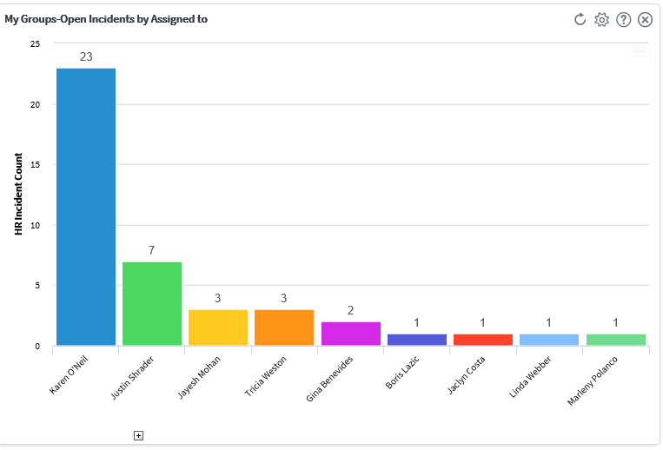
HR Service Management Dashboards
Service Center metrics drive HR business decisions

Slide 23
QUESTIONS?

