Slide 1
Late Night Proposal and Early Morning Service Update
June 4, 2018

Slide 2
Overview
MBTA staff, municipal partners, and advocates have worked to craft a Overnight Service proposal since March 2016
Proposal divided into Early Morning and Late Night
Early Morning pilot started April 1, 2018
Staff continues to gather and analyze ridership data
Marketing efforts show familiarity with the service
The FMCB allocated a maximum of $2 million toward Late Night service in FY19 budget and directed staff to continue working on a viable proposal
This presentation will update the FMCB on staff’s progress
Staff seeks the Board’s authorization to advance today’s proposal for a pilot of late night service

Slide 3
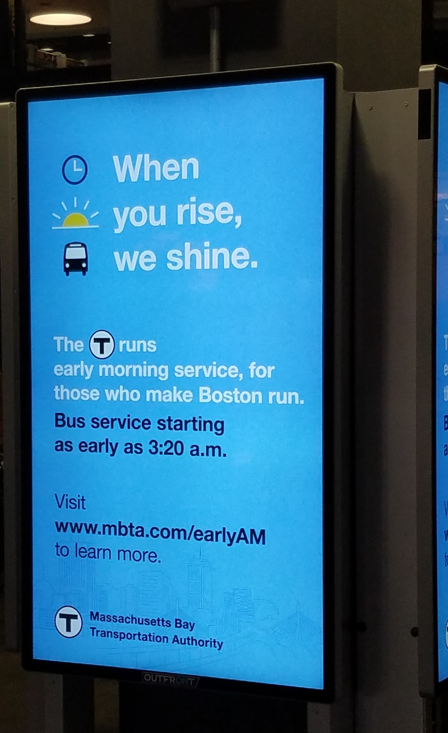
Early Morning Update
Service started on April 1st
Marketing effort has been successful
Between April 1- May 12, 4300 unique page views on the Early AM page on MBTA.com
In a survey the 3rd week of April, 52% of frequent MBTA riders had heard of Early Morning service
33% of frequent riders familiar with Early Morning service learned about it from digital boards and announcements in stations and 15% from MBTA website/social media.

Slide 4
Early Morning, Preliminary Ridership Observations
Passengers are using earlier trips—and crowding is decreasing on previously overcrowded first trips.
Data still being collected on all trips for analysis

Slide 5
Proposal for Late Night Pilot
Goals:
Use a similar incremental approach as Early Morning Pilot; add service where we expect strongest ridership
Collect data to inform future decisions
Timeline:
Phase 1: Fall Rating (September 2018) or Winter Rating (December 2018)
Fall Rating (Sept 2018) if decision by June 4, or Winter Rating (Dec 2018)
Adds three types of additional service:
Add/modify service to build toward a legible overnight network
Add new span where there is high ridership on current last trips, including into 1-2am timeframe
Alleviate crowding on trips between 10pm and 12:30am by increasing frequency
December 2018:
Evaluate Early Morning Pilot and Phase 1 of Late Night
Phase 2: Spring Rating (April 2019) or Summer Rating (June 2019)
Based on findings from Early Morning Pilot and Phase 1 of Late Night, add or revise earlier/later trips on service with high usage to further build out the overnight network

Slide 6
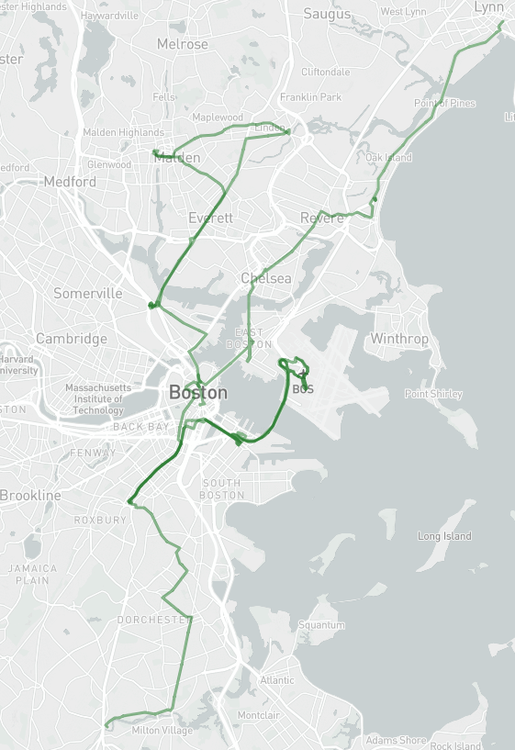
Proposal for Phase 1: Part A—Build toward legible overnight network
Add/modify service to build toward a legible overnight network
Adjust existing overnight/early AM routes structure and branding to be clearer and legible
Add new late night SL1/SL4 service as spine through downtown
Increase legibility of existing Route 171 (two trips at 3:50am and 4:20am)
Add 1-2 trips along portions of Routes SL1, SL4, 15, 24, 104, 108, 109, 117, 442 in the 2am timeframe
Notes:
Overnight when rail isn’t running, late night bus is running

Slide 7
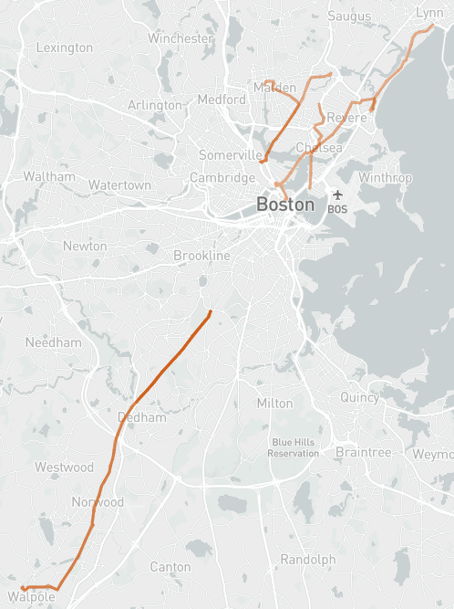
Proposal for Phase 1: Part B—Add new late-night span
Add new span where moderate/high ridership exists on current last trips (after 12:30AM)
Add new later trips on:
34E (Saturday)
104 (weekday, Saturday)
109 (weekday)
111 (Saturday)
116 (Saturday)
442 (Sunday)

Slide 8
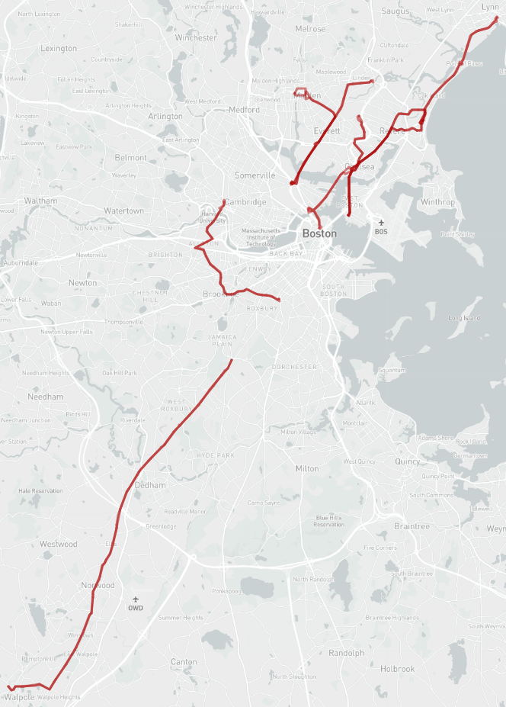
Proposal for Phase 1: Part C—Improve frequency to reduce crowding
Add better frequency to address high ridership/crowding between 10pm-12:30am
Add better late night frequency and more trips on:
34E (Saturday)
66 (weekday, Saturday)
104 (weekday, Saturday)
109 (Saturday)
111 (weekday, Saturday)
116 (weekday, Saturday)
117 (weekday, Saturday)
442 (weekday)

Slide 9
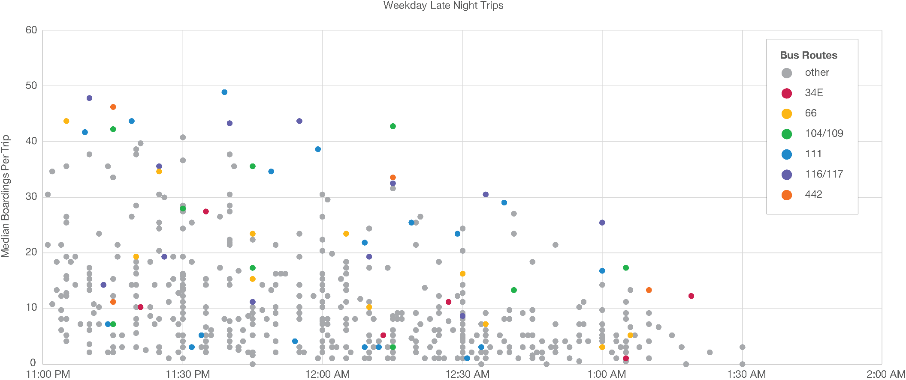
Current Night Bus Ridership
Source: APC April 2018

Slide 10
Phase 1 Cost: $2M FY19 Operating Budget
Phase 1 Resources:
Bus operations
FY19 budget included up to 10 bus operators for late night/overnight; this allocates 6 bus operators leaving room for Phase 2 in Spring/Summer.
Phase 2 Resources:
Remaining budget for Phase 2: $660,000
In December 2018:
Recommendations, based on Early Morning Pilot and Phase 1 Late Night will be drafted and shared with the Board.
Budget allocation will be included in the discussion.
Cost | Allocation
$800,000 | Operations
$250,000 | The RIDE
$100,000 | T Police
$50,000 | Marketing
$1.2M | Total

Slide 11
Pilot Evaluation
Before the Late Night pilot starts the MBTA and partners will agree on a set of performance measures for the pilot
Phase 1 will test:
Which routes are good candidates for extended service in Phase 2
Which routes need more frequent service between 10pm and 1am
Together with Early Morning pilot, which routes are good candidates for all night service
The MBTA will evaluate the Late Night service marketing effort by evaluating who has heard of the service and change in ridership in the Late Night period

