Slide 1
General Manager’s Remarks
Fiscal and Management Control Board
June 4, 2018

Slide 2
Agenda
New ferry: Glory
RIDE
Washington Street, Roslindale
Scan the Street
MBTA Family

Slide 3
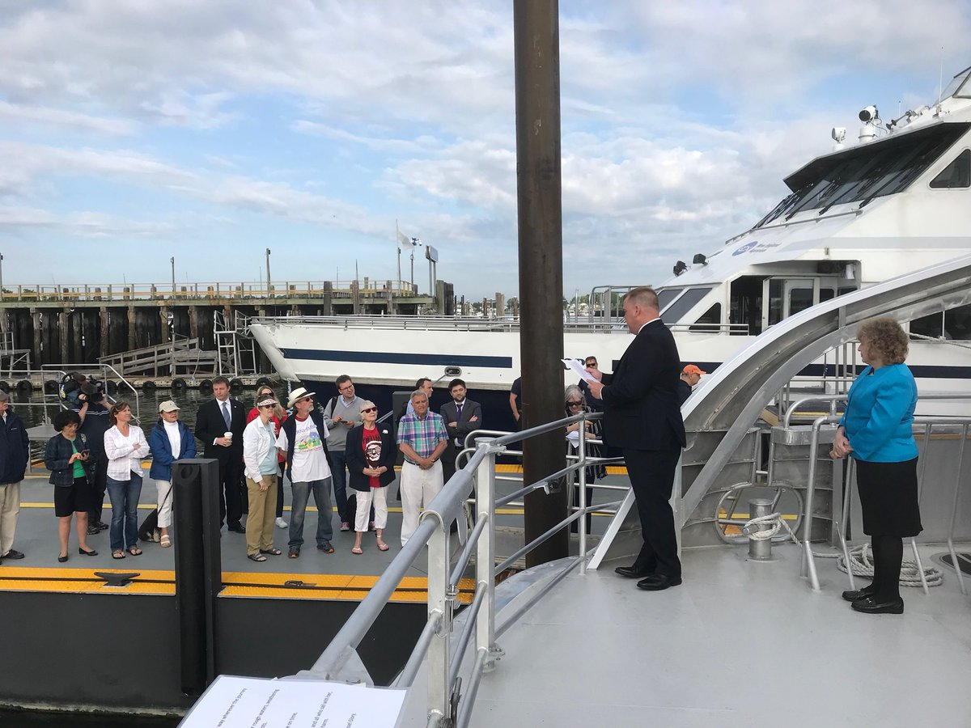
New ferry: Glory
Glory, the sister vessel of Champion, christened by Secretary Pollack on Wednesday, May 30
Built by Gladding-Hearn Shipbuilding in Somerset
Capacity for 150 passengers, includes flat screen info, LED lighting, concessions, luggage racks

Slide 4
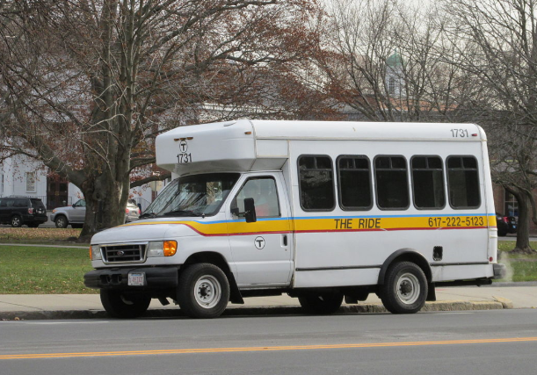
RIDE Update
Transition to Transdev took place effective June 1
New procurement based on lessons learned and helpful insight from RIDE advocates
Ultimate goal is to deliver a reliable service on which our most vulnerable customers can depend
Thanks to RIDE advocates, and our internal team for process improvements
Thanks also to our RIDE customers for their patience during transition

Slide 5
Roslindale Bus Lane Pilot
The City of Boston partnered with the MBTA to pilot a bus and bicycle lane from May 7⁻ June 1, 2018 between Roslindale Sq and Forest Hills station.
In a survey of bus passengers and bicyclists during the pilot, 94% stated they wanted the lane to continue permanently.
Satisfaction with Bus Lane
88% of bus respondents and 89% of bicycle respondents report some degree of satisfaction
Source: Roslindale Bus Lane Pilot Survey - May 2018

Slide 6
Scan the Street for Wheels and Feet
With the improved weather comes an increase in outdoor activities – in particular, the number of cyclists and pedestrians
Reminder to people to be aware of their surroundings
Whether walking, biking, driving, or using some other form of transportation, please be mindful of other people, motor vehicles, cyclists
The Scan the Street campaign is a partnership involving MassDOT’s Highway Division, the Executive Office of Public Safety, Department of Public Health, Boston Vision Zero, WalkBoston, MassBike, and Safe Roads Alliance
As we enter the season of warmer weather, we want everyone to have an enjoyable and safe summer

Slide 7
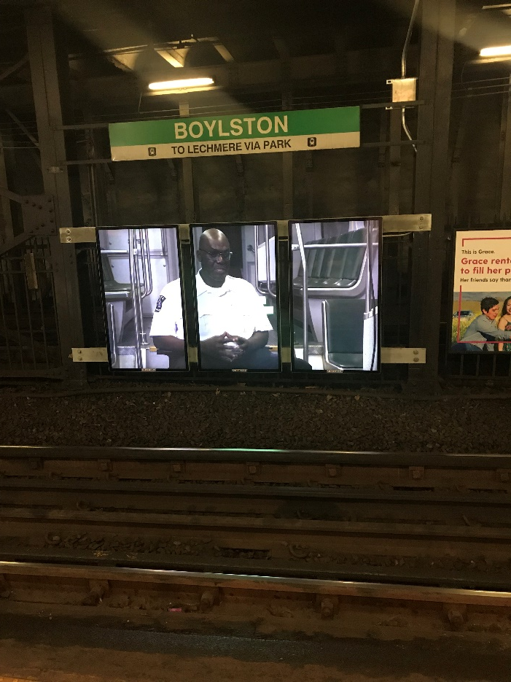
“MBTA Family” – Emerson College
Last week, through a partnership with Emerson College, we launched the first of three videos called, “MBTA Family”
Videos highlight three MBTA employees and their passions in and out of the workplace. With a focus on the employees that make the MBTA system run safely and smoothly, "MBTA Family" accentuates the roles T employees play in their communities
The video content that was written, directed, filmed, and produced by Emerson College students in collaboration with T staff on digital panels.
As many people have noticed, our use of digital panels is a new and dynamic technology that allows us to shift away from the traditional static posters and billboards
New technology still allows for advertising, but also can provide important customer-facing information about service alerts, new services: SL3 and early morning bus service, and also display the work of projects like this one with Emerson

