Slide 1
DGM Remarks
Fiscal & Management Control Board
June 4, 2018

Slide 2
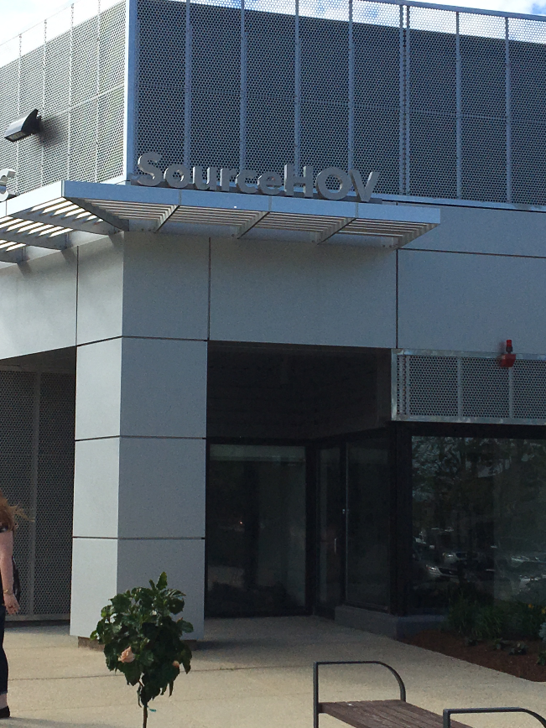
DGM Remarks 6/4/2018
New Call Center Procurement
June 1st successful transition implemented for the new customer call center with SourceHOV in Norwood, MA
3 Year Contract, $3,000,000 with 2 single year options
Notes:
On June 1st we successfully implemented new call center with EXELA, a global company headquartered in Irving, TX who has similar contracts with

Slide 3
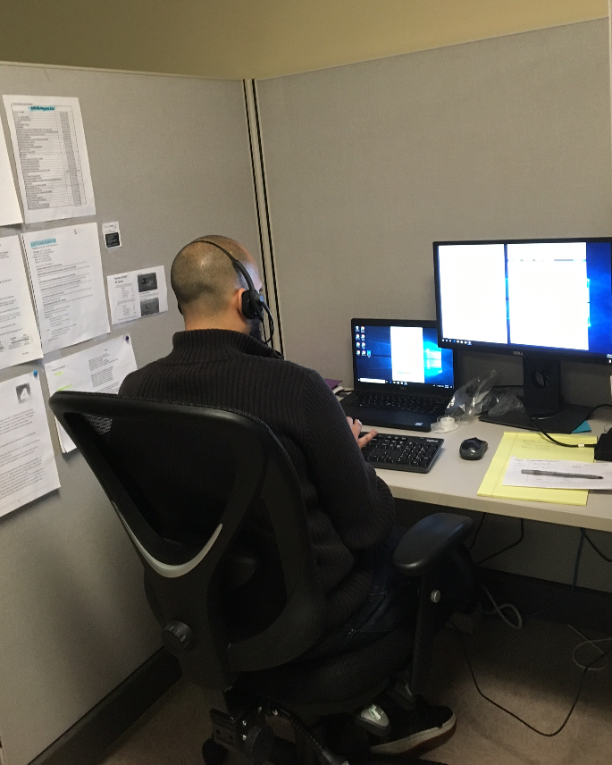
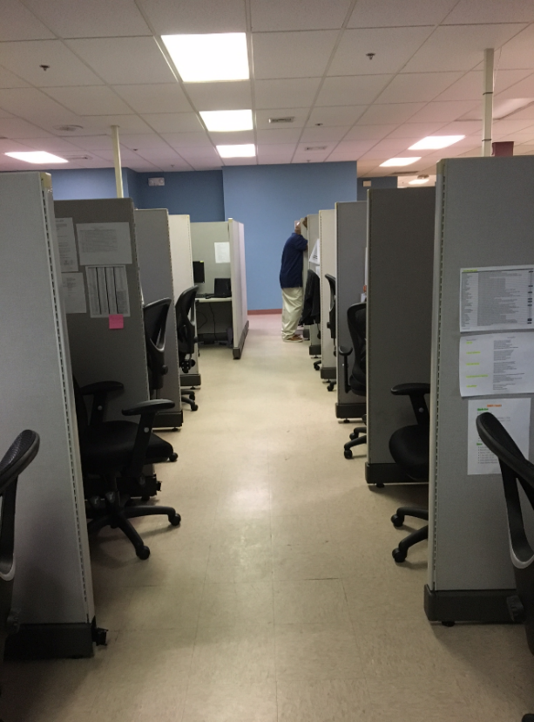
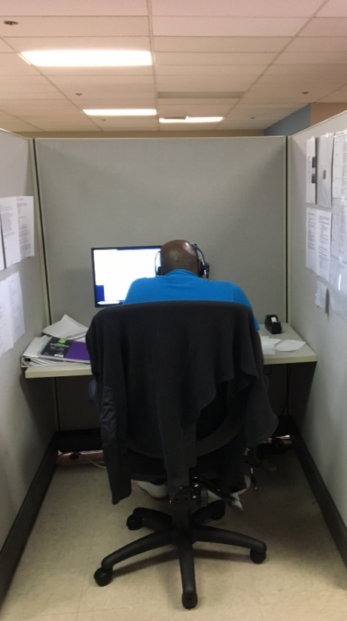
DGM Remarks 6/4/2018
New Call Center Procurement
24 employees were trained by the MBTA Customer Call Center management team.
The first day they successfully responded and redirected 927 calls.

Slide 4
DGM Remarks 6/4/2018
Better Bus Project – Upcoming Outreach
North Quincy High School | Quincy | Monday, June 4 | 6:30 PM – 8:30 PM
North Shore Community College | Lynn | Wednesday, June 6 | 6:00 PM – 8:00 PM
Holiday Inn Boston - Bunker Hill | Sullivan Square | Thursday, June 7 | 6:00 PM – 8:00 PM
Online Feedback:
For individuals who cannot attend any of our in-person meetings, we have an online feedback form at www.mbta.com/betterbus.
Individuals can also signup for our email alerts to get updates and details about the project.
Notes:
On June 1st we successfully implemented new call center with EXELA, a global company headquartered in Irving, TX who has similar contracts with

