Slide 1
Bus Diversions May 29, 2018 to October 15, 2018
Fiscal and Management Control Board
June 4, 2018

Slide 2
Overview
Diversions
Background
MBTA Diversions, to date
Commuter Rail Diversions, to date
Upcoming MBTA and Commuter Rail Diversions
Diversions, of note
MBTA Bus Diversions, by Line
Commuter Rail Bus Diversions, by Line
Communication with the Customer
Strategy
Pre-Closure & During
On the Street
In Person
Appendix
Bus Diversions, by Month (June to October 15, 2018)

Slide 3
Background
The Authority will complete $850M in construction projects this summer, between June 1, 2018 and October 15, 2018.
To complete this work, we partner with three third-party vendors to provide diversion service. The vendors are Yankee, Peter Pan and Paul Revere.
Depending on the construction, four types/categories of diversions can be coordinated:
Urban short-term, weekend work: Longfellow Bridge
Urban mid-term, full week/weekend work: Commonwealth Avenue
Urban long-term, full week/weekend work: Wollaston Station
Suburban/Rural, weekend work: PTC

Slide 4
MBTA Diversions, to date
Planned
Beverly Drawbridge
Wollaston Station Reconstruction and Quincy Center Garage Demolition
Early Access
Three Stop Shuttle
Longfellow Bridge
Commonwealth Avenue, Phase I
Unplanned
Snow Support
Highlights
Replacement of 132-year old Beverly Drawbridge
Installation of power cables, lighting, fencing, and security equipment and welding rails on the Longfellow Bridge
$92.9M Wollaston Station Reconstruction and Quincy Center Garage Demolition
Replace the eastbound side of the Commonwealth Avenue Bridge

Slide 5
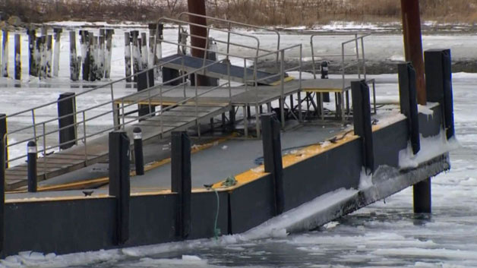
Commuter Rail Diversions, to date
Planned
PTC:
Newburyport/Rockport
Haverhill
Lowell
Franklin
Stoughton
Wollaston Station and Quincy Center Garage Demolition (service between Braintree and Quincy Center)
Unplanned
Hingham Ferry Dock – Ice Damage
Snow Support
Highlights
93, Equipment on Locomotives
58, Equipment on Control Cars
43.8, miles of Fiber
109, Wayside Radios
1,451, ACSES Transponders
Dock repairs to Hingham Ferry Dock in January 2018.

Slide 6
Upcoming MBTA and Commuter Rail Diversions
MBTA Diversions
Wollaston Station
Quincy Center
Braintree Station
Green Line B and D Branch
Orange Line Southwest Corridor
Highlights
7,000ft of rail between Chestnut Hill and Lake Street
5,000ft of rail between BU West and Babcock (Comm Ave)
2,000ft of rail between Sutherland and Washington
7,000ft of rail along the Highland Branch from Riverside to Reservoir (Green Line Track and Signals)
Southwest Corridor
70 locations for concrete slab repairs
2,800ft of rail
Commuter Rail Diversions
Lowell PTC & GLX
Worcester PTC
Stoughton PTC
Highlights
2, Locomotives
26, Control Cars
72, Wayside Interface Units
179.1, miles of Fiber
65, Wayside Radios (BCP)
929, ACSES Transportation
8, Core Ring (links)
GLX early work and tree clearing

Slide 7
Bus Diversions, of note
Wollaston
Duration: 20 months, beginning in November 2017
What: Construction of a new station
Investment: $33M
Flag: This is a long-term duration that requires bus diversions between North Quincy and Quincy Center.
Commonwealth Avenue
Duration: July 26, 2018 and August 11, 2018
What: Accelerated bridge construction to replace the full superstructure (West Bound)
Investment: $81.8M
Flag: This is the second phase of Commonwealth Avenue construction. The Green Line experiences high ridership. The corridor is business dominant.
Positive Train Control
Duration: Deadline of December 31, 2018
What: Installation and testing of Positive Train Control technology and associated supporting positive train control technology and associated supporting infrastructure required to comply with the federally-mandated PTC requirements (49 CFR 236, Subpart I).
Investment: $515.7M
Flag: Deadline of December 31, 2018, as mandated by Congress. The work stretches across the region.
Green Line Track Work and Maintenance
Duration: TBD approx. 36 months, 9pm to close of service – Fall 2018
What: Improvements to power, signal, track and stations, across all Green Line branches
Investment: ~$120M
Flag: This long-term work will begin in September 2018 when schools are returning to the area.

Slide 8
GREEN LINE
MBTA Bus Diversions, by Line
ORANGE LINE
Approved
B: Boston College-Washington Street
Weekends | Jun 2-17
(Track work)
B: Boston College-Packards Corner
Weekends | Jun 23-Jul 22
(Track work)
B: Babcock Street-Blandford Street
All days | Jul 26-Aug 11
(Track work)
Pending D: Stations TBD
9p-close | Sep 1-Dec 28
(Track work)
D: Kenmore-Brookline Hills
Weekends | Sep 29-30, Oct 27-Dec 16
(Track work)
Mattapan Line Shutdown
Dates pending, Anticipated for 5 to 8 days
(Demolish building abutting Central Ave platform)
Approved
Forest Hills-Ruggles
Weekends | Jun 23-Jul 22, Aug 18-Sep 9
(Concrete replacement)
Pending
Forest Hills-Ruggles
Weekends | Jul 28-Aug 12
(Concrete replacement)
Green Line Rail Damage

Slide 9
RED LINE
MBTA Bus Diversions, by Line
SILVER LINE
Approved
North Quincy - Braintree
Mon-Thurs 9pm | June 17-Dec 20
(Wollaston & Quincy Center Projects)
Pending North Quincy - Braintree
Weekends | Sept 7-23, Nov 9-11
(Wollaston & Quincy Center Projects)
Alewife – Harvard
Weekends | Nov 3-8
(Floating Slab Project)

Slide 10
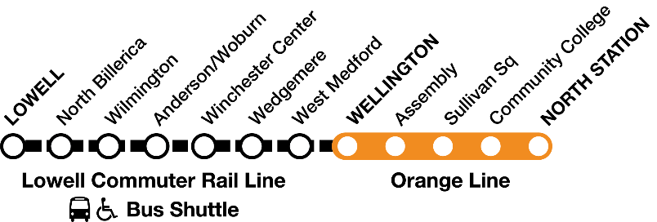
LOWELL LINE
Commuter Rail Bus Diversions, by Line
FITCHBURG LINE
Approved
Lowell – Wellington (Orange Line)
Weekends | July 7-29 and August 11-26
(PTC Testing) **no work weekend of July 28/29 due to Lowell Folk Festival**
Pending Anderson – Wellington (Orange Line)
Weekends | Sept 22-Nov 11
(GLX Work)

Slide 11
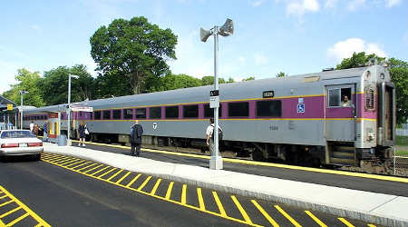
WORCESTER LINE
Commuter Rail Bus Diversions, by Line
FRANKLIN LINE
Approved
Worcester – Framingham
Weekend | May 26-June 17
(PTC Installation)
Framingham – Riverside (Green Line)
Weekends | June 23-July 29
(PTC Installation)
FAIRMOUNT LINE
MIDDLEBOROUGH LINE
Approved
Morton Street - Readville
Saturday 6am-6pm | May 5-September 25
(Blue Hill Ave Station construction)
Approved
Braintree – Quincy Center
Weekends | September 8-September 16
(Wollaston & Quincy Center projects)

Slide 12
KINGSTON LINE
Commuter Rail Bus Diversions, by Line
GREENBUSH LINE
Approved
Braintree – Quincy Center
Weekend | September 8-16
(Wollaston & Quincy Center projects)
Approved
Braintree – Quincy Center
Weekend | September 8-16
(Wollaston & Quincy Center projects)
STOUGHTON LINE
Approved
Stoughton – Route 128
Tuesday to Wednesday Mid-day | May 21-22 to July 30-August 1
(PTC Installation)

Slide 13
Communicating with the Customer - Strategy
From previous diversions, we know customers simply want to know how the service change will affect their own commutes.
The Diversion Strategy for Customers includes:
Educate customers on transportation options available to them.
If they must use the diversion service, educate customers on when the work is happening, how they can access the diversion and provide them with a way to provide comment and feedback.
We structure Diversion discussions in two ways:
Before the Diversion – focused on educating the customer in advance of the construction work.
During the Diversion – throughout the diversion we communicate with the customer to keep them updated.
Feedback and Comments:
We receive feedback and comments through multiple mechanisms. We respond to each comment that is received. Feedback is shared with the appropriate department – maintenance, operations, system wide accessibility, etc.

Slide 14
Pre-Closure Outreach
Communicating with the Customer – Pre-Closure & During
During Closure Outreach
Press release and Legislative briefings
Public meetings and briefings for stakeholders
MBTA/Keolis website, T-Alerts and Twitter
Printed materials (brochures, flyers) available in multiple languages
Public Address announcements in stations and onboard trains
Door to Door Business Outreach
Publishing Detour Routes
Project Website
MBTA/Keolis website, T-Alerts and Twitter
Parking counts at impacted garages (for the first number of weeks)
Real Time Traffic Monitoring System active during shutdowns and plan revision
Public Address announcements in stations and onboard trains
Additional station personnel
Dedicated project email address
Station signage and car card advertisement deployed onboard trains and buses
Close coordination with local businesses including the Red Sox, Longwood Medical and Boston University
Regularly scheduled meetings with Local and Elected Officials and Stakeholders

Slide 15
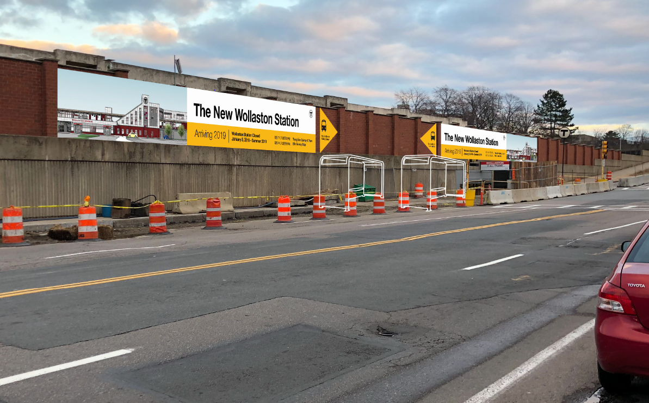
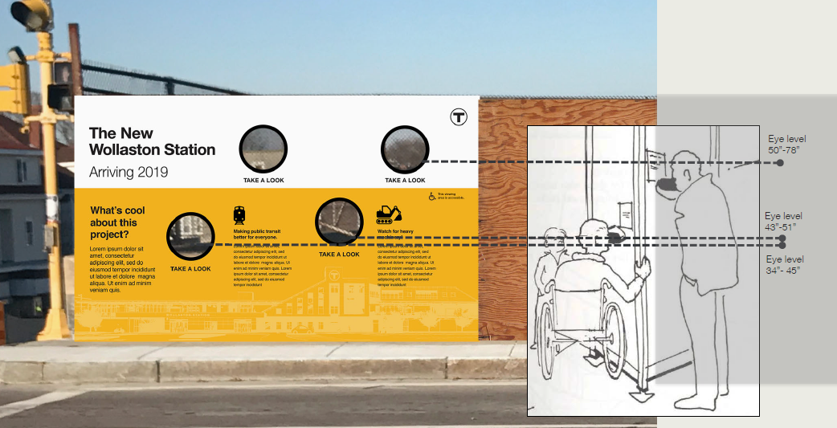
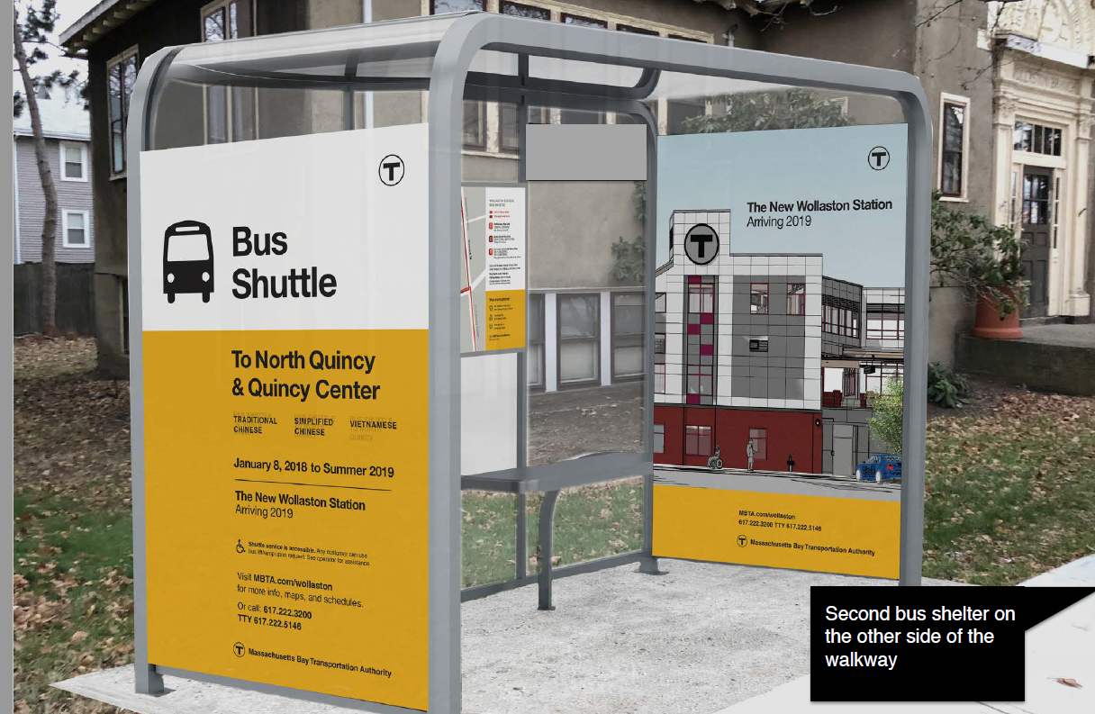
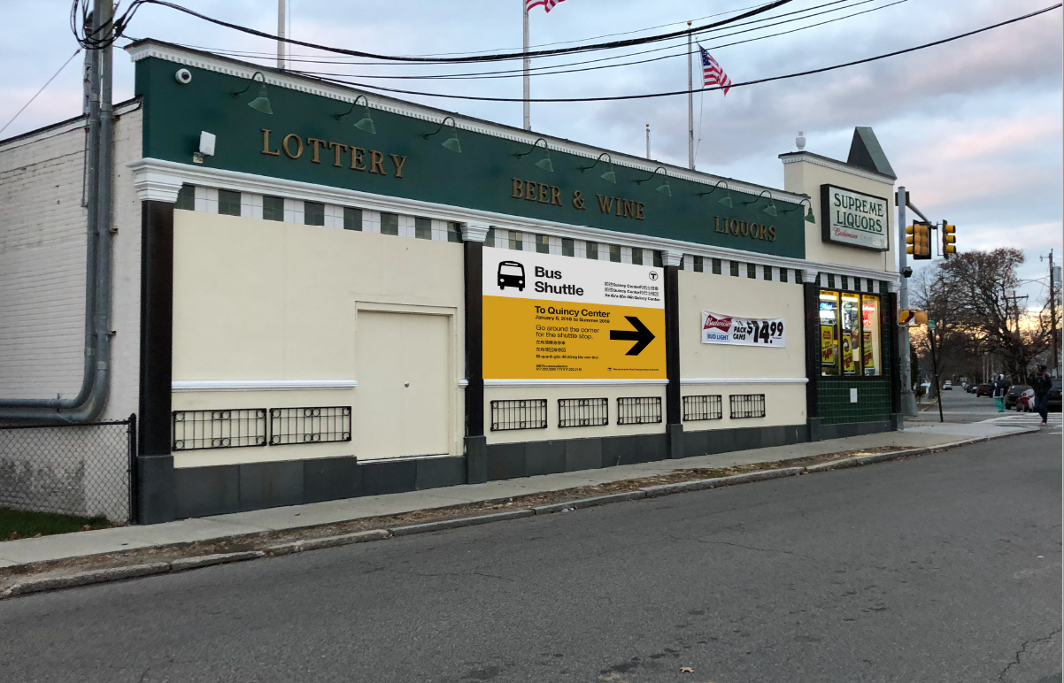
Communicating with the Customer – On the Street

Slide 16
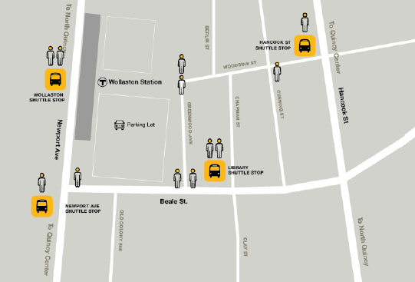
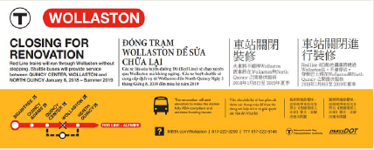
Communicating with the Customer – In Person
For the first two weeks of each diversion, or the first two weekends of each diversion, a full staffing team is onsite at each drop off/pick up.
MTBA Staff
Keolis Staff
Third Party Vendor Staff
T Police
After the first two weeks, or first two weekends, staffing is reduced to skeleton staffing. Social media and comments are monitored regularly to ensure coverage. If issues are flagged, plans are revised to ensure adequate staffing.
For some diversions, we work with local community groups, such as the Quincy Asian Community Resources to staff stations with personnel who have the proper communication skillsets.

Slide 17
Appendix: Bus Diversions, by Month/Line

Slide 18
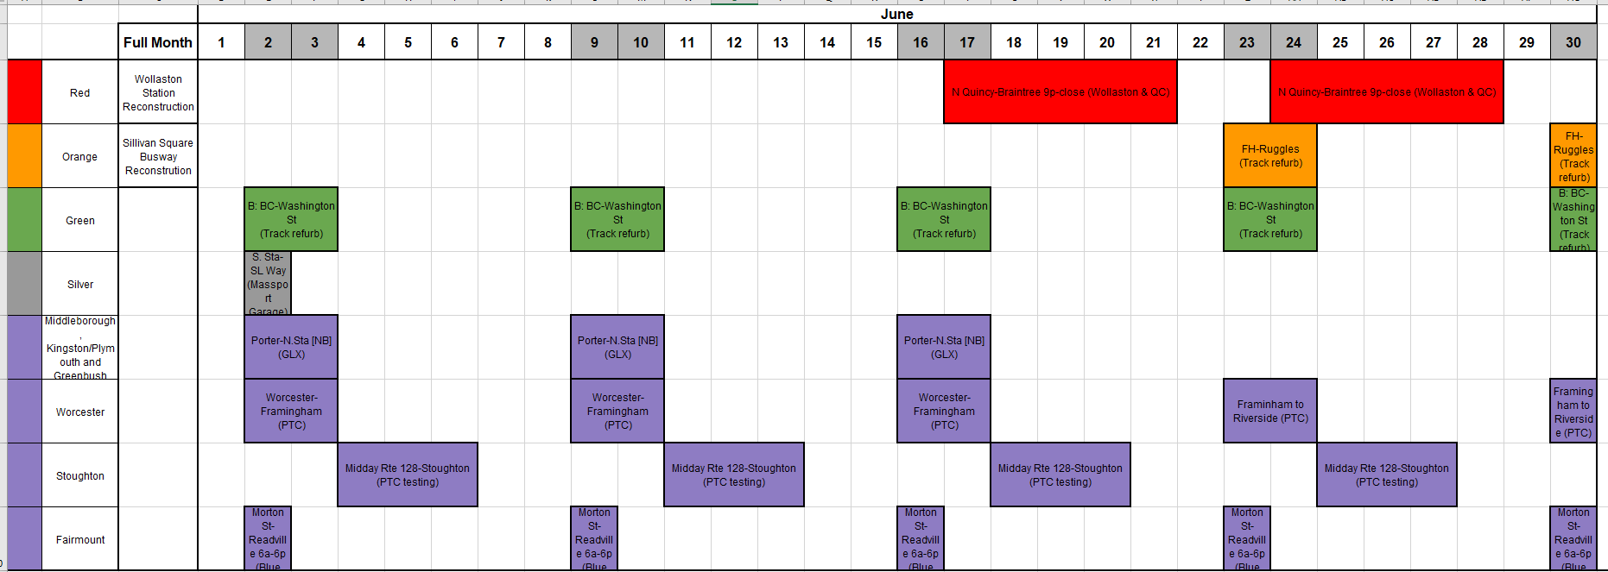
June, MBTA and Commuter Rail Bus Diversions – For Planning Purposes

Slide 19
July, MBTA and Commuter Rail Bus Diversions – For Planning Purposes

Slide 20
August, MBTA and Commuter Rail Bus Diversions – For Planning Purposes

Slide 21
September, MBTA and Commuter Rail Bus Diversions – For Planning Purposes

Slide 22
October, MBTA and Commuter Rail Bus Diversions – For Planning Purposes

