Slide 1
Red Line/Orange Line Improvement Program Update
Vehicle Procurement, Infrastructure Improvements,
State of Good Repair Improvements and Signal Upgrades
July 16, 2018

Slide 2
OVERVIEW
The following summary provides an update to the Fiscal and Management Control Board on the progress of the Red Line/Orange Line Improvement Program; which includes new Vehicle Procurement, Infrastructure Improvements, State of Good Repair Improvements and Signal Upgrades.
This Program supports the MBTA’s goal to improve the Level of Service on the Red Line and Orange Line.

Slide 3



Red Line/Orange Line Improvement Program
Red Line
Orange Line
Total $1,982.03M
NEW VEHICLE PROCUREMENT PROGRAM
$1,009.00M
INFRASTRUCTURE IMPROVEMENTS PROGRAM
$470.36M
SIGNALS UPGRADE PROJECTS
$350.95M
STATE OF GOOD REPAIR PROJECTS
$151.72M
3

Slide 4





Red Line and Orange Line Schedule by Project
Pilot
1st Production
Completed
Vehicle Procurement Program
2016 | 2017 | 2018 | 2019 | 2020 | 2021 | 2022
OL Vehicles
RL Vehicles
Infrastructure Program – Orange Line
Wellington Yard Expansion Tracks 33-38
Orange Line Test Track
Wellington Maintenance Facility
Wellington Yard Rebuild
Infrastructure Program – Red Line
Red Line Test Track
Cabot Maintenance Facility & Cabot Yard Improvements
LEGEND
Pilot
Manufacturing/Delivery
1st Production
Design
Procurement
Construction
Interim Milestone to Support Vehicle Delivery - Completed
Interim Milestone to Support Vehicle Delivery

Slide 5
Red Line/Orange Line Schedule – Signals Upgrades
Signal Upgrades Program - Orange Line
Mainline Signal Upgrades Project
Signal Enhancements
2016 | 2017 | 2018 | 2019 | 2020 | 2021 | 2022
Completed
Signal Upgrades Program - Red Line
Mainline Signal Upgrades Project
Signal Enhancements
2016 | 2017 | 2018 | 2019 | 2020 | 2021 | 2022
LEGEND
Procurement
Design/Build
Procurement
MBTA Installation

Slide 6
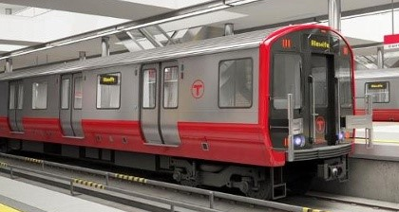
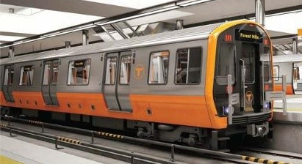
New Vehicle Procurement Program
New Vehicle Procurement Program
Total Project Value: $ 1,009,871,671
Expenditure to date: $ 188,463,035 Carbuilder Percent Complete: 18.66%
Replace 218 Red Line cars
34 new cars
Total = 252 vehicles
Replace 120 Orange Line cars
32 new cars
Total = 152 vehicles

Slide 7

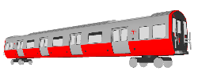
Vehicle Procurement Project Status – Current/Look Ahead
Pilot
1st Production
Vehicle Procurement Program
2016 | 2017 | 2018 | 2019 | 2020 | 2021 | 2022
OL Vehicles
  ● OL Pilot Car Qualification & Acceptance Testing - (through December 2018)
  ● OL Complete Vehicle FAI (Changchun) – (July 2018)
  ● OL Production Delivery from Springfield Facility Starts - (December 2018)
Pilot
1st Production
RL Vehicles
  ● RL Carbody Testing - (July 2018)
  ● RL Mock-up Display - (August 2018)
  ● RL Complete Vehicle FAI (Changchun) – (February 2019)
  ● RL Delivery of Pilot Cars - (March 2019)
LEGEND
Design
Manufacturing/Delivery

Slide 8
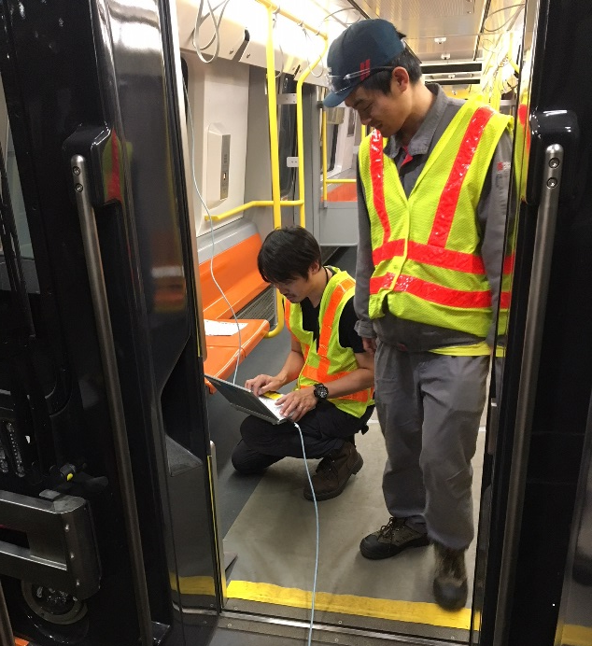
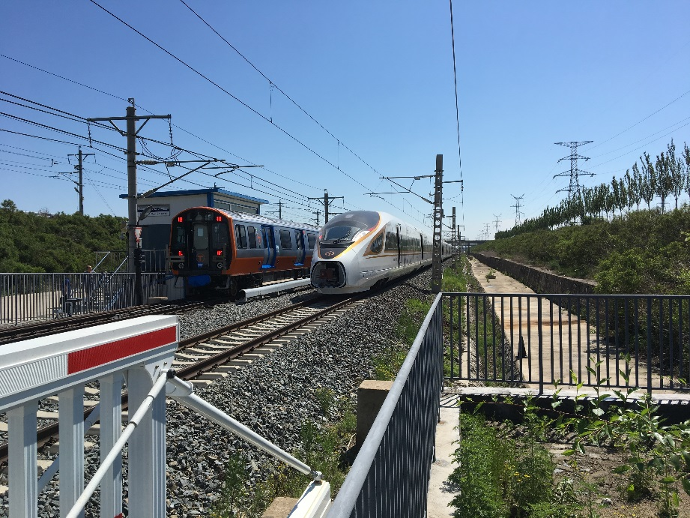
Orange Line Vehicle Procurement Project Status
Wellington - Qualification testing is ongoing along with training for the Operators. The current phase of testing is for the communication system and On-Board Video Recorder. Upon delivery of the remaining pilot cars, extensive 6 car testing will continue through the end of the year.
Changchun – The next 4 Pilot cars are completing qualification testing in China. Testing in Changchun includes brake rate testing at various loaded weights. These cars are scheduled for shipment from China in July with delivery to Boston in late August.

Slide 9
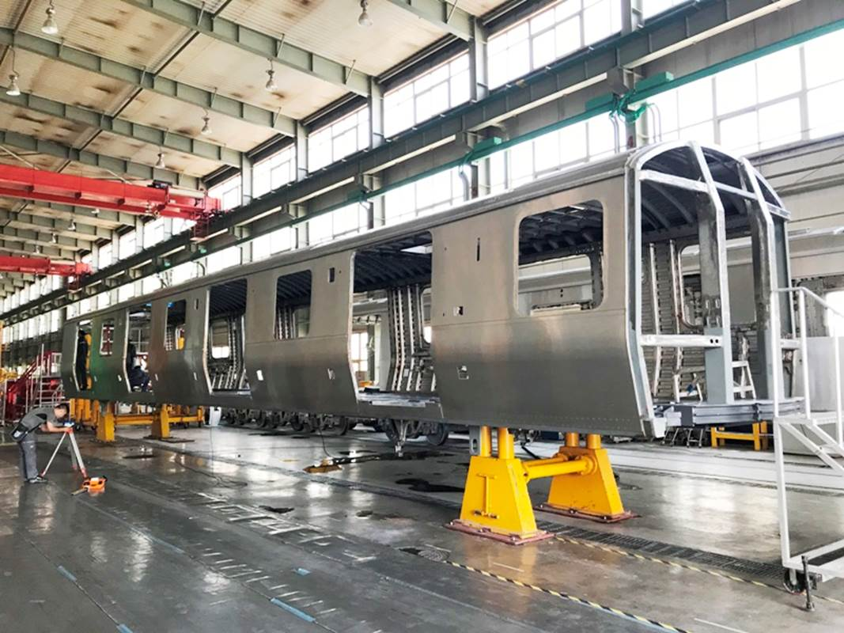
Red Line Vehicle Procurement Project Status
Construction of the Red Line carshell for structural strength testing has been completed. Destructive Carshell Structural testing is scheduled to be performed from July to the first week of August.
Red Line Final Design Review meetings have been completed.
The Red Line Mock-Up was shipped to Boston in June and is scheduled for arrival in July and public display in August @ City Hall Plaza

Slide 10
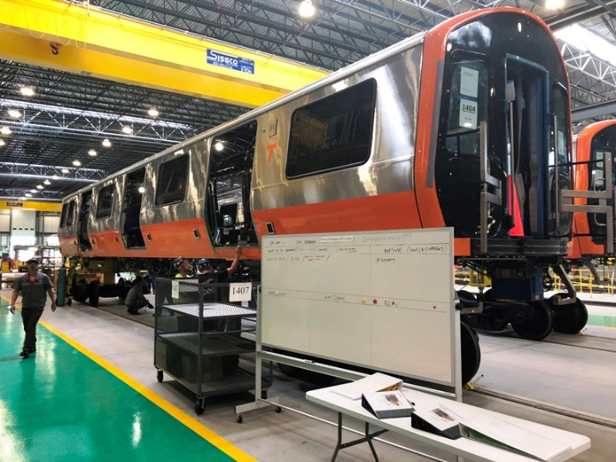
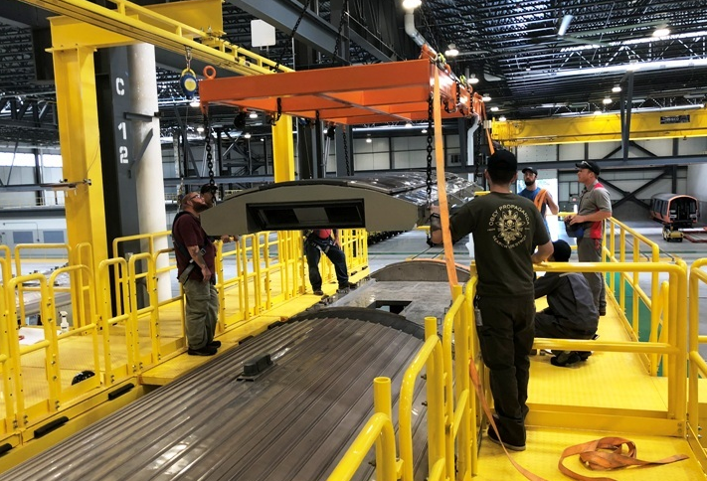
Production Vehicle Final Assembly – Springfield MA
Final assembly on the first four carshells is continuing in Springfield. HVAC units have been installed and installation of undercar equipment brackets is progressing.
In addition to the in-plant inspector who monitors production quality and workmanship the MBTA has now assigned a production surveillance supervisor. The MBTA continues its weekly audits of CRRCMA production and Q/A.

Slide 11
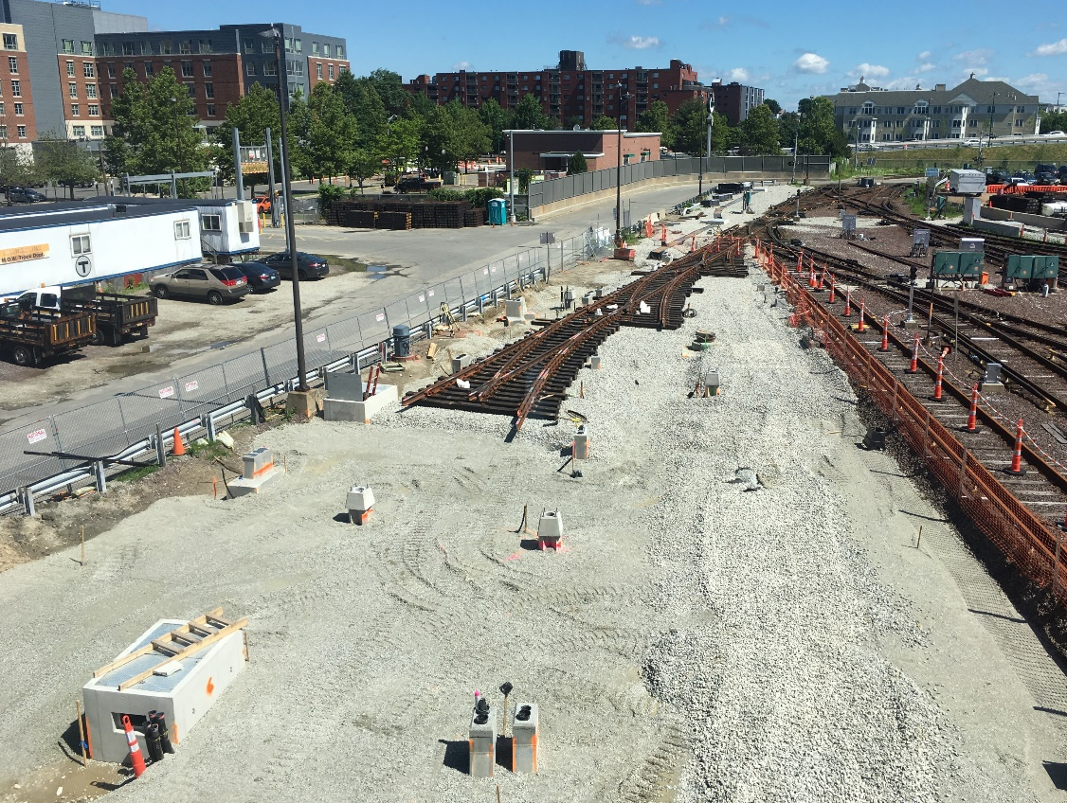
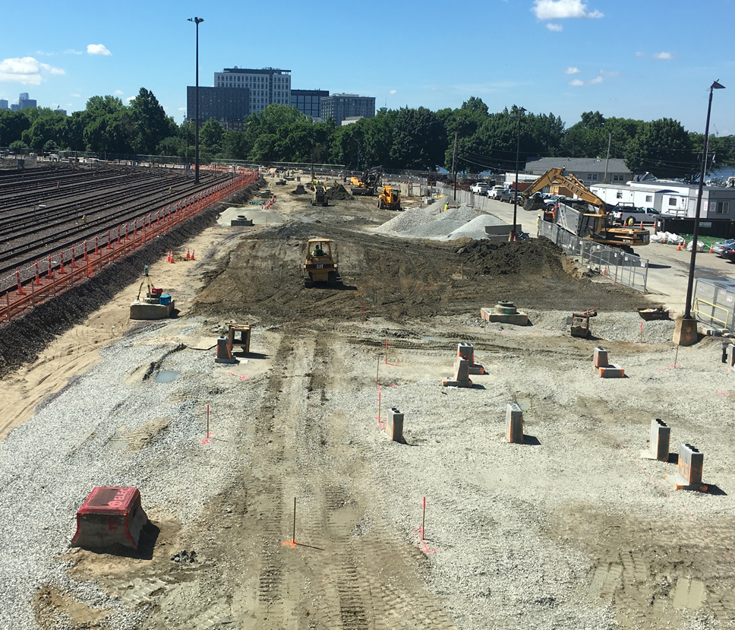
Orange Line Projects: Wellington Yard Expansion Tracks 33 to 38
JF White
Construction NTP: 12/05/2016
Construction Substantial Completion:
  Contractual: 06/23/18
  Projected: 12/23/19 *
Construction Budget: $17,977,777
Construction Expenditures to Date: $6,169,114 Construction Percent Complete: 45%
*Adjusted to account for unforeseen environmental work
Installation of Turnouts
Underground Utilities Installed

Slide 12
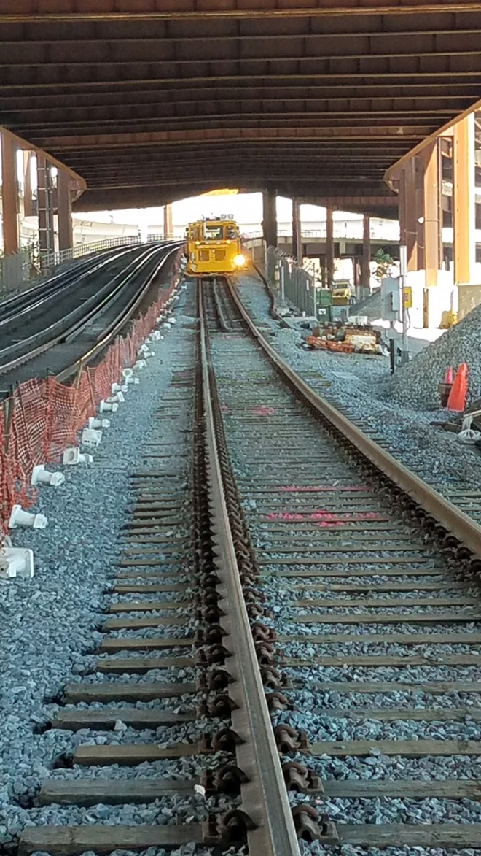
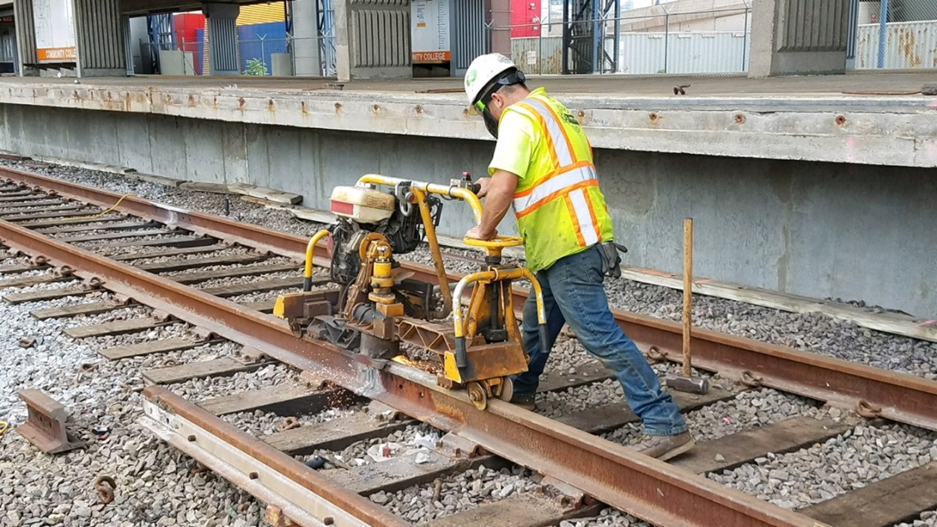
Orange Line Projects: Orange Line Test Track
LM Heavy
Construction NTP: 06/20/17
Construction Substantial Completion:
  Contractual: 09/11/18
  Projected: 08/17/18
Construction Budget: $5,867,000
Construction Expenditures to Date: $3,716,241
Construction Percent Complete: 91%

Slide 13
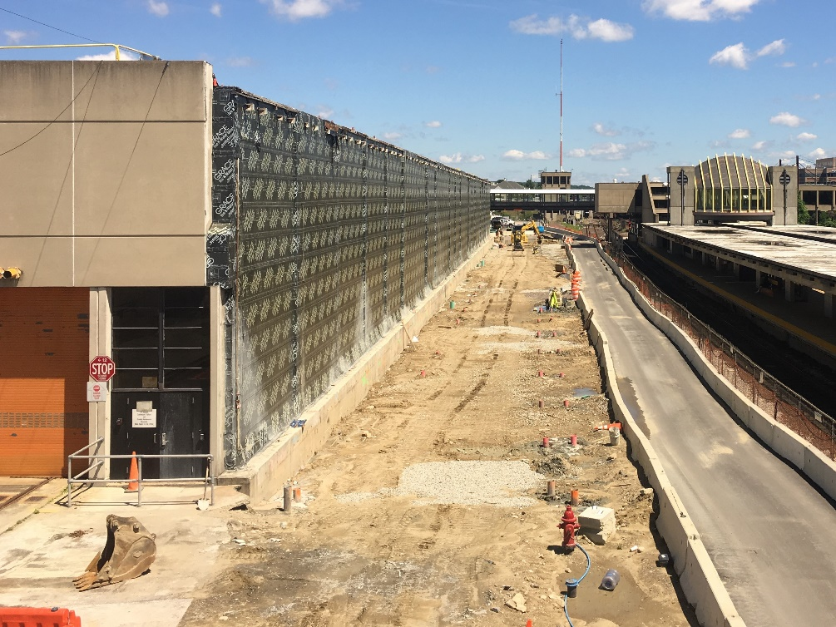
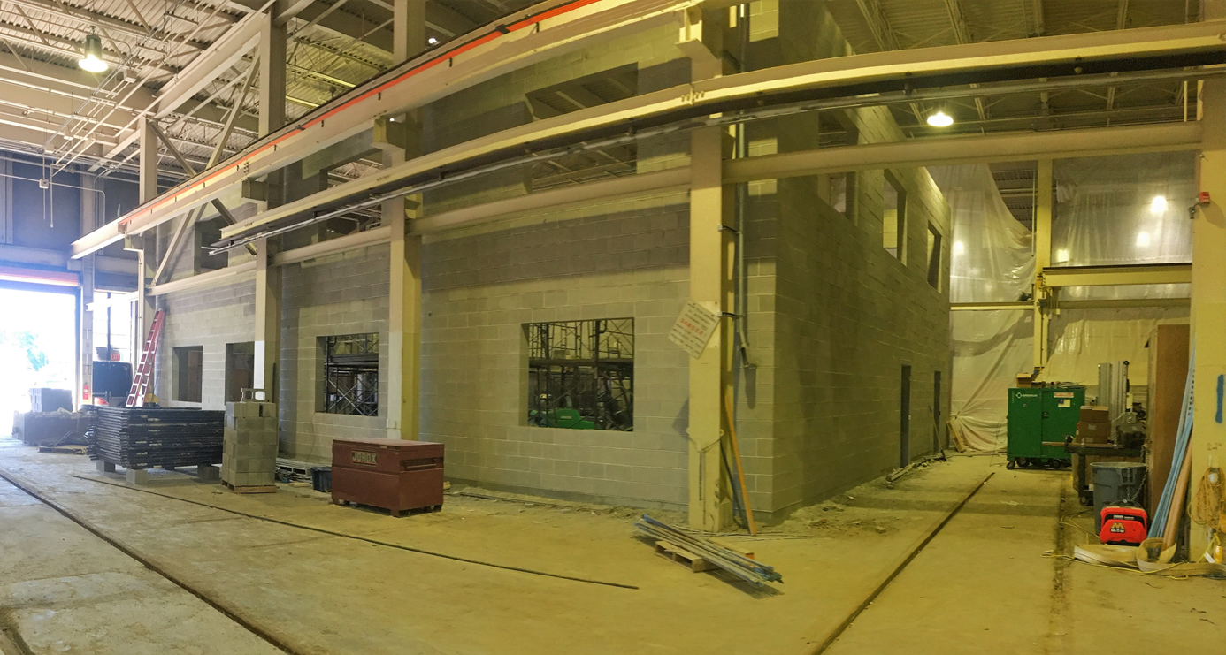
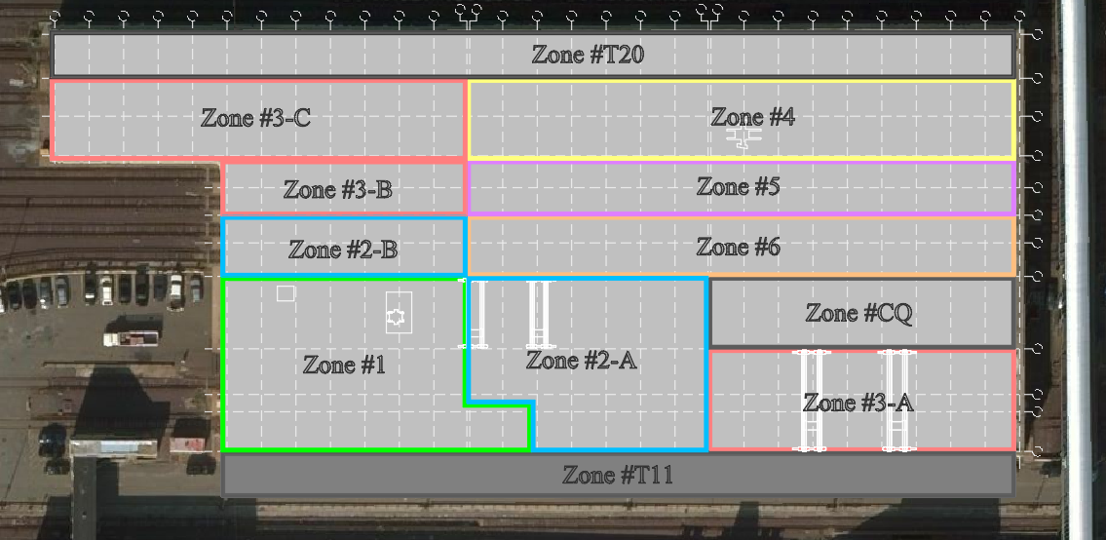
Orange Line Projects: Wellington Maintenance Facility
Barletta Heavy Division
Construction NTP: 06/30/17
Construction Substantial Completion:
  Contractual: 08/04/20
  Projected: 08/04/20
Construction Budget: $72,582,000
Construction Expenditures to Date: $5,864,425
Construction Percent Complete: 16%
* Forecast completing on schedule
Exterior Expansion – Piles Complete
Electronics Building – Masonry Installed

Slide 14
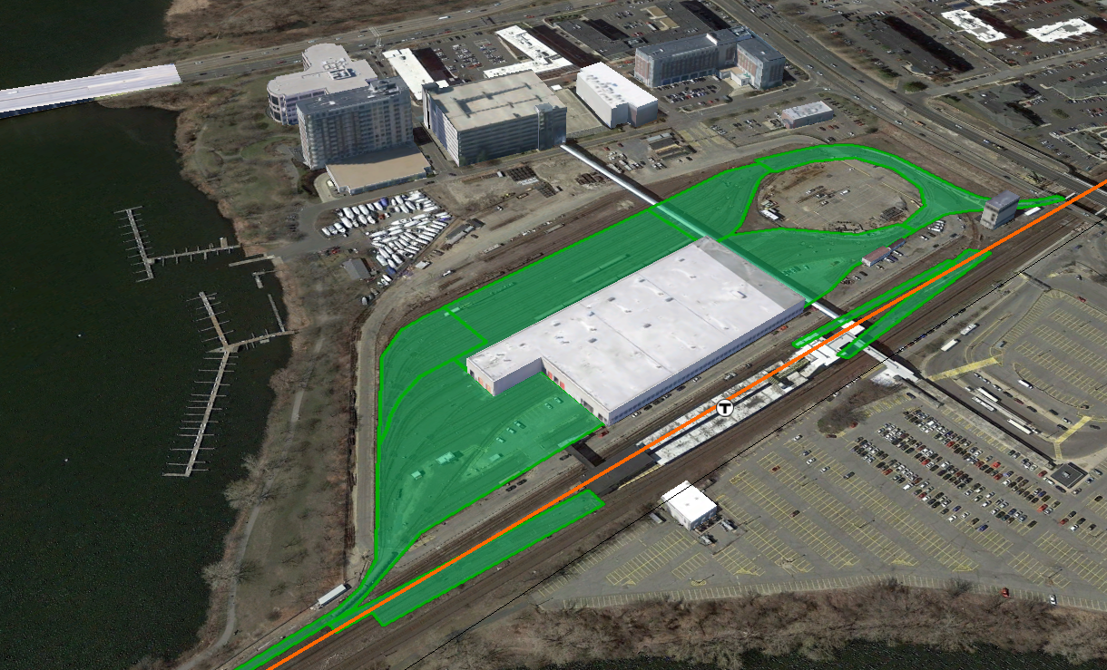
Orange Line Projects: Wellington Yard Rebuild
Barletta Heavy Division
Construction NTP: 05/31/18
Construction Substantial Completion:
  Contractual: 03/07/21
  Projected: 03/07/21
Construction Budget: $102,663,000
Construction Expenditures to Date: $0
Construction Percent Complete: 0%
  Wellington Yard Rebuild

Slide 15
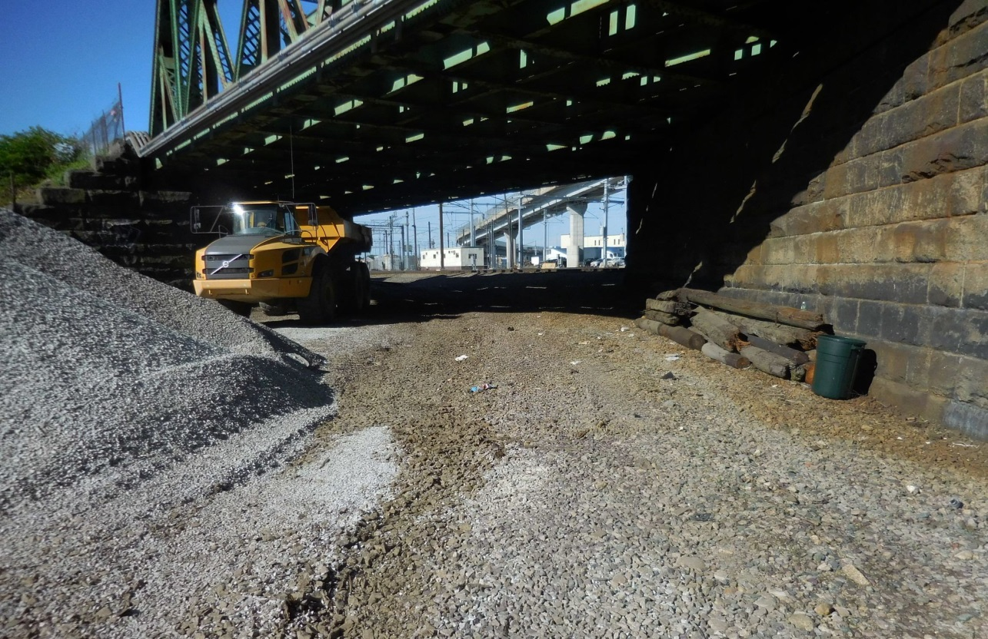
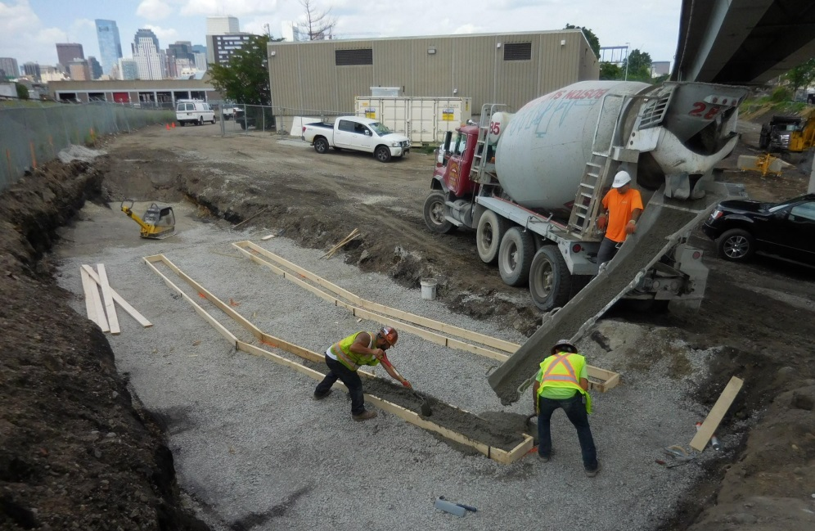
Red Line Projects: Red Line Test Track
Barletta Heavy Division
Construction NTP: 11/17/17
Construction Substantial Completion:
  Contractual: 04/07/19
  Projected: 04/07/19
Construction Budget: $21,269,000
Construction Expenditures to Date: $432,705 Construction Percent Complete: 11%
* Forecast completing on schedule
T Wall Leveling Pads Installation
Track Removed at Midland Street Bridge

Slide 16
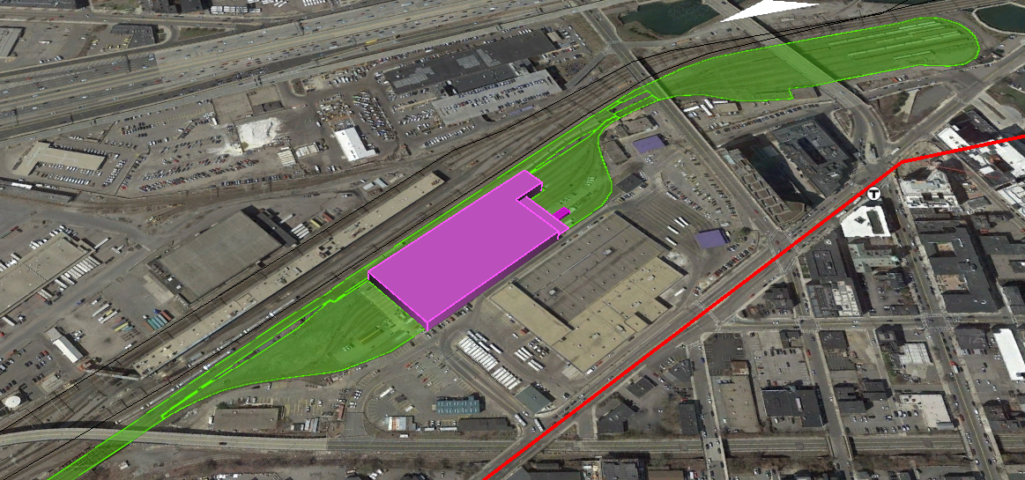
Red Line Projects: Cabot Yard & Maintenance Facility Improvements
LM Heavy/Lane Construction
Construction NTP: 07/20/18*
Construction Substantial Completion:
  Contractual: 12/22/21*
  Projected: 12/22/21*
Construction Budget: $213,817,000
Construction Expenditures to Date: $0 Construction Percent Complete: 0%
* Anticipated
  Cabot Yard & Maintenance Facility Improvements

Slide 17
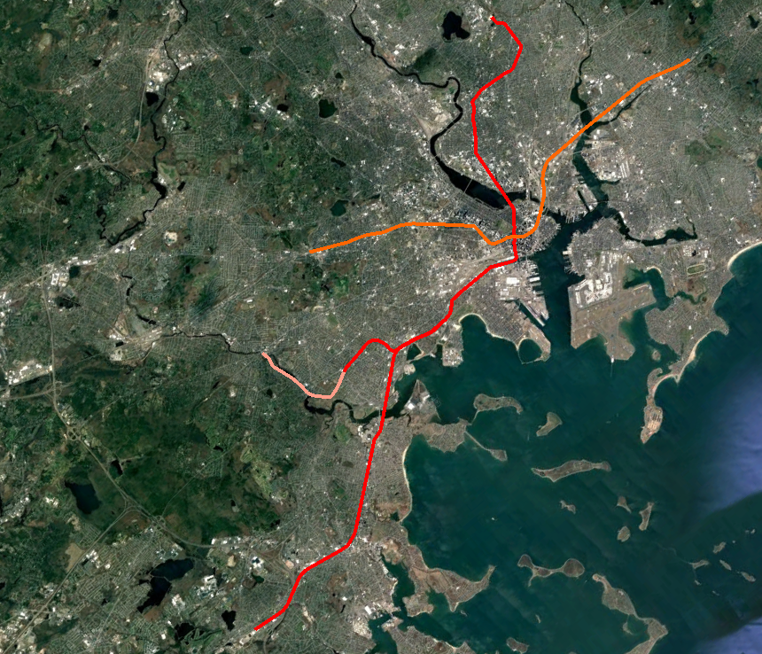
Signals Upgrade Projects Status
RFP Issued – 02/12/18
Proposer Meetings – 05/30/18
Proposals Due – 07/10/18
Public Price Opening – August, 2018
NOA – August 2018
NTP – September 2018
Substantial Completion RL – 10/05/21
Substantial Completion OL – 02/23/22
Red Line
RL Signaling and Train Control System Upgrade
RL Columbia Junction Phase II
Orange Line
OL Signaling and Train Control System Upgrade
OL South West Corridor Wayside Signal Replacement

Slide 18
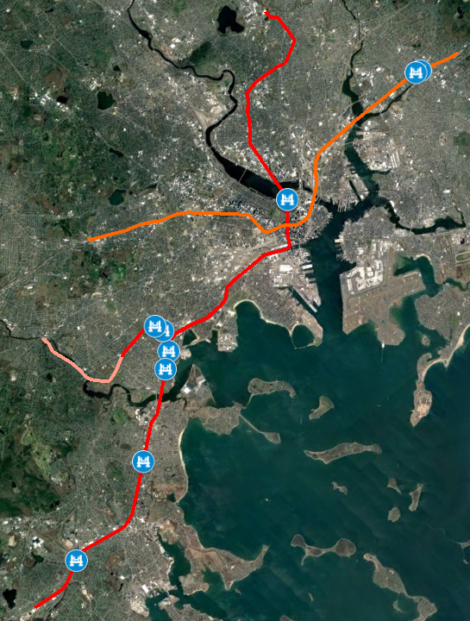
State of Good Repair Projects Status – Bridge Hardening
Status
Bridge Repairs
RL Substantial Completion – 11/01/18
OL Substantial Completion – 11/30/18
Long Fellow Approach – Interim Repairs
Substantial Completion – 12/31/18
Red Line
Bridge Repairs
Granite Spur-B-21-069 (A23)
Conley St.-B-16-136 (A38)
Fields Corner Busway-B-16-418 (A3N)
Victory Rd -B-16-134 (A36)
Geneva Ave-B-16-142 (A3D)
Long Fellow Approach - Interim Repairs
Orange Line
Bridge Repairs
Charles Street-M-01-003 (85)
Adams Street-M-01-002 (85J)

Slide 19
Vehicle Procurement & Improvement Program Collaboration
Early involvement and collaboration with preparation of the Infrastructure Improvement Strategic Program Plan lead to:
  Definition of support categories: testing, storage, maintenance and reliability
  Interim milestones to support the vehicle arrival
  Scope in the Improvements Program to accommodate maintenance of the New Vehicle Features (overhead platforms, vehicle diagnostic room, Wifi, etc.)
Development of vehicle storage models to analyze storage impacts due to both New Vehicle commissioning schedule and construction contracts in the Infrastructure Improvements Program.
Pilot Vehicle Delivery Assessment and logistic coordination

