Slide 1
Capital Series:
Orange Line Improvements
December 3, 2018

Slide 2
OVERVIEW
Orange Line Improvements Update
This Program is designed to improve service and reliability, and bring the Orange Line assets to a state of good repair.
Broadly, investments reviewed in this presentation include:
- new vehicle procurement
- infrastructure modernization
- state of good repair
- signal upgrades, and
- facilities, station and accessibility improvements.
This investment portfolio supports the MBTA’s goal to deliver Orange Line service at 4.5 minute headways resulting in a 40% increase in capacity from scheduled headways.

Slide 3
Orange Line Improvements Update
ORANGE LINE IMPROVEMENTS (OVER $1 BILLION UNDERWAY)
Capital Projects |  | Total Funding Committed (1)
RLOL Improvements Program (OL Projects) | New Orange Line Vehicles | 360,000,000
 | Orange Line Test Track | 9,480,000
 | Wellington Yard Expansion Tracks 33-38 | 28,830,000
 | Wellington Maintenance Facility Improvements | 104,950,000
 | Wellington Yard Improvements | 151,200,000
 | Orange Line Signals Upgrades | 137,530,000
 | Orange Line Bridge Strengthening | 1,210,000
Infrastructure Projects | Orange Line Tunnel Repairs | 32,500,000
 | Systemwide On Call Track and ROW II (2) | 6,330,000
 | Systemwide Power SCADA System Upgrade (2) | 870,000
 | Systemwide Power Resiliency Program (2) | 5,200,000
 | Orange Line Traction Power Substation Upgrade | 47,034,000
Facilities, Stations and Accessibility Projects | Oak Grove Station Vertical Transportation Improvements | 35,290,000
 | Forest Hills Improvement Project | 22,612,000
 | Sullivan Square Station Rehabilitation | 7,250,000
 | Ruggles Station Roof Repair/Replacement (Conceptual Design) | 800,000
 | Back Bay Ventilation (Packages 1 - 3) | 33,000,000
 | Systemwide Wayfinding Improvements (2) | 31,500,000
 | Downtown Crossing Vertical Transportation Improvements Phase I and II | 34,400,000
 | Elevator Program Multiple Locations (Design only) (2) | 14,713,000
 | Systemwide Parking and Paving - On-Call (2) | 9,070,000
TOTAL |  | $ 1,073,769,000
Total Funding Committed includes costs associated with construction, vehicle procurement, professional services, admin and inspection, force accounts, third party costs and contingency.
Project includes more than just the Orange Line. Estimated portion for Orange Line work.

Slide 4
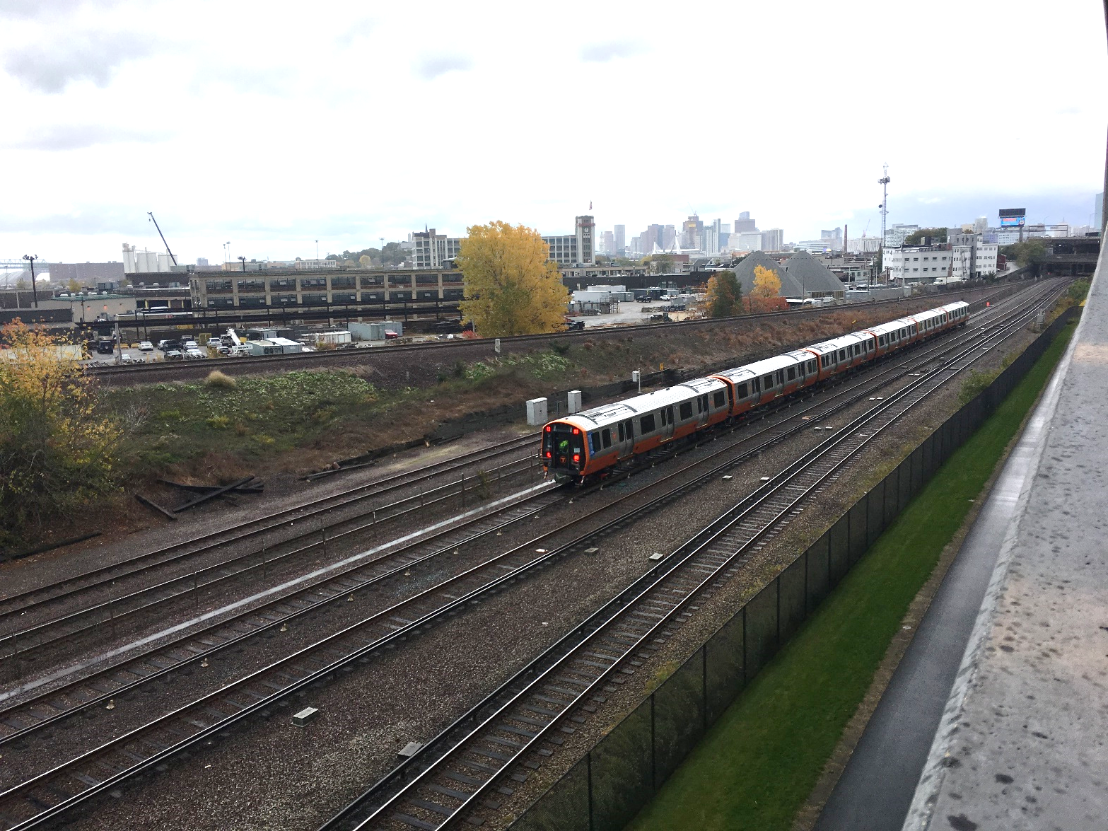
Orange Line Test Track (Construction)
Orange Line Improvements Update
LM Heavy
Construction NTP: 06/20/17
Construction Substantial Completion:8/29/18
  Contractual: 09/11/18
  Actual: 08/29/18
Construction Budget: $5,867,000
Construction Expenditures to Date: $3,939,146
Construction Percent Complete: 99%
New Train On Test Track
Test Track

Slide 5
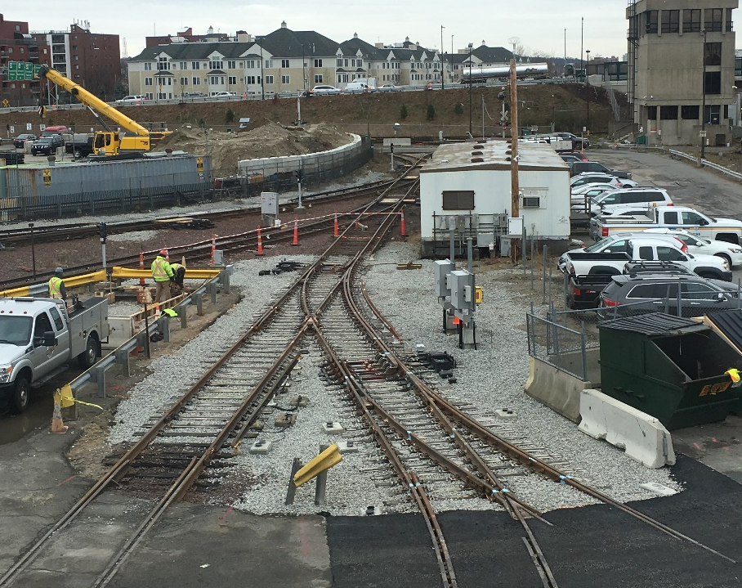
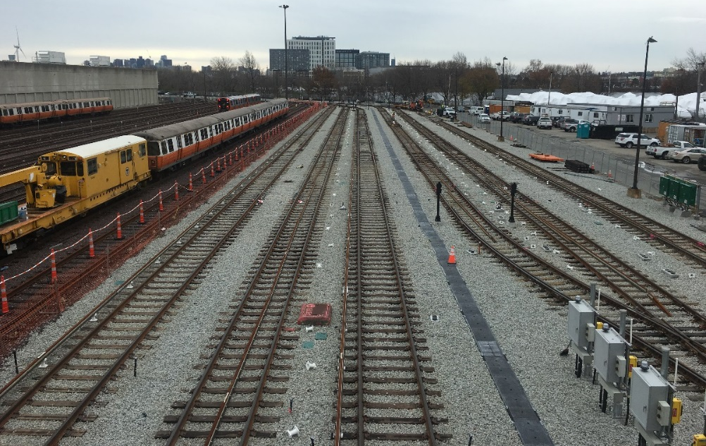
Orange Line Improvements Update
Wellington Yard Expansion Tracks 33 to 38 (Construction)
JF White
Construction NTP: 12/05/16
Construction Substantial Completion:
  Contractual: 01/04/19
  Projected: 03/25/19*
Construction Budget: $17,977,777
Construction Expenditures to Date: $8,932,103 Construction Percent Complete: 72%
*Working with contractor to improve date
New Turnouts: SW319 & SW347
Installing Insulators & 3rd Rail

Slide 6
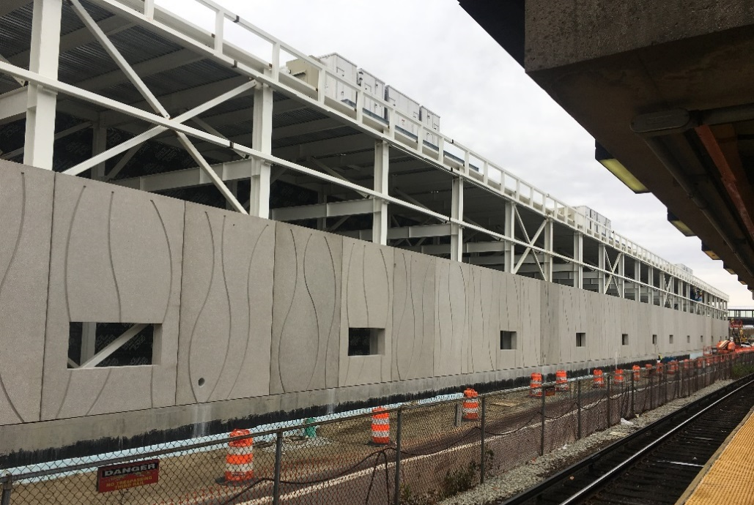
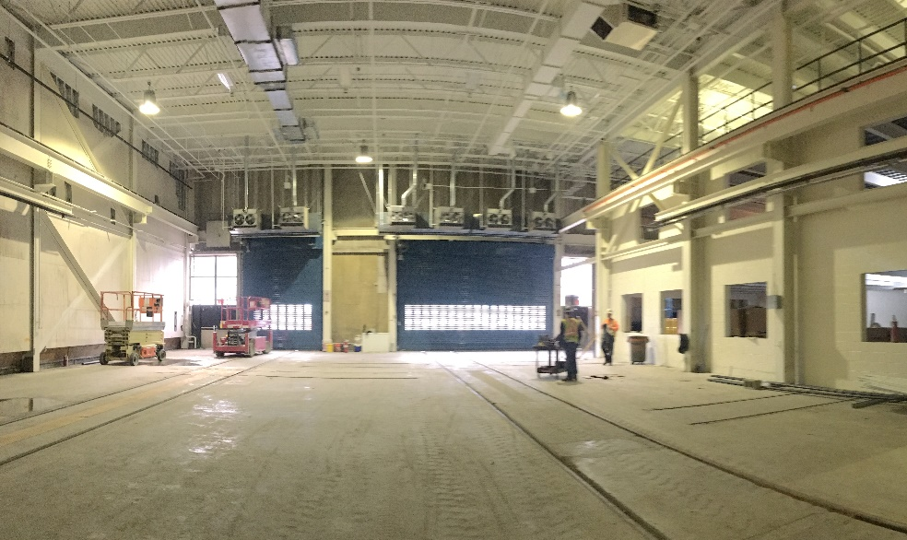
Wellington Maintenance Facility Improvements (Construction)
Orange Line Improvements Update
Barletta Heavy Division
Construction NTP: 06/30/17
Construction Substantial Completion:
  Contractual: 08/04/20
  Projected: 08/04/20
Construction Budget: $72,582,000
Construction Expenditures to Date: $19,950,411
Construction Percent Complete: 36%
Facility Building Expansion Precast Panels
Refurbished Tracks 12/13; and new Electronics Room

Slide 7
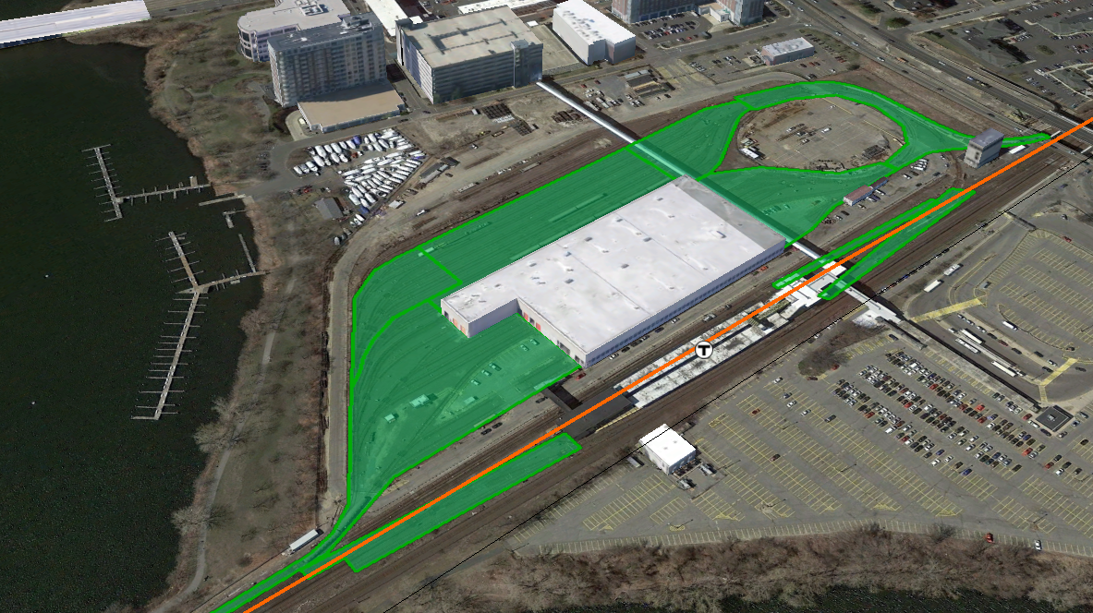
Wellington Yard Rebuild (Construction)
Orange Line Improvements Update
Barletta Heavy Division
Construction NTP: 05/31/18
Construction Substantial Completion:
  Contractual: 03/07/21
  Projected: 03/07/21
Construction Budget: $102,663,000
Construction Expenditures to Date: $1,953,964
Construction Percent Complete: 3%
  Wellington Yard Rebuild

Slide 8
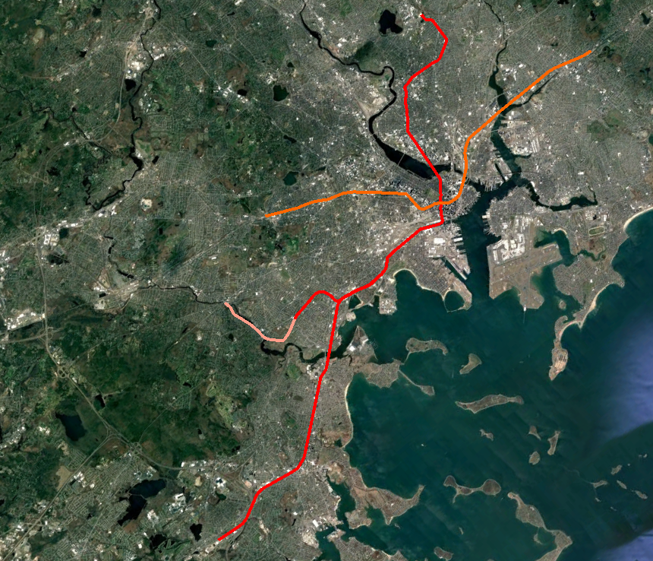
Orange Line Signals Upgrades (Design-Build)
Orange Line Improvements Update
Orange Line
OL Signaling and Train Control System Upgrade
OL South West Corridor Wayside Signal Replacement
Barletta Heavy Division
NTP: November 30, 2018
Substantial Completion: December 2021
Design-Build Budget: $104,000,000
Expenditures to Date: $0
Percent Work Complete: 0%

Slide 9
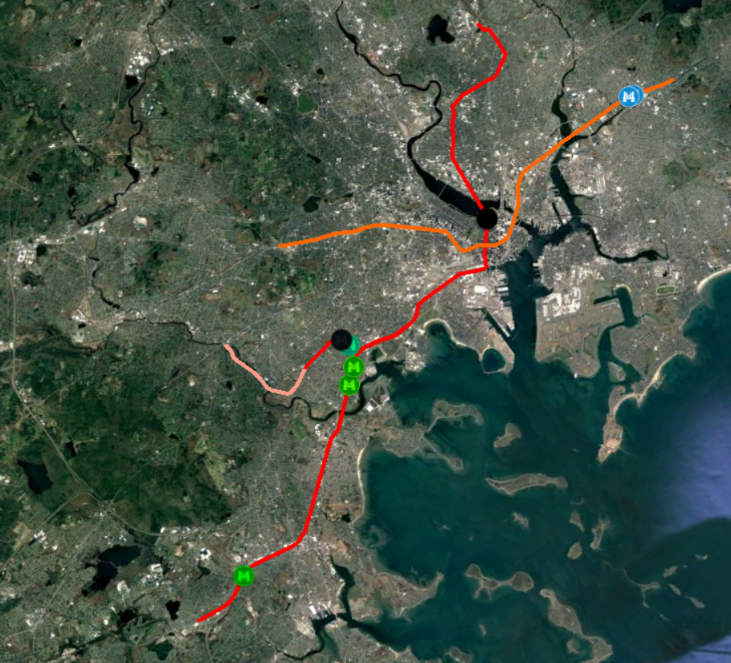
Orange Line Bridge Strengthening (Construction)
Orange Line Improvements Update
Orange Line
Bridge Repairs
Charles Street-M-01-003 (85) IN CONSTRUCTION
Adams Street-M-01-002 (85J) IN CONSTRUCTION
Status
OL Substantial Completion – 01/07/2019
Project Benefits
Bridges will accommodate new heavier Orange Line vehicles at higher speeds and more frequent headways.
Increase controlling bridge rating of structural elements to carry the new fully loaded Orange Line vehicles at 60 mph.

Slide 10
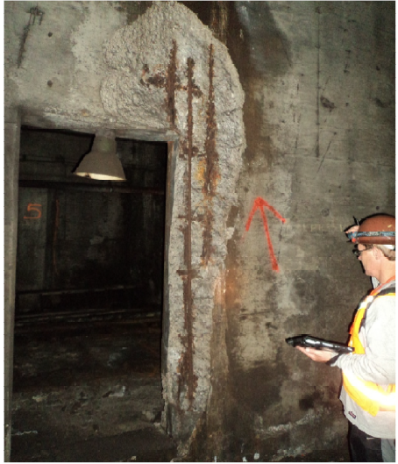
Orange Line Tunnel Repairs (Pre-Bid)
Orange Line Improvements Update
Project Status
Advertise for Bid: January, 2019
Planned Construction NTP: April, 2019
Construction Duration: 30 months
Est. Construction Cost: $24.2 M
Est. Project Budget: $32.5 M
Project Scope
Repair of structural defects and leaks within the Orange Line Tunnels between Chinatown and Haymarket Stations. Repairs include sealing of cracks and joints with water infiltration, repair of framing steel and rebar, and concrete delamination’s.
The scope of the contract also includes the relocation of existing MBTA utilities, where and when in conflict with the repair locations.
One Project Photo
Project Benefits
Orange Line tunnel structural integrity and useful life increase. Address state of good repair needs of the downtown Orange Line Tunnel.
Repairs will enhance on-time performance, and customer experience

Slide 11
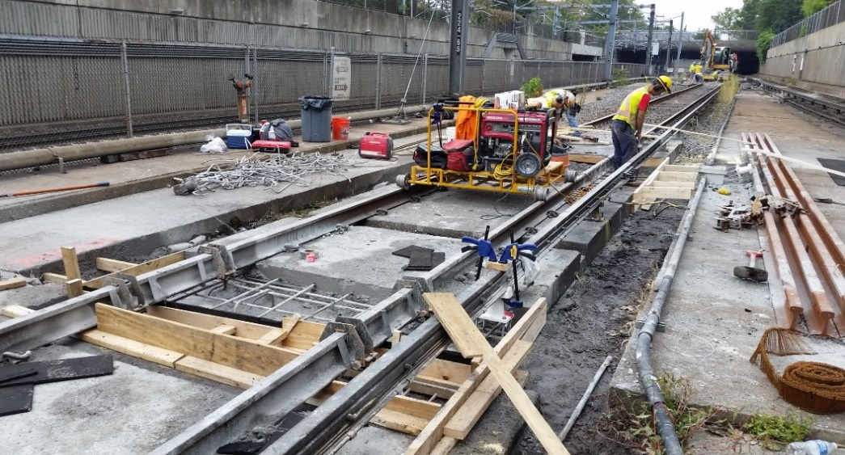
Systemwide On Call Track and ROW II (Construction)
Orange Line Improvements Update
Project Status
Construction NTP: June 29, 2018
Construction Subst. Completion: July 2, 2020
Construction Contract Value: $28.7 M
Construction Expenditures to Date: $2.5 M * Overall Project Budget: $42 M **
Construction Percent Complete: 15%
* Expenditures to date for OL trackwork
** Includes work at locations other than the OL
Project Scope
Providing construction-related services on an on-call basis to support emergency, urgent and routine repair/reconstruction needs of the Authority.
Immediate response to emergency and urgent repair requests
Orange Line work to date includes repair of concrete track bases (Direct Fixation) from Back Bay to Forest Hills
One Project Photo
Project Benefits
Achieve State of Good Repair
Removal of speed restrictions resulting from track defects
Improved Customer Experience

Slide 12
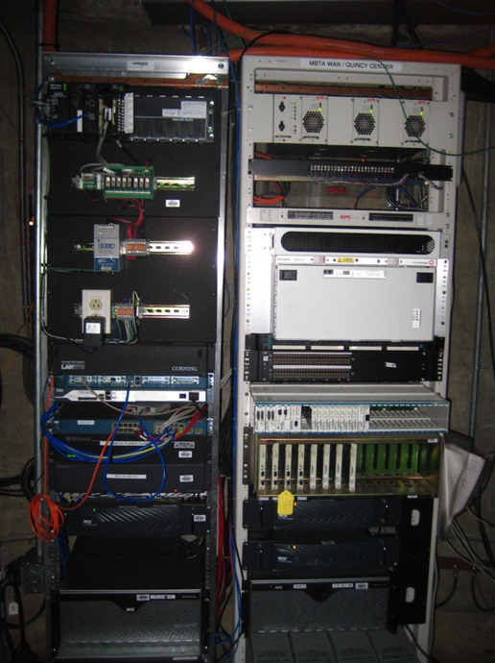
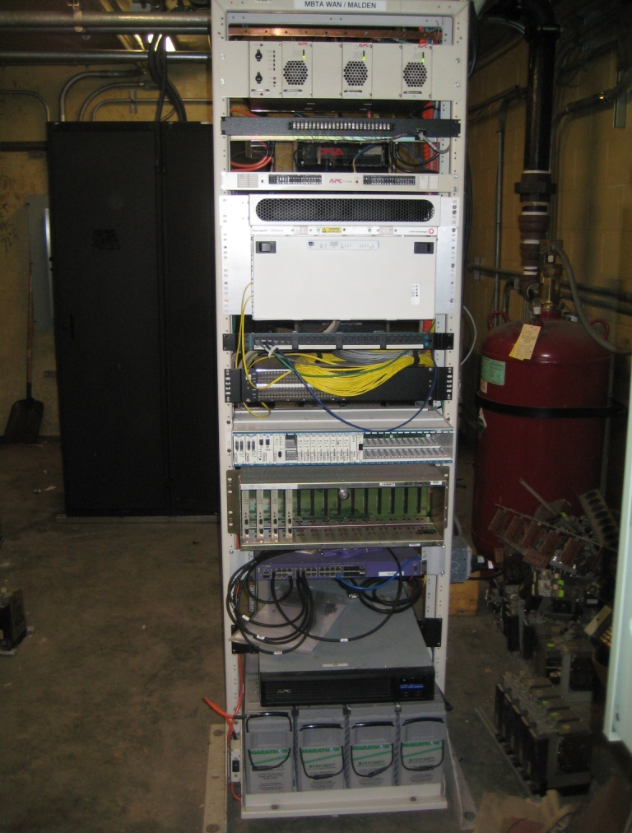
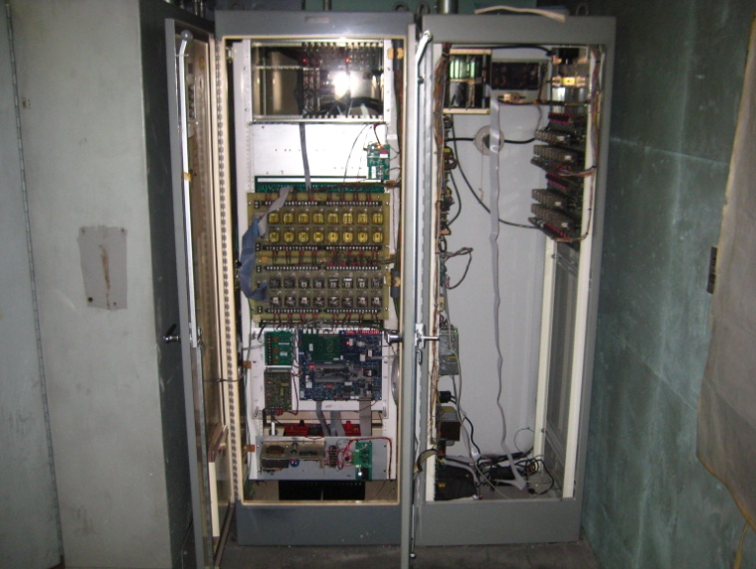
Systemwide Power SCADA System Upgrade (Pre-Bid)
Orange Line Improvements Update
Project Status
Current Design Phase: Complete
Final Design Completion: Complete
Advertise for Bid: December 2018
Planned Construction NTP: January 2018
Construction Duration: 24 Months
Est. Construction Cost: $3.5 M
Est. Project Budget: $9.2 M *
* Includes work at locations other than the OL
14 of 45 locations are on the Orange Line
Project Scope
Installation of Ethernet switches in the Traction Power Substation (TPS) and in the Communication (Comm) Room
Installation of Conduits and Fiber optic Cable between the Comm room and TPS
Program the following: Switches; Remote Terminal Unit (RTU) at each TPS, and the operating system at the Operational Control Center (OCC)
Project Benefits
More reliable communication between the Remote Locations i.e., TPS and the Power Control Center at 45 High Street.
Reduce the need for leased copper circuits from Verizon saving money and adding reliability.

Slide 13
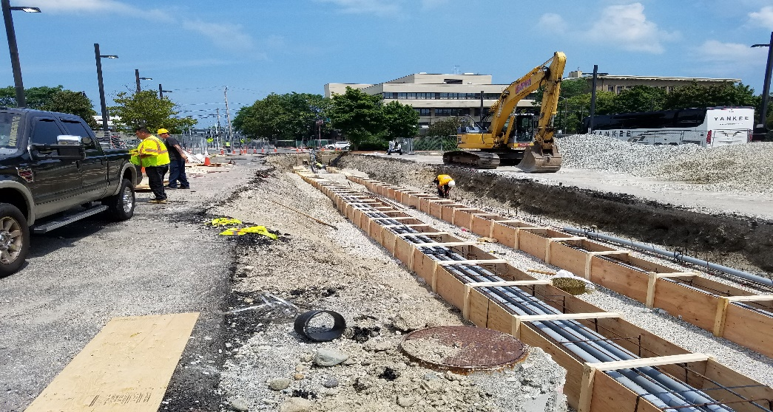
Systemwide Power Resiliency Program (Pre-Design)
Orange Line Improvements Update
Project Status
Current Design Phase: Pre Design
Final Design Completion: TBD
Advertise for Bid: TBD
Planned Construction NTP: Spring Construction Duration: 12 Months
Est. Construction Cost: $6.8 M
Est. Project Budget: $13.3 M *
* Includes work at locations other than the OL
Project Scope
Replace priority Duct Banks at 9 locations
Four (4) locations on the Orange Line
Procure Temporary (10 ea) and Permanent generators (approximately 12 ea)
Provide a Feasibility Study to determine if it is worth installing a redundant power feed from South Boston Power Complex to Lincoln Switching Station
Project Benefits
Address urgent needs across the rapid transit power network
Ability to be more resilient when there is an interruption to the power supplied
Additionally there a study that will provide critical information for deciding how to build in redundancy from the Boston Power Complex to the Lincoln Switching Station

Slide 14
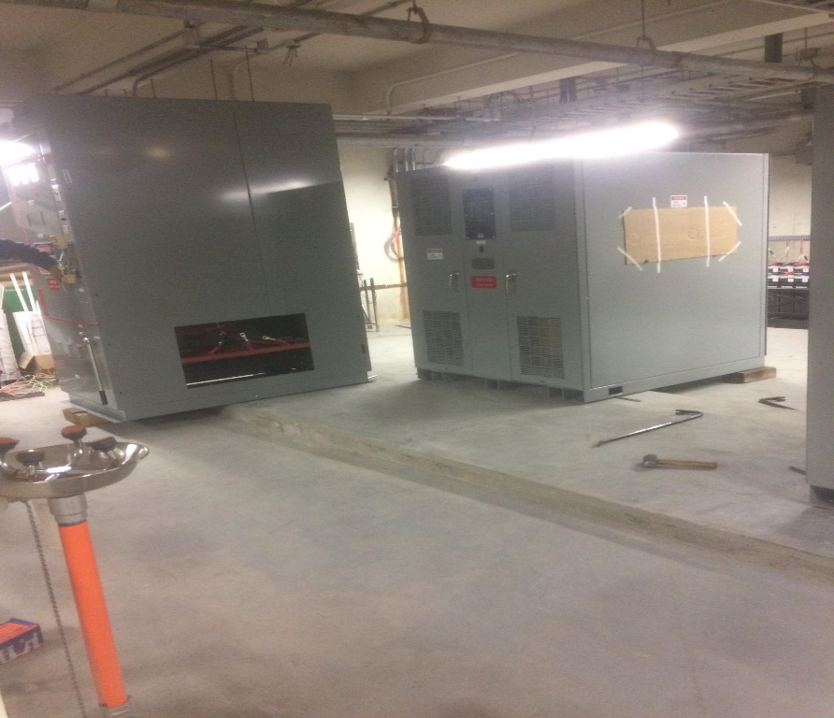
OL Traction Power Substation Upgrade (Construction Phase)
Orange Line Improvements Update
Project Status
Substantial Completion: Summer, 2021
Est. Construction Cost: $37.3 M
Est. Project Budget: $47.0 M
Project Scope
Make needed building repairs
Remove aging switchgear and all associated electrical equipment
Install dielectric flooring in the switch gear area
Install new electrical equipment
Install substation automation system (SAS)
Project Benefits
Improved reliability
Increased safety
Reduced maintenance cost
Increased control from the Operational Control Center
Building Improvements

Slide 15
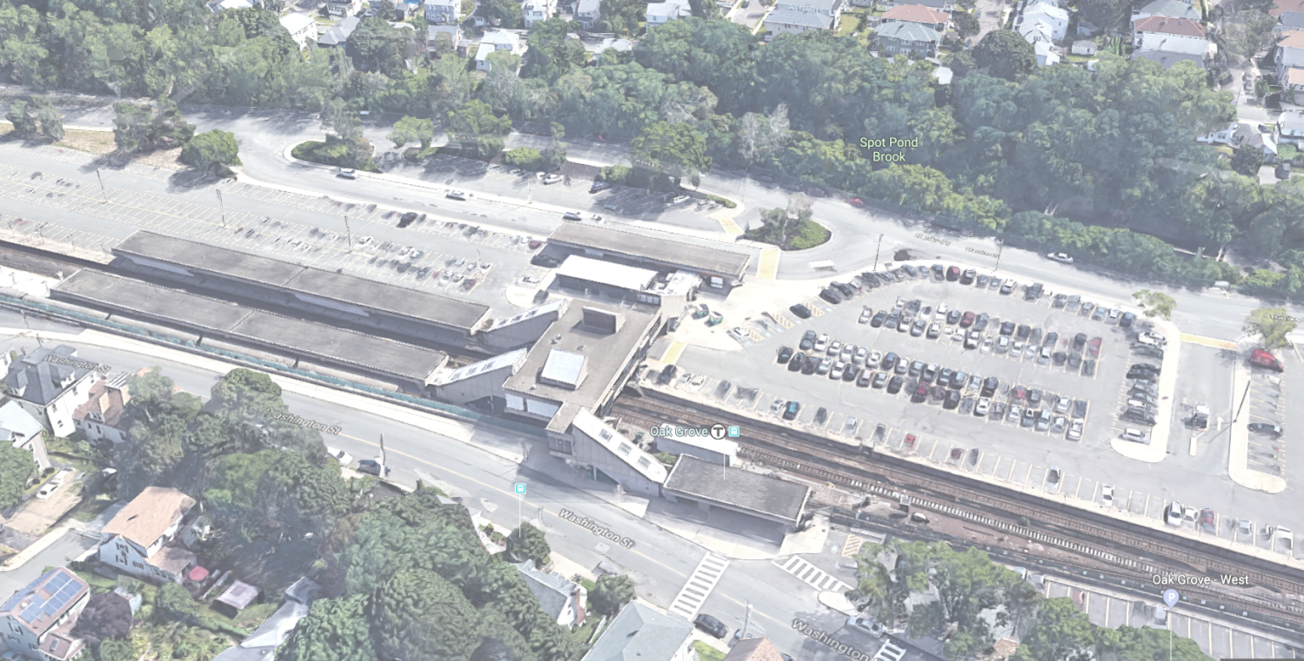
Oak Grove Station Accessibility Improvement (Design)
Orange Line Improvements Update
Project Status
Current Design Phase: Final Design
Final Design Completion: Spring 2019
Advertise for Bid: Summer 2019
Planned Construction NTP: Fall 2019
Construction Duration: 24 months
Est. Construction Cost: $25 M
Est. Project Budget: $35.3 M
Project Scope
Upgrade one existing elevator
Install three new elevators
Improve elevator visibility by use of glass enclosures
Improve station access and signage
Implement station brightening (cleaning, repainting, relighting)
Upgrade Unit Substation and codes
State of Good Repair Improvements
One Project Photo
Project Benefits
Improved station accessibility
    Elevator reliability
    Pedestrian circulation
Improved safety
Increase energy efficiency
Reduced maintenance costs
Improved station signage and wayfinding
Improved customer experience
Improved station reliability
Renovated station finishes for an extended life expectancy

Slide 16
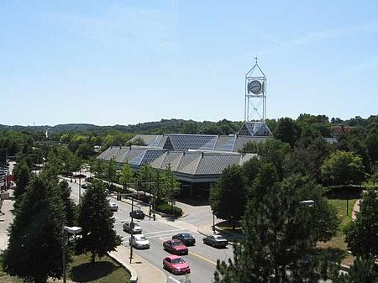
Forest Hills Station Improvements Project (Design) *
Orange Line Improvements Update
Project Status
Current Design Phase: 30% Design
Final Design Completion: Fall, 2020
Advertise for Bid: Jan, 2021
Planned Construction NTP: April, 2021
Construction Duration: 24 months
Est. Construction Cost: $30 M
Est. Project Budget: $46 M
Project Scope
Code compliant Improvements
Tactile at Orange Line and Commuter Rail
Accessible public and employee toilets, T police and employee spaces
Station brightening and replace roof
New wayfinding signage
Replace 3 existing elevators and add 1 new elevator from upper to lower busway
New Commuter Rail platform Point of Safety
One Project Photo
Project Benefits
Will make Forest Hills accessible
Will achieve State of Good Repair
Will improve public safety
Will improve the customer experience
* This project is separate from the bus canopy and headhouse currently being constructed by MassDOT.

Slide 17
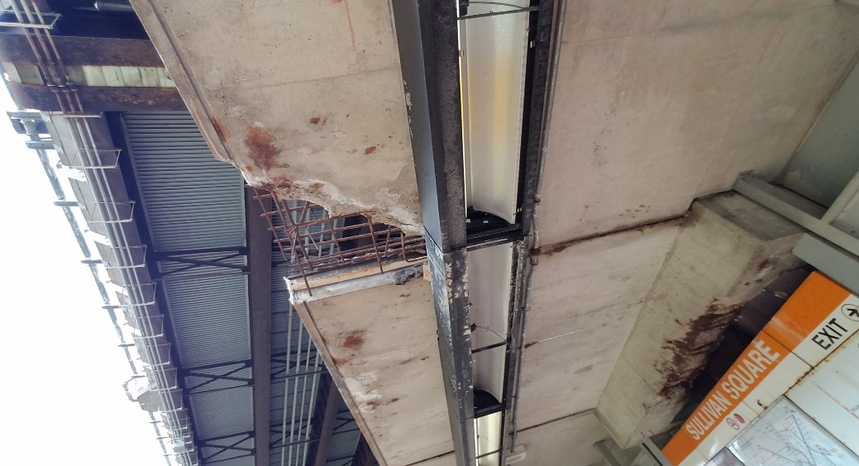
Sullivan Square Station Structural Repairs (Design)
Orange Line Improvements Update
Project Status
Final Design Completion: 12/15/2018
Begin Construction: Spring 2019
Construction Duration: 9 months
Est. Construction Cost: $5.7 M
Est. Project Budget: $9.8 M
Project Scope
Work will include removal and repair of loose and deteriorated concrete on platform canopy, removal and replacement of protective coating to canopy elements, and removal and replacement of damaged paint systems to canopy elements.
One Project Photo
Project Benefits
Bring station toward State of Good Repair.
Improve Customer Experience through better protection from weather and improved lighting.
Extend usable life of station.
Reduce maintenance costs.

Slide 18
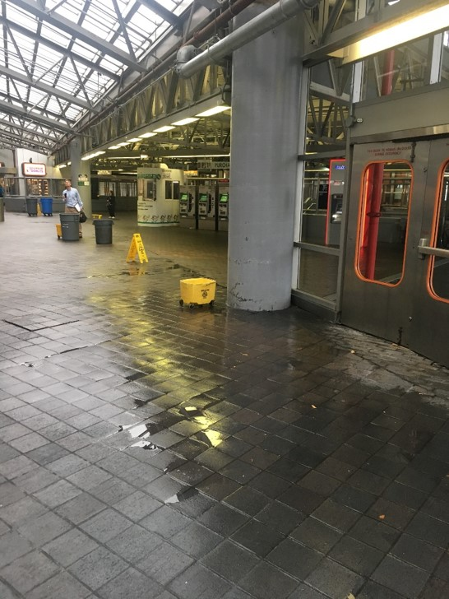
Ruggles Station Roof Repair/Replacement (Conceptual Design)
Orange Line Improvements Update
Project Status
Current Design Phase: Pre-Design
Final Design Completion: Spring 2019
Advertise for Bid: Summer 2019
Planned Construction NTP: Fall 2019
Construction Duration: 12 months
Est. Construction Cost: TBD
Est. Project Budget: $800 K (Pre-Design)
Project Scope
Project will repair and/or replace the existing roofing and skylight systems at Ruggles Station (OL).
One Project Photo
Project Benefits
Project will address urgent State of Good Repair needs for the station by removing sources of leaking which create unsafe slipping (water pooling) conditions as well as damage to MBTA assets within the station enclosure.
Improve Customer Experience through better protection from weather.
Extend usable life of station.
Reduce maintenance costs.

Slide 19
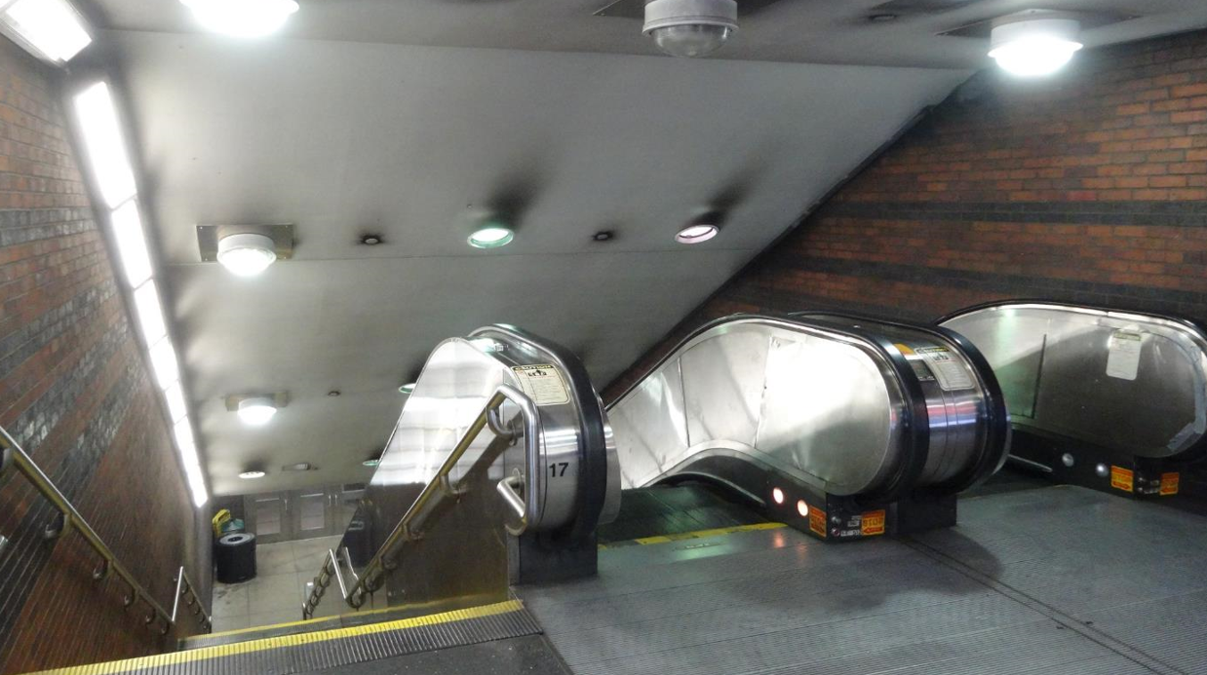
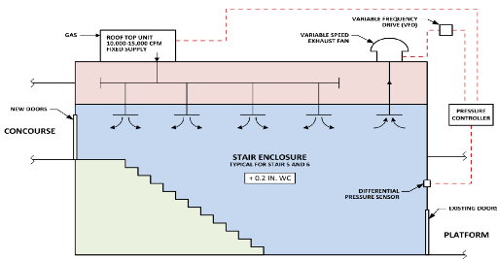
Back Bay Ventilation: Package 1 Stair Pressurization (Construction)
Orange Line Improvements Update
Project Status
Construction NTP: May 2018
Substantial Completion: May 2020
Construction Budget: $5 M
Construction Expenditures to Date: $1.2 M
Construction Percent Complete: 24%
Est. Project Budget: $6 M
Project Scope
Air Pressurize Stairways 5 & 6 (Tracks 1-3)
Install New Doors at Concourse for Separation
Project Benefits
Improved Air Quality - Aerodynamic Separation Between Platform and Concourse – Prevent Train Exhaust Migration
New Mechanical and Electrical Systems

Slide 20
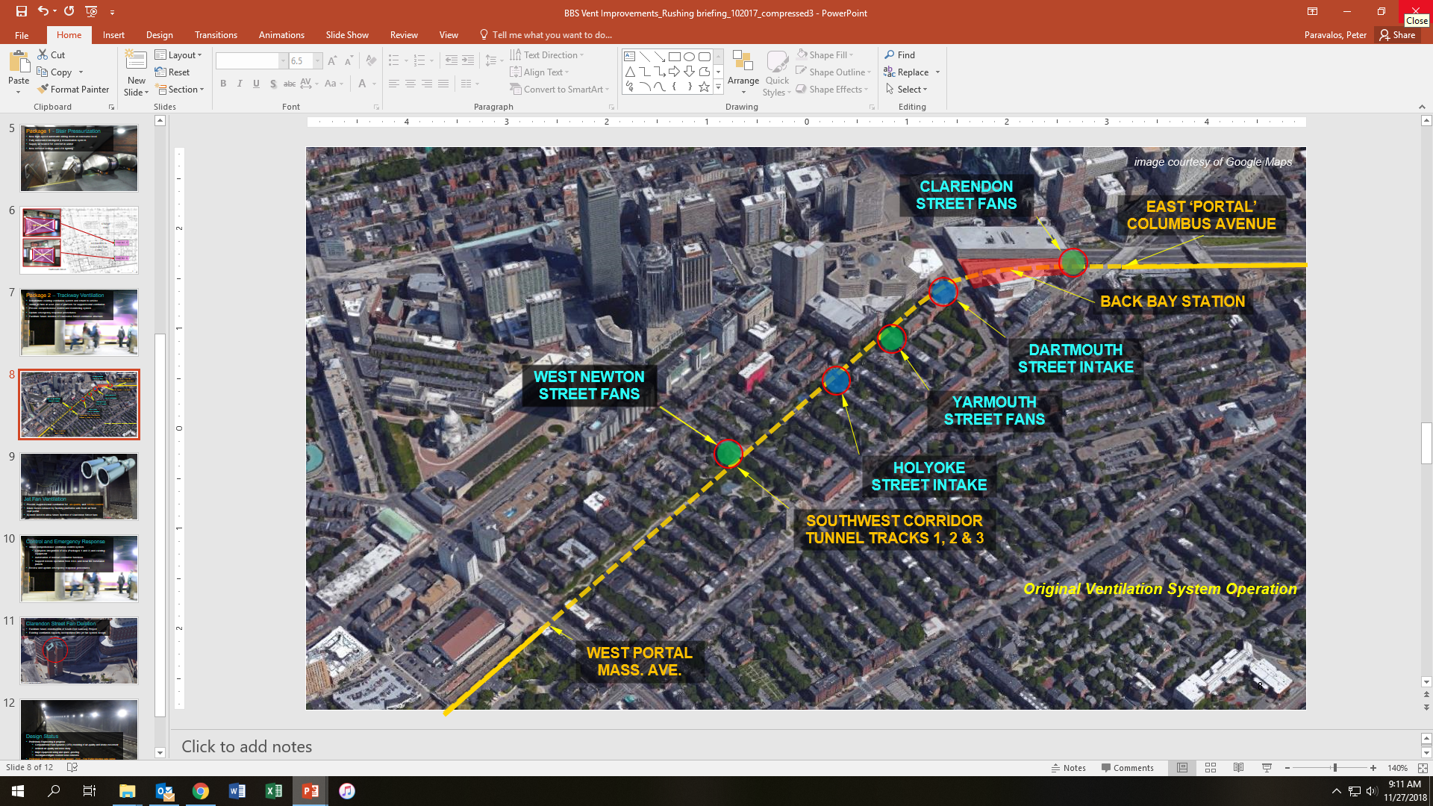
Back Bay Ventilation: Package 2 Tunnel Ventilation (Design)
Orange Line Improvements Update
Project Status
Current Design Phase: 30% Design
Final Design Completion: May 2019
Advertise for Bid: Summer 2019
Planned Construction NTP: Fall 2019
Construction Duration: 12 months
Est. Construction Cost: $10 M
Estimated Project Budget: $11.7 M
Project Scope
New Tunnel Jet Fan Installation - Draw Away Train Exhaust from Platforms
New Improvements to Existing Intake and Exhaust Vent Structures for Improved Functionality, Resiliency and Life Cycle.
Project Benefits
Improve Ambient Air Quality
Improve Life-Safety During Fire Event
Improvements to Existing Intake & Exhaust Structures

Slide 21
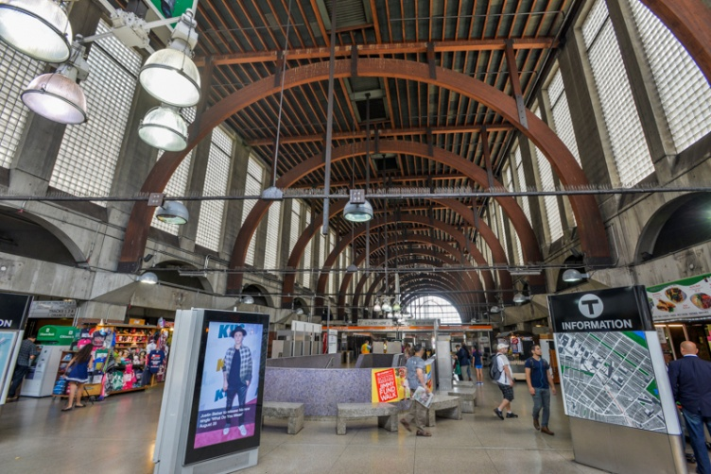
Back Bay Ventilation: Package 3 Systems Imps (Study)
Orange Line Improvements Update
Project Status
Power Study: Jan 2019
Final Design Completion: TBD
Advertise for Bid: TBD
Planned Construction NTP: TBD
Construction Duration: 12 months
Est. Construction Cost: $14 M
Estimated Project Budget: $15.3 M
Project Scope
New Unit Substation - Meet Current/Future Transportation Needs & Provide 1600 amp Service for Future Retail Expansion.
Repair Existing Concourse Expansion Joints
Mechanical and Plumbing Upgrades
Project Benefits
Upgraded MBTA Station Power Grid
Improved Power Resiliency
Improved HVAC Systems
New Concourse Expansion Joints
Power for Retail Tenants for MBTA Revenue

Slide 22
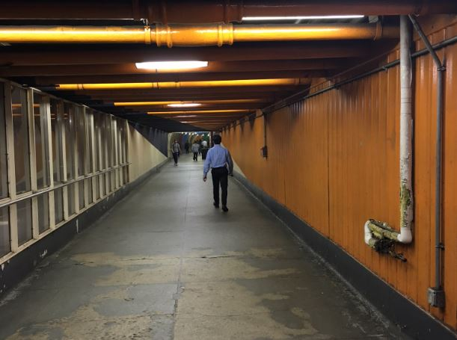
Wayfinding & Station Improvements (8 Stations) (Design)
Orange Line Improvements Update
Project Status
Current Design Phase: 30% Design
Final Design Completion: Spring 2019
Advertise for Bid Summer 2019
Construction Duration 12 Months
Est. Construction Cost $46M
Est. Project Budget $63M *
* Includes work at locations other than the OL
Project Scope
Of the 8 Station 6 are OL stations, including State, Haymarket, DTX, Back Bay, Malden, N. Station
Divided into (2) two (4) four station packages
Wayfinding (Signage)
Select Floor/Wall/Ceiling repairs
Extensive Cleaning/Painting
One Project Photo
Project Benefits
Improve Customer Experience
Bring Wayfinding into compliance with ADA & new MBTA Standards
All customers, including those w/disabilities, will be able to get to destinations quicker & safer
Tripping Hazards to be repaired and improved

Slide 23
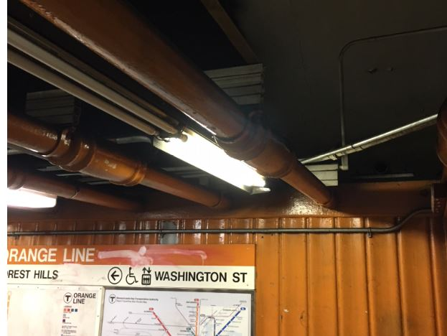
Lighting & Station Improvements (8 Stations) (Design Procurement)
Orange Line Improvements Update
Consultants – TBD
Issue RFQ: December 2018
Complete Design: Winter 2019/2020
Advertise for Bid Spring 2020
Construction Duration 12 Months
Est. Construction Cost $30 M
Est. Project Budget $40 M *
* Includes work at locations other than the OL
Project Scope
Of the 8 Station 6 are OL stations, including State, Haymarket, DTX, Back Bay, Malden, N. Station
Illuminate Wayfinding Signage
Illuminate Path of Travel & Track Edges
Evaluate Existing Lighting
Recommend Improve or Replace
One Project Photo
Project Benefits
Improve Overall Customer Experience
Bring Wayfinding into compliance with ADA & new MBTA Standards
Reduce Operating Costs
Take advantage of energy partnerships

Slide 24
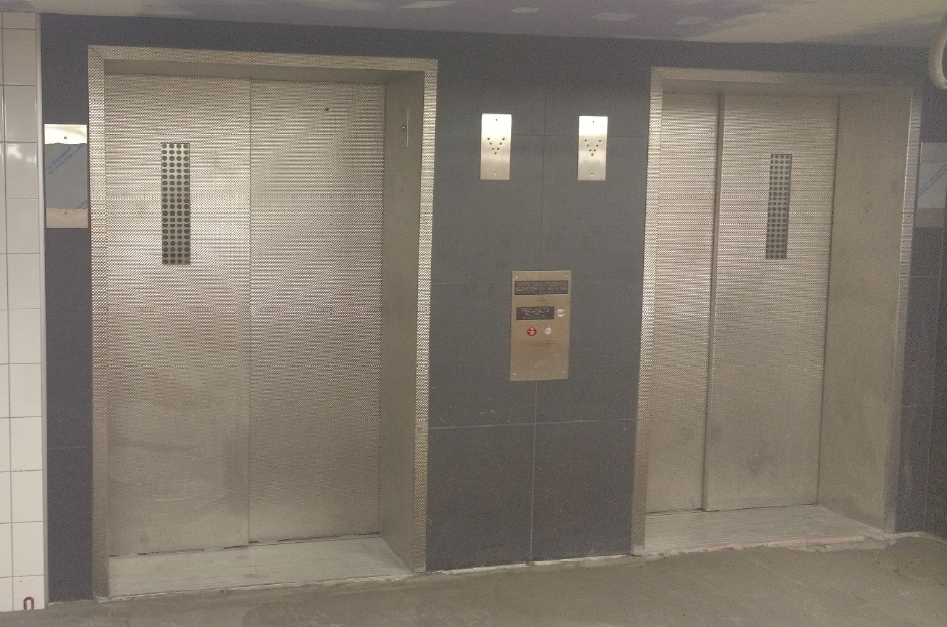
Downtown Crossing Vertical Transp. Improvements Phase I (Construction)
Orange Line Improvements Update
Project Status
Construction NTP: 02/18/16
Projected Substantial Completion: January 2019
Construction Contract Value: $13.6 M
Overall Project Budget: $34.4 M
Construction Expenditures to Date: $9.2 M
Construction Percent Complete: 75%
Project Scope
The Downtown Crossing (DTX) Vertical Transportation Improvements Phase I project includes two new elevators servicing the RL NB to OL NB connection.
Also included are new fire/life systems, improvements to exits and doors to improve egress capacity.
Project Benefits
Provide ADA Compliant and Stretcher-sized elevator for Downtown Crossing Station.
Provide safer experience with increased use of glass.
Provide more reliable and efficient elevator.
Improve life safety systems at DTX

Slide 25
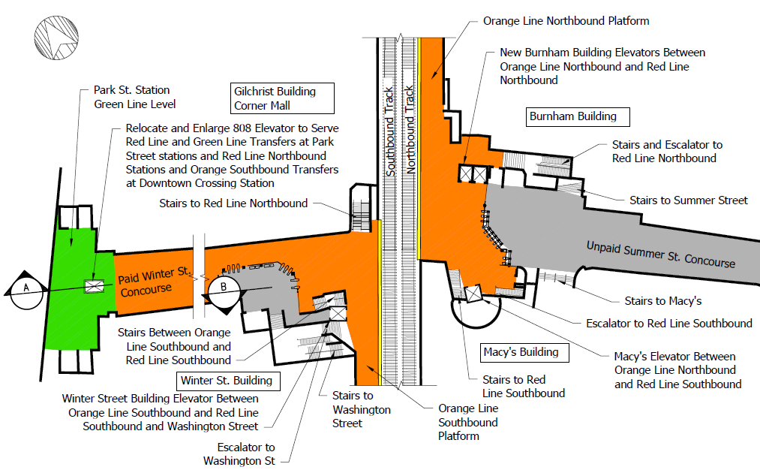
Downtown Crossing Vertical Transp. Imps Phase II (Design Procurement)
Orange Line Improvements Update
Project Status
Issued RFQ: November 6, 2018
Final Design Completion: Winter 2020/2021
Advertise for Bid: Spring 2021
Planned Construction NTP: Summer 2021
Construction Duration: 24 Months
Est. Construction Cost: $35 M
Est. Project Budget: $49 M
Project Scope
The Downtown Crossing (DTX) Vertical Transportation Improvements Phase II project will be part of a 3 elevator improvement project at Park St. and DTX. Servicing the Orange Line will be two new elevators:
  - Wash. St (Surface - OL SB - RL SB)
  - Macy’s (OL NB – RL SB)
One Project Photo
Project Benefits
Provide ADA Compliant and Stretcher-sized elevator for Park Street and Downtown Crossing Stations.
Provide safer experience with increased use of glass.
Provide more reliable and efficient elevator.

Slide 26
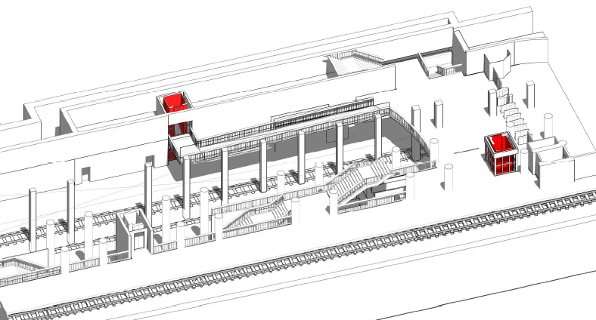
North Station Elevators (2) (Design Procurement)
Orange Line Improvements Update
Project Status
Issue RFQ: Spring 2019
Final Design Completion: Spring 2021
Advertise for Construction: Spring 2021
Construction NTP: Summer 2021
Construction Duration: 27 Months
Est. Construction Cost: $10 M
Est. Project Budget: $18 M
Project Scope
Construct a new elevator between the mezzanine and Orange Line Platform
Construct a new elevator between the mezzanine and the Green Line inbound platform.
Life Safety Systems Upgrades
Two design and construction contracts anticipated (five stations each)
One Project Photo
Project Benefits
Provide redundant elevator service within North Station
Improve accessibility between Orange and Green Line
Upgrade the station fire alarm system
Repurpose existing space within the station to increase functionality

Slide 27
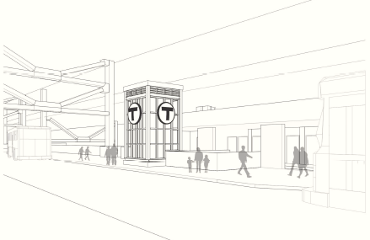
Sullivan Station Elevators (3) (Design Procurement)
Orange Line Improvements Update
Project Status
Issue RFQ: Spring 2019
Final Design Completion: Spring 2021
Advertise for Construction: Spring 2021
Construction NTP: Summer 2021
Construction Duration: 23 Months
Est. Construction Cost: $7 M
Est. Project Budget: $13 M
Project Scope
Construct a new elevator between upper and lower busways
Replace two existing elevators between the lobby and the inbound and outbound platforms
Life Safety Systems Upgrades
Two design and construction contracts anticipated (five stations each)
One Project Photo
Project Benefits
Provide elevator service between the busways
Improve functionality of existing elevators by providing pass-through operability
Bring existing elevators up to a state of good repair
Repurpose existing space within the station to increase functionality

Slide 28
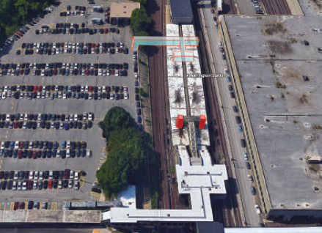
Wellington Station Elevators (5) (Design Procurement)
Orange Line Improvements Update
Project Status
Issue RFQ: Spring 2019
Final Design Completion: Spring 2021
Advertise for Construction: Spring 2021
Construction NTP: Summer 2021
Construction Duration: 30 Months
Est. Construction Cost: $14 M
Est. Project Budget: $25 M
Project Scope
Construct a three new elevators and a headhouse entrance from the parking lot to the south end of the platform.
Replace two existing elevators between the north lobby and the inbound and outbound platforms
Life Safety Systems Upgrades
Two design and construction contracts anticipated (five stations each)
One Project Photo
Project Benefits
Provide redundant elevator service at Wellington Station
Improve egress to the passenger parking lot area
Bring existing elevators up to a state of good repair
Repurpose existing space within the station to increase functionality

Slide 29
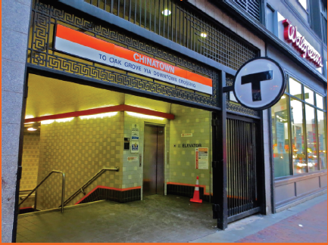
Chinatown Station Elevators (4) (Design Procurement)
Orange Line Improvements Update
Project Status
Issue RFQ: Spring 2019
Final Design Completion: Spring 2021
Advertise for Construction: Spring 2021
Construction NTP: Summer 2021
Construction Duration: 42 Months
Est. Construction Cost: $27 M
Est. Project Budget: $48 M
Project Scope
Construct a two new elevators from Washington St to the Orange Line Inbound and Outbound Platforms
Replace two existing elevators from Washington St to the inbound and outbound platforms
Life Safety Systems Upgrades
Two design and construction contracts anticipated (five stations each)
One Project Photo
Project Benefits
Provide redundant elevator service to both the inbound and outbound platforms
Bring existing elevators up to a state of good repair
Upgrade the station fire alarm system
Re-opening existing station entrances to enhance presence at Washington St level

Slide 30
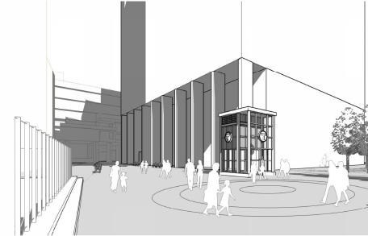
State Street Station Elevators (3) (Design Procurement)
Orange Line Improvements Update
Project Status
Issue RFQ: Spring 2019
Final Design Completion: Spring 2021
Advertise for Construction: Spring 2021
Construction NTP: Summer 2021
Construction Duration: 30 Months
Est. Construction Cost: $17 M
Est. Project Budget: $30 M
Project Scope
Construct a new elevator to serve the Orange Line Outbound platform from the surface in the Washington Mall portion of City Hall Plaza
Replace existing Elevators 802 below the Old State House and 803 at the Milk Street entrance
Reconstruct the Milk Street entrance lobby to provide accessible floor grading
Two design and construction contracts anticipated (five stations each)
One Project Photo
Project Benefits
Create a new entrance at City Hall Plaza to station entrances to enhance presence at Washington Mall level
Update existing elevators to a state of good repair
Bring Milk St Lobby grades to within limits acceptable to MAAB

Slide 31
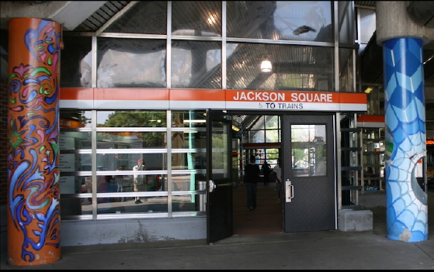
Jackson Square Station Elevators (2) (Design Procurement)
Orange Line Improvements Update
Project Status
Issue RFQ: Spring 2019
Final Design Completion: Spring 2021
Advertise for Construction: Spring 2021
Construction NTP: Summer 2021
Construction Duration: 36 Months
Est. Construction Cost: $9 M
Est. Project Budget: $15 M
Project Scope
Construct a new elevator to serve the Orange Line Center platform
Replace existing elevator serving the Orange Line Center Platform
Life Safety Systems Upgrades
Two design and construction contracts anticipated (five stations each)
One Project Photo
Project Benefits
Provide redundant elevator service to the center platform
Improve functionality of existing elevator by providing pass-through operability
Bring existing elevator up to a state of good repair
Upgrade the station fire alarm system
Repurpose existing space within the station to increase functionality

Slide 32
Mass Ave Station Elevators (2) (Design Procurement)
Orange Line Improvements Update
Project Status
Issue RFQ: Spring 2019
Final Design Completion: Spring 2021
Advertise for Construction: Spring 2021
Construction NTP: Summer 2021
Construction Duration: 32 Months
Est. Construction Cost: $12 M
Est. Project Budget: $21 M
Project Scope
Construct a new elevator to serve the Orange Line Center platform
Replace existing elevator serving the Orange Line Center Platform
Life Safety Systems Upgrades
Two design and construction contracts anticipated (five stations each)
One Project Photo
Project Benefits
Provide redundant elevator service to the center platform
Bring existing elevator up to a state of good repair
Upgrade the station fire alarm system
Repurpose existing space within the station to increase functionality

Slide 33
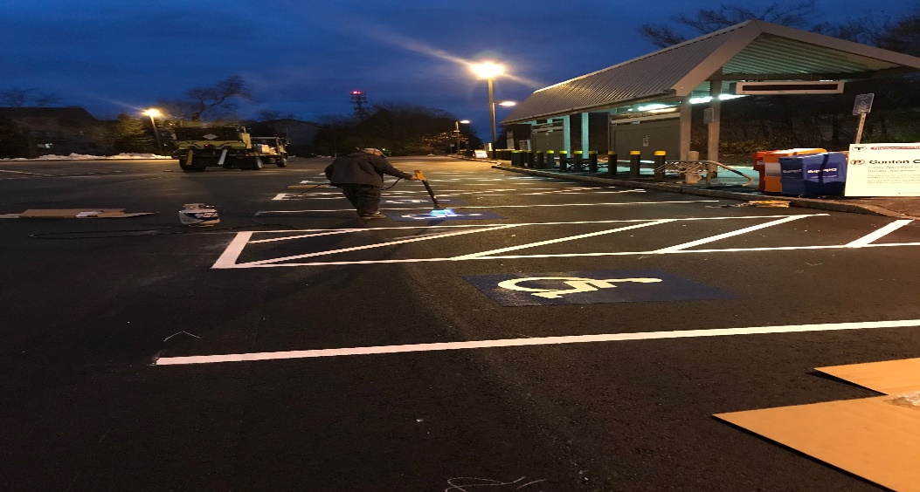
On Call Parking & Paving (Construction)
Orange Line Improvements Update
Project Status
Construction NTP: July 31, 2017
Construction Subst. Completion: July 7, 2020
Construction Contract Value: $21.5 M
Ant. amount to be spent on OL $5M
Construction Expenditures to Date: $7 M
Overall Project Budget: $28.4 M *
Construction Percent Complete: 65% Total
* Includes work at locations other than the OL
Project Scope
Parking and paving repair/reconstruction needs of the Authority and associated work elements on an on-call basis
OL work includes:
Temporary resurfacing of Banks Place
Creation of a CDL training facility at Wellington Yard
Reconstruction of Wellington surface lot
Reconstruction of Oak Grove surface lot
One Project Photo
Project Benefits
Achieve State of Good Repair
Increase parking capacity of certain lots
Improved Customer Experience

Slide 34
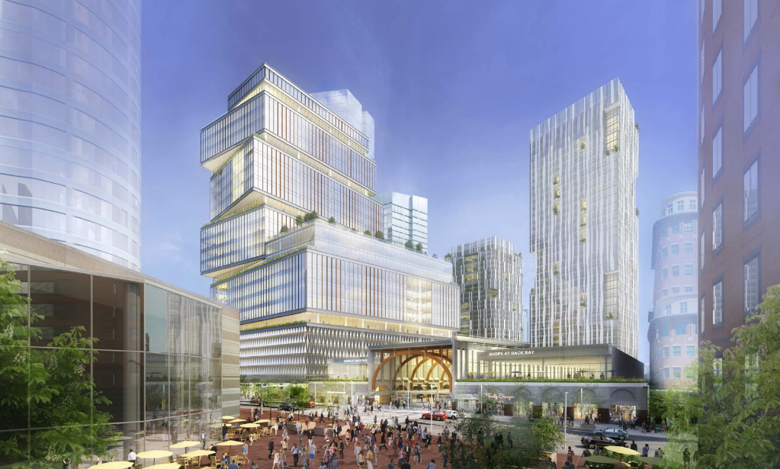
Back Bay Station: Concourse Renovations & Air Rights (Design) - TOD
Orange Line Capital Projects Review
Project Status:
Current Design Phase: 30%
Planned Construction NTP: TBD
Construction Duration: TBD
Est. Construction Cost: TBD
Developer Lease Funded & Constructed
Adjacent/Air-Rights Private Development
Project Scope
Development – Public, Private
Developer – Boston Properties
Residential & Retail Construction
Renovation Station Concourse
New Keolis/AMTRAK Ticket Offices
Power Upgrades
Accessibility Upgrades
Project Benefits
New Fully-Accessible Pedestrian Connection to Station from Stuart Street
MBTA Revenue from New Concourse Leased Retail Space
Enhanced Customer Experience
  - New Ticket Offices
  - Escalators
  - Redundant Elevators
  - Wayfinding

Slide 35
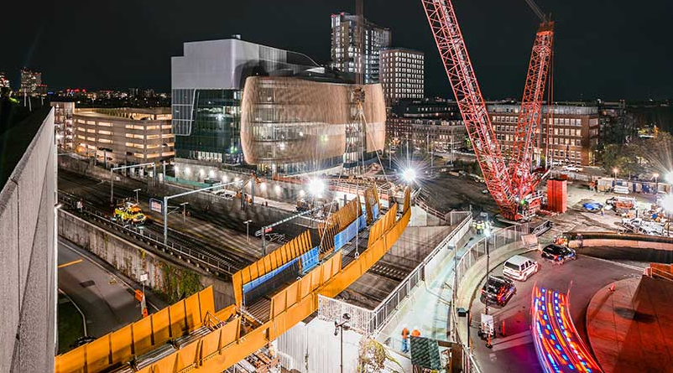
Ruggles Station: Northeastern U. ISEC & Ped. Bridge (Construction) - TOD
Orange Line Capital Projects Review
Project Status:
Construction Start: Jan. 2014
Construction Completion: Sept. 2019
Construction Duration: Multi-phase
Est. Construction Cost: TBD
Developer Funded & Constructed
Adjacent/Air-Rights Private Development
Project Scope
Development – Public, Private
Developer – Northeastern University
New Academic Building & Ped. Brdg.
Relocation of MBTA Utilities
Relocation of AMTRAK Catenary
Accessibility Upgrades
Project Benefits
Fully-Accessible Connection to Proposed New Ruggles Commuter Rail Platforms
Shared MBTA Scope: MBTA Duct Bank Relocation; Wall Demolition; Constr.
Enhanced Customer Experience
- Wayfinding

Slide 36
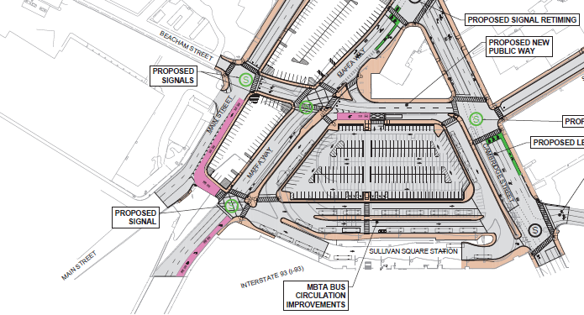
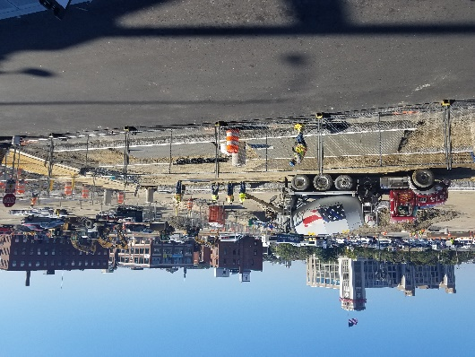
Sullivan Sq. Station: Reconstr. Lower Busway & Parking (Construction) - TOD
Orange Line Capital Projects Review
Project Status:
Construction Start: May 2018
Construction Completion: Dec. 2018
Construction Duration: 10 Months
Est. Construction Cost: TBD
Developer Funded & Constructed
Mitigation by Private Development
Project Scope
Development – Public, Private
Developer – Wynn
Reconstruction of MBTA Lower Busway and Parking Facilities
Accessibility Upgrades
Project Benefits
Reduced Local Traffic Volume
Improved MBTA Bus Capacity; 5 New Bus Berths
New Safer/More Efficient Busway
Enhanced Customer Experience
  - New Sidewalks and Ramps
  - Wayfinding

Slide 37
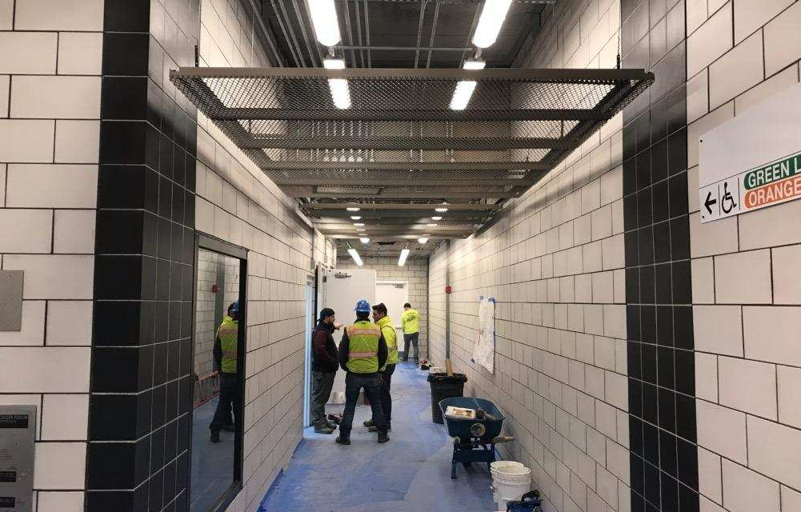
North Station: Transit to Commuter Rail Direct Connection (Construction) - TOD
Orange Line Capital Projects Review
Project Status:
Construction Start: Jan. 2014
Construction Completion: Dec. 2018
Construction Duration: 48 Months
Est. Construction Cost: TBD
Developer Funded & Constructed
Adjacent/Air-Rights Private Development
Project Scope
Development – Public, Private
Developer – Boston Properties
Residential & Retail Construction
New Pedestrian Tunnel Connection Green/Orange Line Below Causeway Street to Commuter Rail Service
New Keolis Ticket Offices and Facilities
Accessibility Upgrades
Project Benefits
Safer, Fully-Accessible Connection to Transit to Commuter Rail
Enhanced Customer Experience
  - New Ticket Offices
  - Redundant Elevators
  - Wayfinding

