Slide 1
Better Bus Project
July 2018

Slide 2
Overview
      Background on Improving Bus Performance
      The MBTA Bus Improvement Strategy
      The Better Bus Project
      Next Steps

Slide 3
Background on
Improving Bus Performance

Slide 4
About the MBTA Bus Service Network
More than a third of all MBTA trips are taken on buses.
The MBTA’s bus network consists of 175 routes.
Nearly 450,000 trips are taken on MBTA buses in a single weekday.
Serving 50 communities, the bus network provides critical connections.
Overall On Time Performance for the bus network is 65%, well below the target of 75%.
Types of bus routes | % of Routes | % of Bus Ridership
Key bus routes (longer span, higher frequency) | 11% | 42%
Local bus routes (full weekday service) | 73% | 55%
Commuter bus routes (limited peak-direction trips, express bus routes) | 24% | 3%

Slide 5
Current Bus Performance is Unacceptable
Service Delivery Metric | Definition | Key Bus Routes/Silver Line (18 Total) | Other Routes (141 Total)
Reliability | Passengers should be able to expect service to arrive when scheduled | 15 below target | 130 below target
Frequency | Passengers should be able to access transit within a reasonable waiting time | 4 below target | 68 below target
Span of Service | Passengers should have confidence that service will operate during expected hours | 2 below target | 55 below target
Comfort | Passengers should have a reasonable amount of personal space during their trips | 13 below target | 45 below target

Slide 6
The MBTA Bus Network
Strategy

Slide 7
MBTA Bus Improvement Strategy
      New/Retrofitted Bus Fleet
      Municipal Partnerships
        Transit Signal Prioritization
        Dedicated Bus Lanes
      The Better Bus Project
        Service Planning Improvements/Network Redesign
        Service Improvements Underway

Slide 8
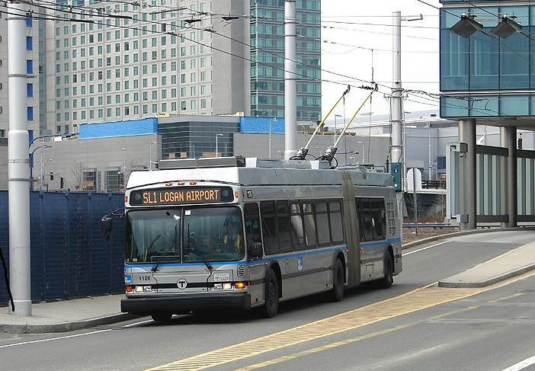
New/Retrofitted Bus Fleet
      The MBTA Bus Fleet is approximately 1,000 vehicles.
      In 2016/17, the MBTA put 375 new buses in service:
        156 diesel-electric hybrids
        175 compressed natural gas
        44 60ft articulated buses
      Later this year, the MBTA will begin procurement for additional buses to replace the oldest buses in the fleet and to expand the existing fleet
      Five New Flyer battery electric buses will arrive in 2018 to assess the potential for a Silver Line replacement feet.

Slide 9
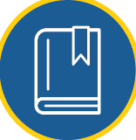


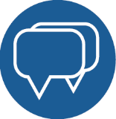
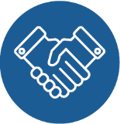
Improving bus service with municipal partnerships
What the MBTA can help with:
Buses, bus stop placement guidelines and management, bus schedules, fare payment structure
What municipalities can help with:
Streets, signals, parking, curb management, sidewalk space, intersections, enforcement
Inform and Engage
Take Action
Watch for Opportunities
PARTNERSHIP
PROCESS
Discuss Issues and Trade-offs
Connect with Partners

Slide 10
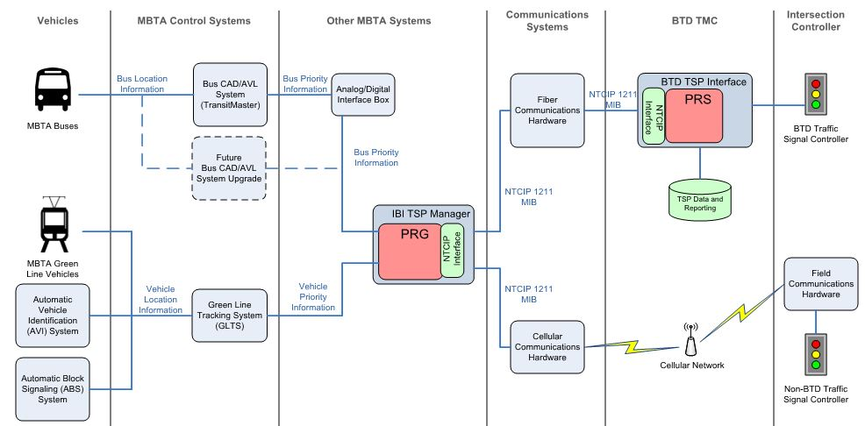
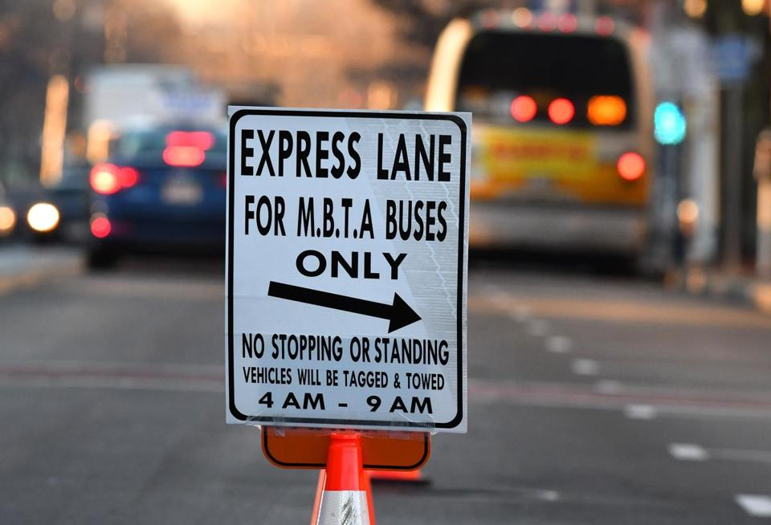
Municipal Partnerships
Transit Signal Prioritization
Boston
Brookline
Cambridge
Everett
Arlington
Watertown
Dedicated Bus Lanes
Broadway Southbound and Northbound, Everett (Complete 2018)
Washington St. (Roslindale), Boston (Fall 2018 completion)
South Mass Ave, Cambridge (Mid 2018)
Mt. Auburn St., Cambridge/Watertown (October 2018)
North Mass Ave, Arlington (Late 2018)
Broadway, Somerville (Late 2018)

Slide 11
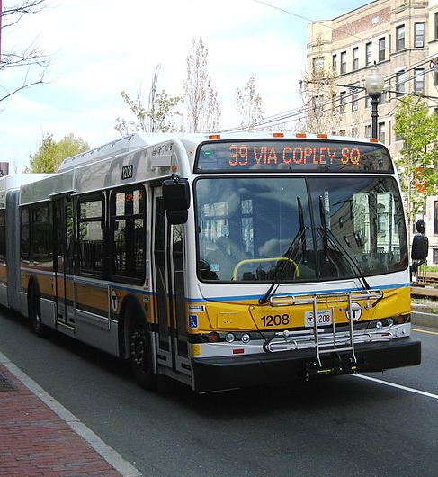
What is Transit Signal Prioritization
TSP uses technology to reduce dwell time for transit vehicles operating in mixed traffic by extending green-light-time, or shortening red-light-time.
TSP helps:
  Improve reliability
  Reduce travel time
  Increase network capacity
  Enhance OTP
Implementation Strategy:
  Pilot TSP at individual intersections in partnership with cities/towns.
  Pilot TSP on longer corridors.
  Roll-out to high-ridership corridors.

Slide 12
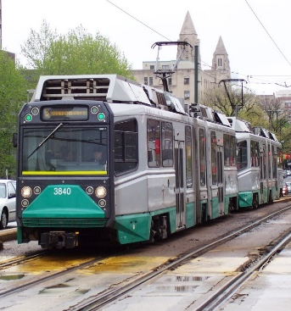
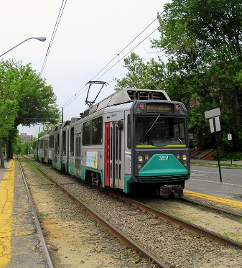
Transit Signal Prioritization – Completed Intersection Pilot
Green Line, B & E Branches
Over 9 days of observation:
Priority was granted 380 times.
Green-light-time extended by 14 seconds (average).
Red-light-time reduced by 8 seconds (average).
No demonstrable negative effect to general traffic.
TSP has been operational since May 2017.
Green Line C Branch
Over 5 days of observation:
Priority was granted 83 times.
Green-light-time extended by 10 seconds (average).
Red-light-time reduced by 6 seconds (average).
No demonstrable negative effect to general traffic.
TSP has been operational since June 2017.

Slide 13
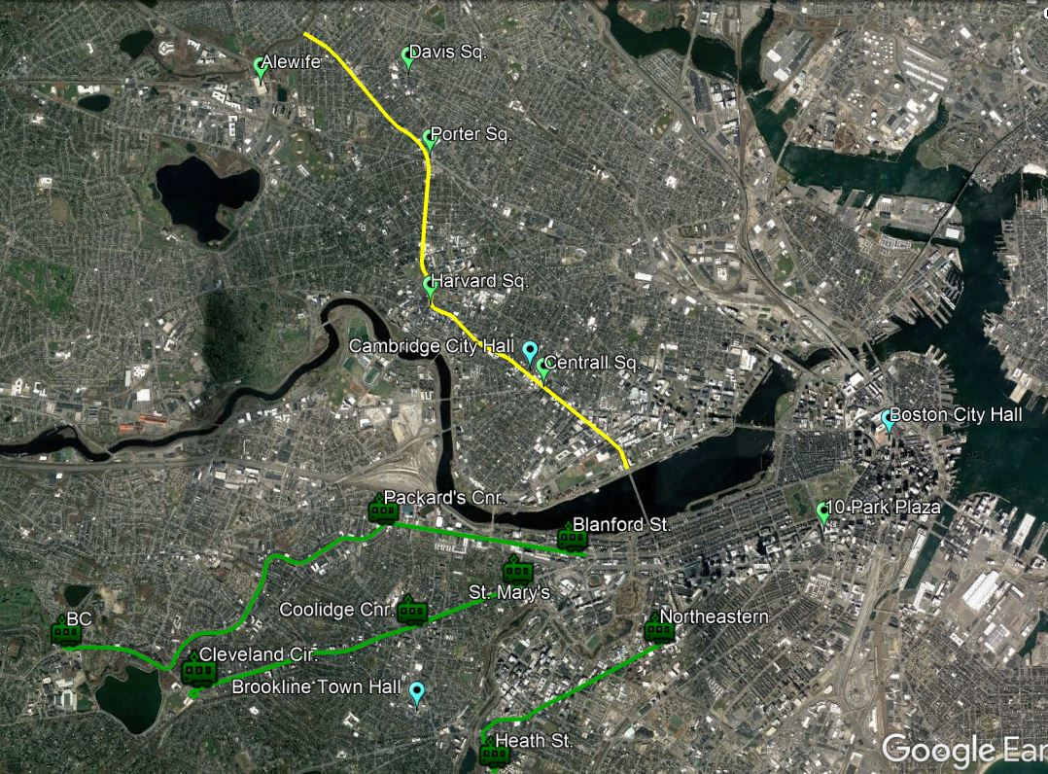
Transit Signal Prioritization – Underway Corridor Pilot
Green Line
2018 Completion
Green Line B Branch:
15 intersections on Commonwealth Avenue in Allston and Brighton. $340,000.
Green Line C Branch:
9 intersections on Beacon Street in Brookline. $185,000.
Green Line E Branch:
5 additional intersections on Huntington Ave. Boston –included in B Branch cost.
Bus, Massachusetts Avenue
2018 Completion
50 intersections (IB/OB) between the Charles River and Arlington border.
Touching upon Routes 1, CT1, 47, 64, 68, 69, 70, 70A, 71, 72, 73, 74, 75, 77, 77A, 78, 83, 86, 96,

Slide 14
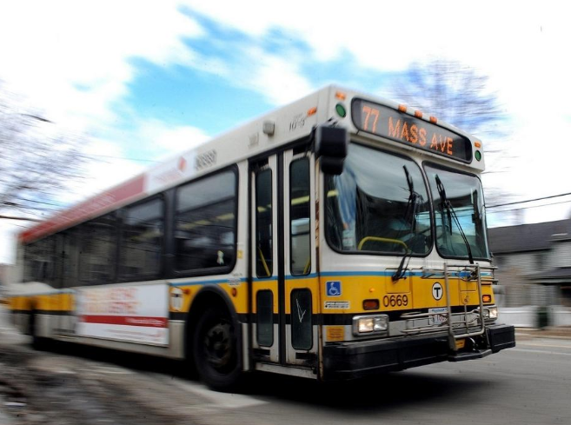
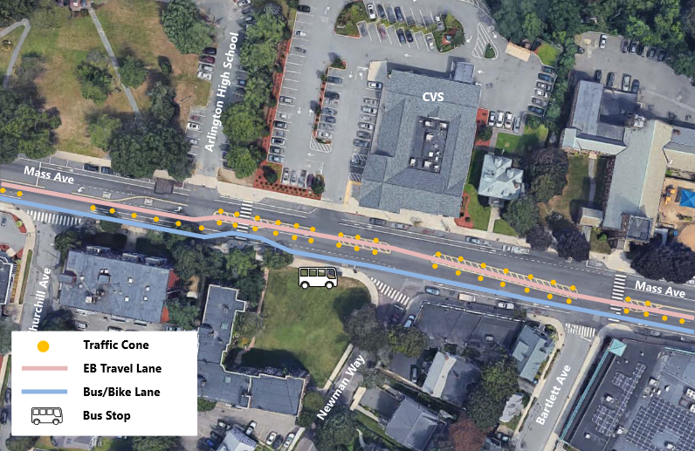
Partnership with Arlington and the Barr Foundation
In collaboration with the MBTA, Arlington will conduct a one-month pilot of several BRT elements on the three-mile #77 bus route along Massachusetts Avenue, the town’s main thoroughfare, which has the highest ridership in Arlington and one of the top 15 highest-ridership routes in the overall MBTA bus system.
The pilot, which will operate Monday through Friday, 6:00 a.m. to 9:00 a.m., includes transit signal prioritization, bus queue jumping at traffic signals, and a dedicated bus priority lane.

Slide 15
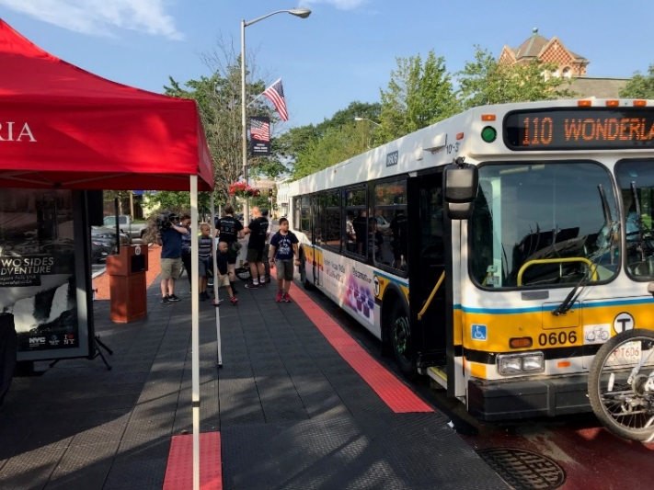
Partnership with Everett and the Barr Foundation
In September 2017, Everett established an inbound dedicated bus lane.
In July 2018, through a $100,000 grant from the Barr Foundation, the City has enhanced the dedicated bus lane by adding further upgrades and improvements to the bus network.
The pilot includes “platform level” boarding facilities (which allow of ease of boarding for riders in wheelchairs, strollers, or carts) at two bus stops in Everett Square, and Transit Signal Priority at three locations along Broadway that give southbound buses priority during peak-hours.
In addition, the City has introduced a dedicated bus lane outbound along Broadway.

Slide 16
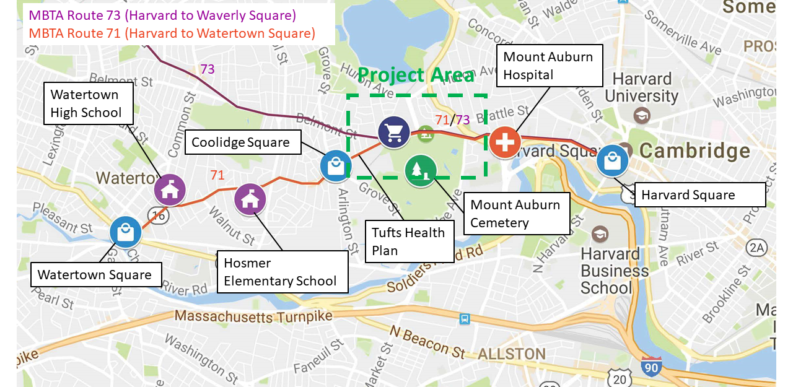
Partnership with Cambridge/Watertown and the Barr Foundation
Cambridge and Watertown have partnered with the MBTA to pilot numerous BRT elements for bus routes on Mount Auburn Street west of Fresh Pond Parkway.
Elements to be tested include all-day, dedicated bus lanes for significant segments of Mount Auburn Street between Belmont Street and Fresh Pond Parkway, inbound queue jump lanes on Mount Auburn Street and Belmont Street, and transit signal prioritization as feasible, which allow buses to travel without impediment from other vehicles.
This effort is supported through a $100,000 grant by the Barr Foundation.

Slide 17
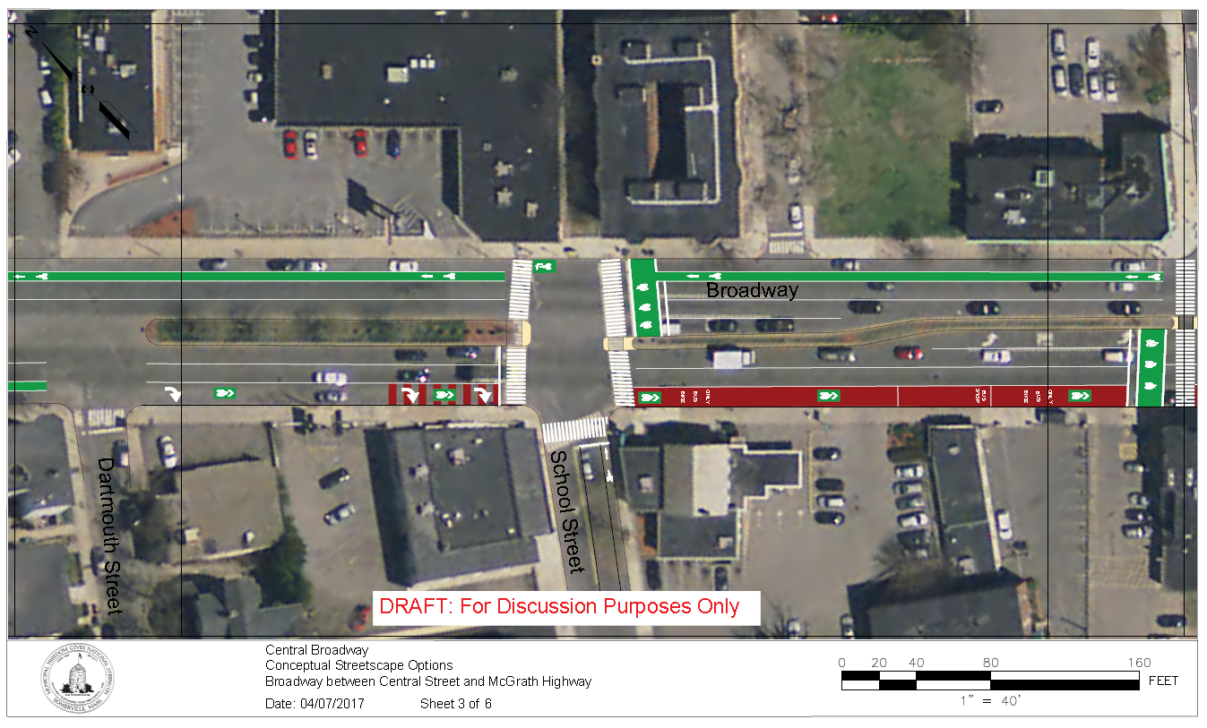
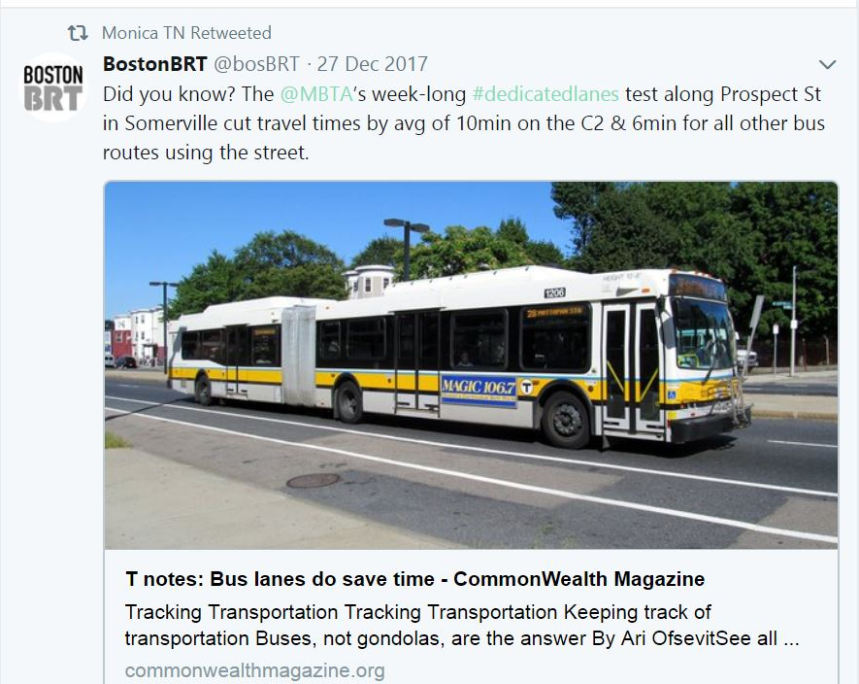
Partnership with Somerville – Dedicated Bus Lane

Slide 18
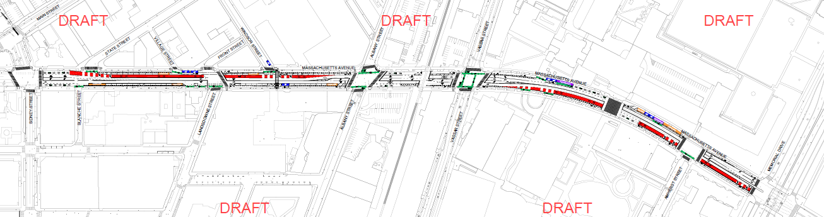
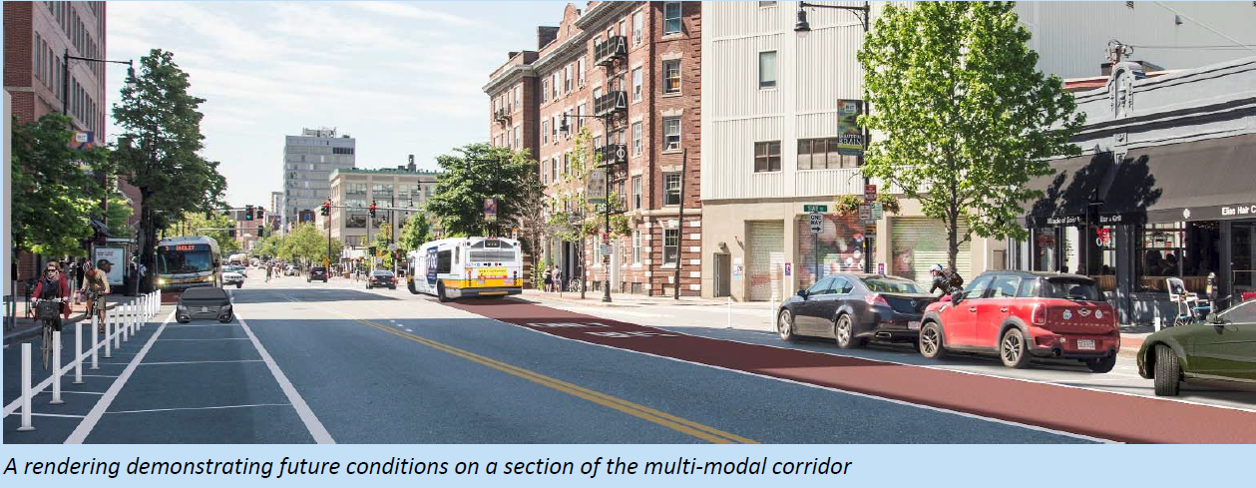
Partnership with Cambridge – Dedicated Bus Lane & TSP

Slide 19
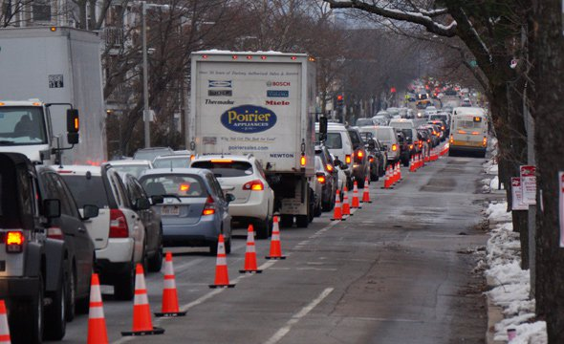
Partnership with Boston – Dedicated Bus Lane
In July 2018, The City of Boston announced a permanent one-mile dedicated bus lane along Washington Street, between Forest Hills and Roslindale Square.
An average of four minutes has been dropped off the trip between the two locations -- dropping from 13 minutes to nine.
The MBTA and City of Boston are working together on paving and painting the lane, which will be completed by Fall 2018.

Slide 20
Partnership with Boston – Dedicated Bus Lane
In July 2018, The City of Boston announced a permanent one-mile dedicated bus lane along Washington Street, between Forest Hills and Roslindale Square.
An average of four minutes has been dropped off the trip between the two locations -- dropping from 13 minutes to nine.
The MBTA and City of Boston are working together on paving and painting the lane, which will be completed by Fall 2018.

Slide 21
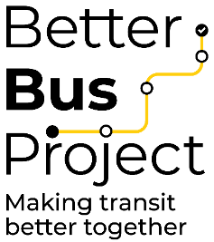
The Better Bus Project

Slide 22
Service Delivery Improvements
Goal:
Improve the bus network for our riders.
Identify the gap between today’s bus service and the standards set by the January 2017 Service Delivery Policy.
Identify and implement changes the MBTA can make to improve the bus network.
Partner with municipalities to identify and implement changes that can improve the bus network.
Evaluate the bus network against the January 2017 Service Delivery Policy.
EVALUATE
Identify changes to each route to better serve our bus customers.
IDENTIFY
Outreach to communities, riders, and municipalities to identify their needs and concerns.
OUTREACH
DEVELOP
Develop plans and recommendations.
Begin to implement capital improvements in 2018 and service recommendations in 2019
IMPLEMENT

Slide 23
Better Bus Project & Network Redesign
 |  | Changes | Focus Areas
Better Bus Project | Phase I | Quarterly Changes No budget impacts | Focused on routes with high passenger trips Focused on specific requests and considerations
 | Phase II | Continued Quarterly Changes Development of investment “tiers”, including proposals to realign routes, alter routes >1 mile, implement bus stop changes, etc. Budget impacts and considerations | Focused on routes with high and moderate passenger trips Focused on specific requests and considerations
Network Redesign |  | A new bus network, including routes, frequency, span of service, and coverage to better serve the region’s travel needs. | All routes, with a specific focus to rebuild moderate to low passenger trip routes and corridors, as higher passenger trip routes and corridors are addressed in Better Bus Project

Slide 24
Service Improvement: Timeline and Sequence
 | 2018 |  |  |  |  |  | 2019
 | July | August | September | October | November | December | January | February | March | April | May | June | July | August | September | October | November | December
Quarterly Service Changes
Infrastructure Improvements
Additional Investments for Service Improvement
Network Redesign
Lane Design
Implementation of Transit Signal Prioritization
Lane Build out
Draft
Vote
Implement
Analysis and Draft
Vote
NTP
* Bus procurement (April 2019)

Slide 25
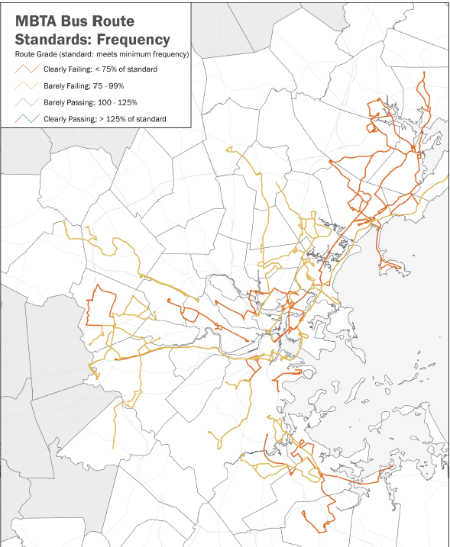

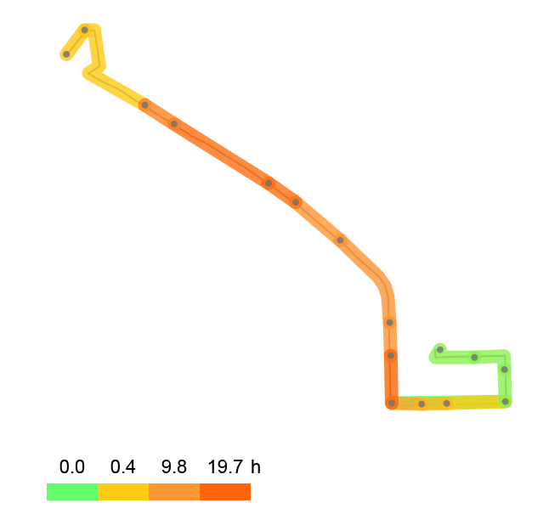

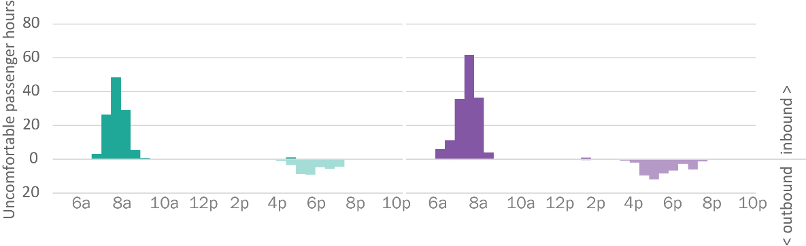
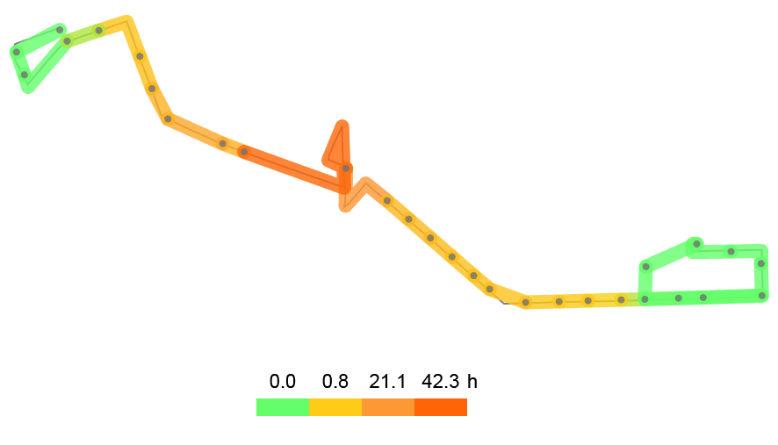
Data Inputs
Crowded Locations on
Routes 7 and 9
31
routes clearly failing
Inbound
7
South
Station
Summer St
City Point
14
routes barely failing
L St
Broadway
Copley
Station
Inbound
9
7
9
Broadway
Station
Berkeley
City Point
Broadway
Source: Average weekday across Fall 2015, based on Service Delivery Policy 2017 comfort thresholds.
Inbound crowding, average weekday across Fall 2015,
based on Service Delivery Policy 2017 comfort thresholds.

Slide 26
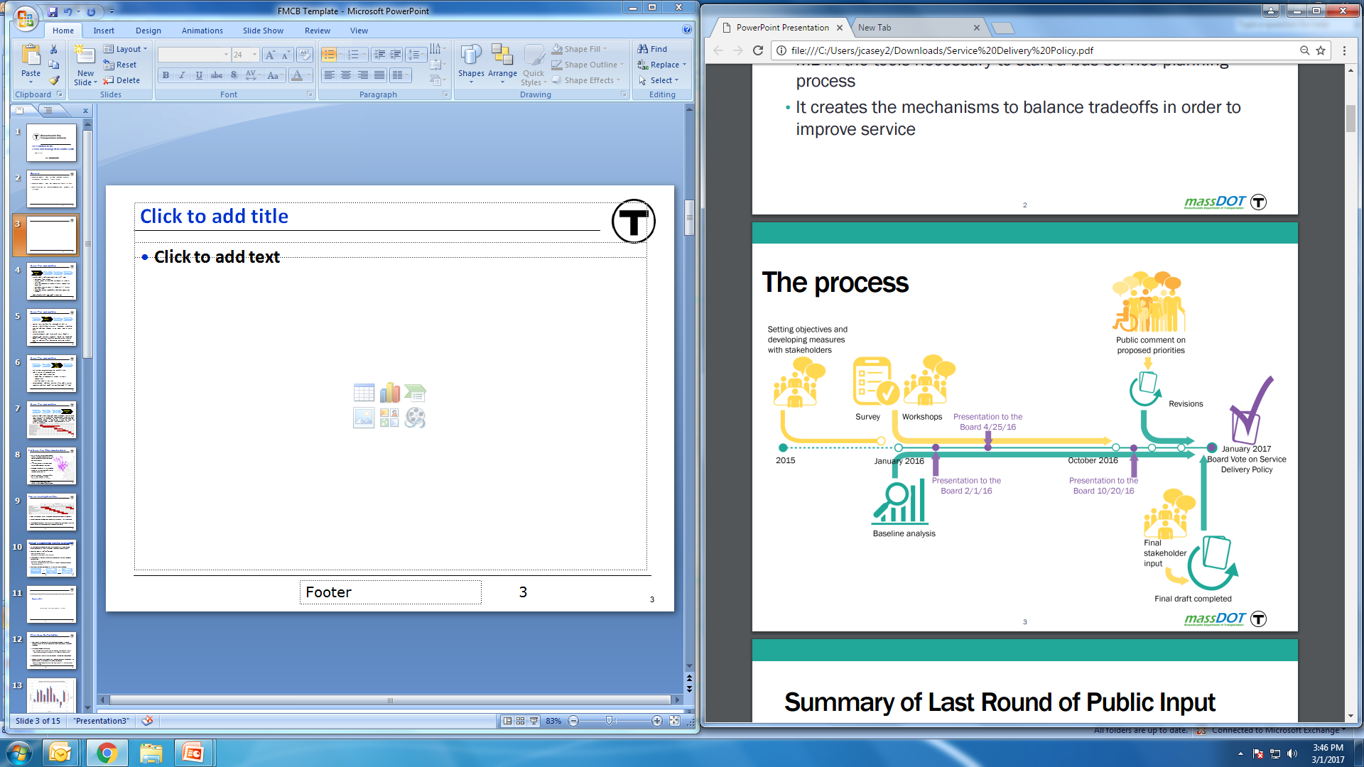
Customer and Staff Feedback
Street Teams to reach out to bus customers at stops and stations
Existing community groups and transit committees
Customer surveying
MBTA bus garage roundtables and other operation channels
Staff surveys, discussions and interviews

Slide 27
What have we learned about the MBTA Bus Network?
Service is too complex
There are too few frequent routes
Service is slow and getting slower
Service is unreliable
Schedules are irregular
Many buses are overcrowded
Many routes start too late
Many routes end service too early
Many routes operate too infrequently

Slide 28
Service Improvements

Slide 29
Service Change: April 2018
Run Time Adjustment
Shift Trips
Headway Adjustment
Resource Adjustment
Partnerships with Communities
114 changes; 53 routes
28,944 Passenger Trips
9.0% of Trips/Weekday
Corridor/Route | Service Type
Route 212 | Route 212 increased from 57% to 68% reliable on weekdays. Routes 210 and 211 saw similar improvements.
Route 7 and 9 | Route 7, weekdays: comfort improved from 79% to 82%; reliability from 74% to 83%. Route 9 improved similarly.
Route SL3 | New route established – 4,300 trips taken daily
Route SL1 | Light cycle adjusted to reduce wait times by 60 seconds
Early Morning Pilot | Additional trips added to ensure first train connect could be made
Route 15 | On-time departures for AM peak trips improved from 80% to 89%
Broadway Ave Corridor | Adjusted running time to allow for better coordination of bus routes along corridor

Slide 30
Service Change: September 2018
Combined Fixed Routes
Run Time Adjustment
Shift Trips
Headway Adjustment
De-interlining
Resource Adjustment
83 changes; 49 routes
158,571 Passenger Trips
38% of Trips/Weekday
Corridor/Route | Service Type
Route 111 | Additional operators New policy for dropped trips implemented De-interlined Updated run time
Route 92 | Additional operators Updated run time
Route 93 | Additional Operators Updated run time
Route 34, 35, 37, 40 and 50 | Dedicated bus lane implementation
Late Night Pilot | $1.1 M dollar investment in late night service 13 routes, 38 changes

Slide 31
Service Change: December 2018, Goal >25% Passenger Trips/Weekday
Running time adjustments
Departure time adjustments
Headway changes to match ridership and service levels (provided the frequency and comfort minimums are still met)
Route alignment changes
Span of service changes within 1 hour or less
Route extensions of 1 mile or less
Route variation modifications
Optimization (Dedicated Bus Lanes, Transit Signal Prioritization and Signal Optimization)
Key Routes & Corridors
35 Routes
Passenger Trips
239,451 wkdy
Average Passenger Trips 6,841/wkdy
58%

Slide 32
Next Steps

Slide 33
Next Steps
      Fleet Modernization and Expansion
      Initiate Future Bus Procurement of 250 buses (50 of 250 will increase fleet size)
      Infrastructure
      Dedicated Bus Lanes
  Broadway Northbound (July 2018),
  Everett (July 2018); Washington St. (Roslindale),
  Boston (Aug 2018); South Mass Ave,
  Cambridge (Late 2018); Mt. Auburn St.,
  Cambridge/Watertown (Oct 2018); North Mass Ave,
  Arlington (Late 2018); Broadway,
  Somerville (Late 2018)
Additional Investment for Service Improvements
October to November 2018 – Finalize Development of Investment “Tiers”
  November 2018 – Board Presentation and Vote for FY20 Operating and Capital Budget Planning
      Network Redesign
      August 2018 – Release of RFP
      October 2018 – Notice to Proceed
      Transit Signal Priority
  Beacon Street, Brookline;
  Commonwealth Avenue, Boston;
  Huntington Avenue, Boston; Massachusetts Avenue, Cambridge;
  Mt. Auburn St., Cambridge/Watertown;
  Massachusetts Avenue, Arlington

