Slide 1
AFC 2.0
Quarterly update to the
Fiscal & Management Control Board
David Sikorski, AFC 2.0 Program Manager
13 Aug 2018

Slide 2
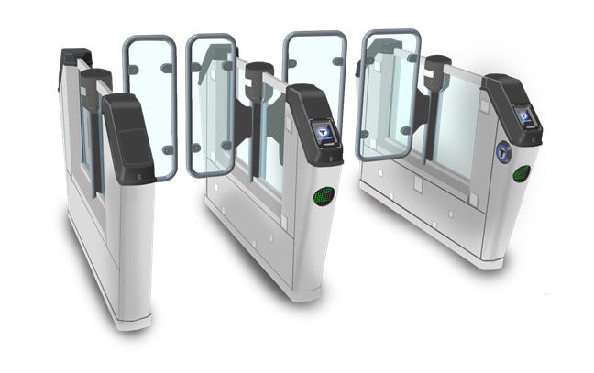
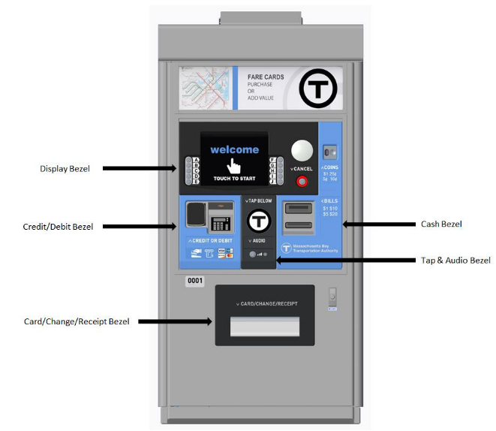
Overview
AFC 2.0 Project update
  Design Review Update
  90-Day Outlook
  Peer learnings - Vancouver
  Pilot Update
  Design-Build Update
  Policy Update
    Laurel Paget-Seekins

Slide 3
Design Review Update
= Complete
= In progress
= Status as of last board update (May 2018)

Slide 4
90 Day Outlook
Project Development
  Progress system design reviews
  Operations and Keolis coordination
  Pilot program development
  User testing with prototype devices and software
  First prototype installations on vehicles
  Policy and configuration development
  Continue peer reviews & coordination
  Test lab (model office) buildout
Design-Build Contract
  Finalize base technical concept
  Issue draft RFP
  Begin commercial negotiations
  Finalize DB RFP
Staff Augmentation
  Continue to build internal team
      Customer and employee transition team lead
      PM for DB and Installation
      Technical PMs for Policy Implementation and System Implementation
      Risk and Mediation Director
      Contracts Manager
      Project and document controls
      Finance lead
  Consultant procurement
      Payment technology, privacy, and fare reconciliation assurance
      Installation PM/CM
      Rollout branding, marketing, communications

Slide 5
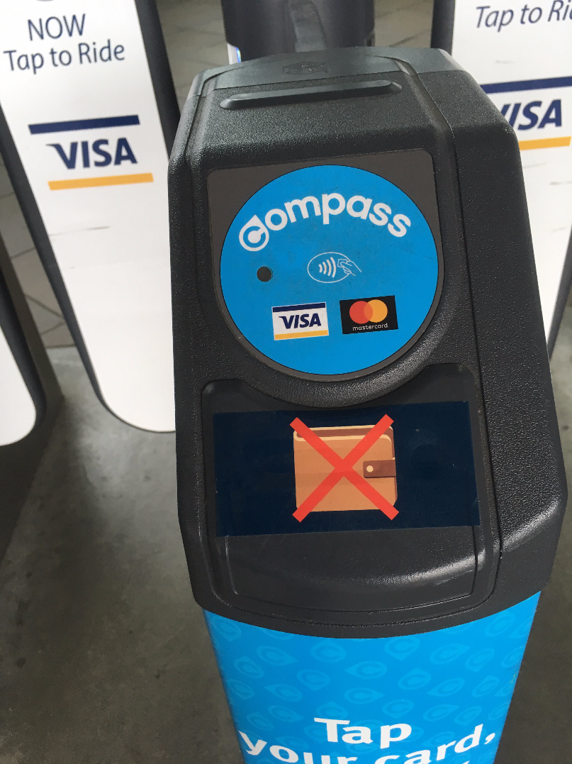
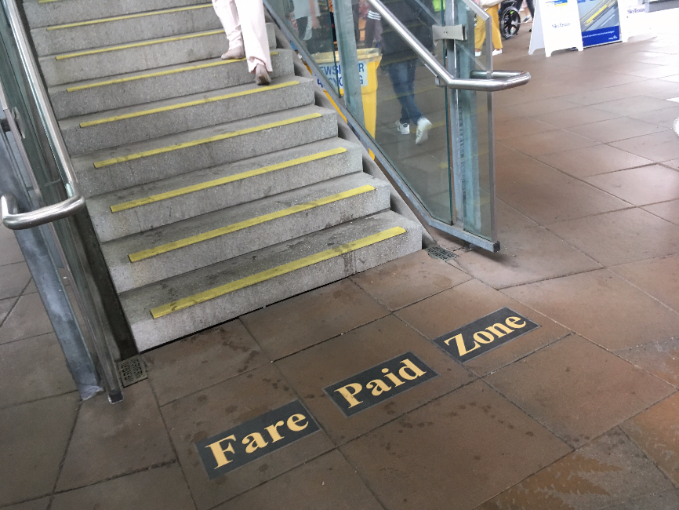
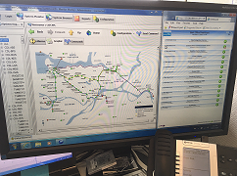
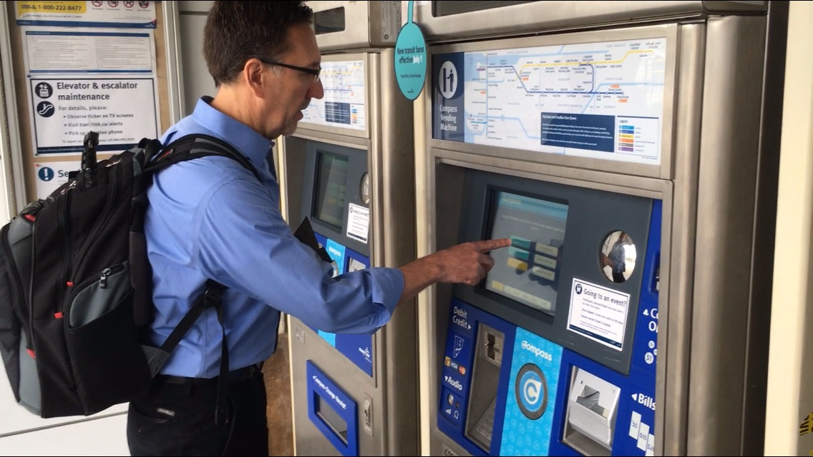
Peer learnings - Vancouver
Translink (Vancouver-area peer agency) and Cubic (system integrator there) hosted MBTA in July 2018
Some similar equipment deployed to what is planned as part of AFC 2.0, and some contract similarities
Focuses were:
  Vendor relationship
  management successes
  and challenges
  Equipment usability and
  reliability
  Card and phone clash –
  communicating with customers
  AFC call center and order
  fulfillment operation
  System and KPI monitoring
  Sponsorships

Slide 6
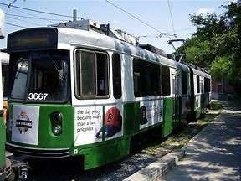
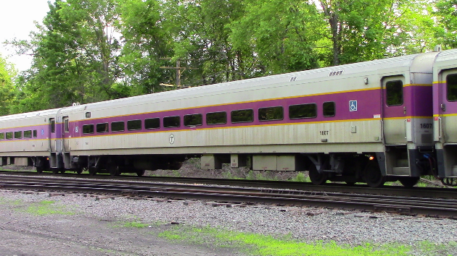
Pilot Update
Pilot participants representative of the larger population of MBTA customers
Locations coordinated to ensure the system can be used as comprehensively as possible
Covering real world use cases
 | Pilot Phase 1 | Pilot Phase 2
When | Late 2019-early 2020 | Early 2020
Who | Small-scale rollout of a small portion of System elements to a group of friendly users (people known to the MBTA) designed to demonstrate System compliance in actual use conditions. | Rollout of a larger portion of System elements to a limited number of users from the general public designed to demonstrate the SI’s operating and maintenance capabilities and confirm the transition approach.
Where | Green Line Haverhill Line | Green Line Haverhill Line Silver Line SL4 and SL5 Bus routes 28 and 39 Orange Line Lowell Line

Slide 7
Design-Build Update
DB Procurement is ongoing, ALONGSIDE Design development with the SI
 | 2016 | 2017 |  |  |  | 2018 |  |  |  |  | 2019
 | Q4 | q1 | q2 | q3 | q4 | q1 | q2 | q3 | q4 | Q1 | Q2 | Q3 | Q4
Issue request for qualifications 22 Dec 2016
Complete shortlisting 20 May 2017
Design development with SI 21 Nov 2017 – Late 2018
Introduce RFP scope to DB shortlist 30 May 2018
Issue draft DB RFP for comment Sep 2018
Issue final DB RFP Q4 2018
Award DB Contract Early 2019
Anticipated DB NTP Mid 2019
Early site preparation design & delivery Starting mid 2019
Pilot installation design & delivery Starting late 2019 |  |  |  |  |  |  |  |  |  |  |  |  | >>>

Slide 8
AFC 2.0 Policy and Outreach Update
Laurel Paget-Seekins, Director of Fare Policy and Analytics

Slide 9
AFC 2.0 Policy Updates
PUBLIC OUTREACH FOR AFC2.0 WILL PRIMARILY FOCUS ON THESE FOUR POLICY AREAS.
Data Privacy
  Policy team working to catalog how the MBTA currently collects and stores customer data, internal data users discussing data needs and sharing requirements, outside counsel reviewing practices and policy areas
  Next Steps: external stakeholder conversations, draft policy for review
Access to Fare Cards and Sales Locations
  Policy team working with AFC 2.0 team and SI to evaluate potential point of sale locations, developing technology requirements for cards distributed for free, identifying policy decisions
  Next Steps: public outreach on point of sale locations, discussions with social service and community organizations on programs for distributing cards for free
Fare Inspections/Proof of Payment
  Policy team working with AFC 2.0 team and SI on requirements for inspection devices and business requirements for citation management software, identifying policy decisions
  Next Steps: outreach on inspection principles
Fare Structure and Products
  Policy team working with AFC 2.0 team and SI on translating existing fare policy into business requirements for initial AFC 2.0 tariff, RFR for revenue and ridership model released
  Next Steps: Award revenue and ridership model contract, draft initial tariff for review

Slide 10
AFC2.0 Outreach Updates
outreach will be: 1) accountable, 2) accessible & proactive, 3) transparent,
and 4) iterative
Outreach in the last Quarter: Make sure we get outreach right
  Kickoff with City Council Forum on June 22
  Meetings to introduce topics and get input on best methods to reach specific communities
Plan for Next Quarter (August-October): Focus on Fare Media Access and Inspections
  Community conversations about AFC2.0, Access to Fare Media, and Fare Inspections
  Broader community input on point of sale locations in coordination with other T efforts (e.g., Better Bus)
Ongoing outreach meetings: Regular updates and input sessions
Policy Development Working Group (quarterly, beginning in August 2018, at 10 Park Plaza during the business day)
Open to all stakeholders, focus will be on
    Identify specific user communities or organizations for future engagement
    Brainstorm solutions to identified policy issues
    Feedback on MBTA proposed policies
Public Advisory Meetings (quarterly, beginning September 2018, rotating locations, evenings)
Will be an opportunity to share and discuss policy and technology updates regarding AFC 2.0

