Slide 1
Quarterly Ridership Update
Fourth Quarter FY18
August 13, 2018

Slide 2
Overview: Ridership in 2017 continued to decline but rate of decline has slowed
Quarterly Ridership Update
MBTA ridership changes are in line with national trends
MBTA bus service is still relatively productive compared to peers
MBTA rate of ridership decline has slowed over the past year
MBTA is undertaking a series of efforts to improve ridership data and release additional data to the public
MBTA continues to analyze ridership trends to understand causes and identify best methods to address declines

Slide 3
Overview: National Transit Ridership
Quarterly Ridership Update
Unlinked Passenger Trips per year
Source: APTA and the NTD

Slide 4
National Trends for Unlinked Passenger Trips- Peer Agencies
Quarterly Ridership Update
Chicago
Los Angeles
SF
DC
Boston
Philly
Seattle
Portland
Source: NTD monthly data

Slide 5
National Trends: Short and Long Term
Quarterly Ridership Update
MBTA ridership is still above 2007 levels
MBTA in the middle of peer agencies in terms of short-term changes
Agency rates of change depend on when ridership peaked and service levels changes
 | Change from CY2007-17 | Change from CY15-17 | Change from CY16-17
Boston | 1.1% | -6.8% | -5.5%
Boston - Bus only | 9.2% | -9.0% | -3.4%
Chicago | -5.0% | -6.4% | -3.2%
Chicago - Bus | -19.2% | -8.6% | -3.0%
Los Angeles | -19.6% | -10.9% | -4.7%
Los Angeles - Bus | -28.4% | -14.3% | -5.8%
Philadelphia | -3.3% | -11.4% | -7.7%
Philadelphia - Bus | -5.2% | -14.6% | -10.5%
Portland, OR | 6.6% | -2.1% | -1.7%
Portland, OR - Bus | -8.5% | -5.9% | -0.9%
San Francisco | 5.5% | -1.9% | -2.1%
San Francisco - Bus | -7.1% | -1.7% | -1.9%
Seattle | 24.0% | 6.8% | 2.0%
Seattle - Bus | 9.7% | 0.5% | 0.5%
Washington, DC | -14.5% | -10.3% | -4.6%
Washington - Bus | -10.1% | -9.9% | -7.2%
Source: NTD monthly data, for comparison Boston Urbanized Area includes 5 RTAs and the MBTA

Slide 6
National Trends per Service Operated – Bus only
Quarterly Ridership Update
MBTA
Source: NTD monthly data

Slide 7
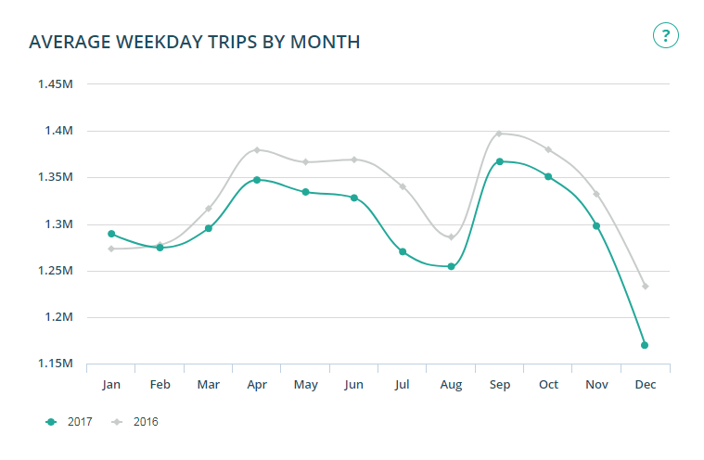
MBTA Back on Track Dashboard – All modes
Quarterly Ridership Update

Slide 8
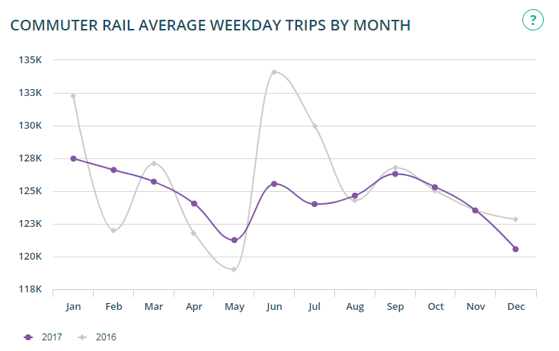
MBTA Back on Track Dashboard – Commuter Rail
Quarterly Ridership Update

Slide 9
Commuter Rail Trend (Zoomed to Show Detail)
Quarterly Ridership Update
Note: Commuter rail data based on manual counts,
multiple efforts underway to improve data collection
Source: NTD for FY12-14, conductor counts after July 2014

Slide 10
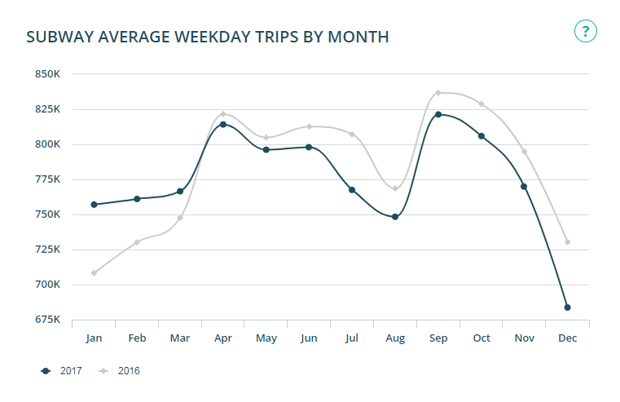
MBTA Back on Track Dashboard – Subway and Light Rail
Quarterly Ridership Update

Slide 11
Heavy Rail Trend (Blue, Orange, and Red Lines)
Quarterly Ridership Update
June 18 vs. June 17
12-month weekday avg.: -0.5%
Comparable AFC taps, not total ridership
Saturday: -2.0%
Sunday +0.2%
Source: AFC data

Slide 12
Heavy Rail Trend Detail FY17-FY18
Quarterly Ridership Update
June 18 vs. June 16
12-month weekday avg.: -2.9%
Comparable AFC taps, not total ridership
Saturday: -8.0%
Sunday: -5.1%
Note: Weekend ridership impacted by bus diversions
for State of Good Repair projects
Source: AFC data

Slide 13
Green Line Only Gated Stations (eliminates other variables)
Quarterly Ridership Update
Comparable AFC taps, not total ridership
Stations Included:
Arlington
Boylston
Copley
Hynes
Kenmore
Lechmere
Prudential
Riverside
Science Park
Symphony
Change from January 2014: -13.3%
Source: AFC data

Slide 14
Green Line Only Gated Stations FY17-18
Quarterly Ridership Update
Comparable AFC taps, not total ridership
June 18 vs. June 16
12-month weekday avg.: -2.2%
Source: AFC data

Slide 15
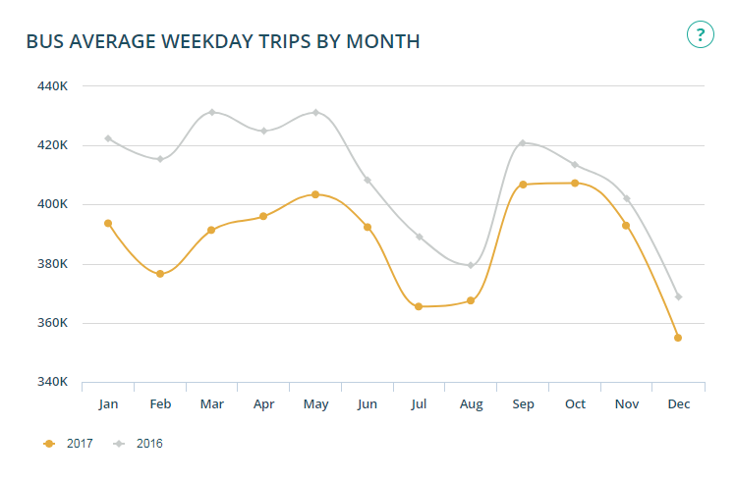
MBTA Back on Track Dashboard – Bus
Quarterly Ridership Update

Slide 16
Bus Trend
Quarterly Ridership Update
June 18 vs. June 17
12-month weekday avg: -2.0%
Comparable AFC taps, not total ridership
Saturday: -1.1%
Sunday -2.3%
Source: AFC data

Slide 17
Bus Trend Detail FY17-FY18
Quarterly Ridership Update
June 18 vs. June 16
12-month weekday avg.: -5.3%
Comparable AFC taps, not total ridership
Saturday: -9.8%
Sunday: -7.6%
Source: AFC data

Slide 18
Data Improvement Projects
Quarterly Ridership
  Green Line
New Type 9 Green Line cars will have Automatic People Counters (APCs) enabling better data collection for surface stations
Commuter Rail
CTPS station count to be completed by end of 2018
APCs being installed on all coaches
More Data on the Dashboard
This Fall we will be updating mbtabackontrack to including data downloads for:
  Station entries at gated stations, updated monthly
  Bus boardings, alightings and load from the most recent APC composite day, updated annually

Slide 19
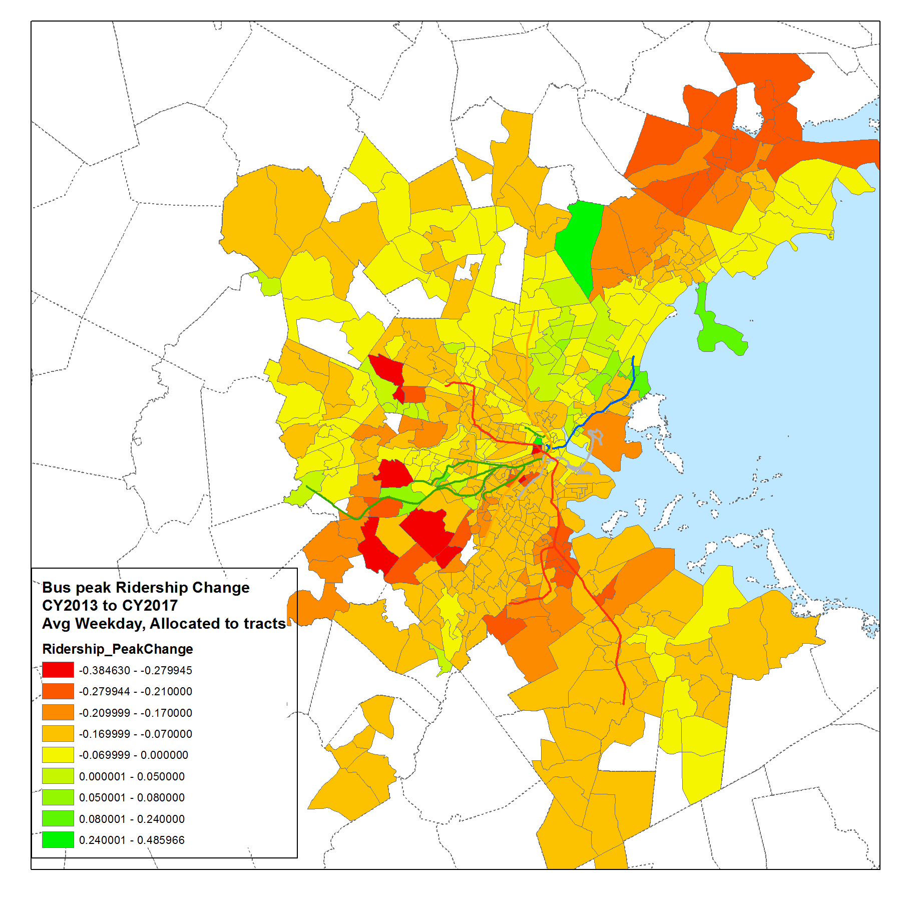
Investigating Ridership
Quarterly Ridership Update
Focus on bus ridership changes from 2013 to 2017
Regression models at the route level and census tract level
Examining impact on peak and off-peak average weekday ridership
Using service and passenger characteristics variables

