Slide 1
Red and Orange Future Reliability
2019 - 2029
August 13, 2018

Slide 2
Agenda
Review Future Capacity
Define the Magnitude of Orange and Red Line Changes
Review the controllable and noncontrollable factors that impact current reliability
Present Prediction for Future Orange and Red Line Reliability

Slide 3
Preface
The Red and Orange Line are complicated networks that operate as a “system of systems” consisting of: Traction Power, Signals, Communications, Vehicles, Operating Rules, Environment, Crew and Customers
Predicting interactions between such complex “system of systems” is challenging given the nearly infinite combination of scenarios and starting conditions.
Reliability predictions utilize system models and expected performance of system components to predict future performance in a defined starting condition.
We have developed a forward looking qualitative reliability prediction utilizing the same tools used for measuring and reporting our performance reliability today.

Slide 4
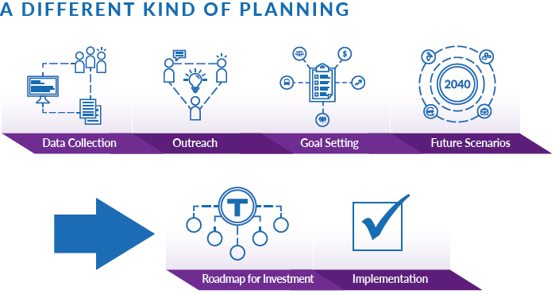
Future Capacity
The MBTA is investing in programs to increase the system capacity on the Red and Orange Lines.
A larger and new fleet of vehicles
Upgrades to the Signal and Train Control System
Dwell Time Improvement Initiative
Future Service
Red Line going to 3 minute peak headways
Orange Line going to 4.5 minute peak headways

Slide 5
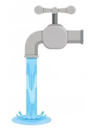
Capacity vs Reliability
Future Capacity
Current Capacity

Slide 6
Capacity vs Reliability
The lines are running faster and doing more in the same time period increasing the wear on our system.
The charts below show the weekly wear before and after of both lines.
Increasing a systems wear increases that systems probability of failure.

Slide 7
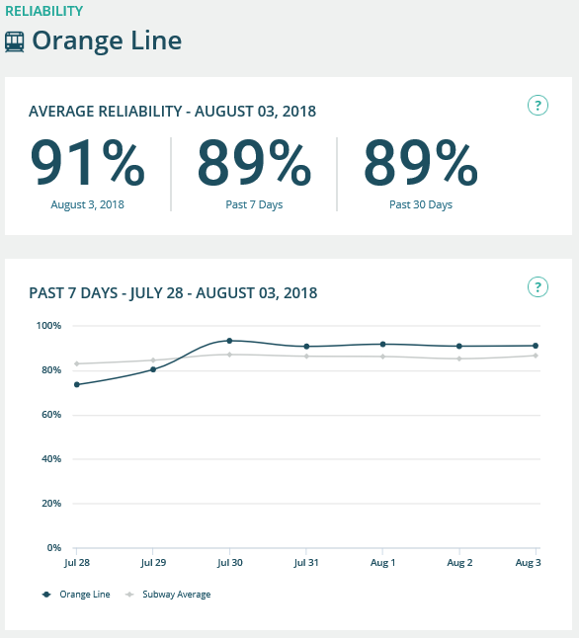
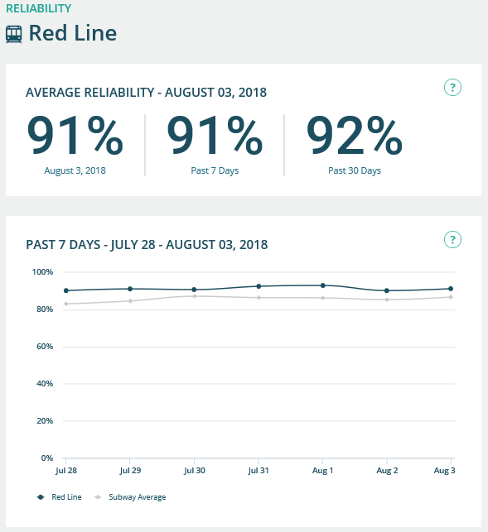
Orange Line and Red Line Reliability Today
Orange Line
Red Line

Slide 8
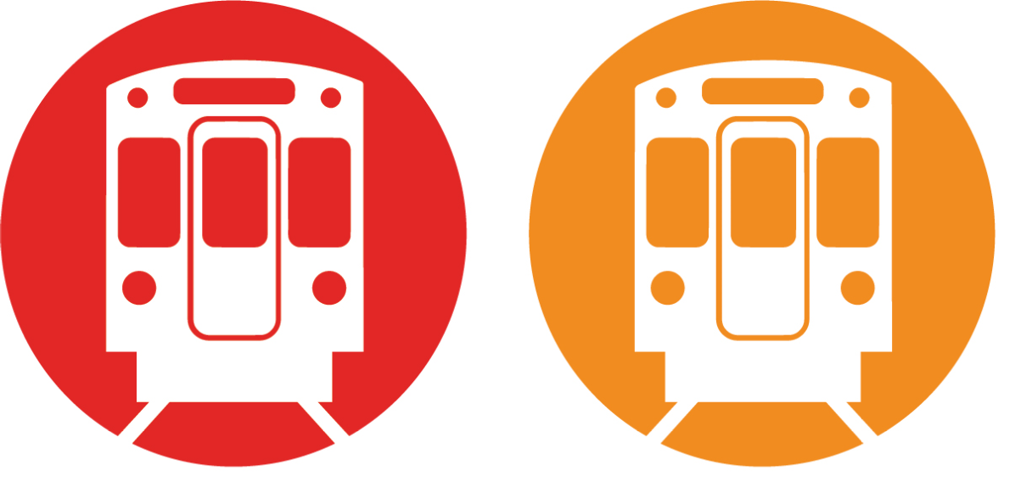
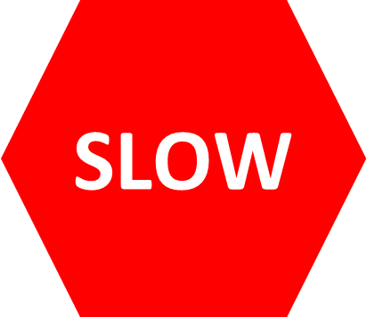
Delay Impact
Any incident has cascading impacts on each line.
Cascading Delays can be worse than the initial delay.
Problem Arises
Detection Time
Trouble Shooting
Recovery
Back In Service
Taken Out
of Service
Dwell Time Impacts
Capacity Impacts
Longer time a passenger takes to board a train due to crowded platforms or trains. This results in train spending more time at a station

Slide 9
Causes of Delay
Delay
30% Uncontrollable Delays
70% Controllable Delays
Police Action
Dwell Time
Special Events
Other Factors
Disabled Train
Signal Problem
Dwell Time
Other Factors
Uncontrollable Delays will always limit our real service reliability.
Using today’s reporting methods our maximum achievable reliability is 97% & 98% for the Red & Orange lines respectively.

Slide 10
Controllable Delays
Delay
70% Controllable Delays
Disabled Train
Signals Problem
Dwell Time
Other Factors
Completely New Fleets
Larger Fleet
Better Maintenance Tech
Automatic Train Control Automatic Station Stopping Wider Doors
Improved Procedures
Modern Signal Controls
Upgraded Sections
Better Maintenance Tech

Slide 11
We expect
A reliability prediction was conducted considering:
Improvements to vehicles and infrastructure
Increased wear on the system due to increased capacity
Shorter recovery time due to faster headways.
Disabled Train
Train Related Delays to drop 50-60%
Signals Problem
Signals related delays drop by 50-70%
Dwell Time
Dwell time related delays will drop by 30-40%

Slide 12
Reliability Goal
We expect to be able to achieve the following Average Performance Reliability when all vehicles, infrastructure and operational programs are implemented:
Orange Line
Red Line
Average Reliability 2025
96%
Average Reliability 2025
95%
maximum achievable 97%
maximum achievable 98%
We expect hourly, daily weekly and yearly variations based on both controllable and uncontrollable variables

Slide 13
Next Steps
Development of a 25 year Long Term Asset Management Plan commencing in 2025 to ensure we sustain asset performance
Develop reliability improvement predictions for the line as projects are being completed by 2025
Refine performance calculation beyond current Reliability Metric
Update to Board in January 2019

Slide 14
Appendix
Additional Information

Slide 15
Red Line Vehicle and Infrastructure Programs
2018
Signal Design/Build NTP
RL Signals Program
Provides early warning diagnostic and maintenance alerts to MBTA Maintenance, reducing failure response time.
RL Infrastructure Program
RL Vehicles Program
Increases fleet size by 16%
All track circuits and 90% of relays will be replaced with electronic microprocessor system, providing redundancy and improved life cycle.
The design considers both reliability and availability.
Improving the Alewife crossover allowing operating speeds through the crossover to increase from 10 mph to 15 mph.
Modern components and systems, which increases reliability.
Decreases the need to immediately remove a car from service and impact to service.
New Test Track
New Testing Shed (allows for static testing/commissioning of the new vehicles without impacting existing maintenance facilities and operations)
Updated Maintenance Facility and Equipment and new Electronics Room (to service the new vehicles and accommodate storage needs)
Upgraded Yard Infrastructure
14 New Cars
Signal Design Underway
Expanded Wellington Yard
2019
2020
62 New Cars
8 Signal Sections Complete
2021
110 New Cars
13 Signal Sections and ATO Complete
186 New Cars
Expanded Codman Yard
Rebuilt Cabot Facility & Yard
2022
2023
252 New Cars
Automatic Train Operation (ATO)
2024
System Tuning
2025
New Headway Operations

Slide 16
Improved Orange Line Reliability Due to Vehicle and Signal Programs
2018
6 New Cars
Signal Design/Build NTP
OL Signals Program
Provides early warning diagnostic and maintenance alerts to MBTA Maintenance, reducing failure response time.
OL Infrastructure Program
OL Vehicles Program
Increases fleet size by 27%
All track circuits and 90% of relays will be replaced with electronic microprocessor system, providing redundancy and improved life cycle.
The design considers both reliability and availability.
Updated Maintenance Facility, Facility Equipment and new Electronics Room (to service the new vehicles and accommodate storage needs)
Modern components and systems, which increases reliability.
Decreases the need to immediately remove a car from service and impact to service.
Upgraded Yard Infrastructure
58 New Cars
Signal Design Underway
Expanded Wellington Yard
2019
106 New Cars
Signal Design Underway
Expanded Wellington Facility
2020
152 New Cars
8 Signal Sections & ATO Complete
Rebuilt Wellington Yard
2021
2022
152 New Cars
11 Signal Sections Complete
2023
Automatic Train Operations (ATO)
2024
System Tuning
2025
New Headway Operations

