Slide 1
Boston Way, Newburyport Transit-Oriented Development
FMCB Meeting
August 13, 2018
Massachusetts Bay Transportation Authority | mbta.com

Slide 2
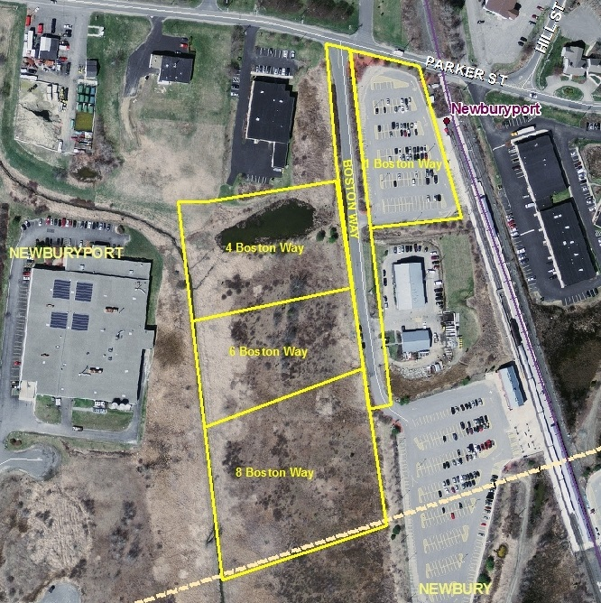
Request: FMCB approval to sell 11.11 acres of land to Minco Corporation
Project Overview
Address: 1,4,6,8 Boston Way, Newburyport, MA
Sale Parcel Size: 11.11 acres (483,951 SF)
ITB Release: 4/23/13
Bid Due Date: 6/27/13
P&S Execution: 10/25/13
Disposition Type: Sale
Minimum Bid: $1,380,000
Purchase Price: $1,799,00

Slide 3
Development Summary
Designated Developer | Minco Corporation
Fee-Simple Sale Price | $1,799,000*
Gross Square Footage | 110,000
Residential Units | 76
Affordable Residential Units | 19 (25%)
Total Parking Spaces | 123
MBTA Parking Requirement Met | N/A (Parking lot is utilized at a low rate; additional parking on-site is sufficient for existing and future parking demand)
Construction Phases | One
Construction Timeline | 18 months
Jobs – full/part time | Construction Period – 108 Permanent -- 25
Zoning Relief Required? | No**
Annual Tax Payment to Town | $280,000
*Minco is required to pay the MBTA an additional $23,000 for every unit over 60 total units that was built. As a result, the MBTA will receive a payment of $368,000 for the 16 additional units that will be built.
**Minco worked with the Town of Newburyport to establish a 40R Smart Growth Overlay District on the site so that zoning variances would not be necessary.

Slide 4
Deal Timeline
Minco Designated as Successful Bidder
Appeal of Planning Board approval filed by abutter
Final MBTA approval on modified design plan received.
Smart Growth Overlay District approval
FMCB Vote
ITB Released
June 2013
October 2013
May 2016
June 2017
March 2018
April 2013
July 2013
October 2015
June 2016
December 2017
August 2018
Bids Received
Purchase & Sale Agreement Executed
Newburyport Planning Board approval received
Settlement Agreement reached between Minco and the abutter. Planning Board approval of modified design plan also received on 6/21/17
Ch. 40 Sec. 54A approval received from MassDOT
Note: During the Due Diligence Period for this deal, it was discovered that a Restrictive Covenant had been placed on the property which prohibited development of the parcel without approval from the abutters. The MBTA and Minco Corporation worked with the abutters to terminate this covenant before it expired on January 1, 2019.

Slide 5
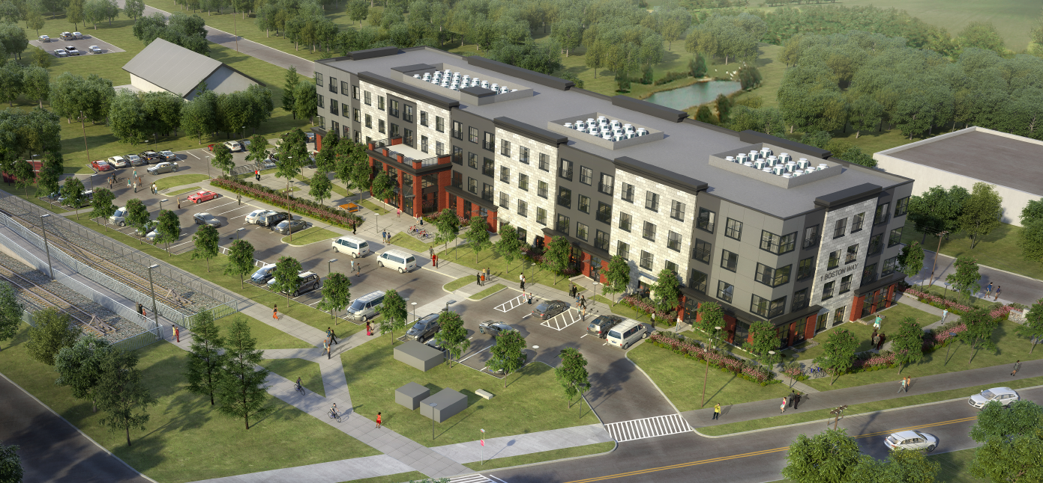
Minco Corporation Project Rendering

Slide 6
Thank You

