Slide 1
General Manager’s Remarks
Fiscal and Management Control Board
August 13, 2018

Slide 2
Agenda
Alewife garage update
Pay Go capital update

Slide 3
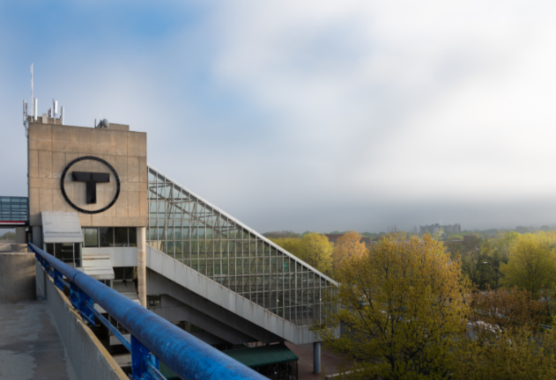
Alewife garage update
Garage reopened to full capacity this morning
Enhanced monitoring includes nightly inspections to ensure safety
Planned closure for weekend of 8/18-8/19 for follow-up assessment
Project advertised in July, awarded last week to invest $5.7 million in garage repairs in Sept.
Next step: advance development of long-term plan for facility

Slide 4
Pay Go capital update
Up to $500 million from Additional State Assistance for Pay Go
Savings in operating budget translates into expanded capacity for capital investments:
Specifically, customer-facing or unplanned needs, without harming established CIP priorities
Direct result of the commitment from FMCB, Secretary, and Chief Administrator Abramo

