Slide 1
MBTA Quarterly Safety Report
Ronald Nickle, Chief Safety Officer
Holly Durso, Director of Transportation Safety
April 30, 2018
Draft for Discussion & Policy Purposes Only

Slide 2
Overview
MBTA Quarterly Safety Report
Regulatory Updates
Workplace Safety Improvement Initiative
Facility Inspections
Safety Data Review
Employee Injuries & Assaults
Derailments
Bus Collisions
Subway & Bus Fatalities
Commuter Rail Trespasser Strikes
Draft for Discussion & Policy Purposes Only

Slide 3
Regulatory Updates – FTA & DPU Regulatory Changes
MBTA Quarterly Safety Report
FTA Final Rule – State Safety Oversight (49 CFR 674)
DPU Revised State Safety Program Standard (220 CMR 151)
Increased DPU authority; changed incident reporting thresholds
New regulation became effective November 28, 2017
MBTA-DPU Transition Team formed January 2018
DPU received FTA Certification in March 2018
Department of Labor Standards (DLS) Oversight – February 2019
Draft for Discussion & Policy Purposes Only

Slide 4
Workplace Safety Improvement Initiative
MBTA Quarterly Safety Report
Accomplished:
Occupational Health & Safety (OHS) Plan
Signed by GM in January 2018
Personal Protective Equipment (PPE) Safety Bulletin issued
Supervisor Injury Investigation Reporting
Facility Inspections: 18/23 baseline inspections completed
Facility scorecard system
OHS Steering Committee & Working Group
Facility OSHA gap analysis checklists completed
Safety Hotline Campaign
PPE poster designed & approved
Draft for Discussion & Policy Purposes Only

Slide 5
Workplace Safety Improvement Initiative
MBTA Quarterly Safety Report
In process:
Urgent Safety Advisory for construction site work plans
Facility & construction OSHA gap analyses
Electrical Safety Bulletin
Fire Life Safety Bulletin
Fall Protection Bulletin
Confined Space Bulletin
Consultant program development blitz
SafeT campaign
Safety culture survey
Draft for Discussion & Policy Purposes Only

Slide 6
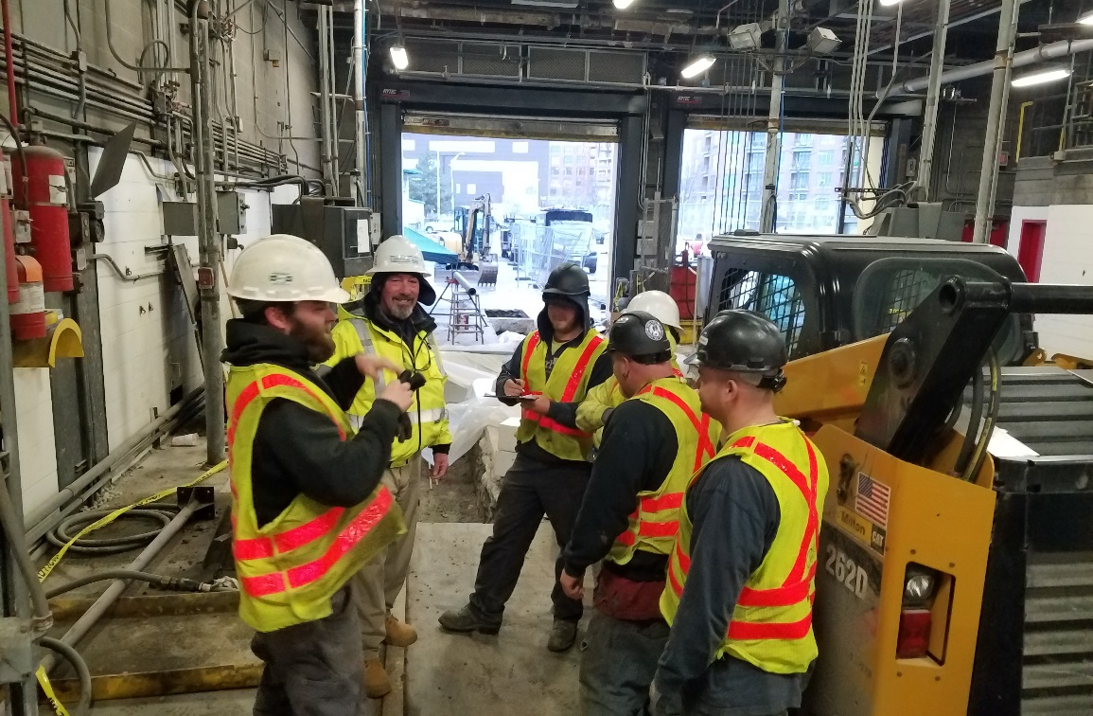
Workplace Safety Improvement Initiative
MBTA Quarterly Safety Report
Initiative Development
Electrical Safety
Confined Space
Fall Protection
Fire Life Safety/Emergency Egress
Facility & Workplace Inspections
Hazard Awareness Training
Personal Protective Equipment (PPE)
Employee Injury Investigations
Winter Storm Occupational Safety
Job Hazard Analyses
Draft for Discussion & Policy Purposes Only

Slide 7
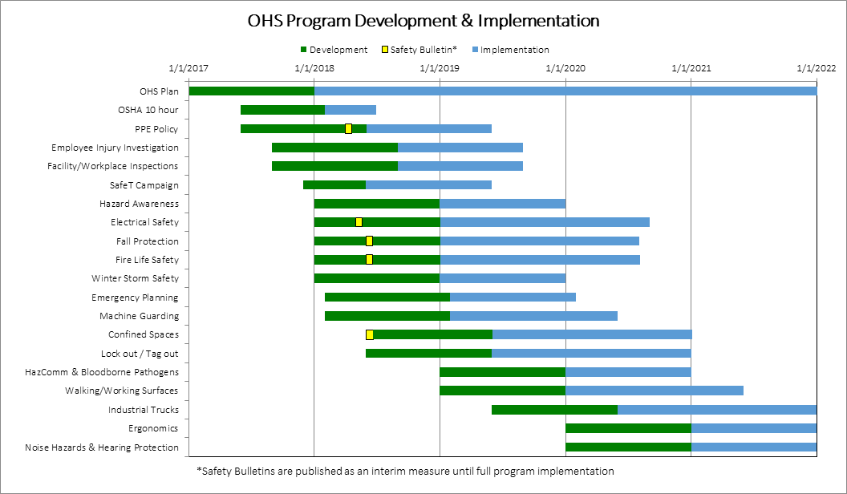
OHS Program Development & Implementation*
MBTA Quarterly Safety Report
*Additional applicable programs & policies will be developed and implemented as identified
Draft for Discussion & Policy Purposes Only

Slide 8
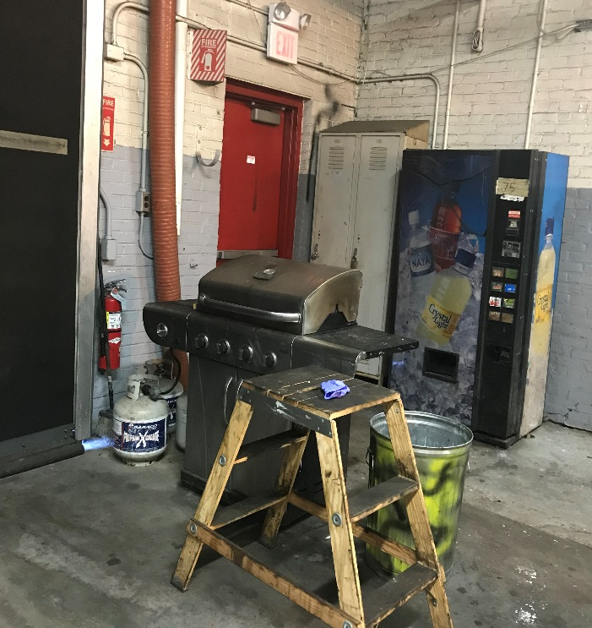
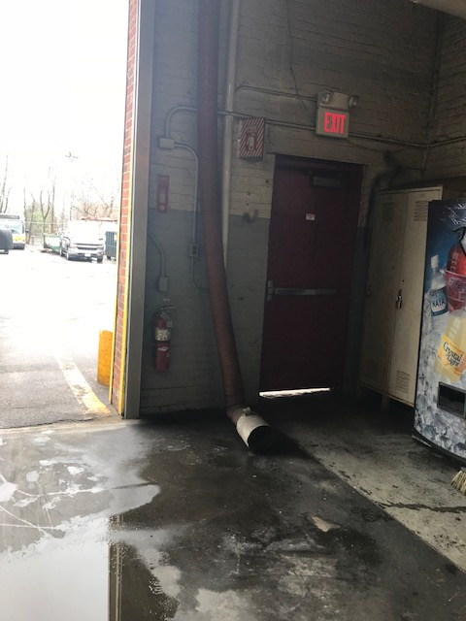
Facility Inspections
MBTA Quarterly Safety Report
MBTA Safety scheduled to inspect 23 facilities
Working with management to perform and record on-site inspections
Draft for Discussion & Policy Purposes Only

Slide 9
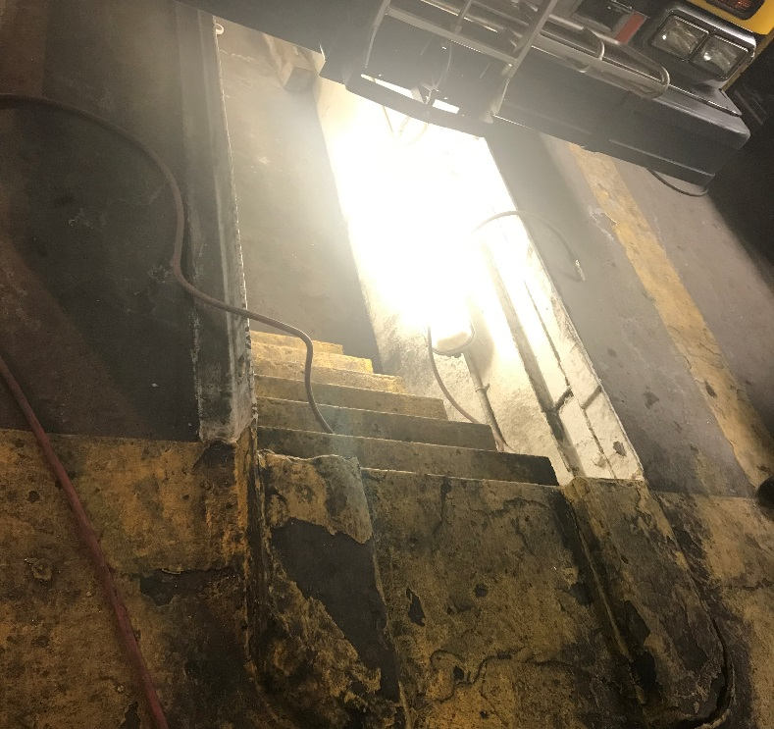
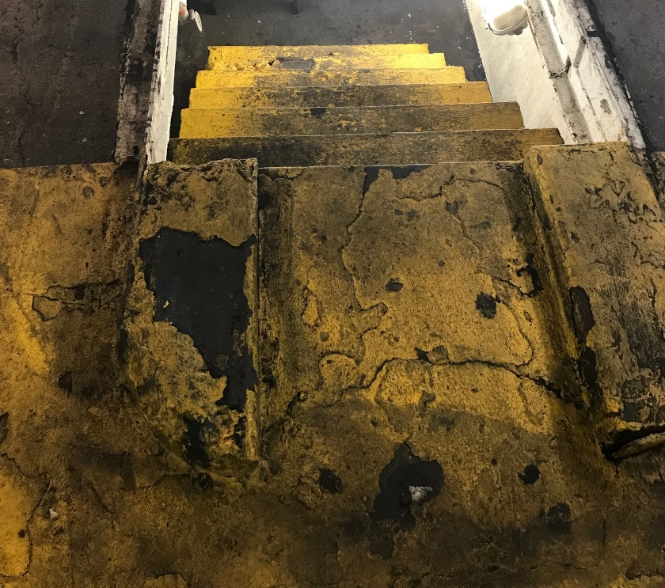
Facility Inspections
MBTA Quarterly Safety Report
Quincy Bus Garage
Draft for Discussion & Policy Purposes Only

Slide 10
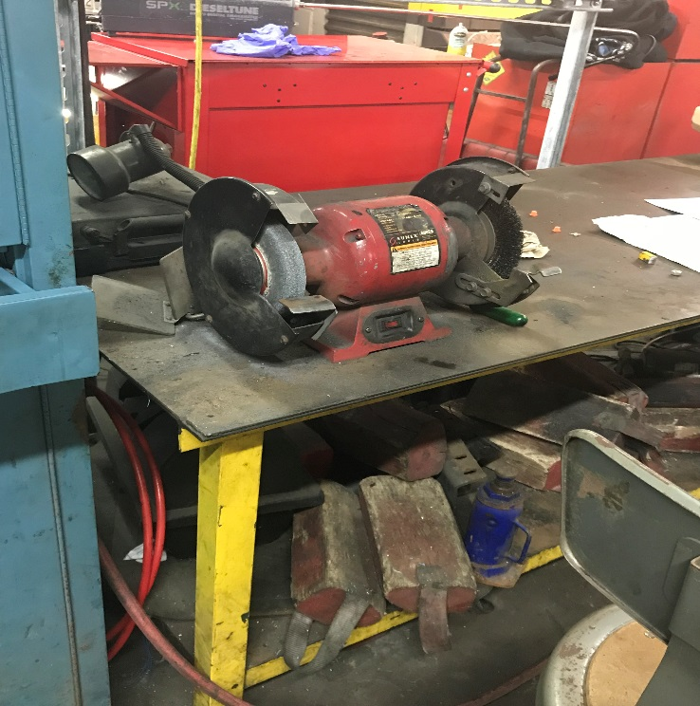
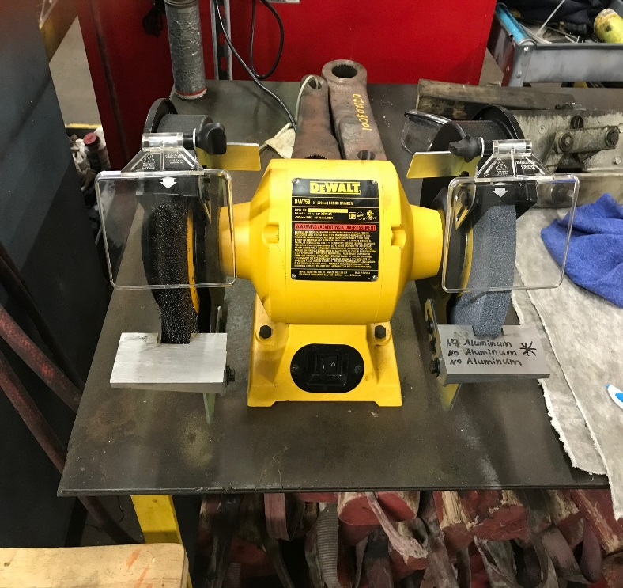
Facility Inspections
MBTA Quarterly Safety Report
Quincy Bus Garage has received new grinders
Draft for Discussion & Policy Purposes Only

Slide 11
Employee Lost Time Injuries
MBTA Quarterly Safety Report
*Totals based on injury reports submitted to MBTA Safety.
March 2018 data is pending final verification with reporting departments and Worker’s Comp.
Draft for Discussion & Policy Purposes Only

Slide 12
Employee Injuries
MBTA Quarterly Safety Report
Most Common Lost Time Injured Body Part in Quarter 1 - 2018
Most Common Lost Time Injury Types in Quarter 1 - 2018*
Back
28%
Injury Type | 2018 Total | %
Sprains / Strains | 28 | 44%
Contusion / Bruise | 17 | 27%
Cut/Laceration | 4 | 6%
Knee
13%
Ankle
8%
Foot
6%
*Totals based on injury reports submitted to MBTA Safety as of March 31, 2018 and is pending final verification with reporting departments and Worker’s Comp.
Draft for Discussion & Policy Purposes Only

Slide 13
Assaults on Employees
MBTA Quarterly Safety Report
*Totals based on a review of Operations Logs and injury reports submitted to MBTA Safety
Draft for Discussion & Policy Purposes Only

Slide 14
Derailments – Data Review
MBTA Quarterly Safety Report
MBTA Safety has coordinated with Transportation Management to improve Investigation processes & procedures.
*2018 Totals are as of April 23, 2018
Draft for Discussion & Policy Purposes Only

Slide 15
Bus Collisions
MBTA Quarterly Safety Report
*Reportable bus collisions are collisions with a person requiring transport to a medical facility, any collision involving three or more transports for medical treatment, or any collision resulting in property damage > $50,000.
Totals based on a review of Operations Logs and incident reports submitted to MBTA Safety
Draft for Discussion & Policy Purposes Only
Notes:
Reportable bus collisions are collisions with a person requiring transport to a medical facility, any collision involving three or more transports for medical treatment, or any collision resulting in property damage > $50,000.

Slide 16
Bus & Subway Fatalities – 2014-2018
MBTA Quarterly Safety Report
*2018 Totals include only January through April 23, 2018
Totals are organized by Calendar Year
Draft for Discussion & Policy Purposes Only

Slide 17
Commuter Rail Trespasser Strikes
MBTA Quarterly Safety Report
*2018 Totals include only January through April 23, 2018
Totals based on a review of Commuter Rail incident and Safety Summary Reports
Draft for Discussion & Policy Purposes Only

Slide 18
Commuter Rail Trespasser Strikes
MBTA Quarterly Safety Report
Categorizations are based on a reasonable determination utilizing the available information.
Undetermined incidents include recent incidents without sufficient initial information to make a determination or incidents without adequate historical information
*2018 Totals include only January through April 23, 2018
Draft for Discussion & Policy Purposes Only

