Slide 1
General Manager’s Remarks
Fiscal and Management Control Board
April 30, 2018

Slide 2
Agenda
Customer Communications Update
SL3-Chelsea
RIDE

Slide 3
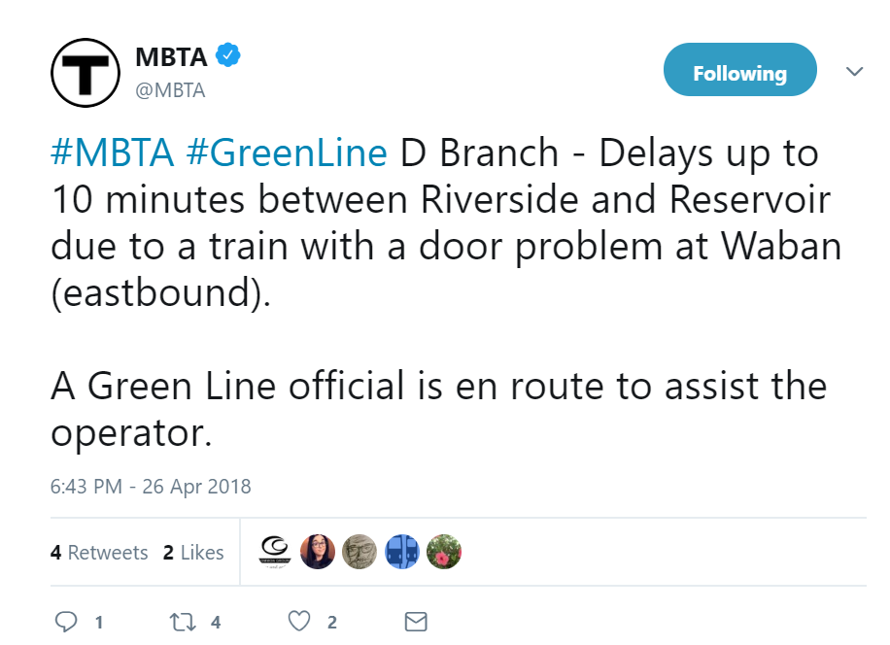
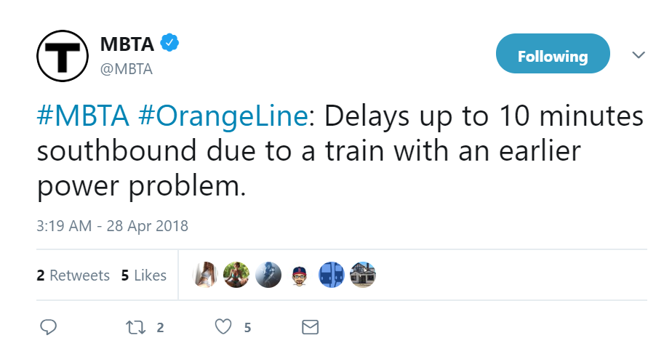

Customer Communications Update
GM’s Remarks 4/20/18
Service delays: shifting away from range of minutes to estimated maximum number of minutes
Further reduces subjectivity found in range and “minor,” “moderate,” “severe”
Customers can make more informed decisions

Slide 4
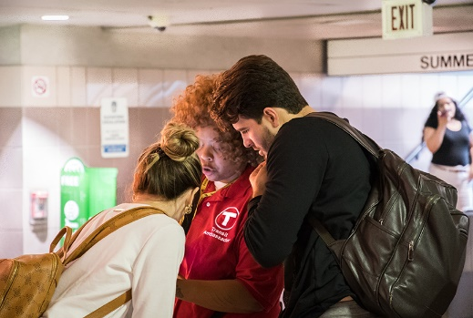
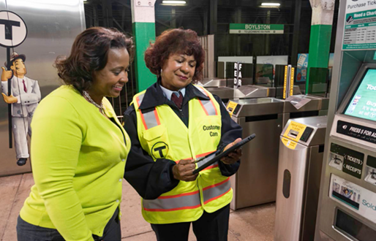
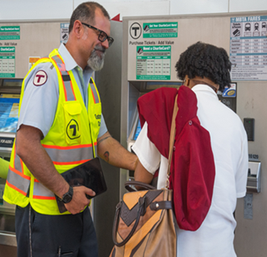
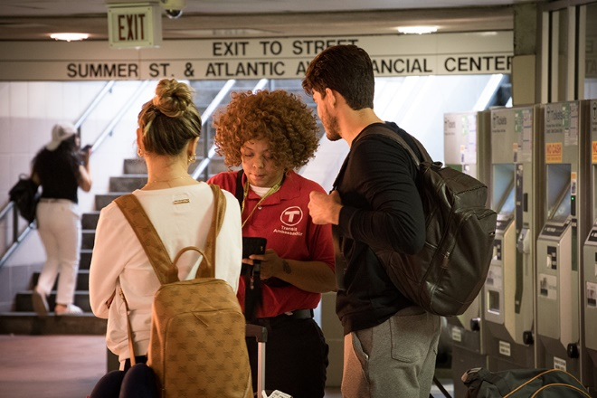
Customer Communications Update
GM’s Remarks 4/20/18
Mirroring practice of Transit Ambassadors, now CSAs have tablets
Effective way to answer common questions, provide directions, directly connect with Customer Support team
Provides increased customer value, especially for visitors and infrequent users

Slide 5
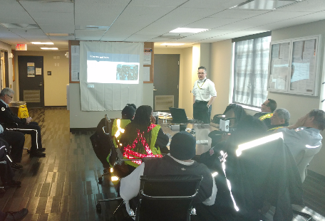
Customer Communications Update
GM’s Remarks 4/20/18
Working group identified need for a new training program for customer communications for all of our vehicle operators
So far close to 300 operators completed program
Training educates all train and bus operators on announcements that have customer value by providing important information
Training also discourages use of T jargon not commonly understood by customers

Slide 6

Customer Communications Update
GM’s Remarks 4/20/18
Starting with Orange Line, pilot asks customers for assistance to identify malfunctioning audio capabilities
In addition to updating announcement protocols, and investing in employee training, also need to focus on vehicle equipment
Pending success, pilot likely to be expanded to other lines

Slide 7
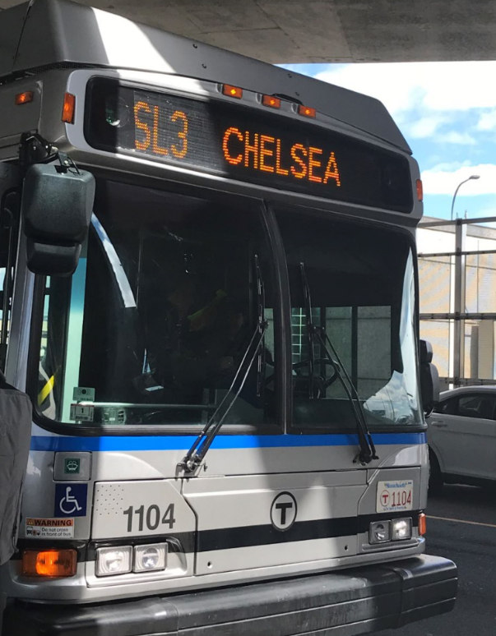
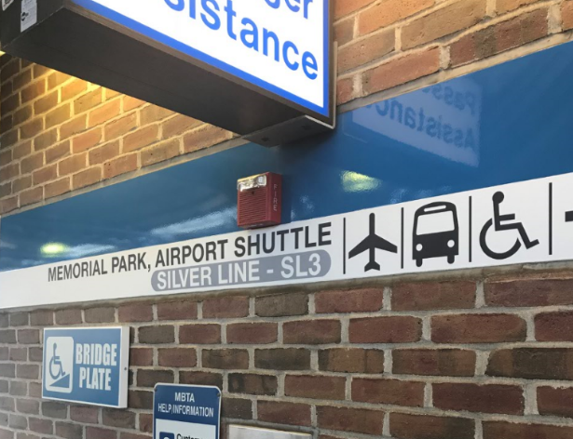
SL3-Chelsea – launched Saturday, April 21
First new service on dedicated ROW since Greenbush in 2007
Offers customers new option of one-seat ride between Chelsea downtown Boston
SL3 runs along 1.2 mile dedicated busway in Chelsea, Coughlin Bypass Road in East Boston before joining existing SL routes to waterfront and South Station

Slide 8
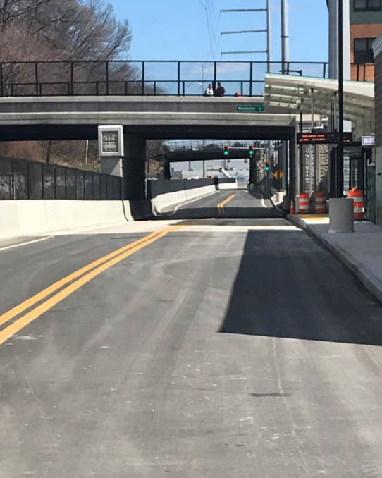
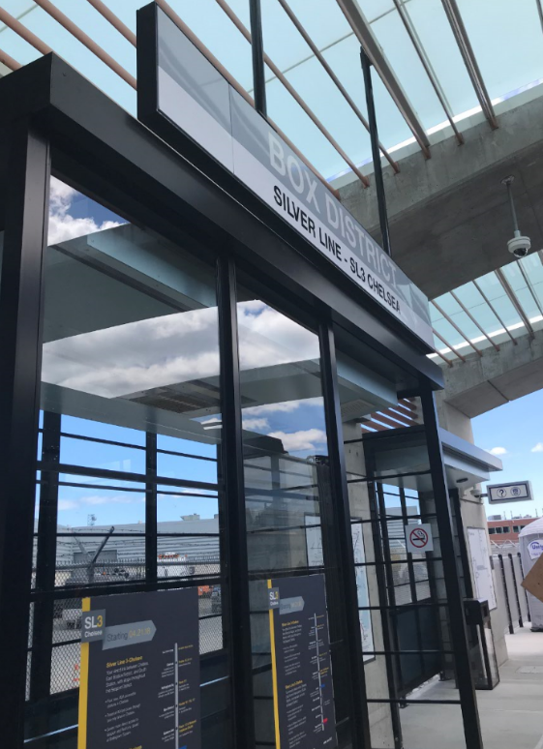
SL3-Chelsea
Thank you to MassDOT Highway Division
Highway District 6
Major improvement for our customers
Significant milestone for cooperation between two agencies
New opportunities for:
  Mobility
  Housing
  Jobs

Slide 9
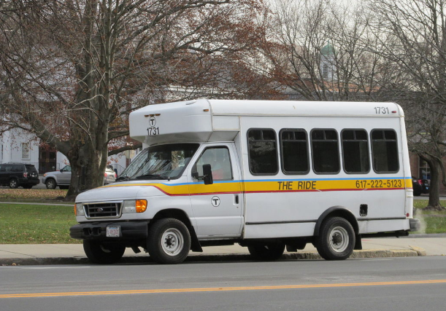
RIDE Update
Transition process started in December 2017
New procurement based on lessons learned and helpful insight from RIDE advocates
Ultimate goal is to deliver a reliable service on which our most vulnerable customers can depend

