Slide 1
Water Transportation Study & Business Planning
Update
September 11, 2017
Last Presentation to the Joint Board – March 2017

Slide 2
Two Water Transportation Studies
Comprehensive Boston Harbor Water Transportation Study and Business Plans
Baseline site profiles for planning of passenger ferry routes in the harbor
Comprehensive business plans for up to three financially sustainable services that can be launched in one to five years
Water Transportation Strategy for the Boston Harbor Islands National and State Park
Baseline site profiles for planning new services at Park Gateway sites
Strategy and scope for an RFP to procure a ferry service operator including recommendations for one or two new services
Notes:
The National Park Service defines the harbor as Salem to Scituate and is looking at ferry service to the 8 islands within the 34 islands of the park
We are currently using the same harbor definition for the comprehensive study of land-side to land-side service, but we are open to expanding the definition to include other key sites including Plymouth, Gloucester, and Provincetown as applicable.

Slide 3
Deliverables: Comprehensive Boston Harbor Study
30
site profiles
10 sites
with models for estimated ridership demand
3 corridors
detailed market and feasibility analysis + estimates of ridership, time savings, operating costs, deficits/ subsidies, and seasonality
Model congestion mitigation and reduced emissions
Financial Model + Business Plan for up to 3 new routes based on these findings
Stated Preference Survey to gather additional data on possible ridership
Notes:
The study will look at the funding gap between service with full fare-box recovery and proposed service and assess the deficit that may need to be subsidized
Having Elliot Bay Design Group on the team enables us to look at the latest in vessel technology and typologies both to study possible emissions as well as to estimate the vessel type and capital costs for the proposed services

Slide 4
Project Schedule
June + July 2017
- stakeholder workshops
- background research on existing conditions and potential sites
Aug + Sept 2017
- site profiles
- recommendations of sites for further study
- stated preference survey
October 2017
- develop an overall strategy with a set of sites and corridors being analyzed for market and operational feasibility
Nov to Feb 2018
- overall strategy + strategic implementation plan

Slide 5
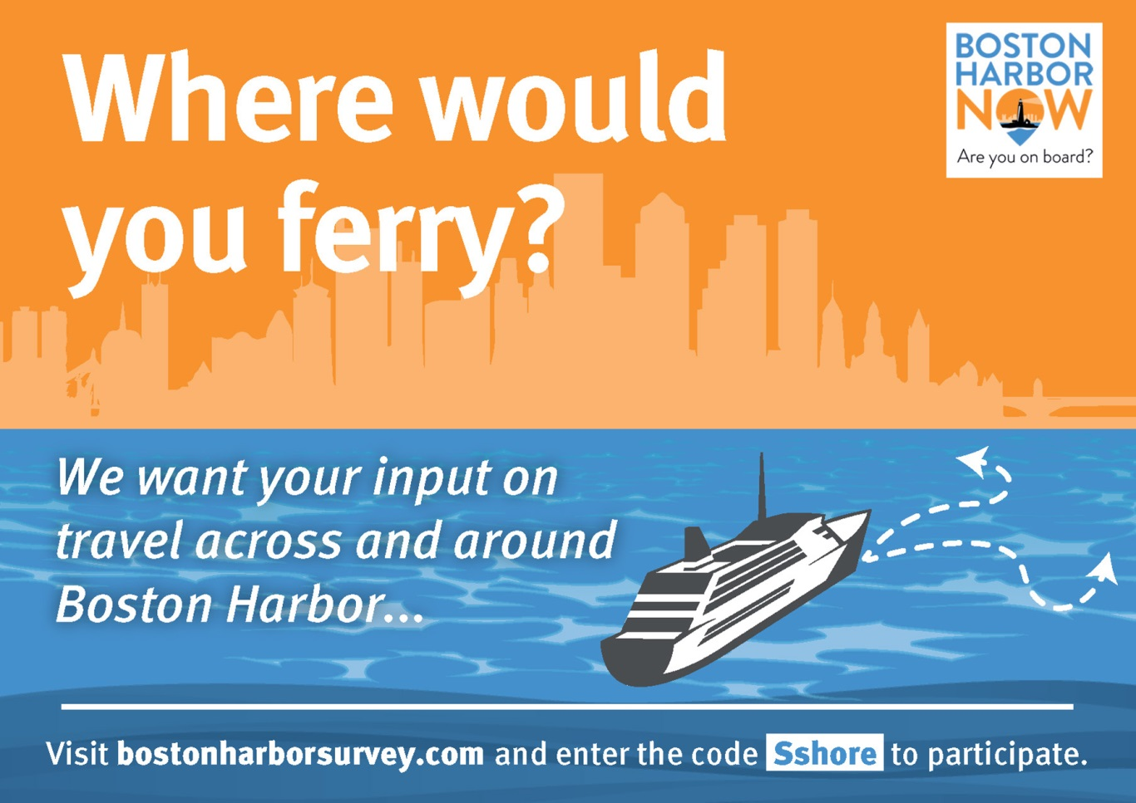
Water Transportation
Survey Update:
Launched - August 21
(after live testing period &
consultation w/ OPMI)
To date: 2500+ taken
In person (on boat) interviews
Posters and postcards
Digital promotion
Key stakeholders & municipal partners
Survey data analysis in begins in October
Notes:
The 2,500+ is 2,535 surveys as of September 6.
In person surveys are being done again this week (previously out on boats August 18 – 24)
Posters and postcards are on all vessels, at park partner locations, and are distributed by street teams at and near transit stations
Digital outreach includes email blasts (17,000 people from Boston Harbor Now alone) and social media (mostly twitter)
Municipal partners and other key stakeholders include members of WTAC

Slide 6
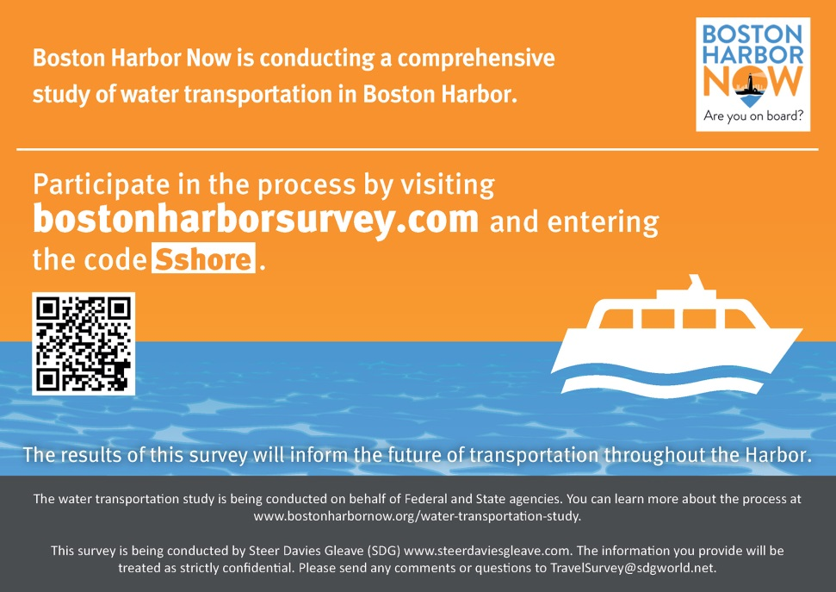
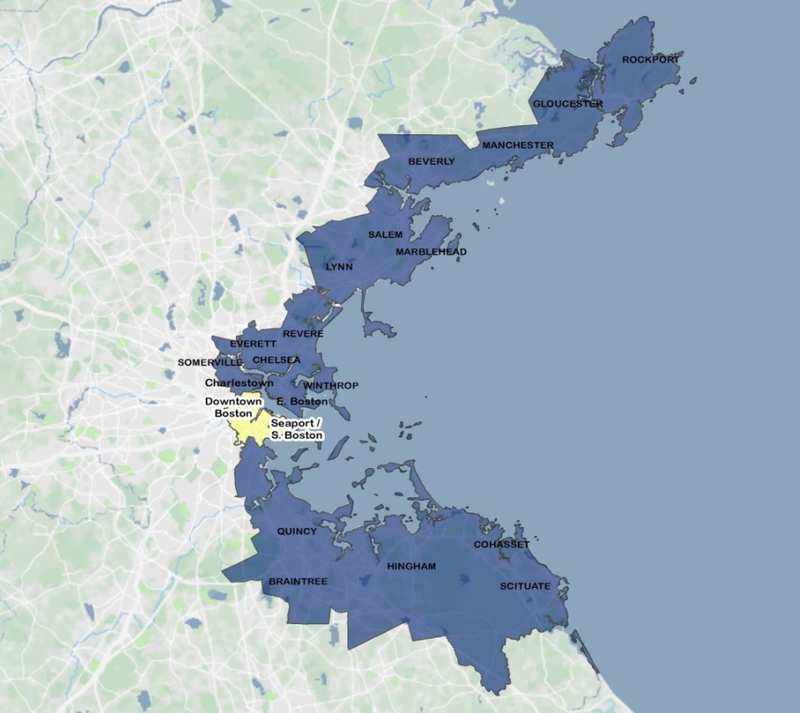
Water Transportation
Survey Update Continued:
Surveys coded to track outreach and enable project management team to promote targeted outreach.
Survey area developed from preliminary research of potential interest and ridership as well as feedback from workshops
Notes:
Include in this notes section any key off slide points for the presenter (David), and/or other information that may be useful or address an anticipated question arising from your 3-4 slides

Slide 7
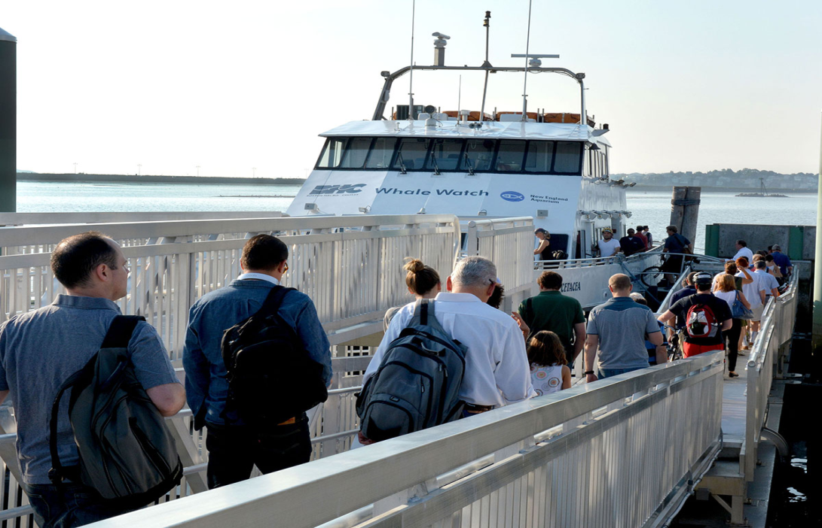
Water Transportation
Next Step:
BHN and consultant team to work with OPMI
Analyze survey data
Present finds back to key stakeholders and municipal partners
Public events and meetings
Water Transportation Advisory Council
MassDOT and FMCB
Seaport Economic Council
Other activities? Organizations?
Notes:
Include in this notes section any key off slide points for the presenter (David), and/or other information that may be useful or address an anticipated question arising from your 3-4 slides

Slide 8
Appendix
Sponsors & consultant team
History & summary of regional services
Additional study objectives
Past board presentation

Slide 9
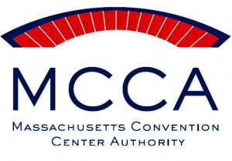
Study Sponsors
MassDOT
Massport
National Park Service
Seaport Council of the Executive Office of Housing and Economic Affairs
Massachusetts Convention Center Authority
The Barr Foundation
Cabot Family Charitable Trust
Envoy Hotel
Clippership Wharf
Notes:
Kathy - Introduce members of the client team present (esp. Hayes Morrison, Astrid Glynn, Nathan Peyton, Giles Parker, Chris Briggs, Doug McGarrah, Phil Griffiths, Alice Brown)
Also point out and introduce/thank any elected officials in the room (Alice will give you a list)

Slide 10
Consultant Team
Steer Davies Gleave
KPFF
Moffatt and Nichol
Elliott Bay Design Group
Progressions
Norris and Norris
Notes:
Kathy - Introduce members of the consultant team (esp. Pierre Villain, Mario Scott, Mike Anderson, and Kristen Kissinger + maybe Charley Norris in Boston)

Slide 11
Ferry History
1600’s & 1700’s
Before the bridges
1630’s:
ferry from Boston to Charlestown, Chelsea, and Cambridge
+ Neponset River crossing
+Fore River ferry
1800’s
New developments
1829: Steam ferries begin operation
1833: Service from East Boston to downtown
1860: Leisure service to Nantasket
1900 to 1950’s
Flourishing to fading
1900’s and 1910’s: peak period for passenger ferry service
1952: East Boston Ferry stops operating
1970’s to 2000
Mitigation
1975: Hingham service (1984 mitigation for SE expressway expansion)
1987: Charlestown service (Central Artery North Area)
1997: Lovejoy to WTC (Third Harbor Tunnel)
Adapted from BRA’s Boston Inner Harbor Water Transportation Plan (January 2000)
Notes:
Pierre: Also note verbally that some of the 34 harbor islands became a state park in 1970 and all 34 islands became part of the Boston Harbor Islands National Recreational Area in 1996

Slide 12
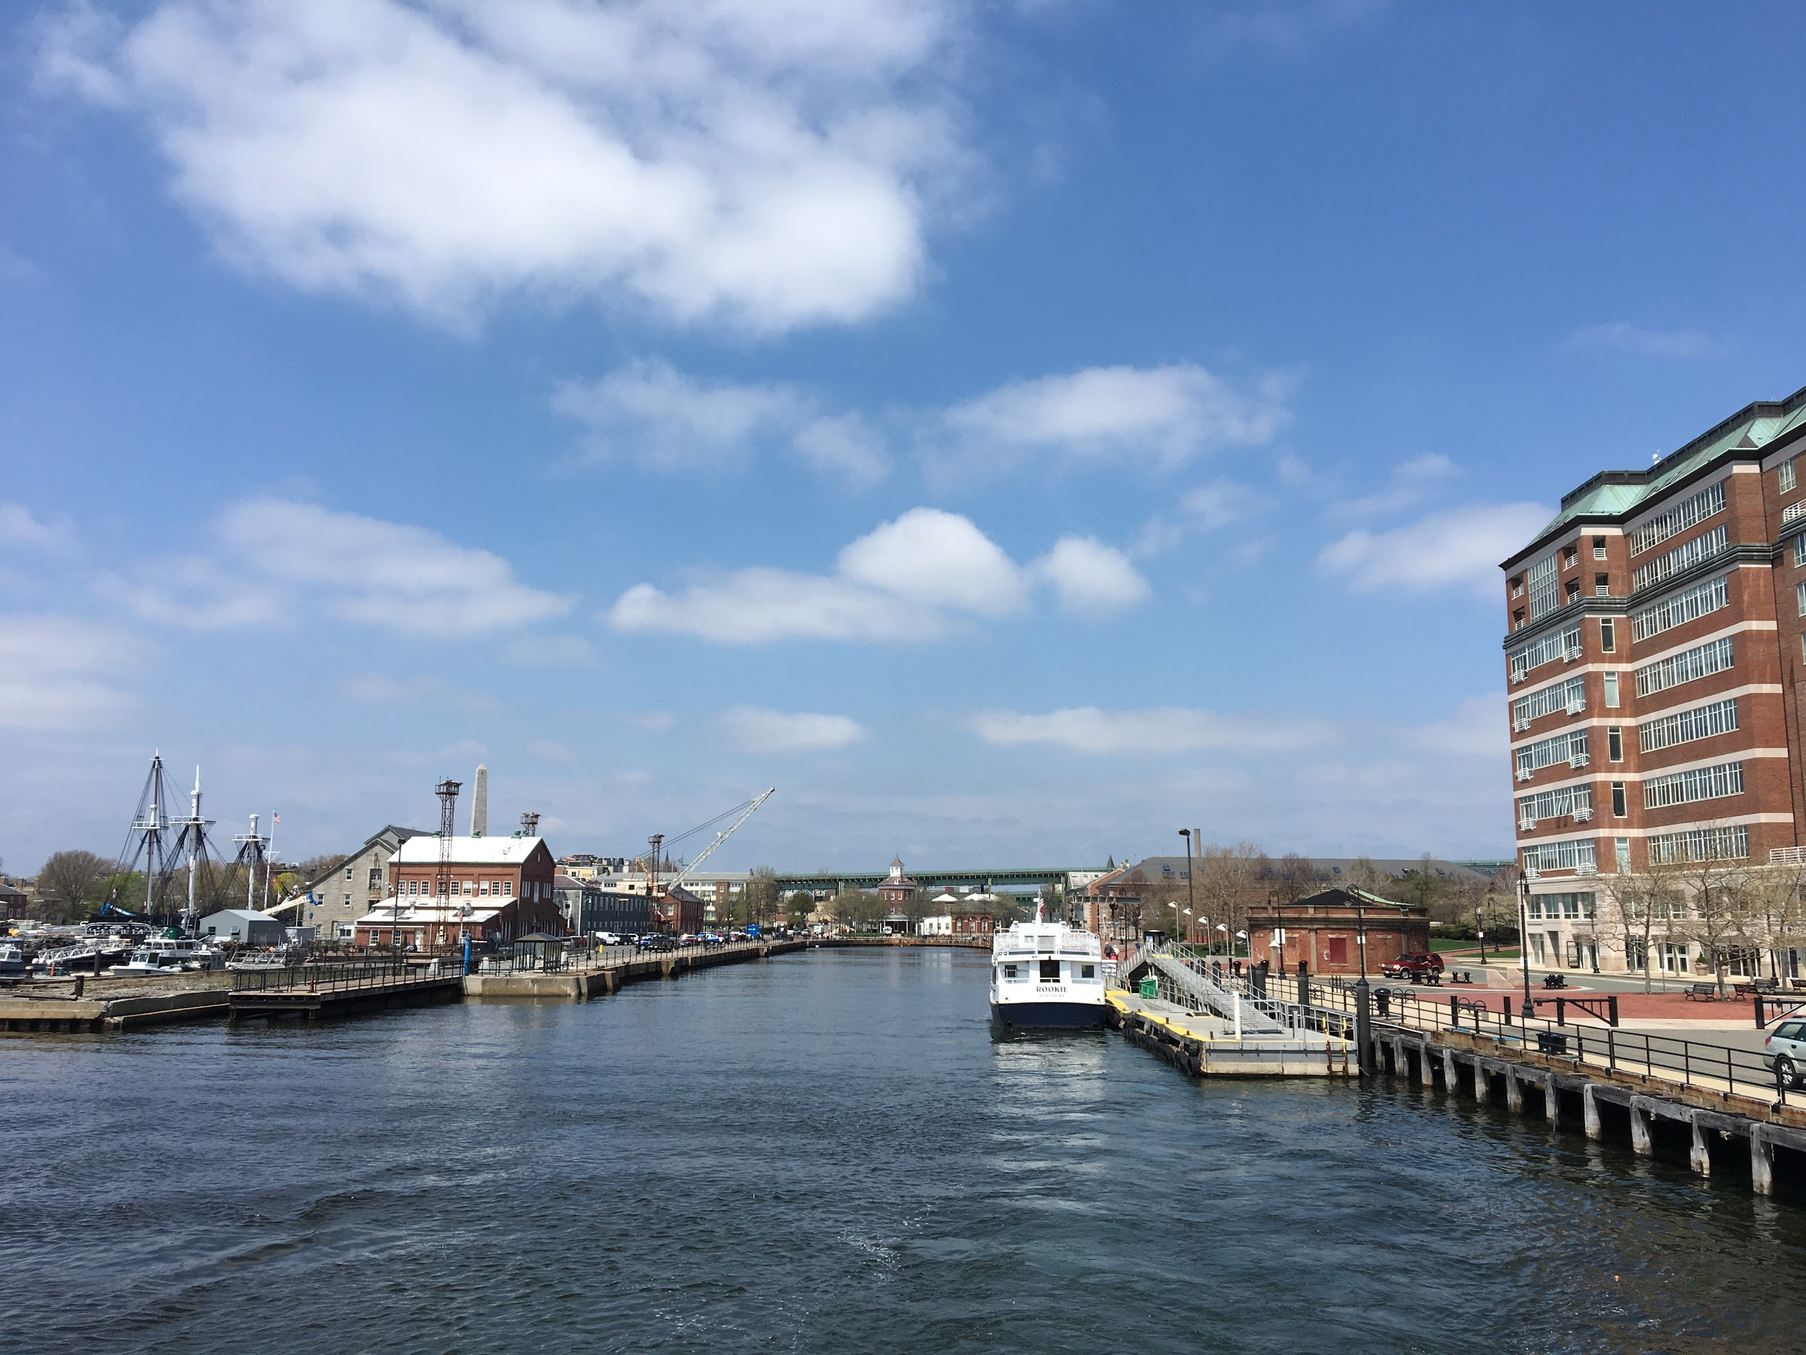
Existing Passenger Ferry Service
in Boston Harbor and to the Islands
Notes:
Pierre: slides 12 - 23

Slide 13
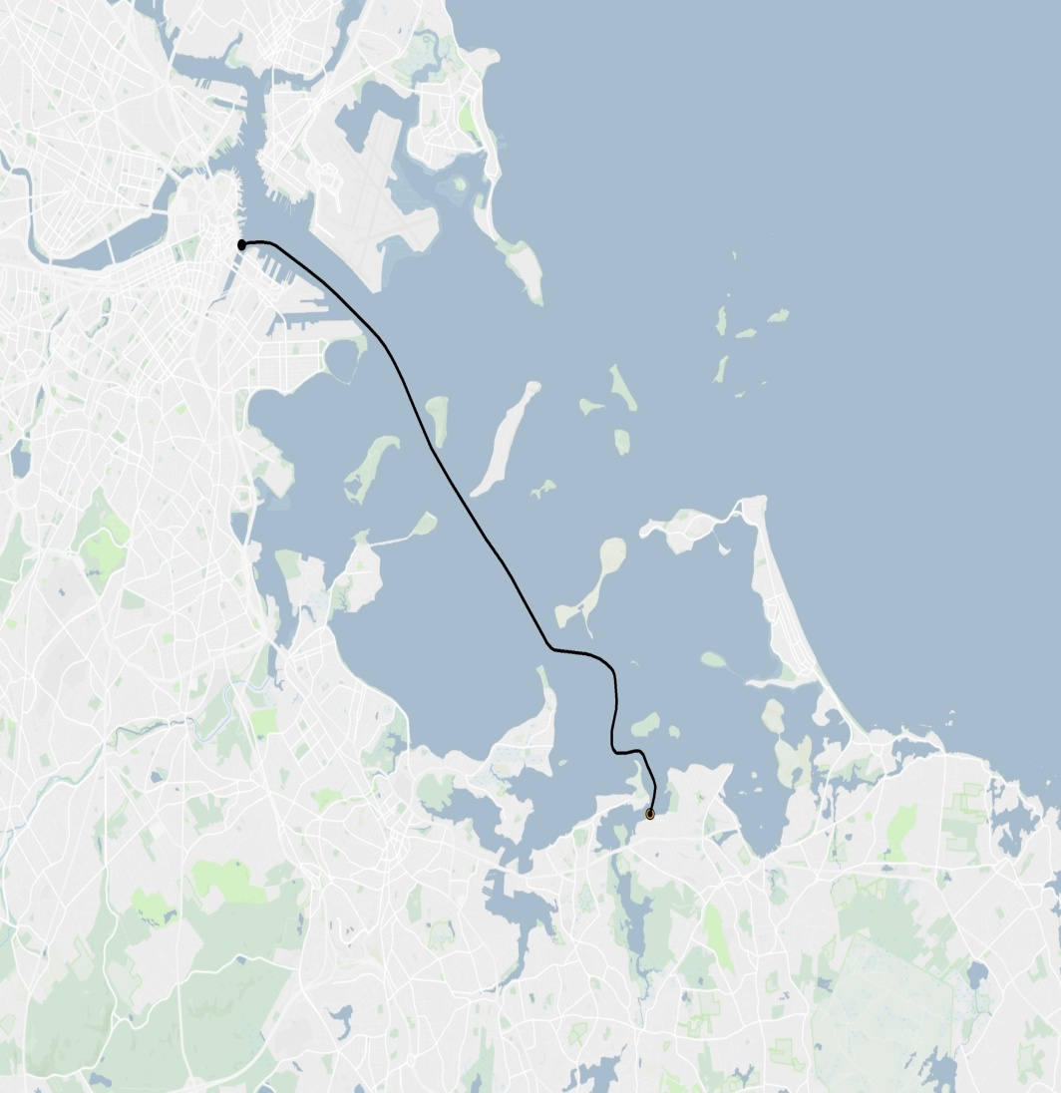
Hingham to Boston MBTA Service
Docks: Hewitt’s Cove to Rowes Wharf
Daily Service
Frequency - 18 departures (direct service)
Fare - $9.25/ride
Farebox Recovery - 68% (system-wide, 2015)
Owner: MBTA owns two boats and contracts with BHC; Operators own additional boats in service
Operator: Boston Harbor Cruises
Funding: MBTA

Slide 14
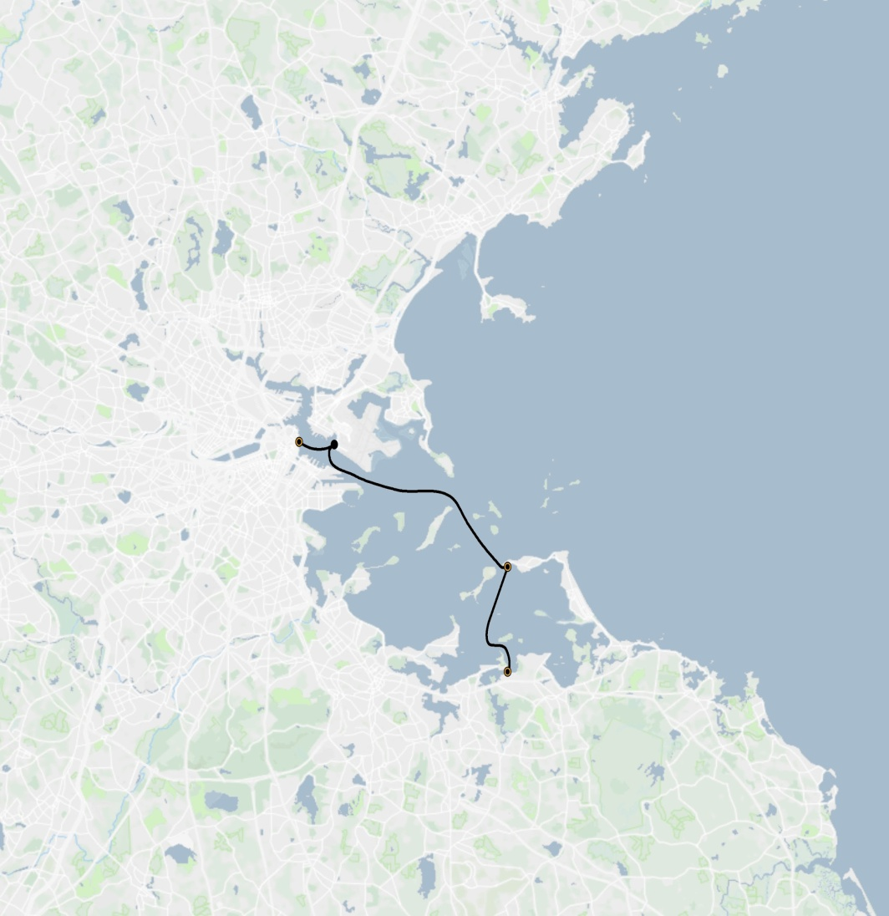
Hingham to Hull to Logan to Boston MBTA Service
Insert Map
Docks: Long Wharf North, Logan Airport, Pemberton Point, Hewitt’s Cove (+ Grape)
Daily Service
- Hingham: 15 arrivals and departures
- Hull: 9 departures, 15 arrivals
- Logan: 14 landings
Fare - $9.25/ride
Farebox Recovery - 68% (system-wide, 2015)
Owner: MBTA contracts with BHC; MBTA owns two boats
Operator: Boston Harbor Cruises
Funding: MBTA
Notes:
This route occasionally serves Grape Island.

Slide 15
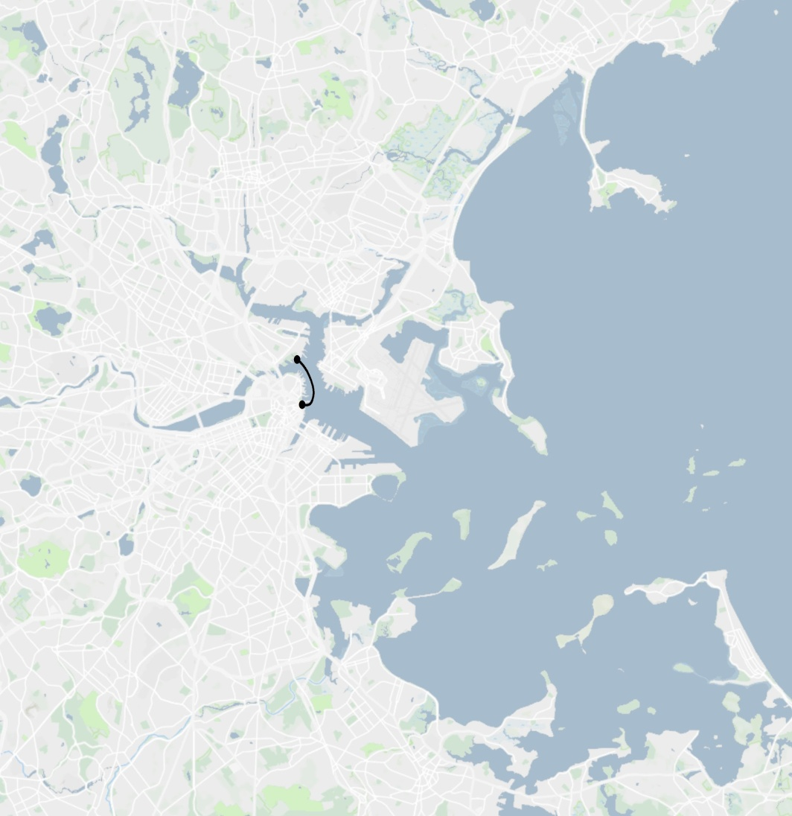
Long Wharf to Charlestown MBTA Service
Insert Map
Docks: Long Wharf South to Navy Yard (Pier 4)
Daily Service
Frequency - 39 daily weekday roundtrips
Fare - $3.50/ride
Farebox Recovery - 68% (system-wide, 2015)
Owner: MBTA contracts with BHC; MBTA owns two boats
Operator: Boston Harbor Cruises
Funding: MBTA

Slide 16
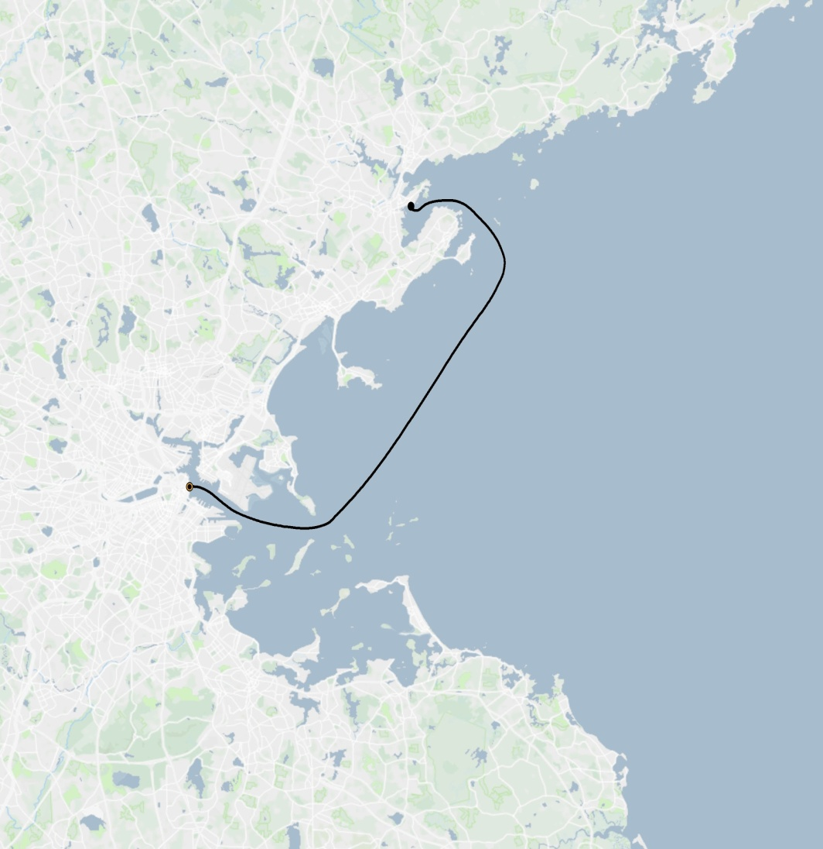
Salem to Boston
Insert Map
Docks: Salem Ferry Terminal to Long Wharf
Daily Service (Seasonal)
Frequency - 5 trips/day
Fare - $25/ride ($8 for commuter boat)
Farebox Recovery - (To be determined)
Owner: Salem owns the boat and contracts with BHC for operations
Operator: Boston Harbor Cruises
Funding: Salem and farebox

Slide 17
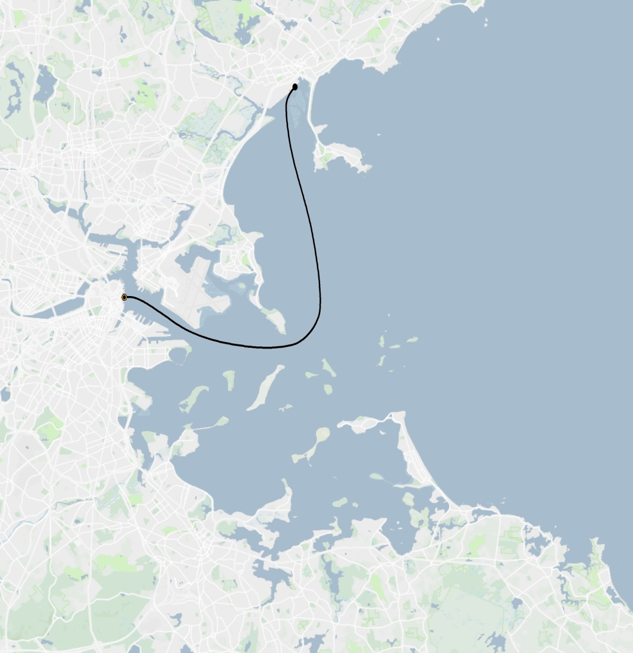
Lynn to Boston
Insert Map
Docks: Blossom Street Pier to Long Wharf
Daily Service (Short term mitigation)
Frequency - 1 trip/day
Fare - $7
Farebox Recovery - (To be determined)
Owner: BHC owns the boat
Operator: Boston Harbor Cruises
Funding: MassDOT and City of Lynn
Notes:
Short term (1 summer) mitigation. Future is TBD and continuation should not be assumed.

Slide 18
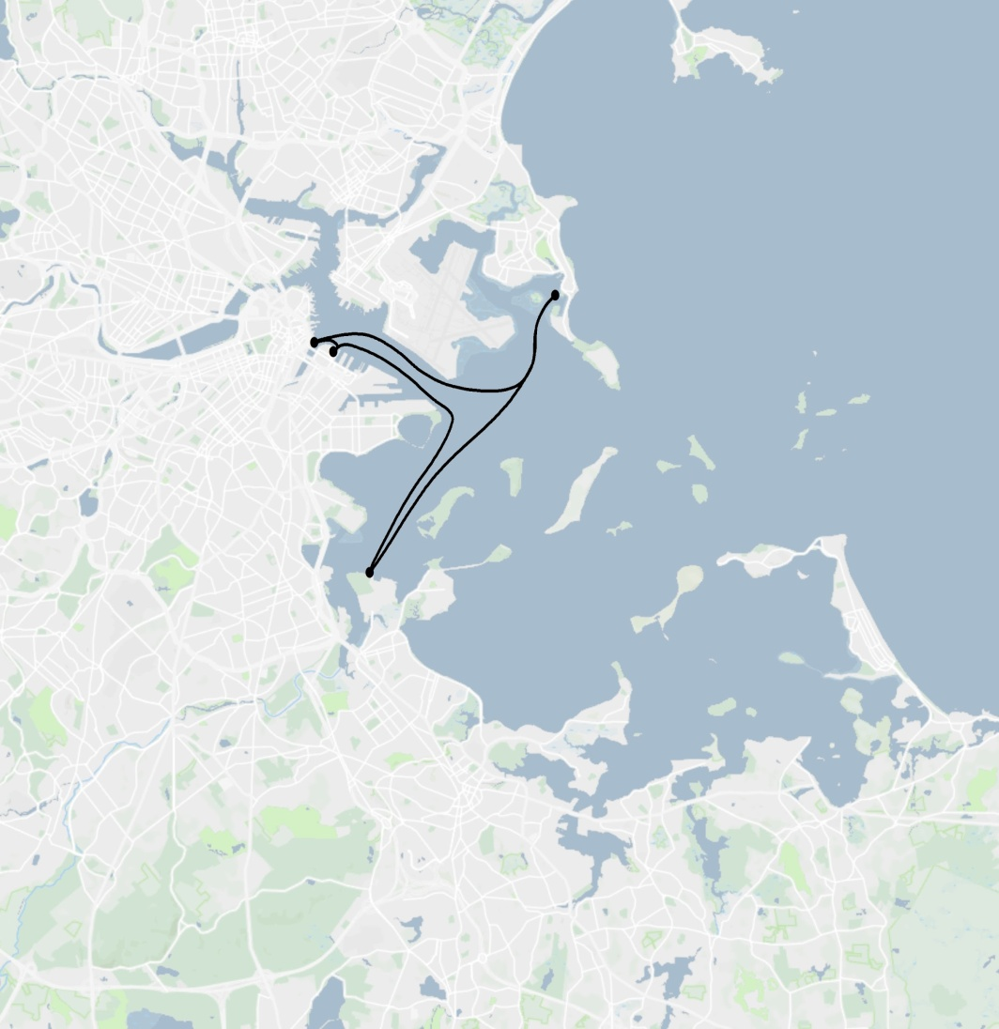
Winthrop to Quincy to Boston
Insert Map
Docks: Winthrop Ferry Dock, Marina Bay/Squantum Point, Fan Pier, Rowes Wharf
Daily Service (Seasonal)
Frequency - 6 to 8 trips/day
Fare - $8.50
Farebox Recovery - (To be determined)
Owner/Operator: Town of Winthrop owns and operates the boat
Funding: Town of Winthrop and farebox with temporary MBTA support
Notes:
Some funding for the service from Quincy is coming from the MBTA as a mitigation for the construction impacts from the Red Line (at Wollaston). The current level of support may not be possible or justified in the future.

Slide 19
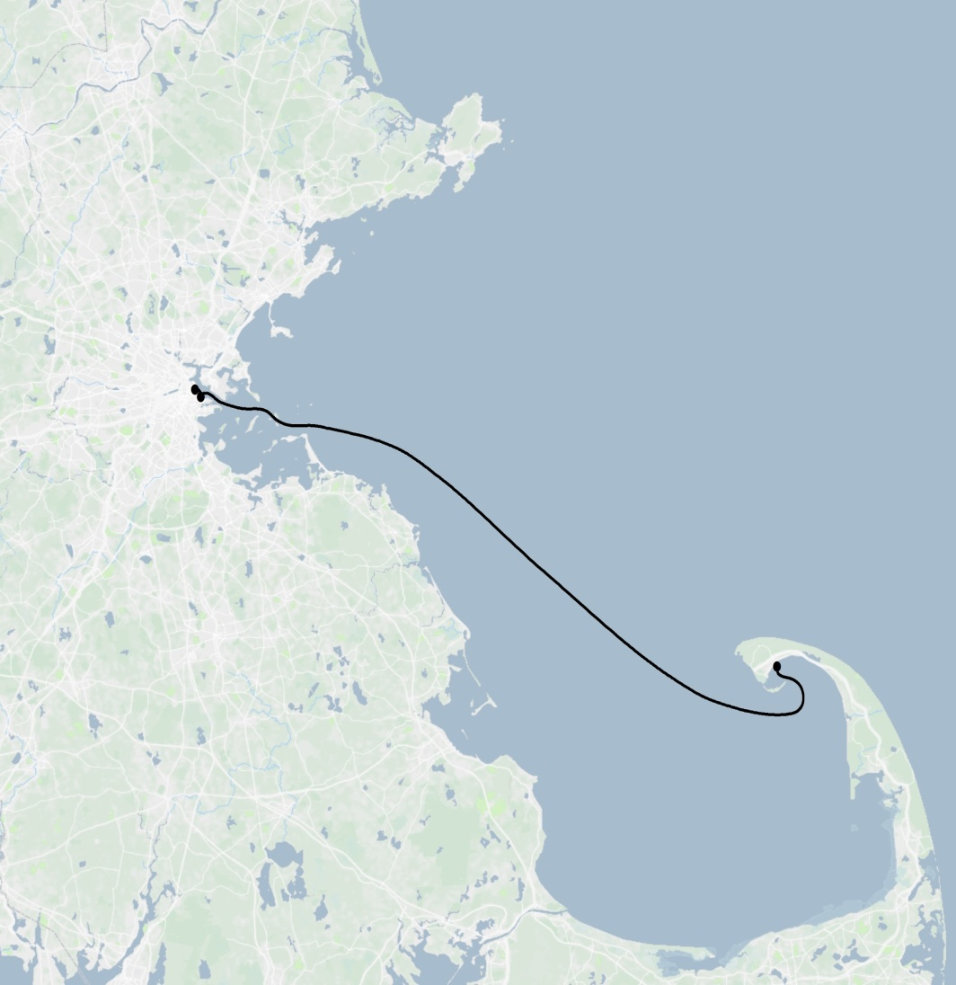
Boston to Provincetown
Insert Map
Docks: World Trade Center West, Central Wharf, and MacMillan Pier
Daily Service (Seasonal)
Frequency - 1 to 4 trips/day/operator
Fare - $59
Farebox Recovery - 100%
Owner/Operator: Boston Harbor Cruises and Bay State Cruise Company own and operate boats
Funding: Farebox with market rate ticket pricing

Slide 20
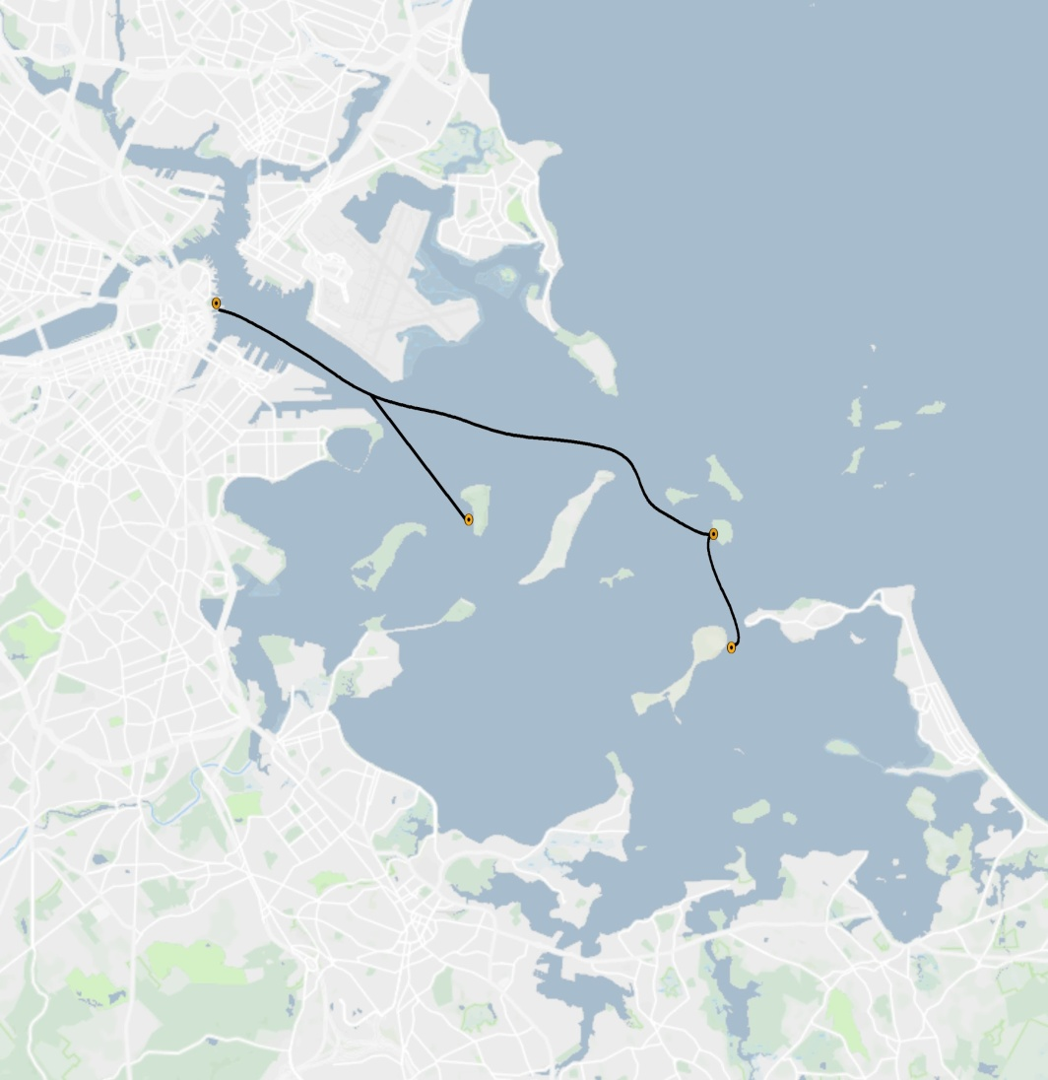
Boston to Georges, Spectacle, Peddocks (+ Inter-Island)
Insert Map
Docks: Long Wharf North
Daily Service (Seasonal)
- Georges: 3 to 7 departures to the island
- Spectacle: 3 to 6 departures to the island
- Peddocks: 2 direct trips to the island
Fare - $17
Farebox Recovery - (To be determined)
Owner: BHN contract to BHC
Operator: Boston Harbor Cruises
Funding: Farebox
Notes:
Note that while there is not direct service from Boston to the camping islands, you can take a ferry from Boston to Georges and change to get on the Inter-Island Service)

Slide 21
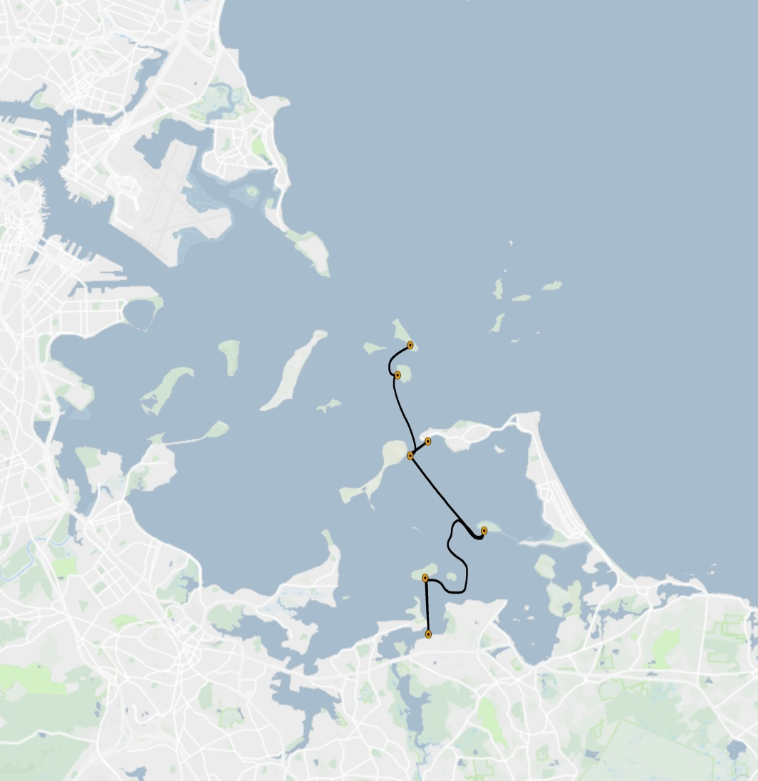
Hingham and Hull to Five Islands
Insert Map
Docks: Hewitt’s Cove, Pemberton Point
Daily Service (Seasonal)
- Grape: 5 landings/day (Wed. to Sun. only)
- Peddocks: 6 landings/day
- Georges: 7 landings/day
- Lovells: 4 landings/day
- Bumpkin: 3 landings/day (Wed. to Sun. only)
Fare - $17
Farebox Recovery - (To be determined)
Owner: BHN contracts with BHC
Operator: Boston Harbor Cruises
Funding: Farebox
Notes:
Same contract as the service from Boston described in the previous slide

Slide 22
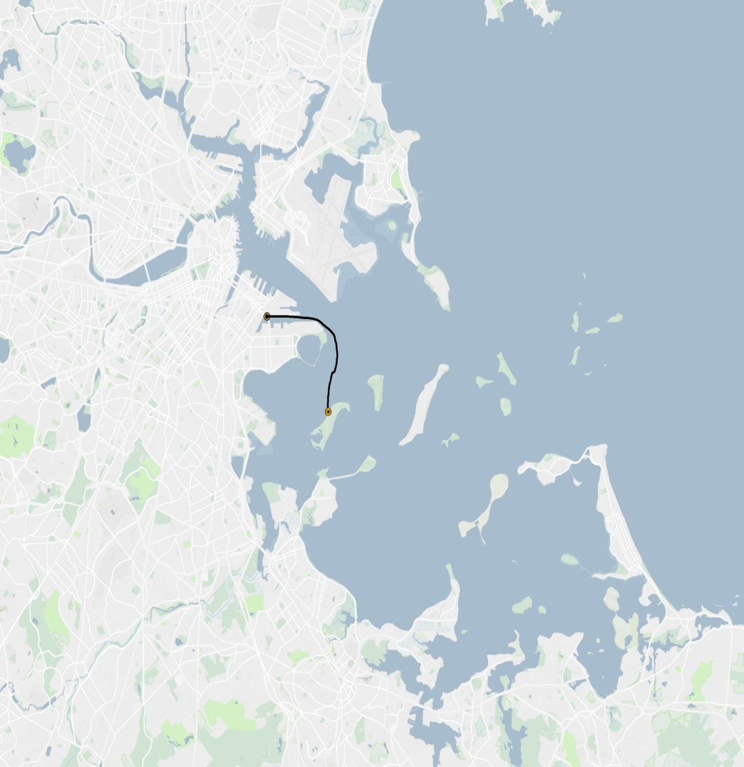
Boston to Thompson Island
Insert Map
Docks: EDIC/Marine Industrial Park
Daily Service (Seasonal)
Frequency - 3 weekend departures to the island
Fare - $17
Farebox Recovery - (To be determined)
Owner/Operator: Thompson Island Outward Bound owns and operates the boat
Funding: Thompson Island and farebox

Slide 23
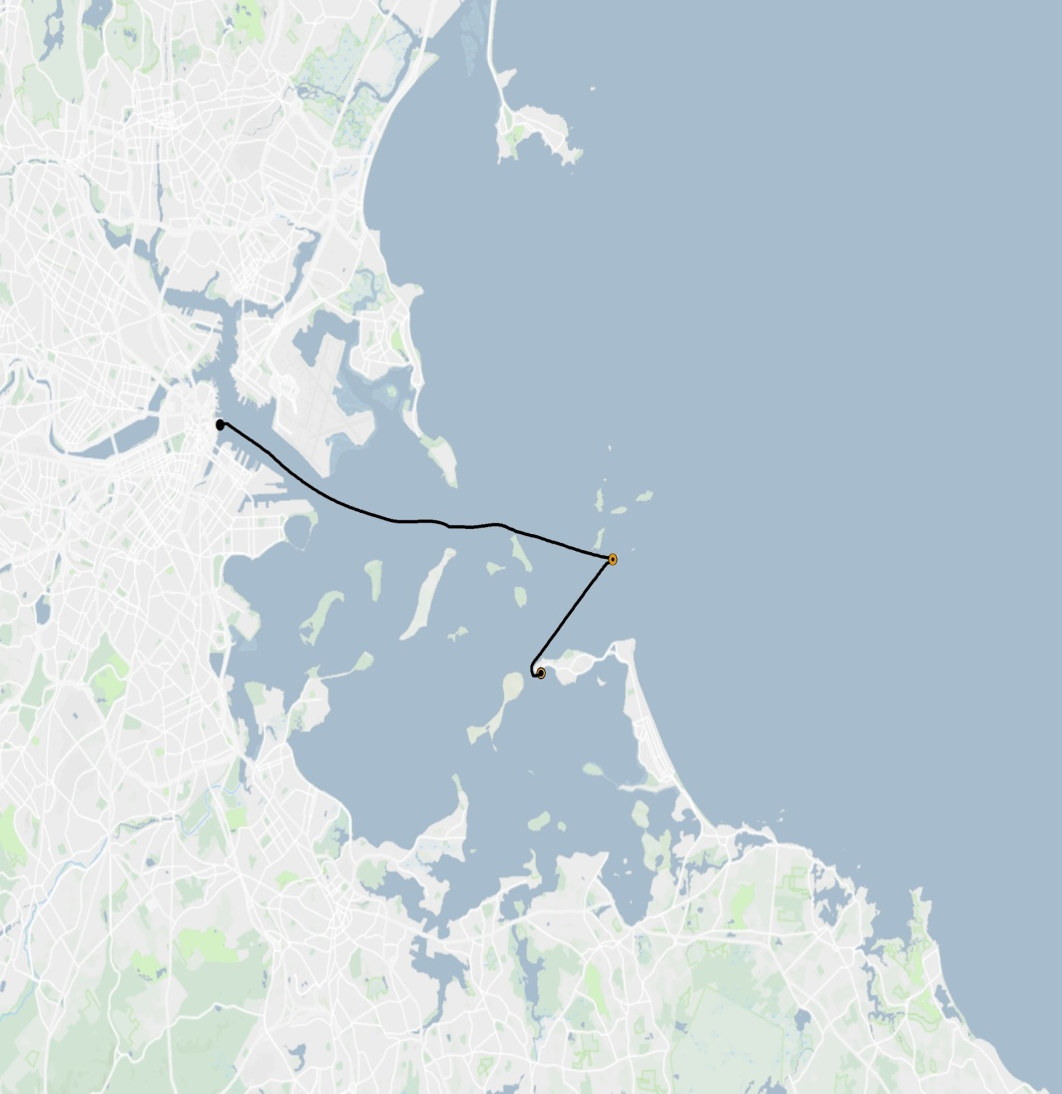
Boston and Hull to Boston Light
Insert Map
Docks: Central Wharf and Pemberton Point
Daily Service (Seasonal)
- 2 departures per day to Little Brewster from Boston on Friday, Saturday, and Sunday
- 3 departures from Hull two days each summer
Fare - $30 ($41 if climbing the light house)
Farebox Recovery - (To be determined)
Owner: BHN contracts with UMass Marine Operations
Operator: UMass Marine Operations
Funding: Farebox

Slide 24
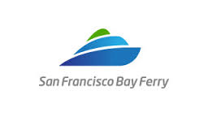
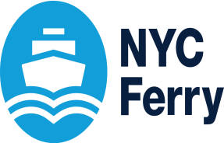
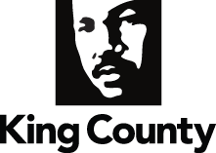
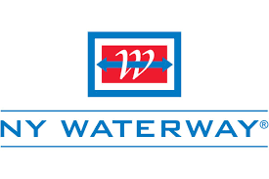
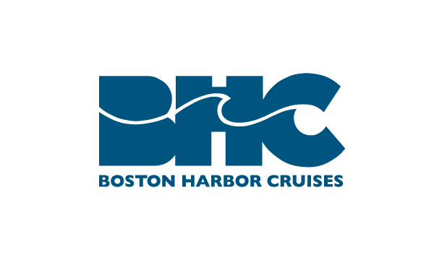
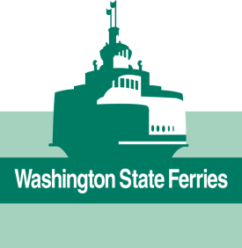
Service Delivery Model
Public/Private Partnership
Contract Relationship
Public Operator
Organization, staffing, and management with marine expertise
Private Operator
Economic Feasibility

Slide 25
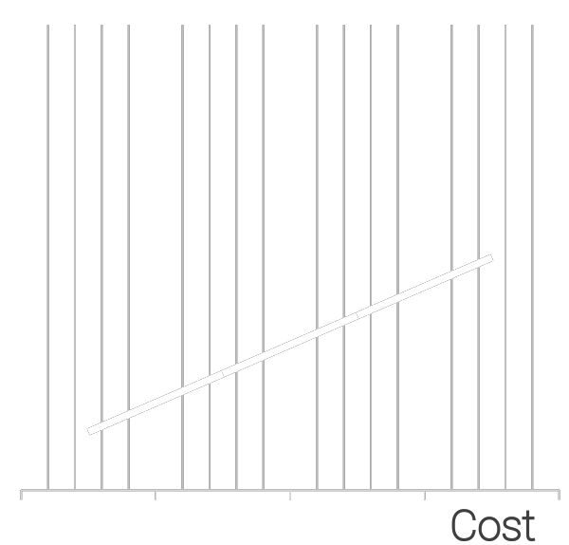
Sustainable Funding
Understanding Costs
Sustainable Funding
Operating Revenue
Farebox Recovery
Parking or other user fees
Ancillary Revenues
Advertising/Concessions
Public Subsidy
Local General fund
Dedicated Tax (sales, property, parking, etc)
Transportation District
Public/Private Partnerships
Private Funding
Developers, employers, etc.
Federal Government Grant Opportunities
Mostly for infrastructure
$
Vessel Size
Vessel
Speed
Route
Length
Frequency
Crew
Requirements
Cost

Slide 26
Performance Measures
Passenger Performance Measures
Safe
Reliable
On-Time
Cost Effective
Experience or Satisfaction
Organizational Performance Measures
Number of passengers carried
Meeting financial goals

Slide 27
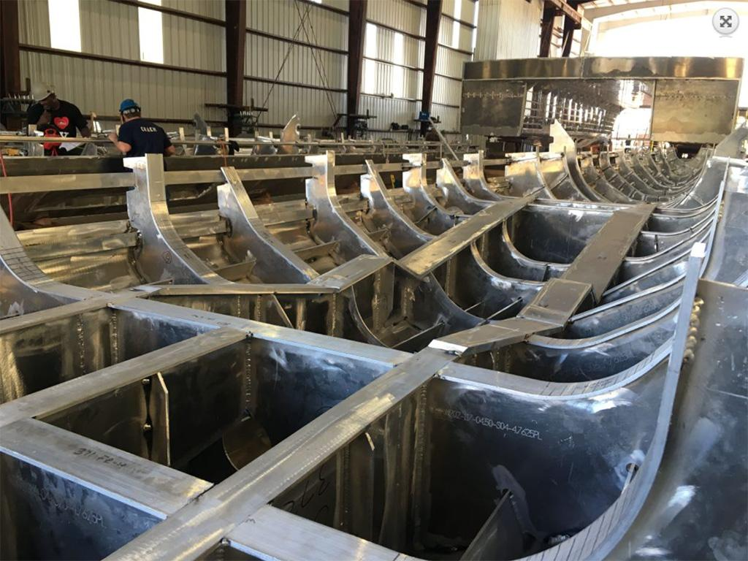
New Vessel Technologies
Environmentally Responsible Design
Vessel Operating Goals
Minimize energy use
Minimize air emissions and discharge
Vessel Construction Goals
Minimize drag
Maximize use of recycled and renewable material
Minimize waste and scrap
New Tech
Design software
Diesel /Electric
Hydrogen Fuel Cell
Notes:
Design software - (computational fluid dynamics)

Slide 28
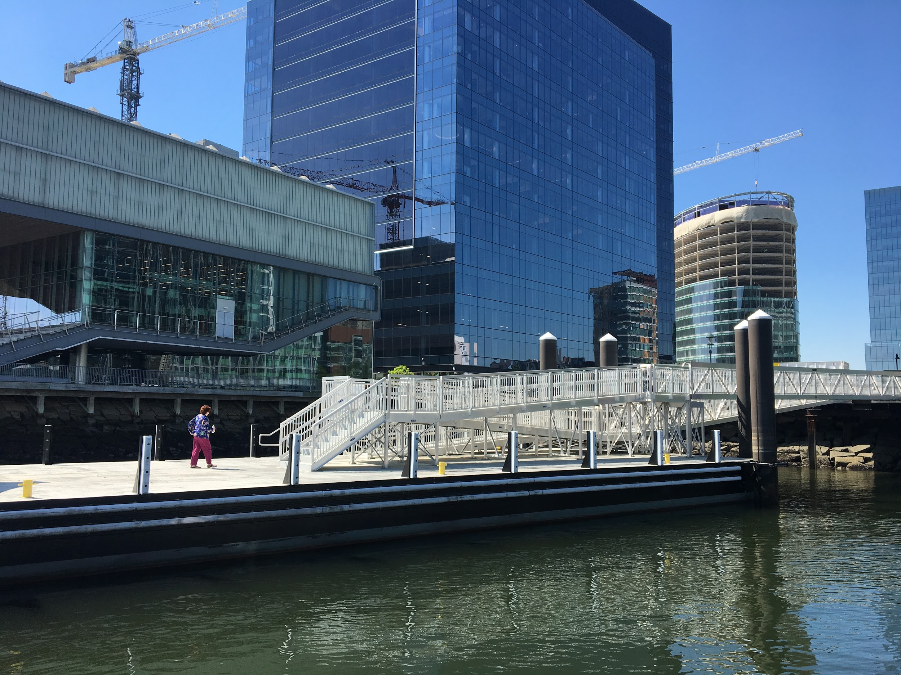
Break-out Session 2: Your Criteria for Prioritizing Sites and Routes

Slide 29
Past Board Presenations

Slide 30
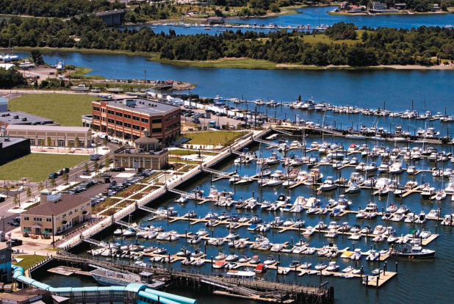
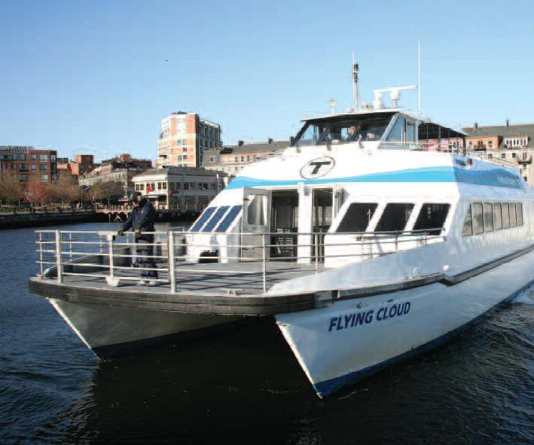
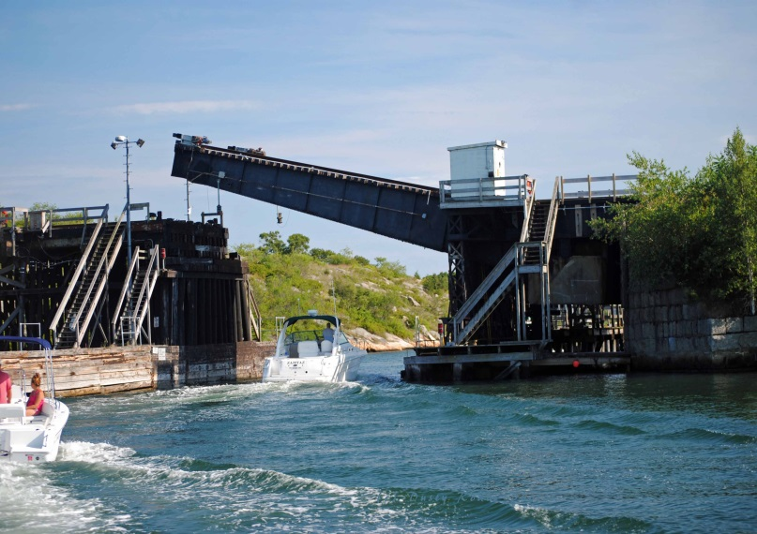
Water Transportation
Advisory Council
March 9th, 2017

Slide 31
Key facts and details
- Water Transportation Advisory Council was created by statute in 2016.
Chaired by the Secretary of Transportation
staffed by MassDOT and the MBTA
Membership is proscribed in statue, though it may be expanded. Currently includes:
Co-Chairs of the Joint Committee on Transportation.
Several Mayors and Town Managers from coastal communities
Massport, Seaport Economic Council…
Boston Harbor Cruises & Steam Ship Authority
Boston Harbor Now
Authority: Advisory to the Secretary of Transportation
The Council is advices the Secretary

Slide 32
Water Transportation Advisory Council Overview
On July 31st, 2016 the Legislature enacted HB 4450, creating the Water Transportation Advisory Council
Create a vision for a comprehensive system of water transportation services to serve the commonwealth’s ferry passengers, including commuters and tourists
Identify an overall vision for the ferry system to enable the transportation of people, goods and vehicles by water
Develop a series of goals and objectives to support the overall vision
Identify implementable policies and improvements including, but not limited to, investment of public funds to support operating and capital expenses for existing and new ferry services
Support the state agencies and independent authorities responsible for planning, designing, constructing, operating, funding and maintaining the ferry transportation infrastructure facilities
Meet at least quarterly and report on activities every 6 months

Slide 33
Key Element of Work Plan
Review and give feedback BostonHarborNow Sustainable Water Transportation Study*
- Business cases presentations for current and past services
Infrastructure/Systems tours
Geographic Working Groups to explore connectivity and coordination options. Including:
Land side connectivity
Walking, biking, & transit
Parking best practice
Economic development & supportive land use
*more information on next slide

Slide 34
Summary: “A Comprehensive and Integrated Water Transportation System Study for Boston Harbor”
Boston Harbor Now to solicit and manage consultants on behalf of principal clients MassDOT and Massport plus a consortium of public and private funders
Goals 1) Compile baseline site profiles for planning of passenger ferry services
2) Comprehensive business plans for up to three financially sustainable services that can be launched in 1-5 years
RFP to be issued in March of 2017 and 8-10 months to complete work
Geography is Gloucester to Provincetown, inner and outer harbor up to dams
Also includes National Park Service funded Transportation Vision, Strategy and Action Plan for the Boston Harbor Islands National and State Park

Slide 35
Study: Project Deliverables
Criteria defined and consistent data compiled for +/- 25 potential passenger ferry sites harbor wide. Can serve as a baseline for ongoing evaluation and planning if maintained and updated
Clear and transparent methodology for evaluating which sites can support financially sustainable services and in what time frame
Business plans for up to three new or expanded and financially sustainable services that could be launched in next 1-5 years

Slide 36
Key MassDOT & MBTA Staff
Astrid Glynn – MassDOT Rail & Transit Administer
John Ray – Assistant General Manager Commuter Rail Services
Mimi Lannin – Deputy Director of Finance Rail & Water Transportation
QUESTIONS?

Slide 37
Appendix

Slide 38
Water Transportation Advisory Council Members
Secretary of Transportation (Chair)
General Manager of the MBTA
House Chair on Joint Committee on Transportation
Senate Chair on Joint Committee on Transportation
President of Boston Harbor Now
Officer of Boston Harbor Now
Executive Director of Seaport Economic Council
General Manager of Woods Hole, Matha’s Vineyard and Nantucket Steamship Authority
CEO of Massport
Representatives of private ferry operations
Mayors of Boston, Lynn, New Bedford, Quincy and Salem
Town Managers of Hingham, Hull, Provincetown and Winthrop

Slide 39
Water Transportation Advisory Council Members
Stephanie Pollack – Secretary of Transportation and MassDOT CEO
Brian Shortsleeve – MBTA Acting General Manager
Senator Thomas McGee – Senate Chair on Joint Committee on Transportation
Representative William Strauss – House Chair on Joint Committee on Transportation
Cathy Abbott – Boston Harbor Now
Philip Griffiths – Boston Harbor Now
Caroline Kirk – Seaport Economic Council
Ellen Cebula - Seaport Economic Council
Wayne Lamson – Steamship Authority
Tom Glynn – MassPort
Alison Nolan – Boston Harbor Cruises
Martin Walsh - City of Boston
Judith Kennedy – City of Lynn
Jon Mitchell – City of New Bedford,
Thomas Koch City of Quincy
Kim Driscoll – City of Salem;
Ted Alexiades – Town of Hingham
Philip Lemnios – Town of Hull
David Panagore – Town of Provincetown
James McKenna – Town of Winthrop
Carlo DeMaria - Everett
James Folk - Convention Center Authority

Slide 40
Calendar (DRAFT)
February 23 10am to 12pm | Work Plan/Schedule Adoption Winthrop Case Study Final update on Boston Harbor Now Study Set Working Groups
May 25 10am to 2pm | Boston Harbor Infrastructure & Ferry Locations Tour and meeting Quincy Case Study
September 14 10am to 12pm | Lynn/Salem Case Study Understanding the work of the SEC – Presentation by Ellen Cebula Parking best practices
December 15 10am to 12pm | TBD

Slide 41
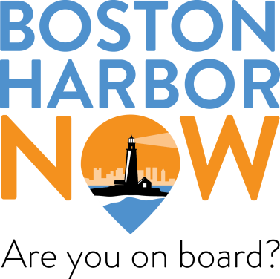
A Comprehensive and Integrated Water Transportation System Study for Boston Harbor
Criteria defined and consistent data compiled for +/- 25 potential passenger ferry sites harbor wide. Can serve as a baseline for ongoing evaluation and planning if maintained and updated
Clear and transparent methodology for evaluating which sites can support financially sustainable services and in what time frame
Business plans for up to three new or expanded and financially sustainable services that could be launched in next 1-5 years
From NPS study a framework for next Harbor Islands ferry contract (2019)
Notes:
Maintaining and updating data may be of interest to the Water Transportation Advisory Council
Consultant expertise and value in:
understanding what we need to profile and how various components of profile weigh in potential success of a service
what time frames and how to categorize services for evaluation, and best practices that inform definitions of “financially sustainable”
detailed market and feasibility analysis requirements specific to passenger ferry services (different from other transportation demand modelling)

Slide 42
A Comprehensive and Integrated Water Transportation System Study for Boston Harbor
Study Approach
Establish a comprehensive list of potential passenger ferry sites harbor-wide, anticipate +/- 25 sites
Compile site profiles, including potential ridership demand, infrastructure, local development/zoning/planning activities and intermodal connectivity
Evaluate each site for likelihood of supporting financially responsible service in 1-5 years and 5-10 years
Select +/- 10 promising sites for ridership demand modelling
Select +/-3 sites or networks for detailed market and feasibility analysis
Develop comprehensive business plan and financial sustainability analysis
Notes:
“Funnel” approach
existing data…
existing models…
then new survey or other data at detailed market analysis
Task include:
best practices for alternative fuel vessels and emissions impact models
model boat specs and estimated costs and time frames for procurement
analysis of grant possibilities and applicability to proposed services

Slide 43
A Comprehensive and Integrated Water Transportation System Study for Boston Harbor
Project Implementation Schedule
January/February 2017 - Boston Harbor Now and, MassDOT finalizing consultant scope of services and confirming funding commitments
March 2017 – anticipated release of RFP
Anticipate 8-10 months for work once contract awarded

