Slide 1
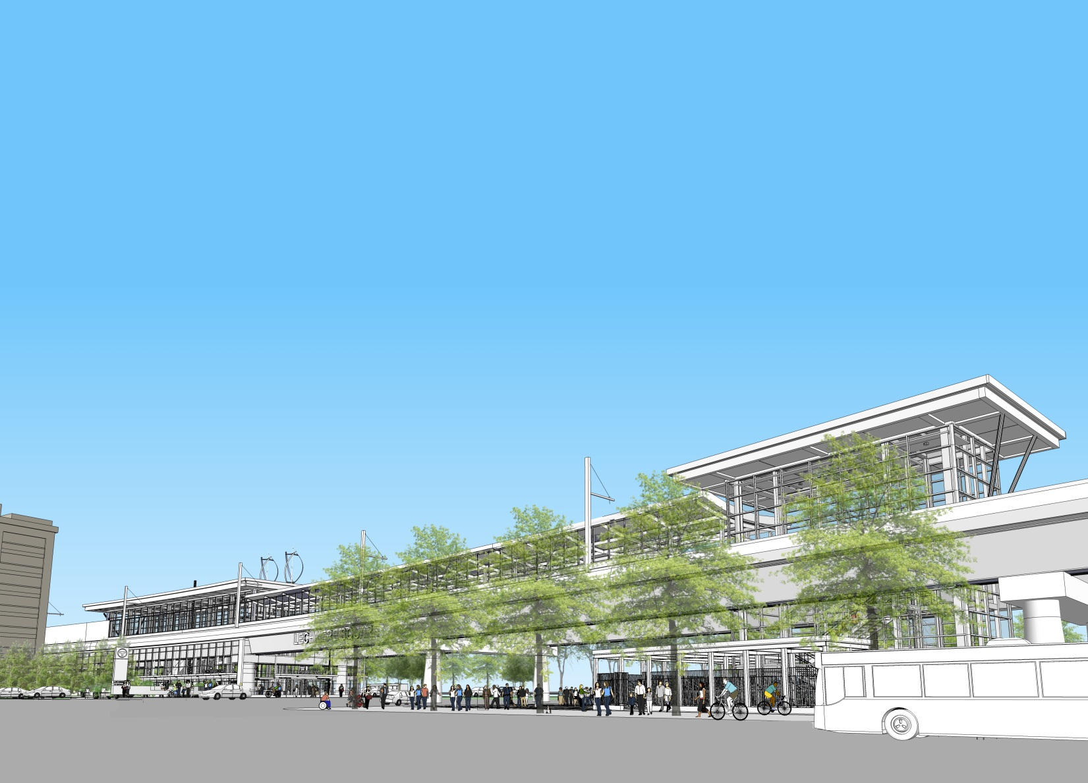
GLX Project
Green Line Extension Project

Slide 2
Agenda
Design Build Procurement Status / Schedule
GLX Program Management/Construction Management (PMCM) Contract
GLX Staff Deployment Status

Slide 3
Project Schedule Highlights
Issue Final RFP 5/23/17 (Actual)
Alternative Technical Concept (ATC) Process 5/30/17 – 8/9/17 (Actual)
FTA Finance Plan Submission 6/5/17 (Actual)
Design Build Proposals Due 9/28/17
Bid Opening/Select Design Build Entity 11/28/17 11/17/17 (11 days early)
Notice to Proceed to Design Build Entity 2/9/18 12/11/17 (61 days early)
Project Completion 12/10/21
-DRAFT-
Notes:
One-on-Ones – Does this term need to be defined? -NP

Slide 4
GLX Design Build Procurement Status
Final round of Design Build (DB) team one-on-one meetings held August 10th
DBE Networking Forum hosted August 16th (second such event)
Second Site walk hosted with 3 shortlisted DB teams August 22nd, 23rd
Alternative Technical Concept (ATC) process completed on August 25th
DB proposals due from Design-Build teams September 28, 2017
Technical evaluation to commence upon receipt of proposals; price opening scheduled for mid-November.
Notes:
“internal and external stakeholders “ – do we need to clarify that the Friends of the Community Path should not be waiting by the phone for a call? -NP

Slide 5
GLX PMCM Procurement
At May 15, 2017, FMCB meeting, board approved contract to CH2M Hill for GLX Program Management/Construction Management Services ($57M)
August 2, 2017, Jacobs Engineering Group and CH2M Hill announce Jacobs Engineering Group’s acquisition of CH2M Hill.
Jacobs Engineering currently serving as the lead designer on one of the 3 competing GLX Design-Build teams
To mitigate any potential or perceived conflict of interest, CH2M Hill’s contract for GLX PMCM services was terminated August 10, 2017.

Slide 6
GLX PMCM Procurement (cont’d)
Termination of PMCM contract has no impact on the Design Build procurement schedule (including submission of proposals, evaluation of proposals or subsequent award of DB contract).
GLX Program Delivery Team coordinating with the FTA to optimize path forward.
The Program Delivery Team is also currently engaged in discussions with the potential PMCM team.

Slide 7
GLX Staffing
Updated GLX Resource Deployment plan
Presently 47 FTE’s supporting GLX representing MBTA staff, Design Professional and outside resources
Continue ongoing MBTA hiring effort
8 new resources joined GLX mid-August
Presently interviewing candidates for 9 additional positions
Job Postings currently open for 5 additional positions

Slide 8
glx

