Slide 1
GM Remarks
Fiscal and Management Control Board
September 11, 2017

Slide 2
Agenda
Public Engagement
Bus Maintenance Update
Major Projects
Contracted Services Report
Commuter Rail Management Organization
System Performance
Bus Rodeo
Coming Attractions
Thank you I, II and III

Slide 3
Public Engagement
Positive Train Control – Weekend Closures
Needham, Haverhill, and Fairmount
Possible Franklin, Fitchburg, Worcester (2018 may be rolled into 2017)
Solar Array Panels at MBTA stations and parking lots
Beginning October 2017 through December 2018 at 37 sites
GLX Early Works
Public meetings with elected officials and neighborhood groups have been ongoing since early Spring
Red Line Station Projects
Wollaston Station and Quincy Center NTP issued June 30th
Quincy Adams and Braintree Garage NTP expected January 2018
100% Design public meetings were held late spring/early summer 2017 for each project
Three Wollaston Station meetings were held due to sensitivity of the closure
Digital Urban Panels
Digital information panels will be located around the MBTA subway and commuter rail system

Slide 4
Bus Maintenance RFP Timeline
DEADLINE | ACTIVITY
7/21/2017 | Release RFP
8/8/2017 | Pre-Proposal Conference
8/8/2017 | Facility Site Visits
8/11/2017 | Deadline to Submit Questions to the MBTA
9/15/2017 | Deadline for MBTA to Respond to Questions
9/27/2017 | Proposals Due
9/27/2017-10/13/2017 | Proposal Evaluations & Oral Presentations
10/16/2017-10/20/2017 | Best & Final Offer
10/23/2017 | Estimated Contract Award

Slide 5
Key Addenda
Responses to 191 vendor questions during request for clarification (RFC) period
Revisions to Exhibit 9.1 – Standards of Maintenance
Full inventory of equipment in facilities and onboard buses to delineate asset ownership and maintenance responsibility for Proposers (e.g., lifts / hoists, bus video equipment, radios)
Such an inventory had not previously existed
Additional addenda clarifying environmental and safety permits required for Contractor to operate MBTA facilities
Modifications to required invoicing procedures

Slide 6
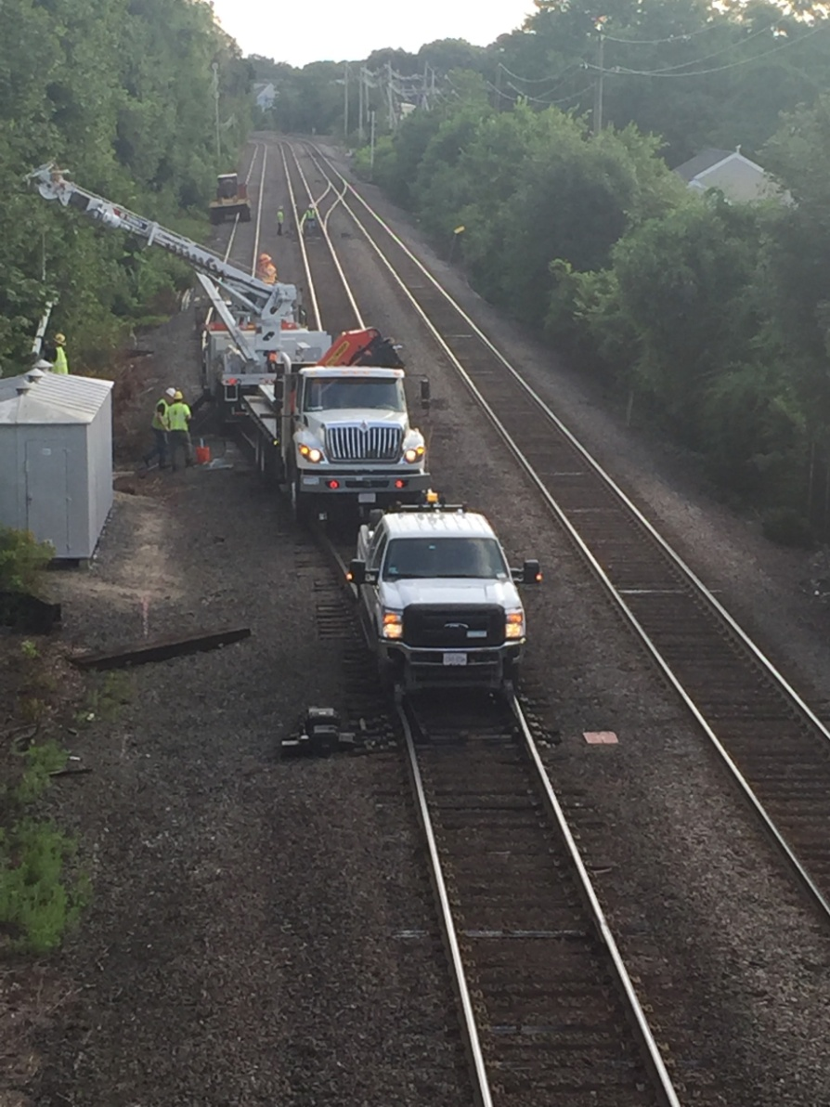
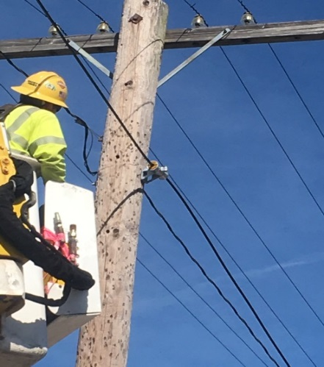
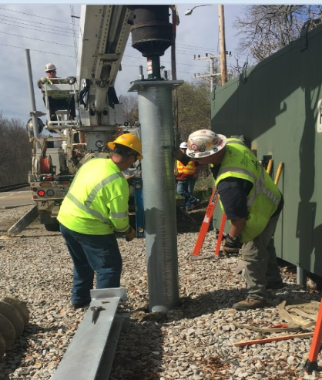
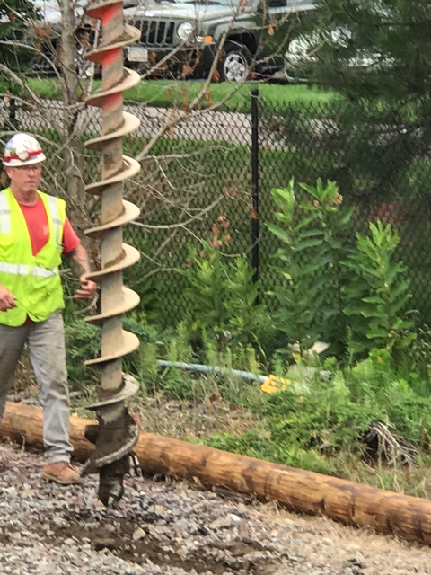
Positive Train Control (PTC) Program Status
The PTC field installation work is proceeding according to the shutdown schedule:
Work started on September 2nd on the Needham Line
Work is continuing on the Lowell Line through the September 30th weekend
Work will start on the Haverhill Line on the weekend of September 23rd
Weekend shutdowns are planned to support the “bulk work” that needs to be done on each line. Field installation work is taking place before, during and after the shutdown periods on each of the commuter rail lines.
We are continuing our outreach to elected officials and community groups in support of the PTC weekend shutdown plans.
PTC House Installation Overhead F.O. Installation Antenna base installation Pole installation

Slide 7
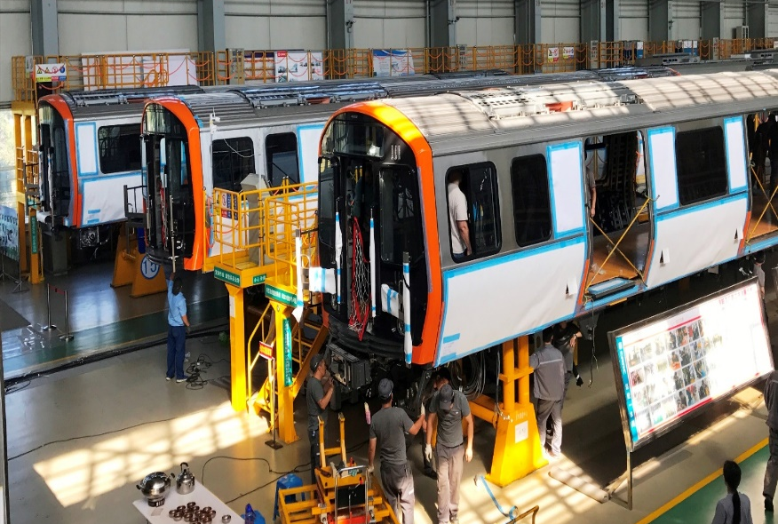
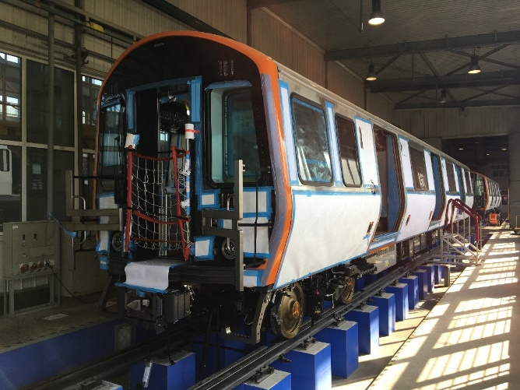
Red and Orange Line Vehicle Procurement
Orange Line Car Manufacture
Pilot Cars 1 – 2 are in testing in Changchun
Pilot Cars 3 – 6 are in various stages of manufacture
Production carshells 7 – 12 are in various stages of manufacture in Changchun
Orange Line Pilot Car Delivery
Pilot Cars are on schedule for delivery in December 2017
Notes:
Orange Line Pilot Car Testing
MBTA Staff is in Changchun this week to witness testing of Pilot Cars 1 – 2
MBTA Test Engineers will remain in Changchun through the shipment of the pilot vehicles
Acceptance testing in Boston will commence upon Pilot Car delivery and continue through December 2018
Red Line Car Design Review
Red Line Car design has commenced
Design Review kick-off and initial meetings were held in both Boston and Changchun in August
Red Line Car design will use the same subsystems (e.g. trucks, HVAC, lighting, propulsion, communication) and many similar other components for interior and carshell as the Orange Line cars, simplifying the design process.

Slide 8
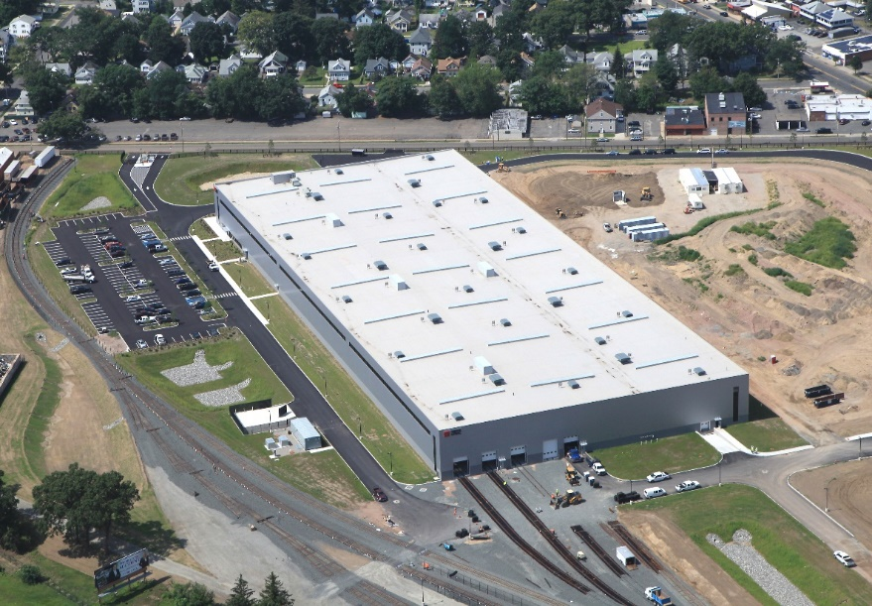
Red and Orange Line Vehicle Procurement – CRRC Springfield, MA
CRRC MA Springfield Facility
Facility construction is on schedule
Staff is being trained in Changchun and participating in manufacturing as well as testing
Assembly of first Orange Line Production Cars will commence in January 2018
MBTA is performing a readiness audit in late September 2017

Slide 9
Other News
Report on Contracted Services
Commuter Rail Management

Slide 10
Locomotive Availability Past 12 Weeks
Commuter Rail

Slide 11
Locomotive Availability and Cancellations Last Week
Commuter Rail

Slide 12
Commuter Rail
Coach Availability
Last 12 Weeks

Slide 13
Commuter Rail
On Time Performance (Actual)
Last 4 Weeks

Slide 14
Peak Subway OTP: August 28 – Sept. 8 (Weekdays)*

Slide 15
Off-Peak Subway OTP: August 28 – Sept. 8 (Weekdays)*

Slide 16
Key Bus Route OTP: August 28-Sept. 8 (Weekdays)*

Slide 17
Bus Rodeo

Slide 18
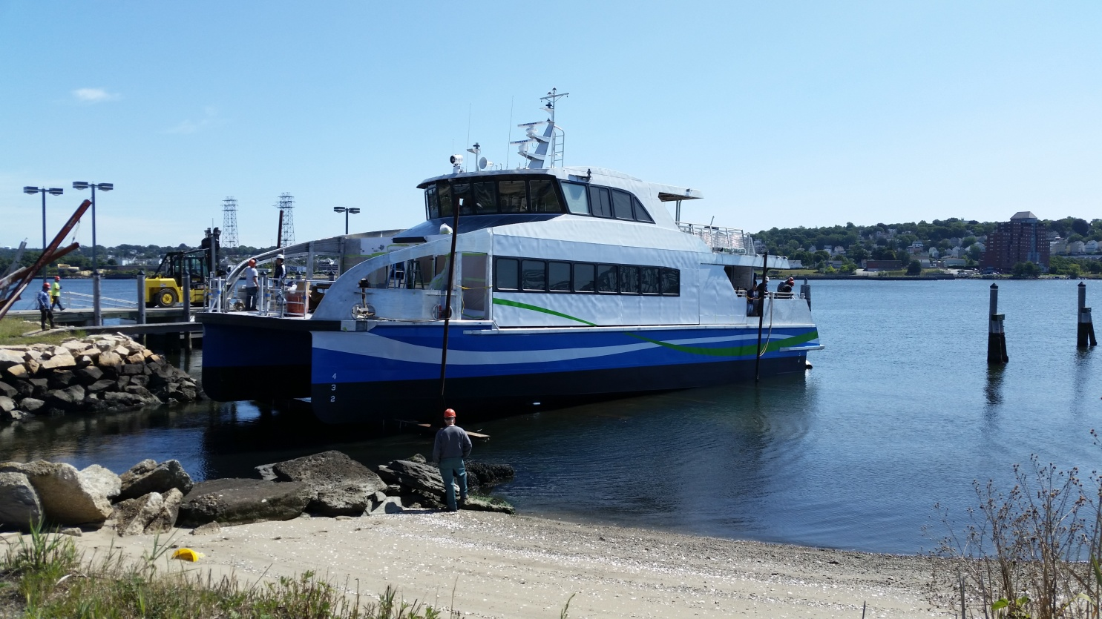
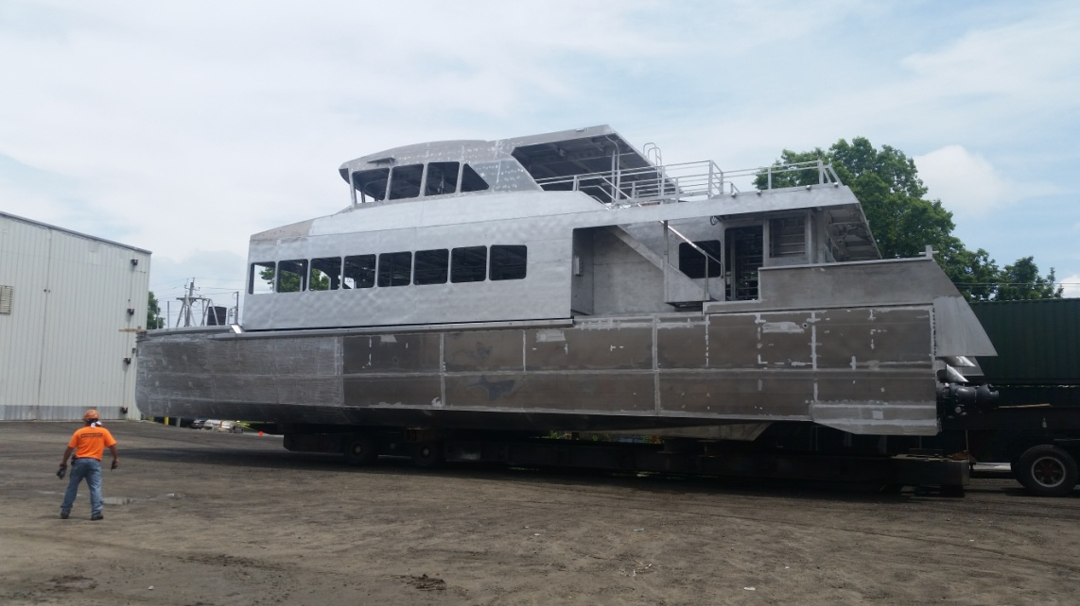
Coming Attractions - Champion & Glory
Contract Awarded: Notice To Proceed was issued on October 15, 2015
Contract Value: $13,577,998
Champion
Scheduled for delivery to MBTA for testing the week of September 25
Glory
In Fabrication scheduled for delivery mid December 2017
Champion being launched
September 1, 2017
Notes:
Two 149 Passenger Ferry Procurement
Contract:
$11,029,017 for material (ferries)
$504,000 for project admin and indirect
$1,165,655 for professional services
$879,326 for contingency
Total: $13,577,998
Finish List for Champion
Sept 7 – Initial Startup and vender checkout
Sept 12 - Dead Weight Survey with Coast Guard
Sept 13 – Install test gear
Sept 14 – Ballast, full weight performance test & wake trials.
Sept 15 - Clean and load for delivery

Slide 19
Coming Attractions – Winter Resiliency

Slide 20
Thank You I

Slide 21
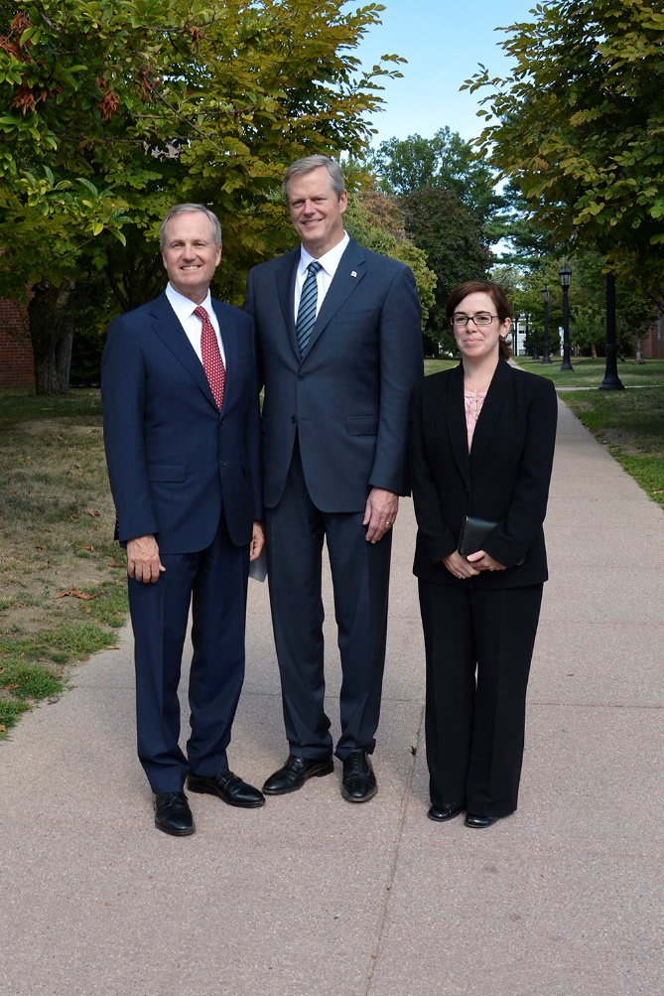
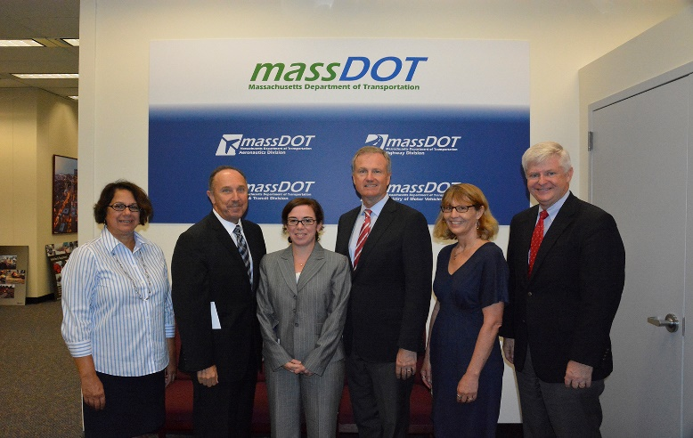
Thank You II – Lisa Calise

Slide 22
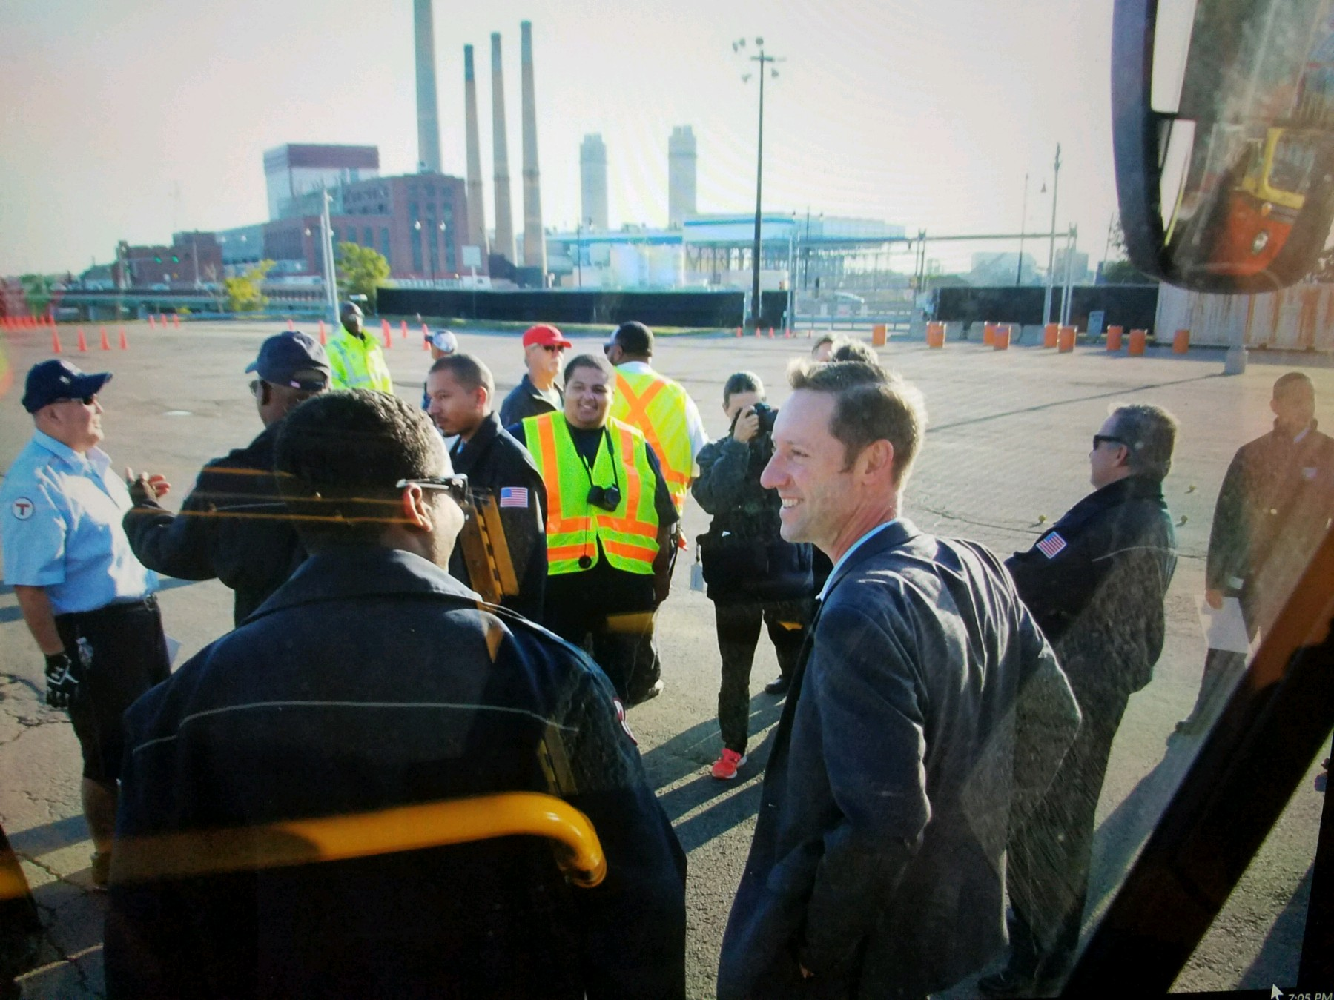
Thank You

