Slide 1
Transit Signal Priority (TSP)
Fiscal & Management Control Board
October 23, 2017

Slide 2
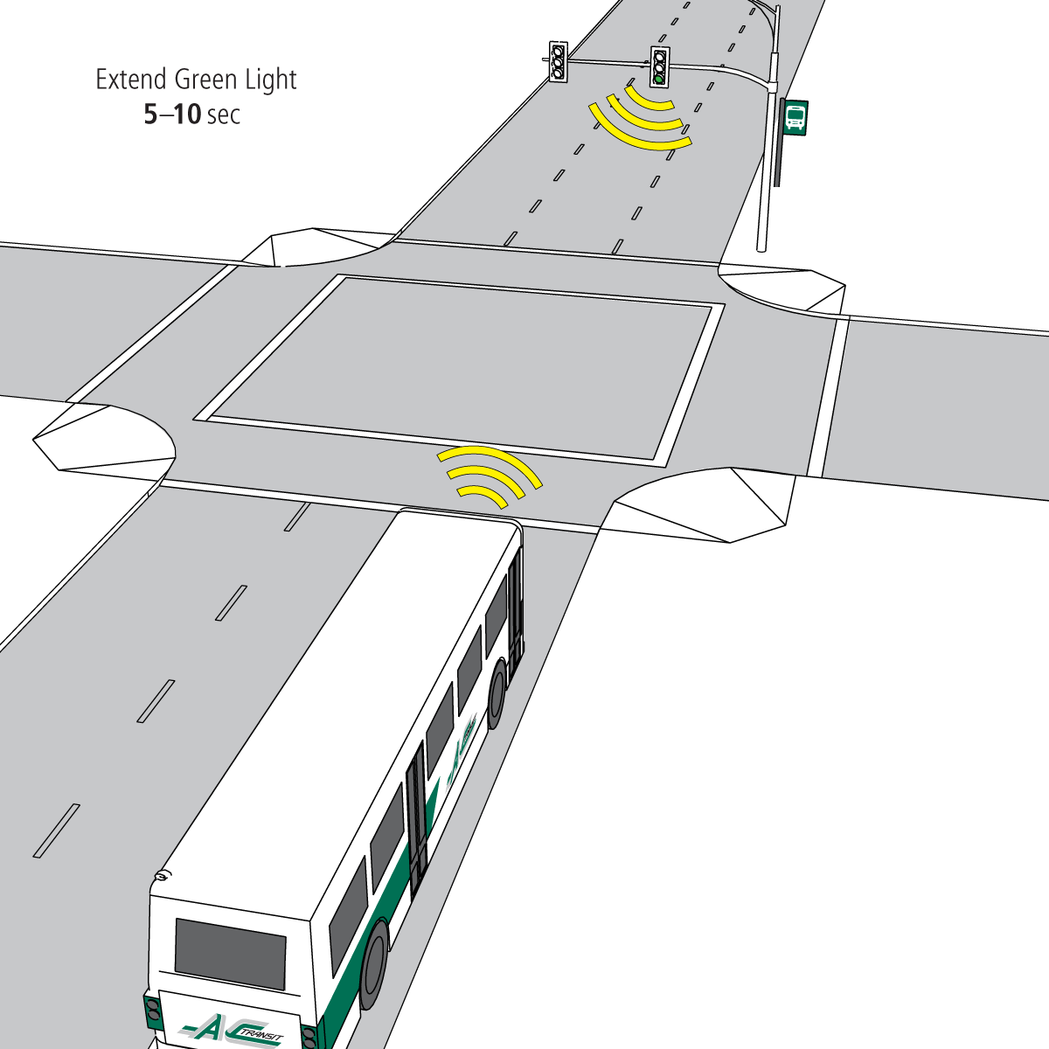
Overview
Transit Signal Priority
Service Delivery Context
About TSP
MBTA TSP Strategy
TSP Signal Pilot Results
Proposed TSP Corridor Pilots
Proposed TSP Roll Out Strategy
Image Source: AC Transit

Slide 3
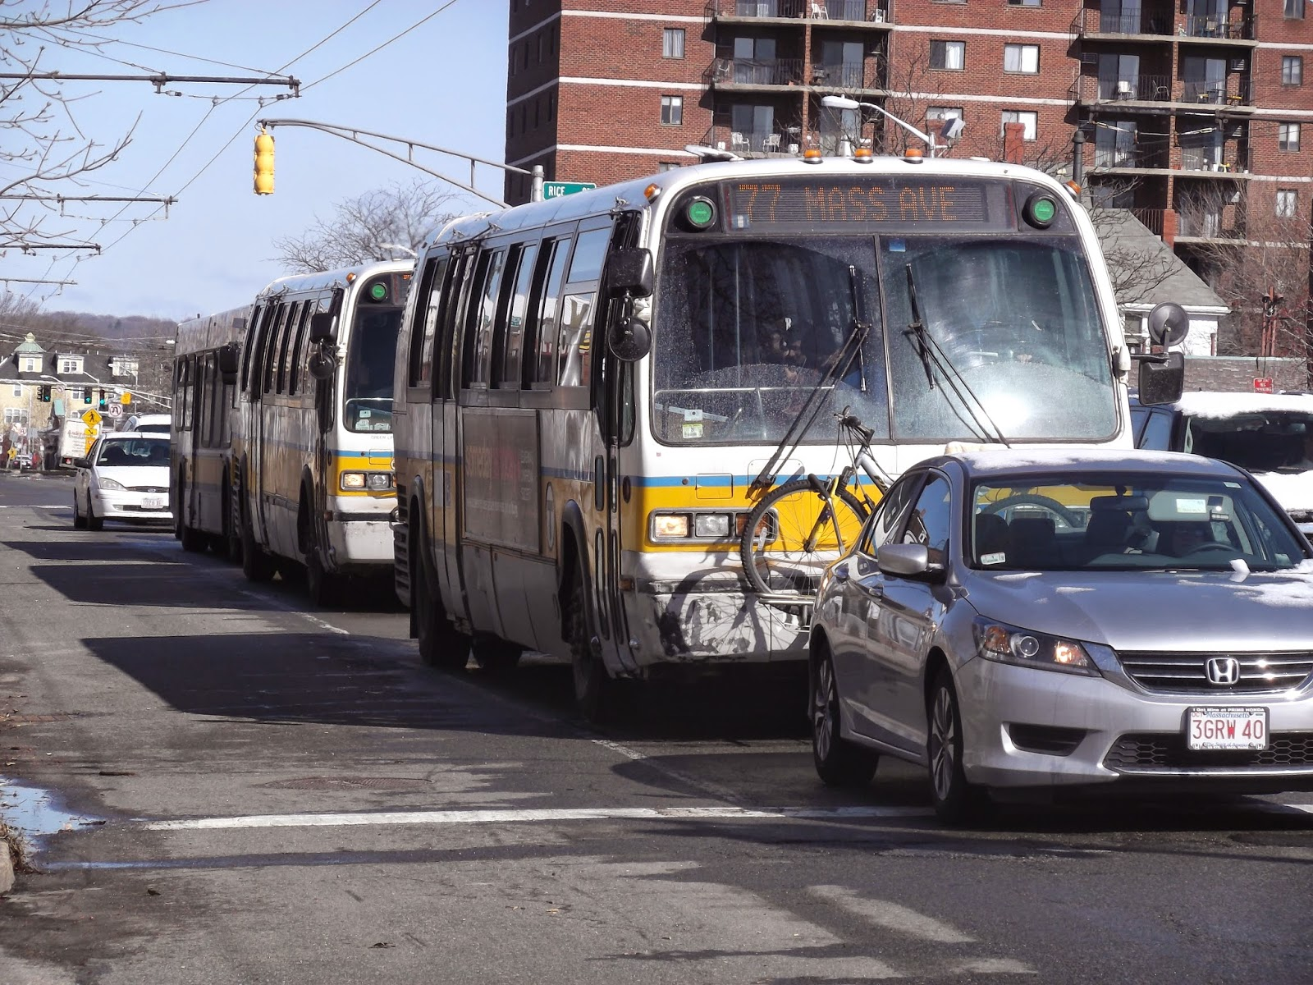
Service Delivery Context
Image Source: @milesontheMBTA

Slide 4
TSP in Service Delivery Context
Transit Signal Priority
Optimal Service Delivery
Planned schedule
Dispatch efficiency
Carrying Capacity
External constraints
Infrastructure upgrades
Vehicle design and quantity
Improve run time
Reliability
Optimal service delivery means trains/buses arrive within their scheduled headway, and with enough space for all passengers to board.

Slide 5
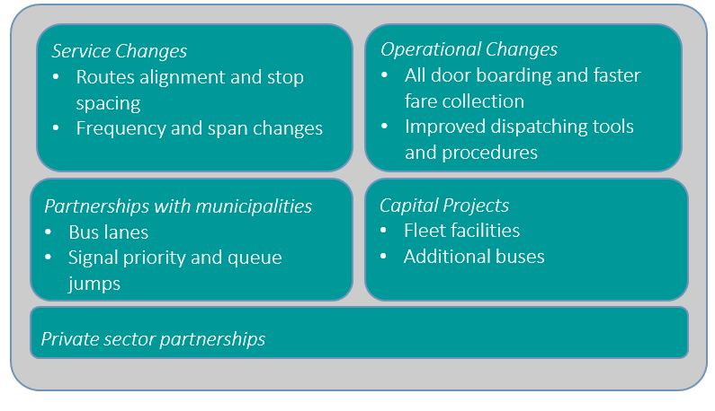
TSP: A Tactical Tool
Transit Signal Priority

Slide 6
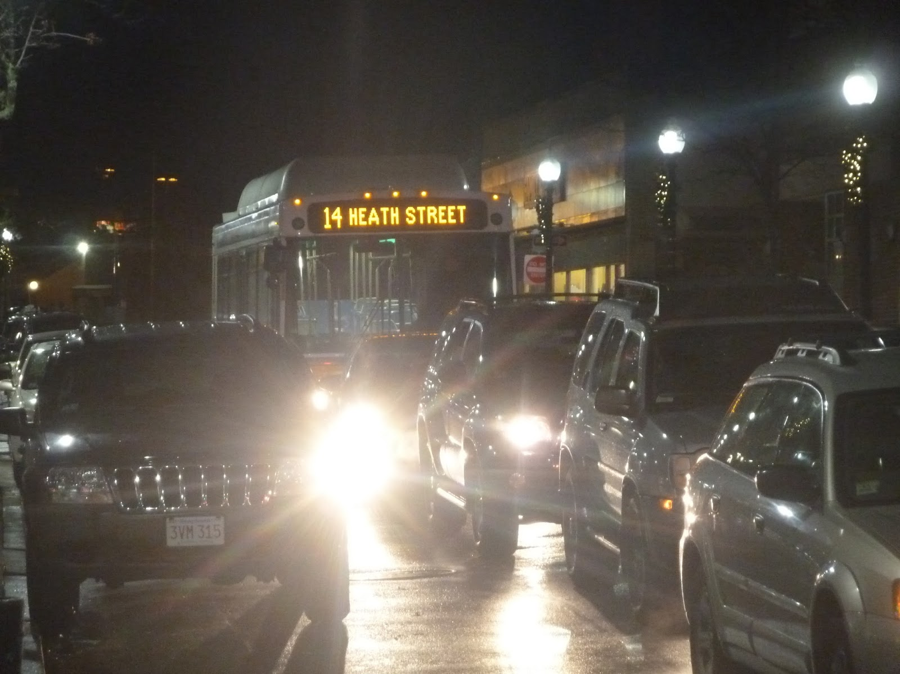
About TSP
Image Source: @milesontheMBTA

Slide 7
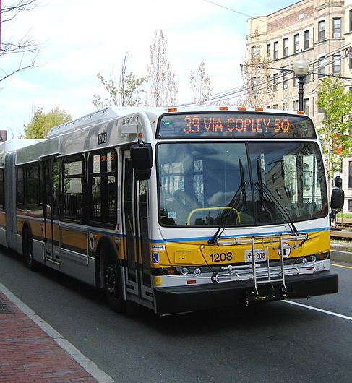
What is TSP?
Transit Signal Priority
TSP uses technology to reduce dwell time for transit vehicles operating in mixed traffic by extending green-light-time, or shortening red-light-time.
TSP helps:
Improve reliability
Reduce travel time
Increase network capacity
Enhance OTP
Image by Grk 1011 licensed under CC BY-SA 3.0

Slide 8
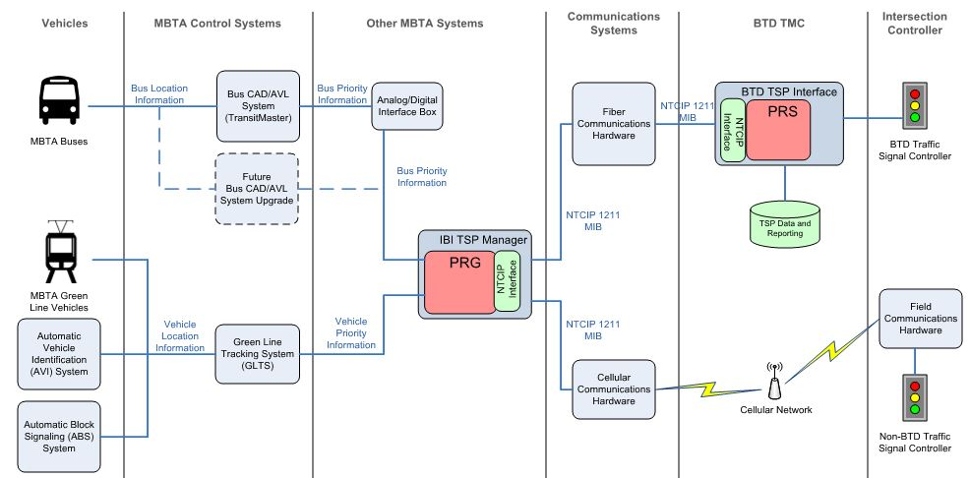
MBTA TSP Communications Scheme
Transit Signal Priority
Image Source: IBI Group

Slide 9
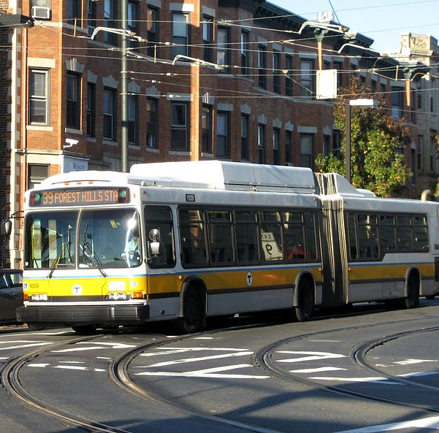
MBTA Requirements for TSP Implementation
Transit Signal Priority
Municipal partnership
Availability of green/red-light-time to “borrow”
Modern traffic control device with space for additional hardware
Far side or no stop at intersection
Applicable to bus and light rail (surface)
Image by Grk 1011 licensed under CC BY-SA 3.0

Slide 10
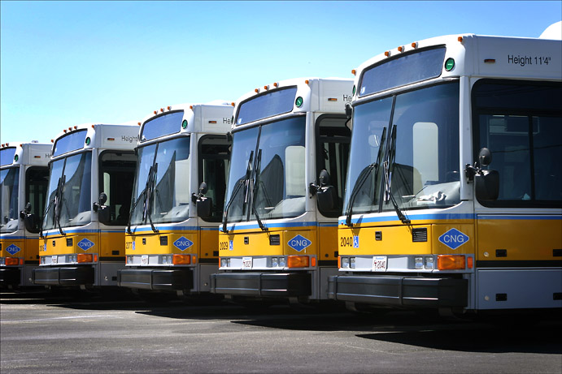
MBTA TSP Strategy
Image Source: MBTA

Slide 11
MBTA TSP Pilot Strategy
Transit Signal Priority
2015
2016
2017
2018
2019
Pilot TSP on corridors
Roll out to high ridership corridors
Develop TSP software and pilot on individual signals
Municipal partnership has been continuously cultivated, and TSP implementation will continue with city/town support.

Slide 12
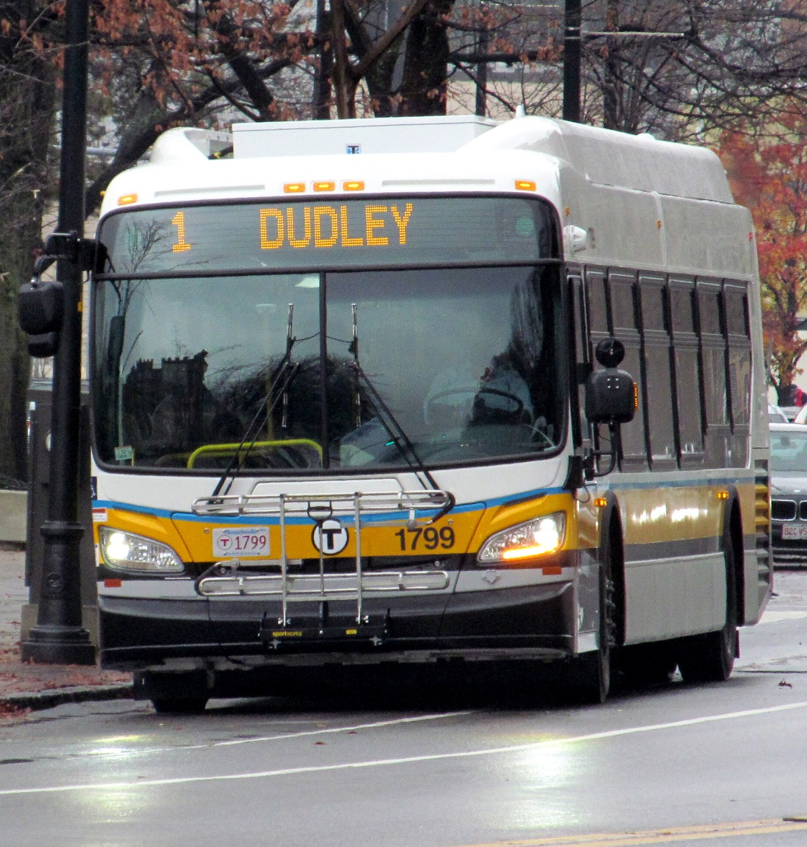
TSP Signal Pilot Goals
Transit Signal Priority
Develop software to connect light rail, buses, and municipal signals
Develop protocols to send and receive TSP requests
Create a scalable, transferable, and feasible implementation process
Successfully give priority to MBTA vehicles in the field
Image by Pi.1415926535 licensed under CC BY-SA 3.0

Slide 13
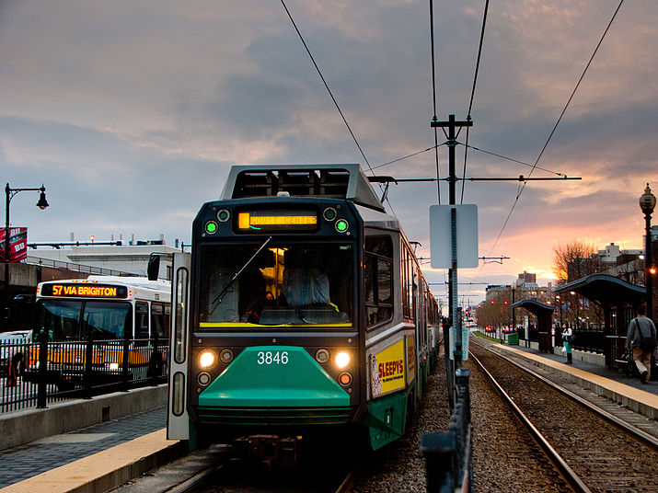
TSP Signal Pilot
Image by Mark Zastrow licensed under CC BY 2.0

Slide 14
TSP Signal Pilot Summary
Transit Signal Priority
Eight signals at six intersections in three municipalities
Two modes: bus and light rail; three Green Line branches
Varying data collection time periods – 5 to 9 days
Signal | Arterial | Mode | City/Town | Route or Branch
Brookline St. (IB/OB) | Massachusetts Ave. | Bus | Cambridge | 1, CT1
Carlton St. (IB) | Beacon St. | Light Rail | Brookline | C Branch
Evans Way (IB/OB) | Huntington Ave. | Light Rail | Boston | E Branch
Longwood Ave. (IB) | Huntington Ave. | Light Rail | Boston | E Branch
Saint Mary’s St. (OB) | Commonwealth Ave. | Light Rail | Boston | B Branch
Silber Way (IB) | Commonwealth Ave. | Light Rail | Boston | B branch

Slide 15
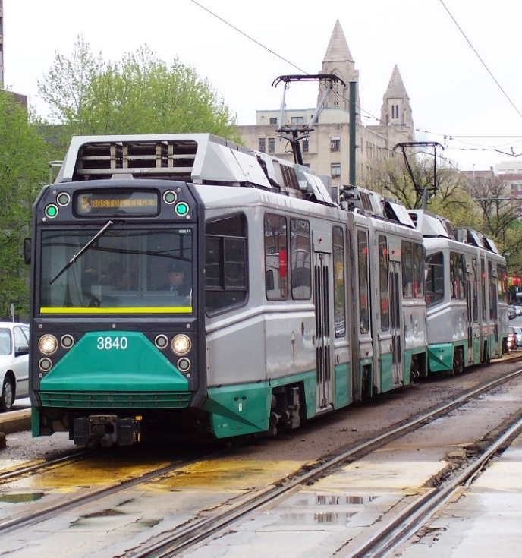
Signal Pilot Results – Green Line B & E Branches
Transit Signal Priority
Results from 9 days of data from 5 signals at AM peak:
Priority was granted 390 times
Green-light-time extended by 14 seconds (average)
Red-light-time reduced by 8 seconds (average)
No demonstrable negative effect to general traffic
Operational since May 2017
Image by Adam E. Moreira licensed under CC BY-SA 3.0

Slide 16
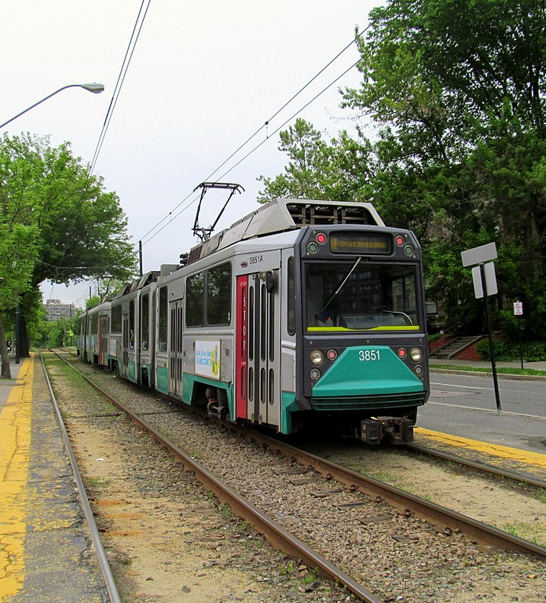
Signal Pilot Results –Green Line C Branch
Transit Signal Priority
Results from 5 days of data from 1 signal at AM peak:
Priority was granted 83 times
Green-light-time extended by 10 seconds (average)
Red-light-time reduced by 6 seconds (average)
No demonstrable negative effect to general traffic
Operational since June 2017
Image by Adam E. Moreira licensed under CC BY-SA 3.0

Slide 17
Signal Pilot Results – Bus Routes 1 & CT1 (Video)
Transit Signal Priority

Slide 18
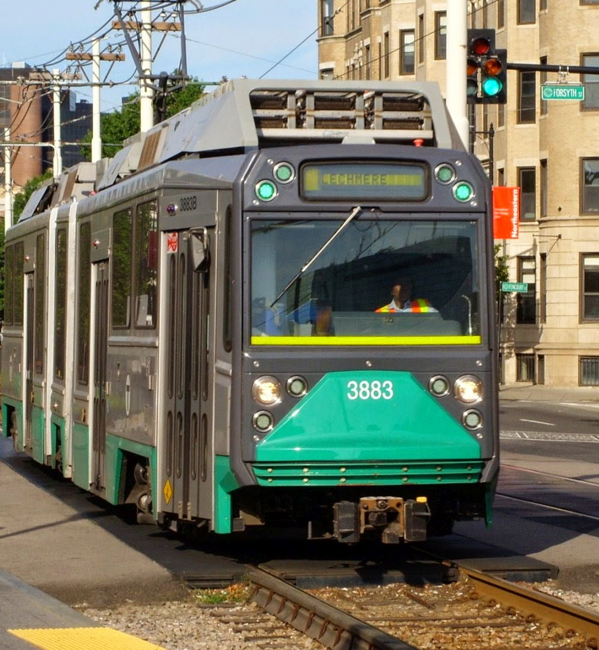
Signal Pilot Results – Lessons Learned
Transit Signal Priority
TSP moves buses and train through signals faster.
Impact on customers is difficult to measure at the signal-level. A corridor approach is recommended.
Success depends on fast processing time, municipal support, and internal resources.

Slide 19
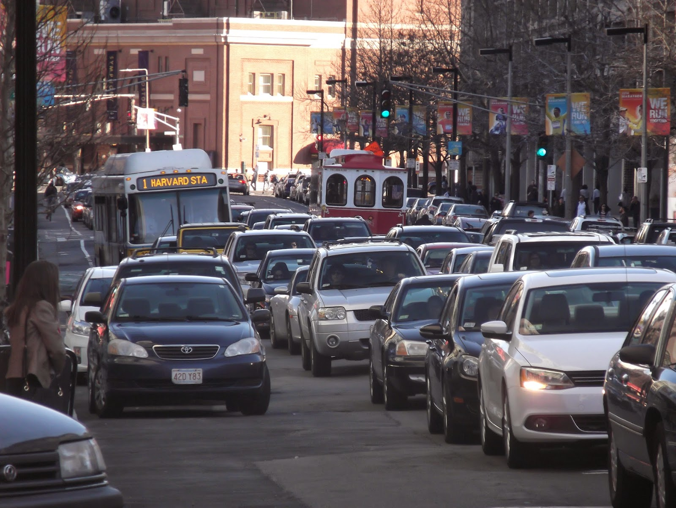
Proposed TSP Corridor Pilots
Image Credit: @milesonthembta

Slide 20
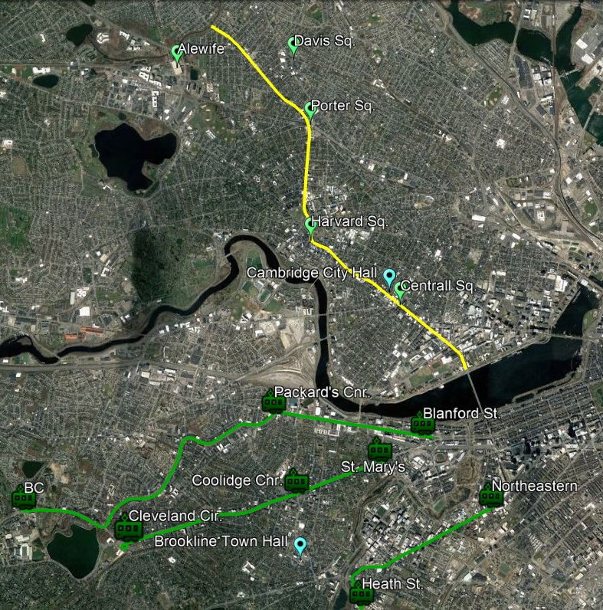
Four TSP Corridor Pilots Proposed
Transit Signal Priority
Beacon Street in Brookline
Commonwealth Avenue in Boston
Huntington Avenue in Boston
Massachusetts Avenue in Cambridge

Slide 21
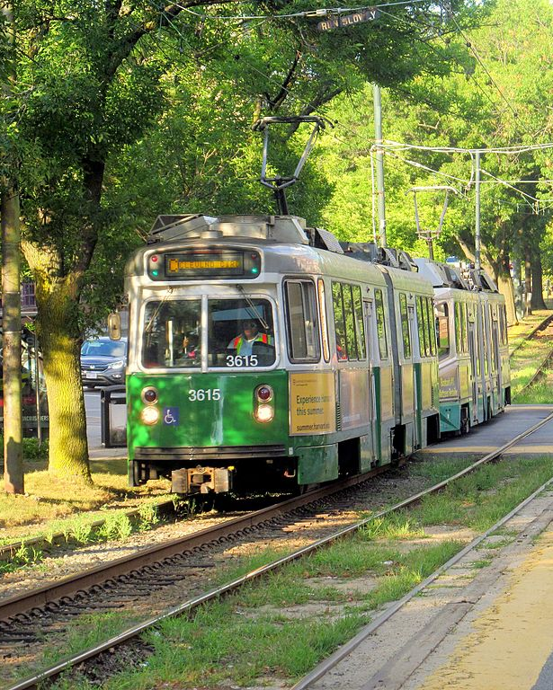
Proposed Green Line Pilot Corridors
Transit Signal Priority
Beacon Street:
9 additional signals serving the Green Line C branch
Commonwealth Avenue:
20 additional signals serving the Green Line B branch
Huntington Avenue:
10 additional signals serving the Green Line E branch
Image by Pi.1415926535 licensed under CC BY-SA 3.0

Slide 22
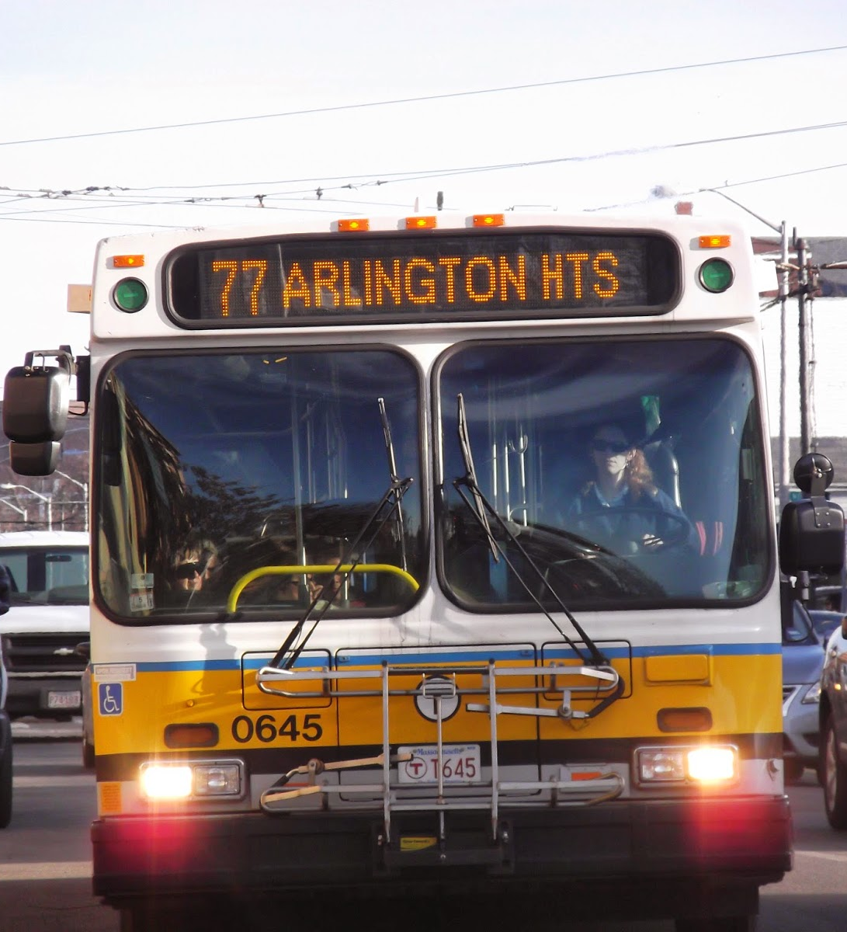
Proposed Bus Pilot Corridor
Transit Signal Priority
Massachusetts Avenue:
50 additional signals between the Boston and Arlington borders in Cambridge.
Serving segments of bus routes: 1, CT1, 47, 64, 68, 69, 70, 70A, 71, 72, 73, 74, 75, 77, 77A, 78, 83, 86, 96
Image Source: @milesontheMBTA

Slide 23
Estimated Cost for Proposed Corridor Pilots
Transit Signal Priority
City or Town | Pilot Corridor | # Signals
Boston | Commonwealth Avenue | 20
Boston | Huntington Avenue | 10
Brookline | Beacon Street | 9
Cambridge | Massachusetts Avenue | 50
 |  | 89
Estimated pilot cost: $1.125 million, or $12,640 per signal

Slide 24
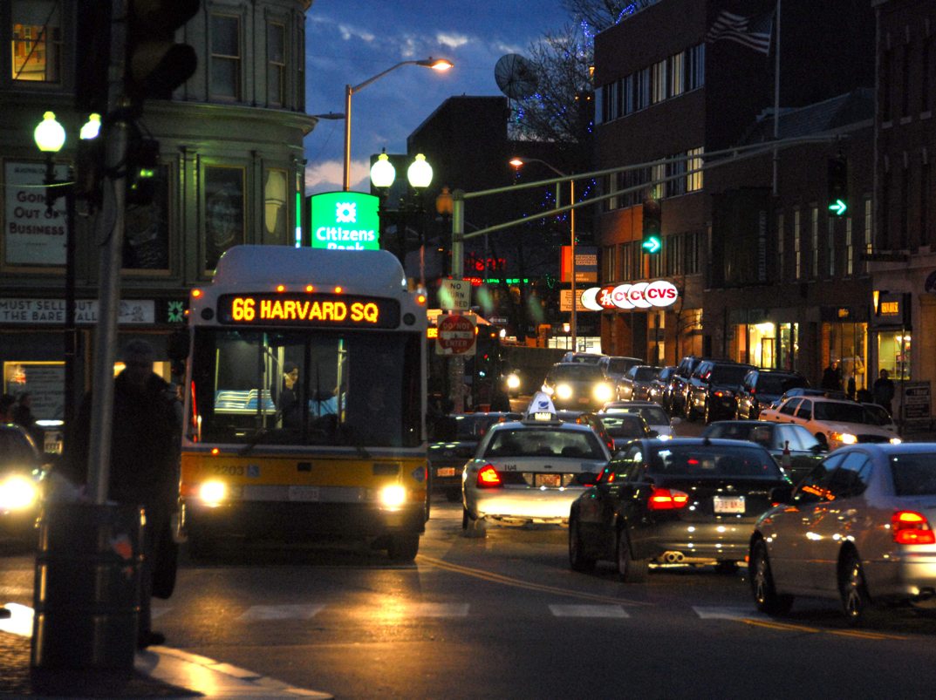
Proposed TSP Roll Out Strategy
Image by Eric Kilby licensed under CC BY-SA 2.0

Slide 25
Post-Pilot TSP Roll Out Strategy
Transit Signal Priority
Focus on high-ridership, high-delay corridors
“Piggyback” on other traffic signal projects to add TSP
Emphasis on municipalities eager to partner
Concentrate on dedicated bus lane corridor candidates
Image by Pi.1415926535 licensed under CC BY-SA 3.0

Slide 26
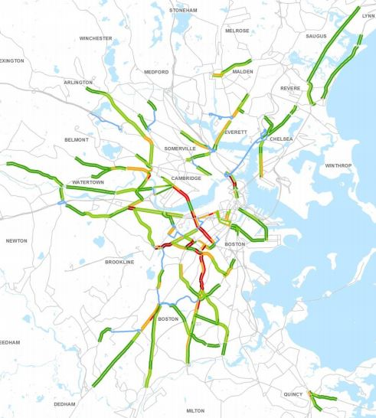
Roll Out: High Ridership & High Delay TSP Corridors
Transit Signal Priority
2016 CTPS study of high-ridership bus corridors with high rates of delay.
Roads identified in 20 communities serving dozens of MBTA bus routes.
All Key Bus Routes operate on parts of these corridors.
Image by CTPS

Slide 27
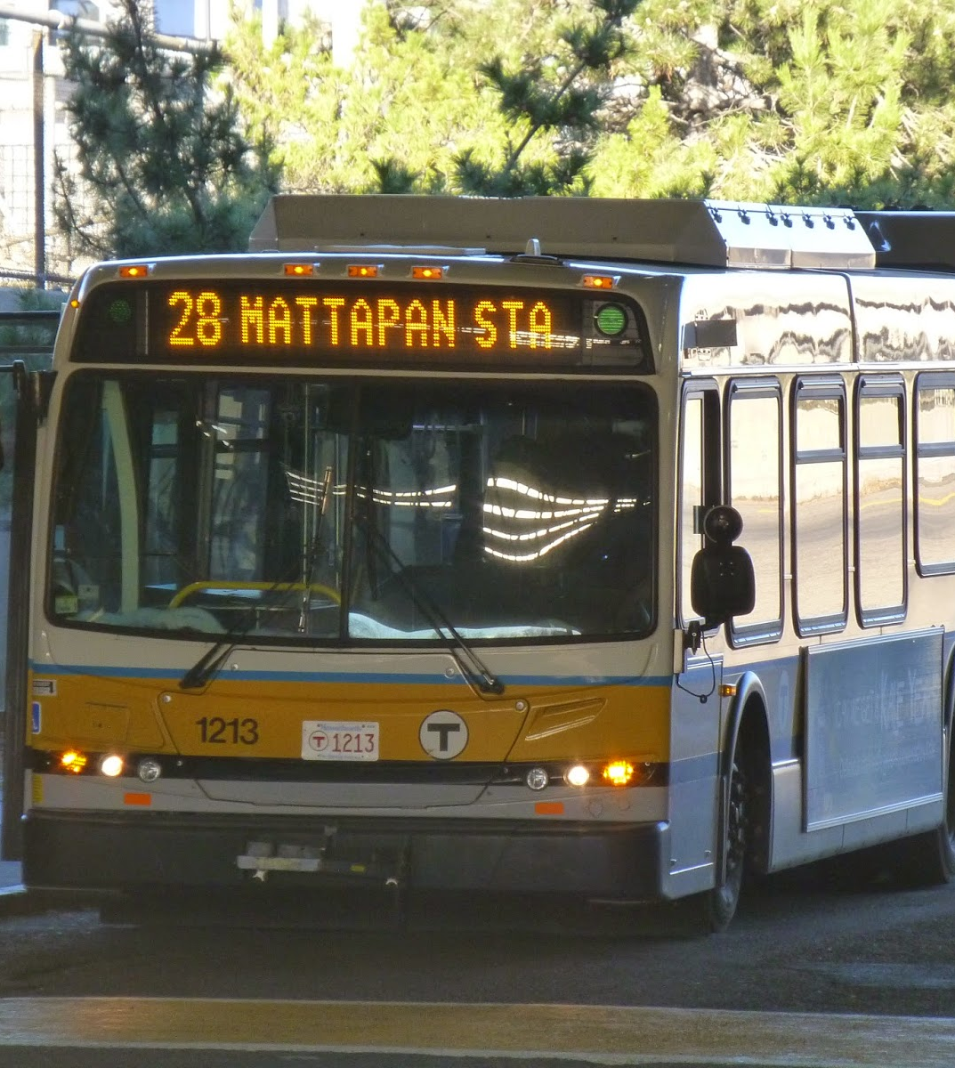
Roll Out: Piggybacking on Existing Projects
Transit Signal Priority
Case Study: Blue Hill Ave. & Warren St. Traffic Signal Improvement Project
Joint Highway/BTD initiative to rebuild 16 intersections, including new traffic signals by 2019
MBTA is working to ensure that TSP is included in the project during design.
Touching on bus routes 14, 19, 23, 28, 29, 44
Image Credit: @milesonthembta

Slide 28
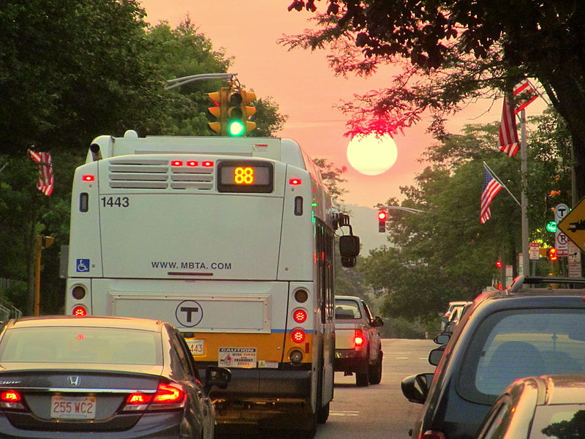
Thank you!
Image by Pi.1415926535 licensed under CC BY-SA 3.0

