Slide 1
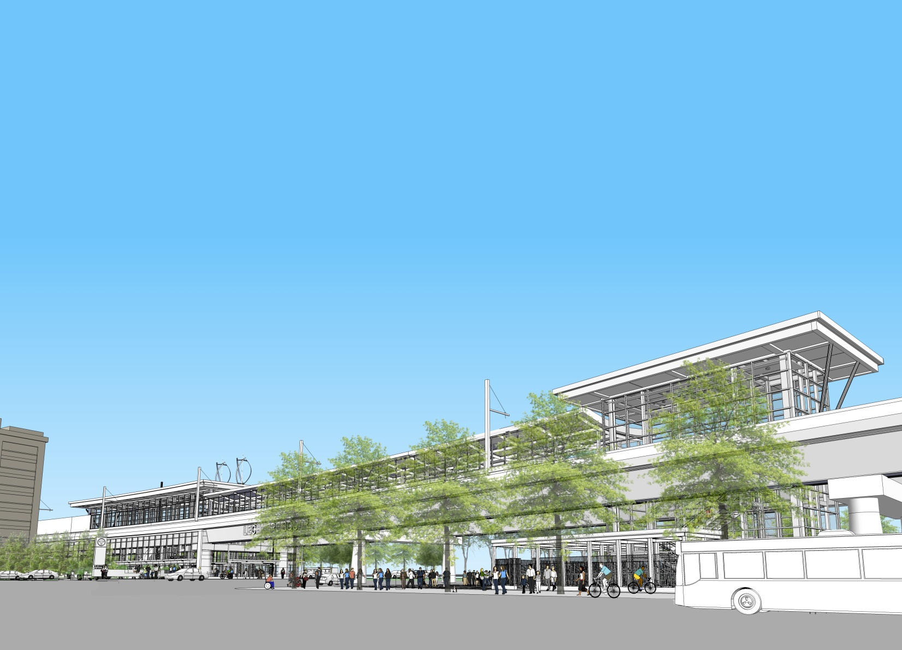
GLX Project
Green Line Extension Project

Slide 2
Agenda
GLX Update
GLX Early Work Summary
Early Work Packages
Recommended Board Action

Slide 3
GLX Update
Design-Build (DB) Procurement Schedule Improvement
DB Notice-to-Proceed (NTP) advanced 2 months from February 2018 to December 2017
Increases field productivity window during 2018 construction season
Receipt of federal funds
All funds expended to date ($536M) have been Commonwealth funds
Grant application approved for federal Congestion Mitigation and Air Quality (CMAQ) funds on June 29, 2017
GLX received first federal funds on July 14, 2017
Notes:
“internal and external stakeholders “ – do we need to clarify that the Friends of the Community Path should not be waiting by the phone for a call? -NP

Slide 4
GLX Early Work Concept
High-risk scope elements identified during GLX redesign effort
Risk items selected due to interface complexities and commuter rail signal coordination
Early Work packages (plus mobilization authorization) to be performed in advance of future GLX Design-Build Entity mobilization:
Tufts Interlocking - $8.3M
Swift Interlocking at Grand Junction - $13M
Additional Track and Signal Relocation Work- $4M
Yard Lead 10 – Proposal/final pricing development underway

Slide 5
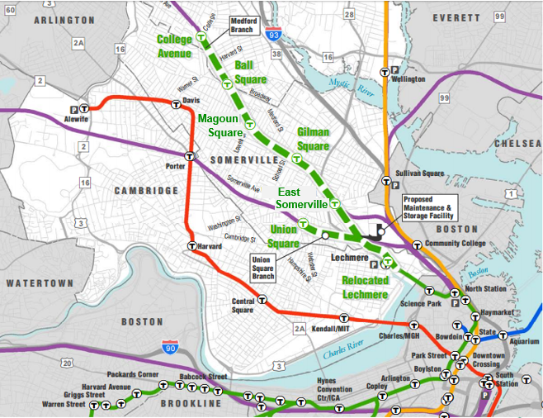
Location of Early Works
Tufts Interlocking
Yard 10 Lead

Slide 6
GLX Early Works Support
Project Initiation (PI) Authorizations – total not to exceed $17M
Scope:
Signal and related track work to replace existing railroad interlocking at Grand Junction in Somerville
Additional Track and Signal Relocation work
Started: March 2017 (Early Mobilization PI)
Anticipated completion: Summer 2018 (prior to DB construction)
Notes:
“internal and external stakeholders “ – do we need to clarify that the Friends of the Community Path should not be waiting by the phone for a call? -NP

Slide 7
Recommendation
That the FMCB approve and authorize the early works project initiation (PI) agreement with Keolis Commuter Services, LLC, for certain signal and related work for Swift Interlocking at Grand Junction and additional track and signal relocation work in support of the Green Line Extension Project, in a total amount not to exceed $17,000,000.

Slide 8
glx

