Slide 1
Human Resources Workforce & Strategy Q2 CY-2017 Update
August 14, 2017

Slide 2
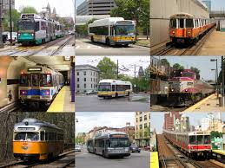
Human Resources Workforce & Strategy Update
Payroll Reduction Program

Slide 3
Bending the cost curve: Streamlining workforce
Human Resources Workforce & Strategy Update – Payroll Reduction Program
Annual value: $51M
$35.5M net salary reduction
($50.7M including cash fringe)
7/1/16 – 6/30/17

Slide 4
Human Resources Workforce & Strategy Update
Time to Hire
&
Critical Hires

Slide 5
Time-to-Hire (# of Positions Filled to Open Job Reqs)
Human Resources Workforce & Strategy Update – Time to Hire
Q2 – CY 2017 Time to Hire By Hiring Method
Q2 – CY 2017 Executive Summary
Date Range: 04/01/2017 – 06/30/2017
Total Hires: 43
Average time to hire: 63 days
Note: For the purposes of this report, time to hire is defined as the date of job posting to the offer date.
5
Time-to-Hire
Goal (90)
Actual Average (63)
19
13
6
Average # of Days
Source: Internal MBTA data

Slide 6
Time-to-Hire / Program Hiring (Lottery and T Police)
Human Resources Workforce & Strategy Update – Time to Hire
Q2 – CY 2017
Executive
Summary
Date Range:
04/01/2017 –
06/30/2017
Total Hires: 30
Average time to
hire: 44 days
Note: For the purposes of this report, time to hire for Lottery is defined as the interview date to the job offer date
For T-Police, time to hire is defined as the date offering candidates to start the process to the job offer date.
For Streetcar, it is defined as the date the need arose for Operations to hire date (of already hire-ready candidates)
Q2 – CY 2017 Time to Hire By Hiring Method
7
Time-to-Hire
Goal (90)
Actual
Average (44)
4
19
Average # of Days
Source: Internal MBTA data

Slide 7
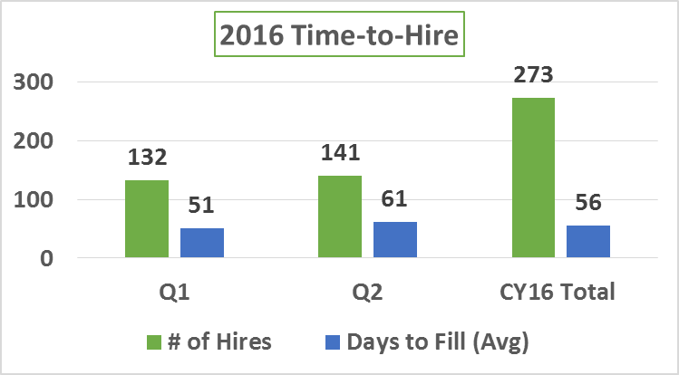
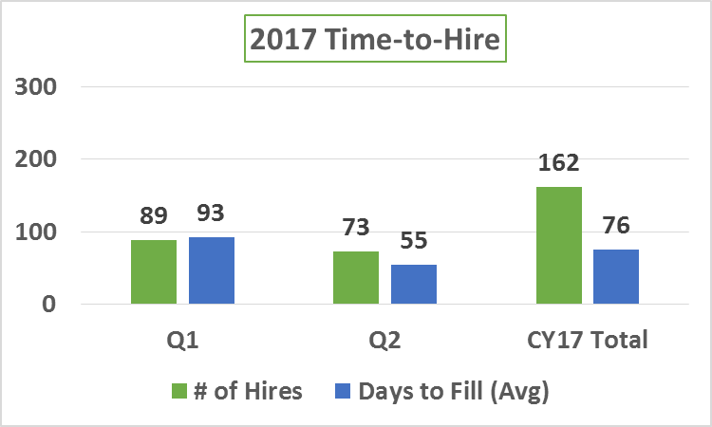
Time-to-Hire (CY2016 vs CY2017)
Human Resources Workforce & Strategy Update – Time to Hire
Source: Internal MBTA data

Slide 8
Hires Highlights – CY 2017 YTD
Human Resources Workforce & Strategy Update – Time-to-Hire
CRITICAL HIRES WORKING ON
 | Q1 Hires | Q2 Hires
Administration | 11 | 10
Operations | 27 | 9
Capital Delivery | 7 | 24
Total | 45 | 43
Capital Delivery:
Sr. Project Manager – Bridge
Sr. Project Manager – Bridge & Tunnel Inspec
Deputy AGM for Transit Programs
Resident Engineer(s)
Sr. Director of Program Controls
Operations:
Chief Engineer – E&M
Security Project Manager
Technical Project Mgr. – Ops Plans & Schedules
2 Section Forepersons – MOW
11 TrackPersons – MOW
MOW Division Foreperson
Night Crew Maint. Foreperson – MOW
Supt. Power Systems Equipment – Power Systems
Supv. Electrical Maint. – Power Systems
Mgr. Technical Projects – Vehicle Engineering
Administration:
CFO - Finance
Sr. Systems Exchange Admin – IT
Director of Procurement Ops – Procurement
PROGRAM HIRING | Q1 Hires | Q2 Hires
Lottery – Operators | 27 | 26
T-Police | 17 | 4
Total | 44 | 30
Grand Total Hires | 89 | 73
Source: Internal MBTA data

Slide 9
Human Resources Workforce & Strategy Update
Absence Management
&
TPA Update

Slide 10
TPA Leave Strategy – UPMC WorkPartners
Human Resources Workforce & Strategy Update – TPA & Absence Management
1
Phase I
Sept –Dec 2016
Pilot Program launched on 9/1/16 in 9 Areas with 1557 Employees
Continued review of practices, policies, TPA
Completed
Phase II
Jan 15 2017
Phase II launched 1/15/17 in 31 Areas with 1735 Employees
Bi-weekly calls to review questions/concerns
2
Completed
3
Phase III – Feb 19 2017
Phase III launched on 2/19/17 in 63 Areas with 1405 Employees
Completed
4
Phase IV
Mar 19 2017
Phase IV launched on 3/19/17 in the final 38 Areas and 1823 Employees
Completed
5
Phase V
April 2017
Full organizational roll-out complete
Continued review of practices, policies
On-going data integrity & reconciliation
On-going reporting follow-up & evaluation of key metrics
On-Going

Slide 11
FMLA certification % continues below FY15 baseline as absence management program proceeds
Human Resources Workforce & Strategy Update – TPA & Absence Management
8
Source: Internal MBTA data

Slide 12
Managing the Case Load: Fiscal Year Comparison FY15-17, TPA in place in FY17 (MBTA-wide March 2017)
Human Resources Workforce & Strategy Update – TPA & Absence Management
Policy Changes
March 2016 Intermittent Recertification frequency changed from 1 year to 6 months meant to be a temporary change to facilitate getting everyone on new leave year plan.
In March 2016 the Leave Year determination changed from a Static Year to a Rolling Backward Calendar.
December 2016 reverted back to 1 year re-certification
9851
7998
5011
Requests per
Work Day
FY15 19
FY16 31
FY17 38
Distinct # of Employees 2548 3232 3324
Source: Internal MBTA data

Slide 13
TPA Implementation reduces employee caseload by 28% in Q2-2017
Human Resources Workforce & Strategy Update – TPA & Absence Management
Authority-wide
Implementation
3/19/17 TPA IMPACT on caseload reduction
1121
Distinct # of Employees 1455 1045 % difference -28%
Source: MBTA Internal Data

Slide 14
FMLA usage of 5+ days down 15% from FY14
Human Resources Workforce & Strategy Update – TPA & Absence Management
Source: MBTA Internal Data

Slide 15
More days used in Q2 of 2017 versus prior 3 years
Heat Map – All MBTA FMLA Ratio of Days Used
Less employees absent longer
(FMLA is a third of total absence reasons)
FMLA Ratio: Total # of FMLA days used/Total number of working days.

Slide 16
More days used in Q2 of 2017 versus prior 3 years
Heat Map – All Transportation Operators FMLA Ratio of Days Used
Less employees absent longer
(FMLA is a third of total absence reasons)
FMLA Ratio: Total # of FMLA days used/Total number of working days.

Slide 17
Case Management: Leave as an Accommodation under ADA 2Q2016 vs 2Q2017
Human Resources Workforce & Strategy Update – TPA & Absence Management
Days Absent
153
Cases
155
Cases
181
Cases
141
Cases
Source: Internal MBTA data

Slide 18
2017 Q2 update – Absenteeism by Classification
Human Resources Workforce & Strategy Update – TPA & Absence Management
Combined Classifications
MBTA Average 2017 Q1 – 7.85%
Source: MBTA Internal Data

Slide 19
2017 Q1 update – absenteeism by classification
Human Resources Workforce & Strategy Update – TPA & Absence Management
Combined Classifications
Source: MBTA Internal Data

Slide 20
Transportation Operators: Absenteeism Rate reduced in all titles except for FT Motorpersons in Q2
Human Resources Workforce & Strategy Update – TPA & Absence Management
Less time absent
More time absent
Avg. HC Q2 2,460 1,349 357 205 50 409 90
Avg. HC Q1 2,498 1,356 365 203 60 417 97
Source: MBTA Internal Data

Slide 21
Bus operations and maintenance (combined) absenteeism rate was 10.3%
Human Resources Workforce & Strategy Update – TPA & Absence Management
Bus Operations and Maintenance | 10.3%
MBTA Overall | 7.68%
Note: “Bus Machinists” includes machinists at bus garages (067400 and 067600), as well as Everett Automotive Machinists (057100)
Source: MBTA Internal Data

Slide 22
ADA usage dropped in Q2-16v17, FMLA & “Reported Injured” grow
Human Resources Workforce & Strategy Update – TPA & Absence Management
% of
Total
% of
Total
7%
8%
6%
4%
10%
6%
6%
12%
8%
10%
23%
11%
32%
38%
Source: MBTA Internal Data

Slide 23
Average Daily Absence-Related Overtime Hours Down 22% from FY14
Human Resources Workforce & Strategy Update – TPA & Absence Management
Source: MBTA Internal Data.

Slide 24
Enforcement: 41 Employees Terminated for Attendance Violations in CYTD17
Human Resources Workforce & Strategy Update – TPA & Absence Management
Source: MBTA Internal Data

Slide 25
More than 70 employees are currently in steps 3, 4 and 5 of progressive discipline for violating attendance policy during Q2 of 2017
Human Resources Workforce & Strategy Update – TPA & Absence Management
Discipline Steps
Step 5: | 70-day suspension with RFD
Step 4: | 5-day suspension time-served
Step 3: | 3-day administrative suspension
Step 2: | 1-day administrative suspension
Step 1: | Written warning
Source: MBTA Internal Data

Slide 26
Human Resources Workforce & Strategy Update
Compensation Update

Slide 27
Compensation: Approach to the Talent Challenge
Human Resources Workforce & Strategy Update – TPA & Absence Management
Phase I
Jan – July 2017
Internal Talent Parity
We’ve developed an understanding of how we are currently compensating our leaders & identified parity risks through an Internal Study
1/17/17 Outlined recommended immediate compensation adjustments for high-value roles & retention of talent.
10 Salary Adjustments made effective 3/30/17
52 Add’l Salary Adjustments made effective 7/2/17
1
Completed
Benchmark / Align Compensation to Market
RFP issued on 11/21/16 - RFP Comp Committee interviewed vendors in January 2017 with contract execution planned by March
This competitive analysis will help set up a baseline view of how MBTA’s pay levels compare to market.
6/1/17 Formal Kick-off of project
Held Various information gathering interviews with Sr. Leaders (June & July 2017)
Preliminary Data Analysis completed on 7/31/17
Phase 2
Jan – July 2017
2
Completed
Talent Management
Implement a Talent Management Process to identify hi-potential talent and develop plans to invest in them
Implement a Succession Planning Process to ensure a pipeline of “ready now” talent is available to ensure continuity of the MBTA
Phase 3
Jan – Aug 2017
3
In-Process
Phase 4
Sept/Oct 2017
Review of Mercer Study
Last stretch of project where Consultants will meet with CHRO on 8/17/17 to discuss Compensation Philosophy and initial results of study
4
In-Process

Slide 28
Human Resources Workforce & Strategy Update
STRATEGIC
INITIATIVES

Slide 29
HR Strategic Initiatives To Be Presented in Q3 Report
Human Resources Workforce & Strategy Update
Branding
As we move towards a “People First” approach to HR, we need to create & convey a value proposition that compels individuals to JOIN-STAY-GROW
Workforce Development – Talent Review & Succession Planning
To build sustainable leadership bench strength to achieve our objectives by assessing, selecting, developing, retaining and engaging the future leaders and critical talent of the Organization
Talent Management
Design a competency based Management & Supervisor Certificate program
Talent Acquisition
Identify and define career ladders leading up to the critical positions identified by the Strategic Planning team.
Process Simplification
Implement a centralized process that is easily trackable and ensures critical steps have been completed. Provide clear guidance to hiring managers regarding the onboarding process, timelines, roles, and responsibilities.

