Slide 1
Lodge 264 Collective Bargaining Contract Authorization
Dan Kazakis
Sr Director of Labor Relations
December 2023

Slide 2
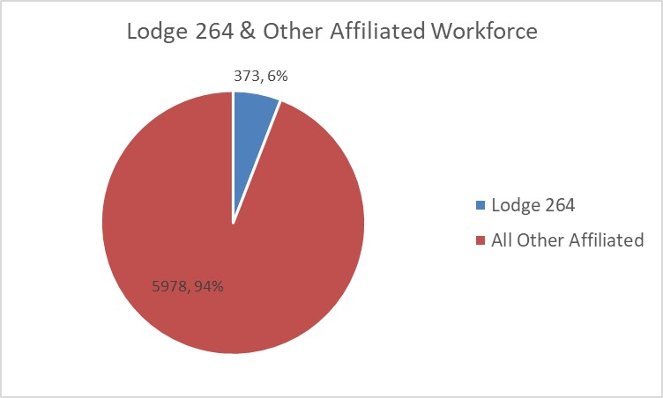
2023 Bargaining Cycle
Negotiation Timeline
As the terms of the Agreement with Local 589 establish the fiscal parameters for the rest of the MBTA Unions, bargaining with Lodge 264 began FY24-27:
August 3, 2023: Board of Directors Approve L589 Agreement
September 2023: Bargaining begins with Lodge 264
October 2023: Final Negotiations with Lodge 264
November 2023: Tentative Agreement reached
December 2023: Agreement presented for Board Approval
Lodge 264 represents 373 Service Technicians (Bus Mechanics), Bus Fuelers, and Machinists

Slide 3
Tentative Agreement Summary
Lodge 264 Tentative Agreement
The tentative agreement was reached and later ratified by the Union in November 2023, with terms including:
Four-Year Contract Duration, July 1, 2023 – June 30, 2027
Total of 18.0% in increased wages over term of contract
Establishes a Longevity Incentive for existing employees
Retirement Eligible Retention Incentive
Clarification Language on Bereavement Leave and expanded definition of “Immediate Family”
Increase in Tool Allowance to $500, from $350
Increase in Meal Allowance to $10 from $3.50
Addition of $2/hr differential for employees becoming licensed to performed state vehicle inspections
Increase Holiday Pay to 1.5x on Thanksgiving and Christmas to encourage and reward employees for working on these holidays
Lay groundwork to establish apprenticeship program for Machinists
*total cost over the four-year term of the contract
Longevity Incentive
YOS
% Increase
Increment
10
0.50%
0.50%
15
1.25%
0.75%
20
2.50%
1.25%
25
3.50%
1.00%

Slide 4
Contract Authorization

Slide 5
Vote Language
IT IS VOTED:
That the General Manager is hereby authorized to enter into a Collective Bargaining Agreement with Lodge 264 for the term from July 1, 2023 to June 30, 2027 and to execute any necessary or ancillary documents in the name and on behalf of the Massachusetts Bay Transportation Authority to effectuate this Agreement.

