Slide 1
Local 104 Collective Bargaining
Contract Authorization
Dan Kazakis
Sr Director of Labor Relations
December 2023

Slide 2
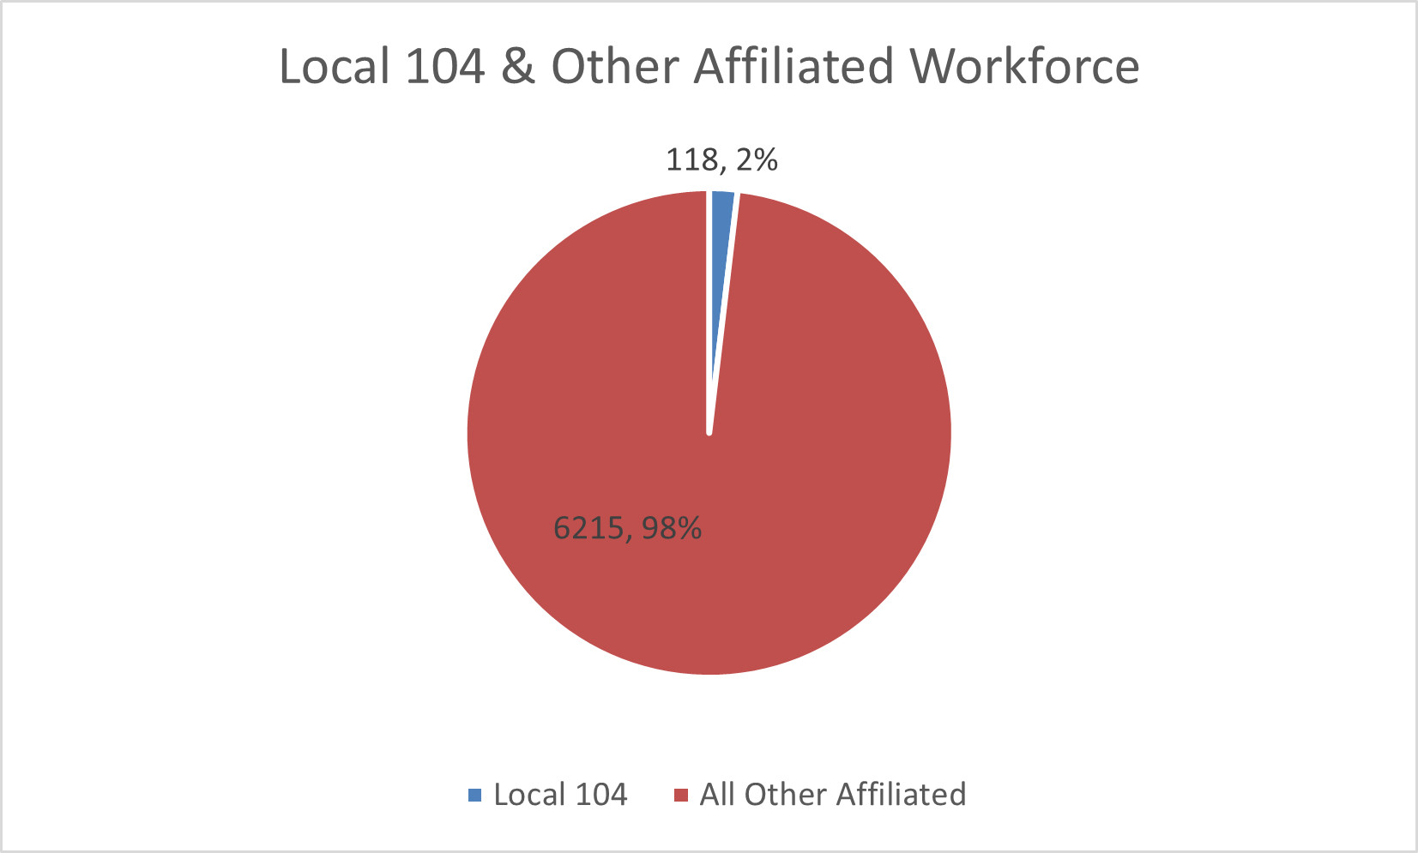
2023 Bargaining Cycle
Negotiation Timeline
As the terms of the Agreement with Local 589 establish the fiscal parameters for the rest of the MBTA Unions, bargaining with Local 104 was conducted in November 2023, following the ratification and Board approval of the L589 Agreement, for FY24-27:
  August 3, 2023: Board of Directors Approve L589 Agreement
  October 2023: Negotiations with Local 104 begin
  November 2023: Tentative agreement reached
  December 2023: Agreement presented for Board Approval

Slide 3
Tentative Agreement Summary
Local 104 Tentative Agreement
The tentative agreement was reached and later ratified by the Union in November 2023, with terms including:
Four-Year Contract Duration, July 1, 2023 – June 30, 2027
Total of 18.0% in increased wages over four years
Retirement Eligible Retention Incentive
Establishes a Longevity Incentive for existing employees
Clarification Language on Bereavement Leave and expanded definition of “Immediate Family”
Increase in Meal Allowance to $10 from $3.50
Increase in Holiday Pay to 1.5x on Thanksgiving and Christmas to encourage and reward employees for working on these holidays
Increase in Third Shift Differential for Power Equipment Technicians from $1.50/hr (~3.5%) to 7.5% of regular wage to encourage work on critical shift
Commitment to resume first aid training for Line Repairers
*total cost over the four-year term of the contract

Slide 4
Contract Authorization

Slide 5
Vote Language
IT IS VOTED:
That the General Manager is hereby authorized to enter into a Collective Bargaining Agreement with Local 104 for the term from July 1, 2023 to June 30, 2027 and to execute any necessary or ancillary documents in the name and on behalf of the Massachusetts Bay Transportation Authority to effectuate this Agreement.

