Slide 1
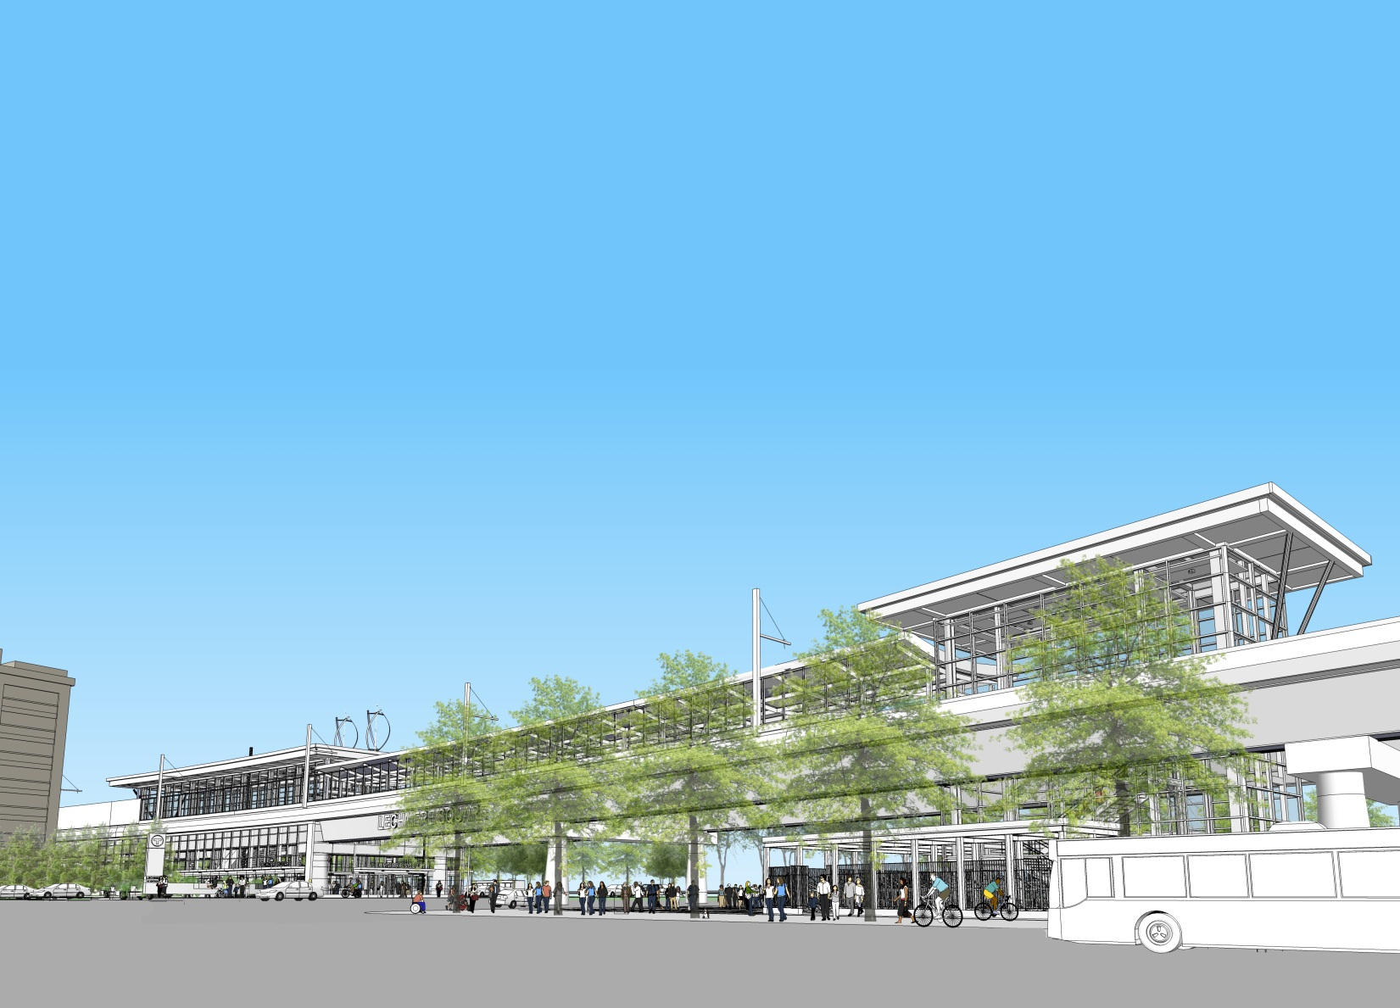
GLX Project
Green Line Extension Project

Slide 2
GLX Program Update
Schedule Update
DB Selection Details and Sequence
Contract Actions
GLX Web-based Project Management System

Slide 3
Project Schedule Highlights
Design Build Proposals Due 9/28/17
Bid Price Opening 11/17/17
Notice to Proceed to Design Build Entity 12/11/17
Project Completion 12/10/21
-DRAFT-
Notes:
One-on-Ones – Does this term need to be defined? -NP

Slide 4
GLX Design Build Procurement
Design Build proposals are due this Thursday, September 28th.
Proposals will include 3 primary elements:
Technical Proposal
“Base” project, without Additive Options or price
Additive Option Proposal (sealed)
Additive Options included if the AO is achievable within both Affordability Limit and Project schedule
Price Proposal (sealed)
Proposed pricing of the “base” and the AOs

Slide 5
GLX Design Build Procurement
Technical Proposal evaluation completed prior to opening Additive Option Proposal and Price Proposal.
Where applicable, points for minimally acceptable AOs will be added to the Technical Proposal Score to calculate the Quality Score.
Additive Options (must be added back to scope in following order):
Station Canopies
Additional Elevators
Station Art Program
Community Path Connection at Chester St
Community Path connection (East Somerville to Lechmere)
Enhanced Vehicle Maintenance Facility

Slide 6
GLX Design Build Procurement
Public Price opening November 17, 2017
Evaluation Formula
Overall Value Rating = Proposal Price
Quality Score
Proposal Price includes the GLX Lump Sum, Allowances, and Additive Options Price
Quality Score is the Technical Proposal Score + AO points
Affordability Limit: $1.319 billion
Successful Proposer has the lowest price per quality score, or lowest “Overall Value Rating”

Slide 7
GLX PMCM Procurement
At May 15, 2017, FMCB meeting, board approved contract to CH2M Hill for GLX Program Management/Construction Management Services ($57M).
August 2, 2017, Jacobs Engineering Group and CH2M Hill announce Jacobs Engineering Group’s acquisition of CH2M Hill.
Jacobs Engineering currently serving as the lead designer on one of the 3 competing GLX Design-Build teams.
To mitigate any potential or perceived conflict of interest, CH2M Hill’s contract for GLX PMCM services was terminated August 10, 2017.

Slide 8
GLX PMCM Procurement (cont’d)
Original PMCM procurement completed with award to CH2M
To address urgent and immediate need in maintaining team capacity, engaged 2nd place team from original procurement through FTA approved sole source engagement
To enhance technical and capacity offering, proposer has entered a joint venture with Louis-Berger - GLX PMCM Partners
Scope for GLX PMCM Partners is akin to scope originally awarded to CH2M aside from field office lease management, office administration, etc.

Slide 9
GLX PMCM Procurement (cont’d)
To maintain GLX office functionality (currently housing 43 GLX staff) and avoid disruption in the current DB procurement effort, scope of field office management and office administration was transferred to existing GLX contract of Weston & Sampson.
Costs and staffing associated with office management and lease oversite have been transferred from PMCM budget and reallocated to Weston & Sampson contract.
There has been no budgetary impact to any Program budget line item resulting from the termination of CH2M or any subsequent scope transfers.

Slide 10
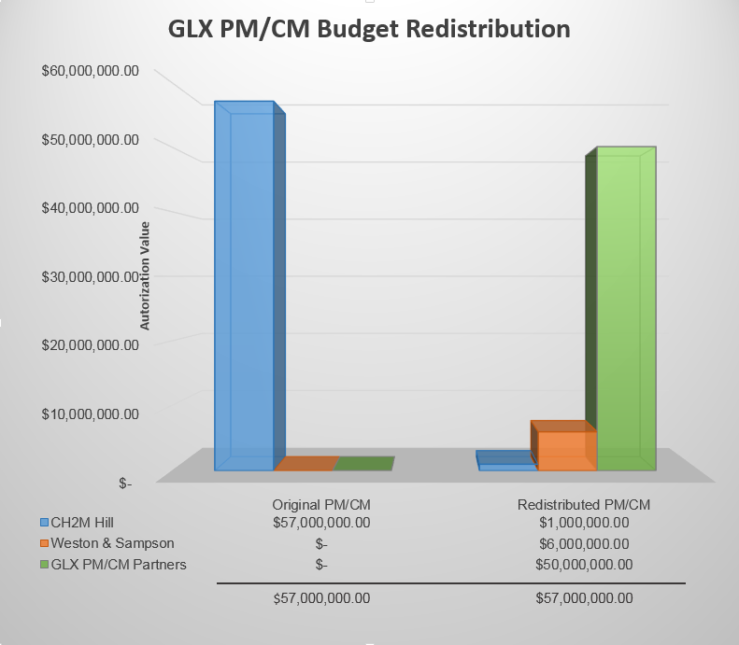
GLX PMCM Procurement (cont’d)

Slide 11
GLX Contract Actions
Contract with GLX PM/CM Partners to provide PM/CM services in a not-to-exceed amount of $50,000,000.
GLX PM/CM Partners will assume the majority of scope that was to be performed by CH2M
Increase the E22PS08 (Weston & Sampson) award amount by $6,000,000
Weston & Sampson will assume the Program Office costs that were to be overseen by CH2M
Notes:
-NP

Slide 12
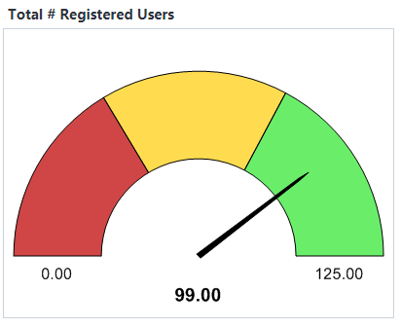
GLX e-Builder Implementation
Procurement started late January, 2017
Implementation started in late February, 2017
System in place to support DRAFT RFP, March 13th, 2017
Issued Final RFP on May 23rd and all subsequent addenda
Current User Licenses Issued – 99
Notes:
-NP

Slide 13
GLX e-Builder Implementation
Current Uses
Sending, receiving and tracking Design Build proposer communications
Reviewing, commenting and coordination of ATC reviews
Coordination of Program Management Plan (PMP) development
Document Control
Current Implementation & Development:
Workflows & Process
Requests for Information (RFIs)
Design Package & Construction Submittals
Invoicing (Professional Service and Construction)
Funding, Budget and Cost Management
Risk Management
Future Implementation & Development
Interaction and Coordination with selected Design Builder
Tracking and documenting construction activities and progress
Notes:
-NP

Slide 14
glx

