Slide 1
FTA Triennial Report
Overview,
Triennial Monitoring Results, and Next Steps
Part 2
September 25, 2017
DRAFT
Notes:
Good afternoon, Chairman Aiello and FMCB Board, Secretary Pollack and General Manager Ramirez.
This is the second part of the conversation we began last week on Title VI and our pending submittal of the 2017-2020 MBTA Title VI Program to the Federal Tranist Administration.

Slide 2
Recap of Previous Title VI Presentation
Last week’s presentation included:
  An overview of the Title VI Triennial requirements
  The nature of the Board vote to approve the 2017-20 Title VI Program
  A review of the service standard monitoring requirement and data where potential disparate impacts were or were not identified
  The MBTA response to identified potential disparate impacts
Notes:
Last week we touched on Title VI and the basic requirements, this Board’s obligations and service monitoring results and the MBTA’s response to those internal self-assessments.

Slide 3
Part 2 - Overview
Today, staff will complete the Authority’s update on the triennial MBTA Title VI Program obligation, procedures, and achievements during the 2014-2017 cycle, and update the FMCB on
    the results of the service policy monitoring efforts related to conditions and amenities
    our public engagement work and the draft revised Public Participation Plan
Staff recommends that the FMCB approve the Title VI Program document for submission to the FTA. This document is due by October 1, 2017, to be in effect from 2017-2020
Notes:
Today, we will complete our discussion, addressing the results of our service policy monitoring efforts, and the response of MBTA staff to these findings, where needed. We will also highlight some of our public participation efforts, including training, language assistance and accessibility. You will also learn about our interest in revising the current MBTA Public Participation Plan and our strategy to improve that already good guidance to better support our efforts to improve our infrastructure and the services we provide to the public.
Based on the results of this and last week’s presentation, as well as your review of the Title VI Program, we believe that this Board has met its obligation to be aware of and understand the results of our monitoring efforts and the overall Title VI Program. With your having met this obligation, we believe this Board is in position to approve the 2017-2020 MBTA Title VI Program, and as part of today’s presentation we are asking for your vote to approve our program, which will enable staff to submit it to the Federal Transit Administration.

Slide 4
Service Monitoring Process
FTA requires monitoring of performance on service standards and policies
MBTA works with the Central Transportation Planning Staff (CTPS) to collect, review, analyze, and address data findings
Each analysis compares performance on standards between minority and nonminority identified riders or areas
MBTA Disparate Impact threshold of 20% is used to identify potential disparities
Notes:
Before going into the results of our service policy monitoring effort, lets pause for a moment to review the elements involved in this work. We are obligated by FTA Circular requirements to conduct monitoring as to both our service standards and policy to ensure that there is no risk of bias in our performance in these areas. We rely on the 20% threshold for identifying disparity to conduct these analyses, which focus on the difference in impact on minority and nonminority riders or areas that our service impacts.

Slide 5
Monitored Elements of Service
  FTA specifies monitoring of the following service standards:
    Vehicle Load
    Vehicle Headway
    On-Time Performance
    Service Availability
  FTA specifies monitoring of the following service policies:
    Distribution and Condition of Transit Amenities
    Vehicle Assignment
  MBTA’s Service Delivery Policy incorporates additional standards:
    Span of Service
    Platform Accessibility
    Vehicle Accessibility
    Service Operated
Notes:
Last week, we addressed assessments under FTA mandated service standards and those established under the MBTA service delivery policy that this Board approved in 20bus frequency and commuter rail cancellations that the MBTA has either addressed or is working to improve.
Today’s focus will be on the two elements in the center of the slide, distribution and condition of transit amenities and the assignment of vehicles. You will see that across a clear majority of the areas monitored, there are no disparities requiring consideration of further action.

Slide 6
Monitoring Schedule Details for Policies
  Biennial, odd years:
    Bus shelter placement, condition, seating, and amenities
  Biennial, even years:
    Rail station and Silver Line amenities and condition
    Provision of information
  Annual:
    Availability of fare collection and vending terminals
    Station escalator operability
    Vehicle assignment (by age and bus air conditioning operability)
Notes:
For simple reference, here is the current schedule established for our monitoring activities. Based on improved technology innovation, such as in cleaniness monitoring, we intend to increase the level of annual monitoring.

Slide 7
Responding to Monitoring Findings
The monitoring process provides findings, as to each service aspect analyzed, which are reviewed overall with MBTA department leads.
If potential disparities are found:
  Data will be scrutinized and reevaluated
  Non-Title VI related factors may be identified as causes or contributing factors
  Staff and leadership are asked to address potential disparities and confirm compliance through future monitoring results
In recent triennial cycles, MBTA’s monitoring activities have not identified recurring disparities, but have cited areas that were reviewed and addressed through corrective action.
Notes:
I want to briefly underscore that our monitoring efforts are not an assertion or proof of discrimination. These findings serve to point out disparities which then triggers the need for staff and leadership review to consider whether there are factors unrelated to Title VI which have led to the condition, and whether the condition warrants responsive action. We study areas that have been identified for disparities into the future to ensure no recurrence.

Slide 8
Service Policy - Findings
No potential disparities among the following:
Automated Fare Collection – four variables assessed (Table 6-66 to 69)
Bus stop shelter placement
Bus stop seating
Bus shelter conditions – three variables (Table 6-51),
Subway Rapid Transit Amenities - 9 variables assessed (Tables 6-52, 53)

Slide 9
Service Policy - Findings
No potential disparities among the following:
Surface Rapid Transit, platform and shelter conditions – 8 variables assessed (Table 6-59)
Commuter Rail, station amenities – 5 variables assessed (Table 6-62)
Provision of Information – four variables assessed (Tables 6-70 to 73)
Escalator operability
Vehicle age (all modes) and bus air conditioning operability

Slide 10
Service Policy - Findings
Of the 13 areas the Authority monitored, ODCR’s analysis indicated POSSIBLE disparities in three areas:
Subway Rapid Transit Conditions - 20 variables assessed, with six potential disparities
Surface Rapid Transit, station amenities – 5 variables assessed, with two potential disparities
Commuter Rail, platform and shelter conditions – 11 variables assessed, with one potential disparity

Slide 11
Service Policy - Findings
Subway Rapid Transit Conditions - 20 variables assessed, with three potential disparities related to the condition of stations:
  Stairwells
  Platform surfaces
  Platform stairwells
Actions –
-In addition to other efforts by the Authority to reduce the State of Good Repair (SGR) backlog and improve the customer experience, the Engineering & Maintenance Department continues to review these observations and, if not addressed through other efforts, will prioritize a scope of work for maintenance and/or program for capital investment.
-It is important to note that CTPS observations are one time visual assessments for Title VI monitoring purposes only, and are not intended to reflect the more technical and detailed asset management criteria refined and implemented by the Authority since the start of triennial assessment activities in 2014.

Slide 12
Service Policy - Findings
Subway Rapid Transit Conditions - 20 variables assessed, with 3 potential disparities related to cleanliness
  Station exteriors
  Lobbies
  Platforms
Actions –
-New station cleaning contracts had been put in place and cleanliness monitoring has improved through oversight via app-based assessment tool
  -It is important to note that CTPS observations were conducted from February-March 2016 and are one time visual assessments for Title VI monitoring purposes only. They are not intended to reflect the more technical and detailed metrics put in place under the new station cleaning contracts in 2017, after the start of 2014 triennial assessment activities.

Slide 13
Service Policy - Findings
Surface Rapid Transit, station amenities – 5 variables assessed, with two potential disparities
Availability of trash receptacles
Availability of recycling receptacles
Action –
Engineering & Maintenance Department will review maintenance issues presented and evaluate findings, toward a prioritized scope of work for maintenance or to program for capital investment.
Note: Surface Rapid Transit was monitored from February-June 2016

Slide 14
Service Policy - Findings
Commuter Rail, platform and shelter conditions – 11 variables assessed, with one potential disparity
Cleanliness of platforms
Action –
Four Corners/Geneva and Uphams Corner were the stations identified for cleanliness concerns, although each is currently cleaned five days per week. Recurring vandalism is a cause for this condition, and efforts will be made to repair damaged items as quickly as possible, with modifications made to items damaged most frequently.
Talbot Avenue station was being cleaned on a two day per week schedule, which will be increased to five days per week.
Note: Commuter Rail was monitored from February-March 2016

Slide 15
Monitoring – Looking Ahead
During the 2017-2020 triennial cycle, MBTA Title VI Working Group will meet routinely to plan for triennial submission, reporting, trend analysis and response to data findings
  ODCR, OPMI and CTPS will coordinate on data reporting as part of the Working Group strategy
Based on new annual monitoring strategy, meetings with key departments for review of findings will be done on a quarterly basis
Findings and response activities will be reported to FMCB on at least an annual basis:
  To review progress and the Authority's trajectory.

Slide 16
Public Participation Plan (PPP)
As part of Title VI compliance efforts, transit providers must create public participation plans, including opportunity for public comment, mandated board approval and federal review and concurrence
FHWA and FTA concurred with MassDOT’s Public Participation Plan in 2014, for both Highway and Rail & Transit Divisions
The MBTA adapted the MassDOT PPP to meet its requirement as part of the 2014 MBTA Title VI Program, it remains in effect for the 2017 MBTA Title Program.

Slide 17
Public Participation Plan (PPP)
Key public participation opportunities in transit include:
  disparate impact/disproportionate burden equity analyses
  service delivery policy development
  major service changes
  mitigation in cases of adverse disparate impact (on fare and major service changes)
  impacts related to construction activities

Slide 18
Key Title VI Public Engagement Elements
Diverse and effective outreach
Accessible location and reasonable accommodations
Language support
Timely response to public questions and consideration of public comments
Effective information dissemination across demographics
Flexibility required to ensure the Authority can meet its public commitments to reduce SGR backlog and modernize

Slide 19
Accessible Public Meeting Policy
MBTA is committed to ensuring that all public meeting are fully accessible to persons with disabilities.
MassDOT/MBTA Accessible Meeting Policy, created in 2013, frames the obligations and protocols for accessible interactions with the public and provides resources, like checklists, to ensure accessibility
Guidelines and checklists exist for the following strategies:
  Accessibility of location, room, and set-up
  Alternate formats
  Sign language and real-time transcription

Slide 20
Draft PPP Revisions
The MBTA is working to revise the PPP to better align with our need to rapidly reduce the SGR backlog and modernize to provide the reliable system our customers deserve.
Draft PPP retains the philosophy, guidance, and standards, including language to support the Authority’s work on fiscal and infrastructure challenges
The revised PPP is under internal review and will be shared with the public once all departments have assessed the potential impact on operations
Final PPP will be implemented through on-going training for departments responsible for conducting public engagement
The MBTA will engage the public during fall 2017, and seek to finalize the new PPP during winter 2018

Slide 21
Request for Board Approval
Staff requests and recommends that the Board approve this document for submission to FTA.

Slide 22
Appendix
  New public participation tools

Slide 23
New Tools for PPP
OTP and ODCR have developed an online tool to support public engagement for transportation programs, services, and initiatives
“Engage” software tool supports Title VI and PPP compliance, allowing project managers, frontline staff, planners, leadership, and partners to build stronger engagement strategies, including language access.
Features:
  Language Demographics
  Mail merge ready community contacts (with emphasis on Title VI organizations); 4000 contacts to date
  Accessible Meeting Locations
  All data is available at custom, user-defined geographies

Slide 24
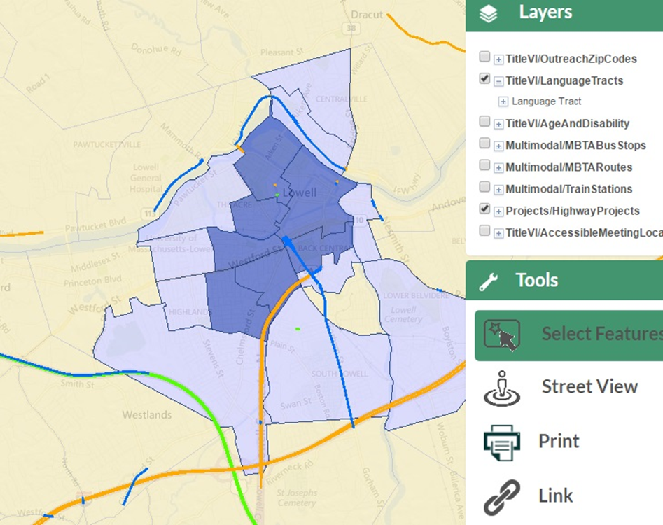
Languages in the Project Context

Slide 25
Engage - Future Development
Taking “Engage” tool to “Analyze”
  Provide staff and project partners with data about transportation project impacts on protected populations.
Risk based solution - identifying impacts will help MBTA staff to better understand the potential risks of Title VI or Environmental Justice related disparities on projects.

