Slide 1
Deputy General Manager Remarks
Fiscal & Management Control Board
September 25, 2017

Slide 2
Green Line Performance August 2016 – July 2017*
DGM Remarks 9/25/17
Average OTP: 76.0%
Peak OTP: 74.6%
Off-Peak OTP: 77.4%
B Branch: 76.3%
C Branch: 76.1%
D Branch: 76.2%
E Branch: 76.2%
**Passenger weighted
*February 2017 data is partial.

Slide 3
Green Line Short Term Initiatives
DGM Remarks 9/25/17
Transit Signal Priority (TSP)
Currently deployed at 5 GL intersections.
Plans underway to deploy to B,C,&E surface lines in 2018.
Intersections left on the Green Line:
B Branch: 15
C Branch: 9
E Branch: 5

Slide 4
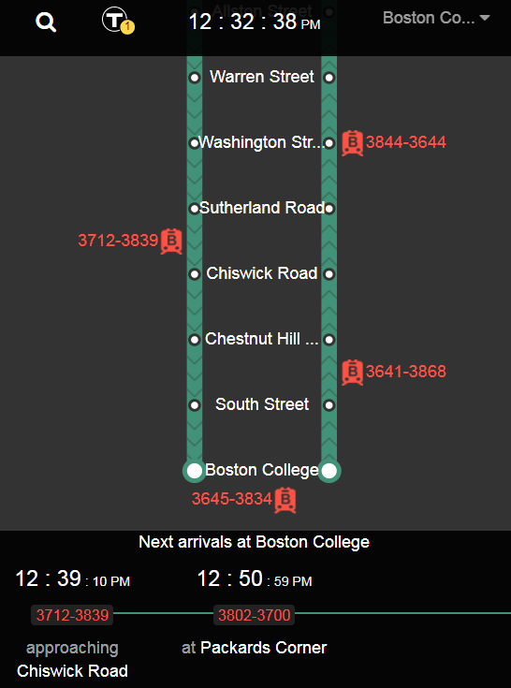
Green Line Short Term Initiatives
DGM Remarks 9/25/17
Dynamic Dispatching via Green Line Tablets
Extension of a pilot run in coordination with MIT, February–March 2017
The development of a tool that will provide shared situational awareness and better communications tools for the Green Line Officials
Riverside and Lechmere officials are using tablets to view headways in real-time.
Reaction is positive, and plan is to continue roll out across Green Line.

Slide 5
Green Line Track Maintenance Improvements
DGM Remarks 9/25/17
A new management team was hired
Outside track engineering specialist firms are being utilized
Improvements include
Process re-engineering
Workforce evaluation and training
Performance dashboard development and data consolidation
Development of wheel/rail interface dynamic simulation
Conduct quality inspections

Slide 6
Green Line Track Maintenance Improvements
DGM Remarks 9/25/17
Results:
Enhanced identification of track defects
Replacement of 4.6 miles of rail
Profile and gauge face angle grindings
The entire network was completed for the first time in 9 years
Infrastructure improvements- Delays were reduced by 17 minutes
Rail
Switches
Crossovers
Grade crossings

Slide 7
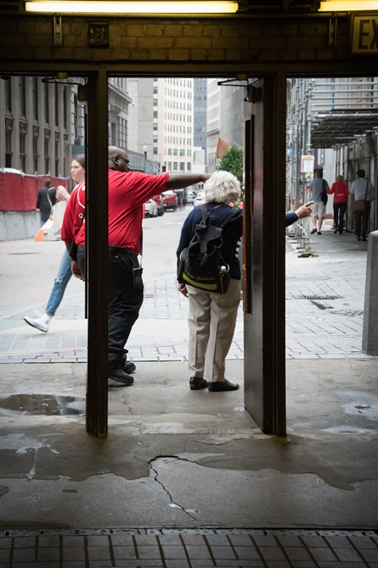
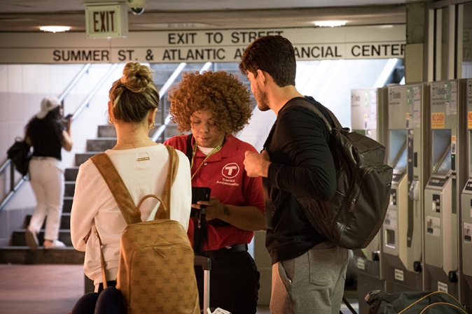
Transit Ambassadors Contract Update
DGM Remarks 9/25/17
Block by Block (BBB) provides in station customer service at these select stations:
First rollout of pilot on 8/2: Chinatown and Mass. Ave.
Second rollout on 9/3: South station, Park St., State St. and Downtown Crossing
Currently there are 39 ambassadors in the MBTA system
Ambassador services are provided from 6am to 12am
Ambassadors were trained by a program development by MBTA and BBB.
The ambassadors are equipped with a smart tablet enabling them to report and track information in real time.
All ambassadors carry a handheld radio, and are trained to contact the OCC and other MBTA departments depending on the situation

Slide 8
Rail Safety Week – Partnering with Samaritans
DGM Remarks 9/25/17
Working together to prevent suicide
Education, awareness and support efforts
The MBTA has been partnering with Samaritans, Inc. for past 15 years. Increased effort in last 3 years. The T is Samaritan’s primary communication channel for public awareness.
You are not alone 2017-2018 awareness campaign
To Includes digital screens, billboards, social media posts via Twitter, permanent station signage, and station and bridge lighting in support of suicide prevention.

Slide 9
Rail Safety Week – Operation Life Saver
DGM Remarks 9/25/17
See tracks? Think train.
Education, awareness and support efforts
Rail Safety Awareness Week Activities
Monday 9/25
Press conference and outreach at South Station
from 10AM to 11:30AM
Attleboro and Mansfield Stations from 6AM to 9AM
Franklin and Norfolk Stations from 4PM to 7PM
Tuesday 9/26
Lowell and Lawrence Stations from 6AM to 9AM
Norwood and Hyde Park Stations from 4PM to 7PM
Wednesday 9/27
Bridgewater and Brockton Stations from 6AM to 9AM
South Weymouth Station from 4PM to 7PM
Thursday 9/28
Worcester Station from 6AM to 9AM
Friday 9/29
Lynn Station from 6AM to 9AM
Beverly and Woburn Stations from 4PM to 7PM

Slide 10
Rail Safety Committee
DGM Remarks 9/25/17
Rail safety committee
Working together to research, analyze data, identify key areas of focus, discover the most promising efforts from around the world, and recommend a course of action to help reduce person-train collisions on the MBTA system.
MBTA and Keolis
Railroad Operations, Subway and Bus Operations, MBTA Safety Department, Keolis Safety Department, MBTA Transit Police, Customer Service and Communications, Customer Experience
Volpe Center
The National Transportation Systems Center is a center of transportation and logistics expertise, operating under the (U.S. DOT).
Samaritans, Inc.
Samaritans provides life-saving suicide prevention services throughout the Commonwealth. Samaritans is a United Way of Massachusetts Bay affiliate and also a certified member of Contact USA, and a founding member of the Massachusetts Coalition for Suicide Prevention and the Greater Boston Regional Coalition for Suicide Prevention.
Operation Lifesaver
Working to end collisions, deaths and injuries at highway-rail grade crossings and on railroad property through a nationwide network of volunteers who work to educate people about rail safety.
Massachusetts Department of Public Health
Works to prevent illness, injury, and premature death, to assure access to high quality public health and health care services, and to promote wellness and health equity for all people in the Commonwealth.

