Slide 1
Deputy General Manager Remarks
September 18, 2017

Slide 2
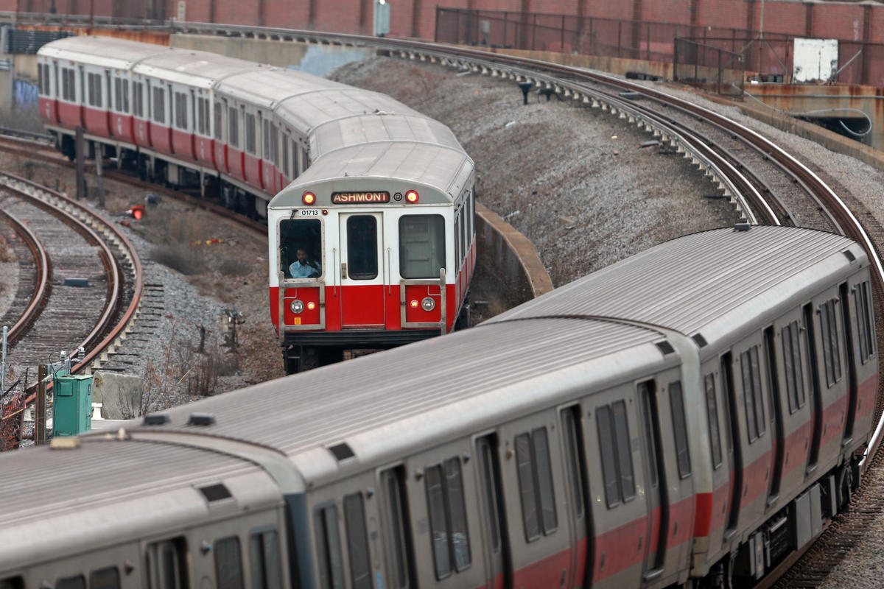
Red Line Update
About Red Line

Slide 3
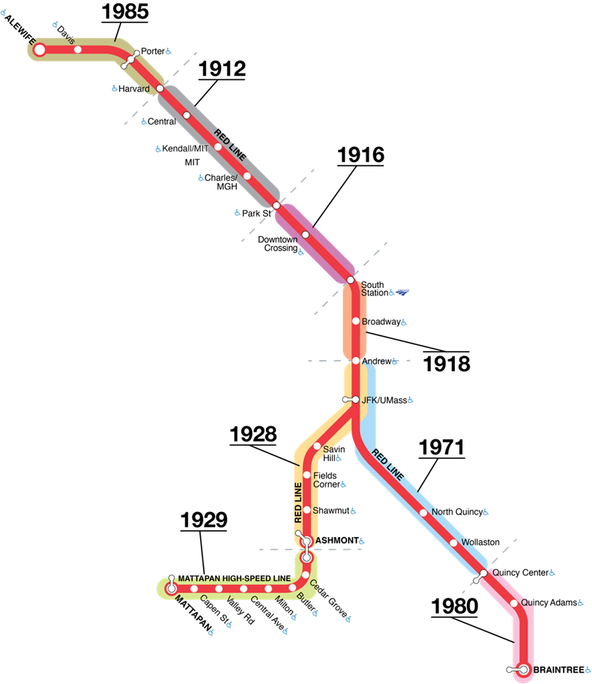
Red Line Key Facts
Red Line Update -DGM Remarks 9/18/17
Over 280,000 trips each weekday - the MBTA’s busiest line
22% of all MBTA ridership
22 stations
Right of Way
54 track miles (yard + revenue)
165 switches, 16 signal bungalows
64 bridges (31 transit, 22 road, 11 pedestrian)
9 miles of tunnel
218 Red Line Vehicles
1.1 million miles per month

Slide 4
Red Line 18 month On Time Performance*
Red Line Update -DGM Remarks 9/18/17
*Passenger Weighted

Slide 5
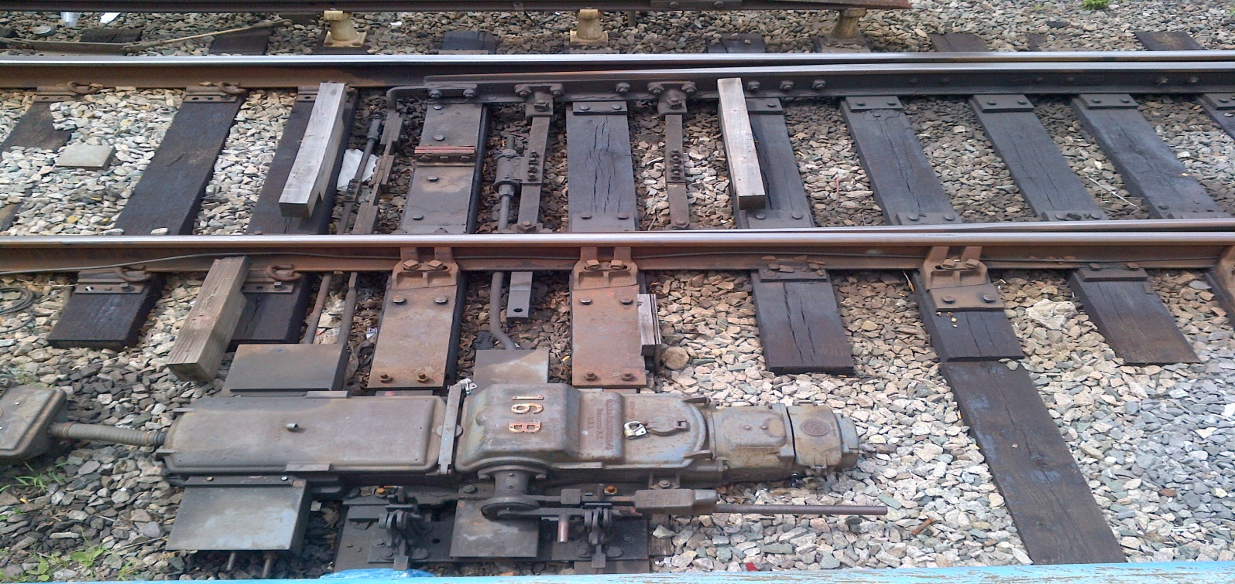
Red Line Signal Asset Overview
Red Line Update -DGM Remarks 9/18/17
Red Line signal system is an 1970’s-era, analog-based train control system
Signals: 206
Switches: 140
AC relays: 303
Track circuits: 302
AF track modules: 413
Relays: 5,839
Insulated joints: 10,000+

Slide 6
What Are We Doing Now? - Signal Reliability
Red Line Update -DGM Remarks 9/18/17
Evolving Preventative Maintenance Programs
Proactively identifies issues before
causing delays.
Examples:
Daily
Switch Point &Lock Rod Adjustments
Broken or missing C-Bonds
Troubleshooting equipment
Monthly
Switch obstruction testing
Automatic Train Stop testing
Signal Equipment ground testing
Annually/Bi-Annually
Signal function/timing testing
Inspect timing releases and devices
AF track circuit parasitic oscillation & level testing
Reliability Investment Program
$30 million investment in key areas to prevent delays
100 miles of new control and communications cabling
New fiber-optic cable
New signal wiring
Replacement of 1970’s era control relays
New signal trough to protect control cables
Redirection of signal controls to OCC
Modernization of critical communications infrastructure

Slide 7
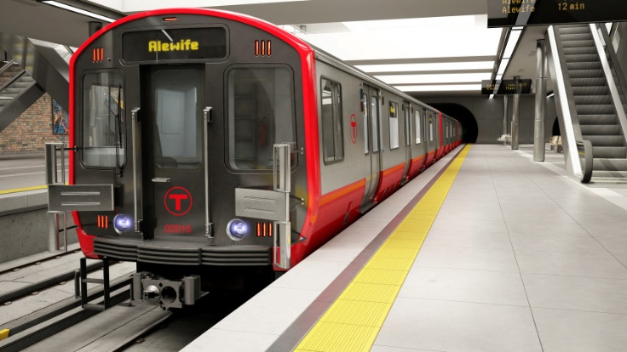
What’s Next? - Signal Reliability
Red Line Update -DGM Remarks 9/18/17
50% capacity increase on Red Line with modern reliable system
$185 million investment
Full technology upgrade to digital signal system
Letter of Interest issued this week
Contract Award Expected Next Year
Upgrade to Automatic Train Operation (ATO)
Consistent travel time between stations to improve reliability
Upgrade of Alewife Crossover
Critical bottleneck for system
Targeting doubling speed through this area

Slide 8
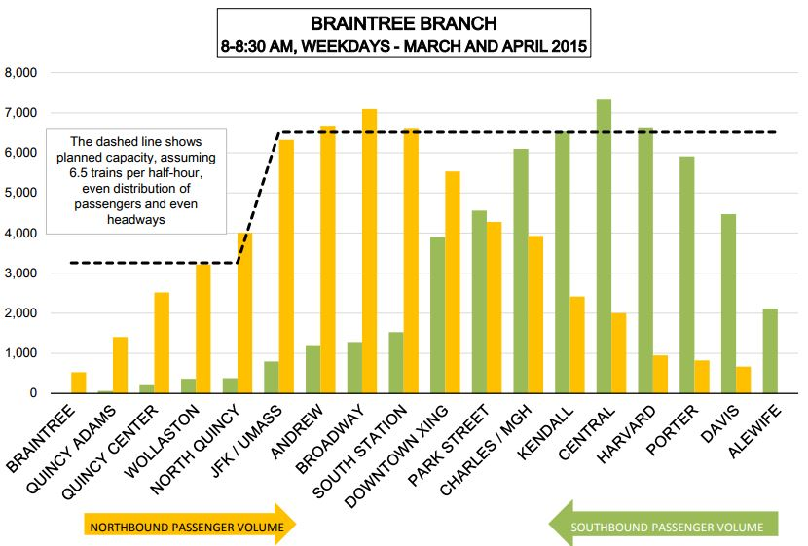
Other Short Term Initiatives -Run As Directed (RAD)
Red Line Update -DGM Remarks 9/18/17
To add capacity, close headway gaps, and reduce left-behinds, a unscheduled Run-As-Directed (RAD) train into AM peak service.
The RAD operates from Quincy Center to Alewife and back with room for up to 1600 passengers.
Headways are cut in half and platform crowding reduced when the RAD is used.
Investments in current Red Line fleet keep our car count up, and make the RAD possible.

Slide 9
Operations Winter Preparedness
September 14, 2017

Slide 10
Overview
Operation Winter Preparedness – DGM Remarks 9/18/17
Operations’ Response
Winter of 2016/2017
Always Evolving – Further Shaping the Response
Preparedness Status for Winter 2017
Infrastructure
Rail Vehicles
Bus/Non Revenue Vehicles
Commuter Rail
Management

Slide 11
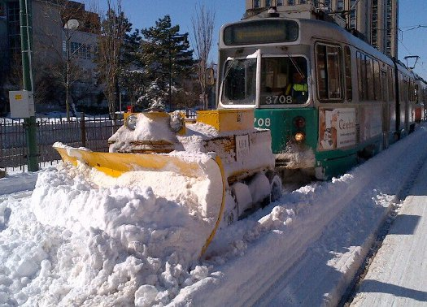
Winter 2016/2017 Overview
Operation Winter Preparedness – DGM Remarks 9/18/17
6 named winter storms; 42 inches of snow
9 declared events (scheduled and unscheduled)
7 Storm Desk activations, 5 EOC activations
Pre-deployment of snow fighting equipment (Braintree, Ashmont, Forest Hills & Mattapan)
Increase Storm Desk staffing pool
No system shutdowns or closures

Slide 12
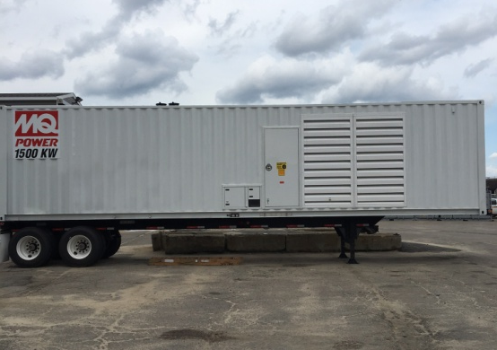
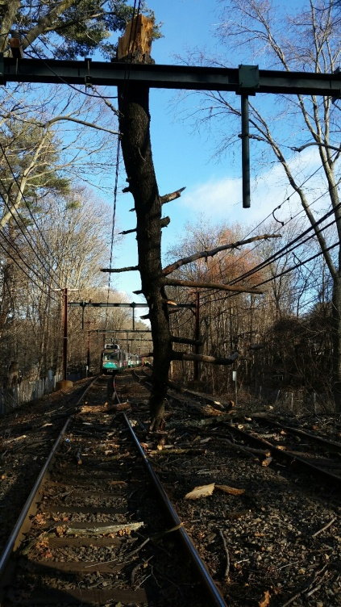
Always Evolving – Further Shaping the Response
Operation Winter Preparedness – DGM Remarks 9/18/17
Revised Snow & Ice Operations Plan
Tree Removal and Trimming Project
Emergency Power Generation
Updated Decision Tool for Storm Level Classification
Expanded Snow Clearing and Snow Removal Contracts
Refreshed training for storm desk and field coordinators
Further integrated of MBTA service, Keolis and Railroad Ops
Full Deployment Drill Late December

Slide 13
Preparedness for Winter 2017
Operation Winter Preparedness – DGM Remarks 9/18/17
Operations has already begun to prepare:
MBTA Service
Railroad Ops
RIDE
It is early for the season. We aim to be at 100% for each element, with varying target dates of November and December.
Preparedness focuses on:
Infrastructure
Rail Vehicles
Bus/Non Revenue Vehicles
Commuter Rail
Management
Communications

Slide 14
Infrastructure
Operation Winter Preparedness – DGM Remarks 9/18/17
 | September Goal | Actual | 100% Goal Date
Snow Fencing | 50% | 60% | Nov 2017
Switch Covers | 5% | 30% | Oct 2017
Third rail, Switch and Trip Heater audits | 5% | 5% | Nov 2017
Winter Supplies (shovels, salt and sand) | 15% | 25% | Nov 2017
Installing Clearing Stakes (fire hydrants and other critical locations) | 5% | 30% | Nov 2017
Supplemental Snow Removal Contracts | 100% | 100% | Nov 2017
Supplemental Bus Stop/Station Snow Clearing Contracts | 50% | 50% | Nov 2017
Emergency Power Generation – Facilities | 100% | 100% | Sept 2017
Emergency Power Generation – Traction Power | 50% | 50% | Nov 2017
Emergency Power Generation – Sub-Station | 25% | 25% | Jan 2018
Dewatering Pumps | 75% | 75% | Nov 2017

Slide 15
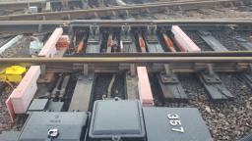
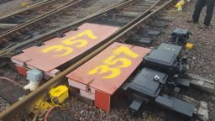
Example: Switch Cover Replacement
Operation Winter Preparedness – DGM Remarks 9/18/17
Switch without cover
Switch with cover

Slide 16
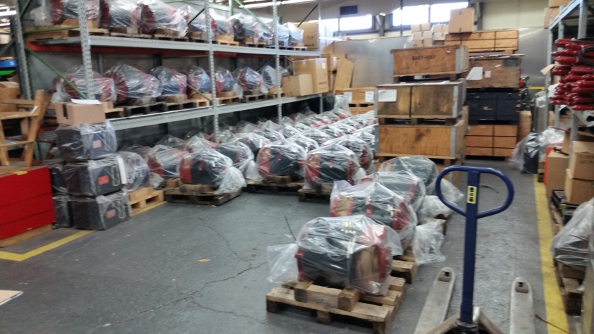
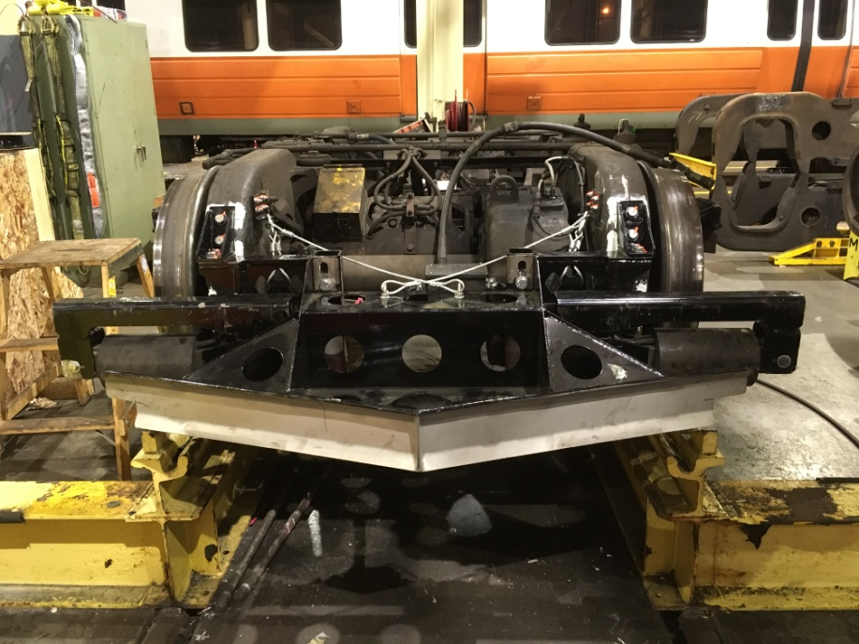
Rail Vehicles
Operation Winter Preparedness – DGM Remarks 9/18/17
Revenue | September Goal | Actual | 100% Goal Date
Spare Traction Motors | 50% | 75% | Nov 2017
Car Equipment Preparations & Inspections | 5% | 5% | Nov 2017
Installation of Snow Plows | 5% | 0% | Nov 2017
Anti-Icing Equipment Preparation | 5% | 5% | Nov 2017
Type 7 Thyristors | 50% | 50% | Nov 2017

Slide 17
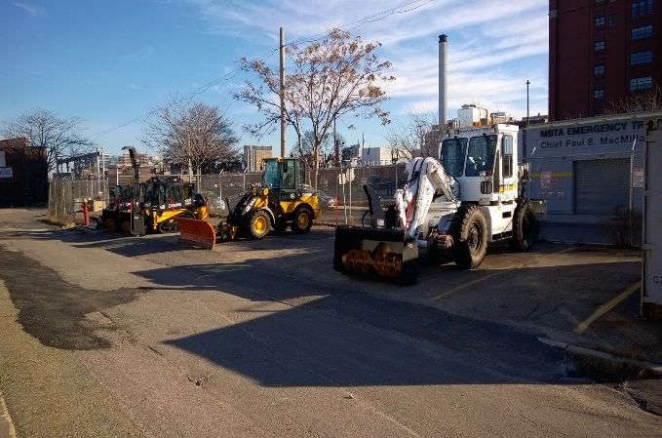
Non-Revenue Vehicles
Operation Winter Preparedness – DGM Remarks 9/18/17
Non-Revenue | September Goal | Actual | 100% Goal Date
Winter Equipment Preparedness (Plow Trucks, Rail Borne Equipment, and Snow Blowers) | 5% | 5% | Nov 2017
Conversion of Swingmaster with Jet Blowers | 5% | 5% | Dec 2017
Conversion of Ballast Regulators to Auger Snow Blowers | 5% | 5% | Dec 2017
Track Loaders with Rail Gear and Auger Snow Blowers | 15% | 25% | Dec 2017
ASV Track Loaders with Plows | 5% | 5% | Dec 2017

Slide 18
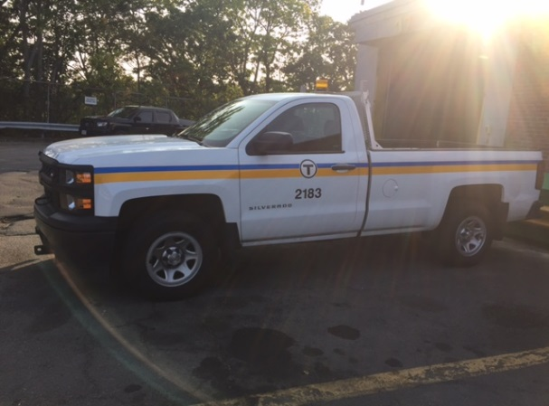
Bus Vehicles
Operation Winter Preparedness – DGM Remarks 9/18/17
Bus | September Goal | Actual | 100% Goal Date
Plow Truck in each Repair Facility | 100% | 100% | Complete
Southampton Lot Paved | 100% | 100% | Complete
Winterization of all Revenue Vehicles | 10% | 10% | Nov 2017
Proactive Materials Planning for Winter Parts | 60% | 50% | Nov 2017

Slide 19
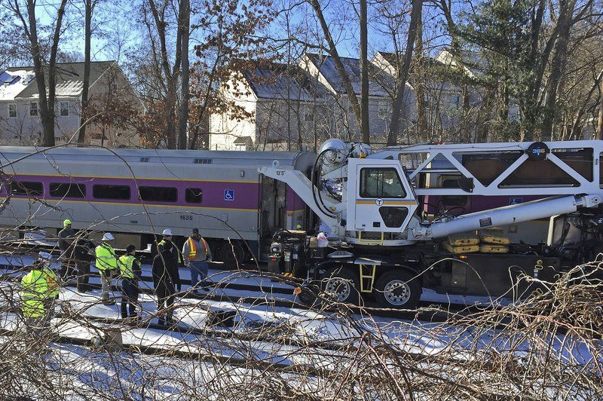
Commuter Rail
Operation Winter Preparedness – DGM Remarks 9/18/17
Infrastructure | September Goal | Actual | 100% Goal Date
Station Supplies | 0%¹ | 0% | Nov 17
Electric Switch Heater Inspections | 60% | 60% | Nov 17
Switch Cover Installations | 100%² | 100% | Complete
Propane Switch Heater Installations | 85% | 85% | Nov 17
Brush Clearing (Fall & Winter Prep) | 20%³ | 20% | Nov 17
¹Begins in November
²Evaluating continuance of installations on additional switches
³As part of PTC project and Slippery Rail PI

Slide 20
Commuter Rail
Operation Winter Preparedness – DGM Remarks 9/18/17
Vehicle | September Goal | Actual | 100% Goal Date
Non-Revenue Snow Equipment Preparations | 20% | 20% | Nov 17
Revenue Rolling Stock Winterization | 40% | 40% | Nov 17
MPI Guru & Dayton-Phoenix Drain Valves | 40% | 40% | Dec 17
MPI Battery Charger Replacement | 100% | 100% | Complete
Critical Parts Inventory - Legacy | On-going |  | On-going
Critical Parts Inventory – MPI, Rotem | On-going¹ |  | On-going
Layover Winter Assessment & Training | 0%² | 0% | Nov 17
Work Equipment Operator Training | 0%³ | 0% | Dec 17
¹Delay on ordering, depletion of supply
²Begins first week of October – 2 week field program
³Begins first week of December – depends on weather and production season, primarily refresher, 12-15 snow equipment employees

Slide 21
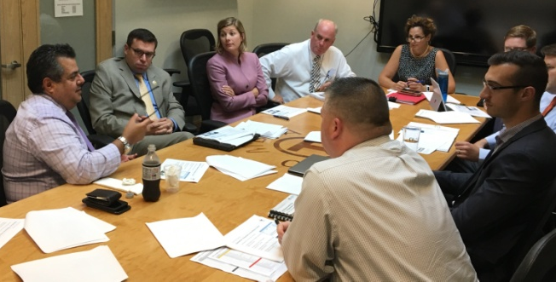
Management
Operation Winter Preparedness – DGM Remarks 9/18/17
Planning | September Goal | Actual | 100% Goal Date
Revise Snow and Ice Operations Plan Revised Storm Classification Tool Commuter Rail Snow Plan Integration Customer Call Center updates EOC and Storm Desk Activations Roster and POC Updates RIDE/GCS Plan Development and Finalization | 25% | 25% | Nov 2017
ESF1 Training | 25% | 25% | Nov 2017
Training and Exercise | September Goal | Actual | 100% Goal Date
Equipment Deployment Drill | 10% | 10% | Dec 2017
Storm Desk and Field Coordinator | 10% | 10% | Dec 2017

Slide 22
Communications
Operation Winter Preparedness – DGM Remarks 9/18/17
Goal: Communications are Driven by Operational Decisions
1. Communicate in one voice with one message at one time
Our customers don’t view service as being provided by either the MBTA or Keolis. To our customers, it’s all the responsibility of the MBTA. Our combined communications need to reflect one voice and one message, and be written from the customer perspective at all times.
2. Work together – each week, and all year long
Continuously improve unified winter communications from previous years and hone these efforts on projects throughout the year by meeting on a weekly basis, and sharing information throughout the week.
3. Be there when service decisions are being made
When the EOC gets activated, comms representatives from the MBTA and Keolis are present to monitor customer communications on social media, inform operational leadership, and deliver service information to team members as quickly as possible.

Slide 23
Methods: How we get the word out
Operation Winter Preparedness – DGM Remarks 9/18/17
Communicate with customers throughout their journey
Channel | Method | Planning the Journey | Getting to the Station | Navigating the Station | During the Journey | After the Journey
TV/Radio | Media/Radio/PR* | X | X | X | X | X
Online/Mobile | Website* | X |  | X | X | X
 | Tweets and T-Alerts* | X | X | X | X | X
 | Mobile Apps | X | X | X | X | X
 | Rail mail email | X
Phone | Live and recorded messages | X | X | X | X | X
In stations | Platform station LED Signs | X |  | X | X | X
 | Boston Station Departure Boards |  |  | X
 | Boston Station Signage | X |  | X
 | In station customer assistants | X |  | X
 | In station announcements | X |  | X
On the street | Digital urban panels |  |  |  | X
On vehicles | On board announcements* | X |  | X
On highways | Electronic billboards | X | X |  |  | X
 | Amber alert message boards |  |  |  | X | X
*Quickest methods available.

Slide 24
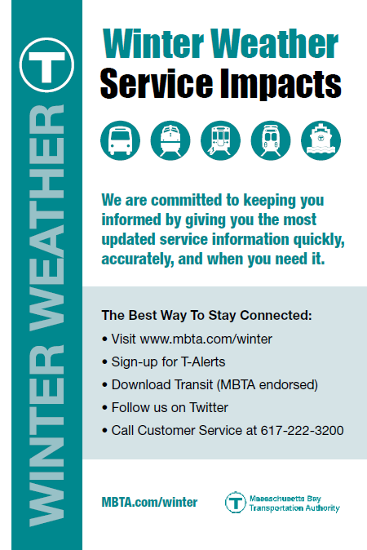
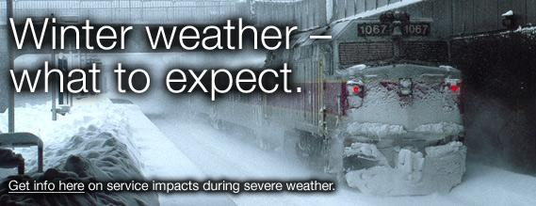
Example: Communicating with the Customer
Operation Winter Preparedness – DGM Remarks 9/18/17

Slide 25
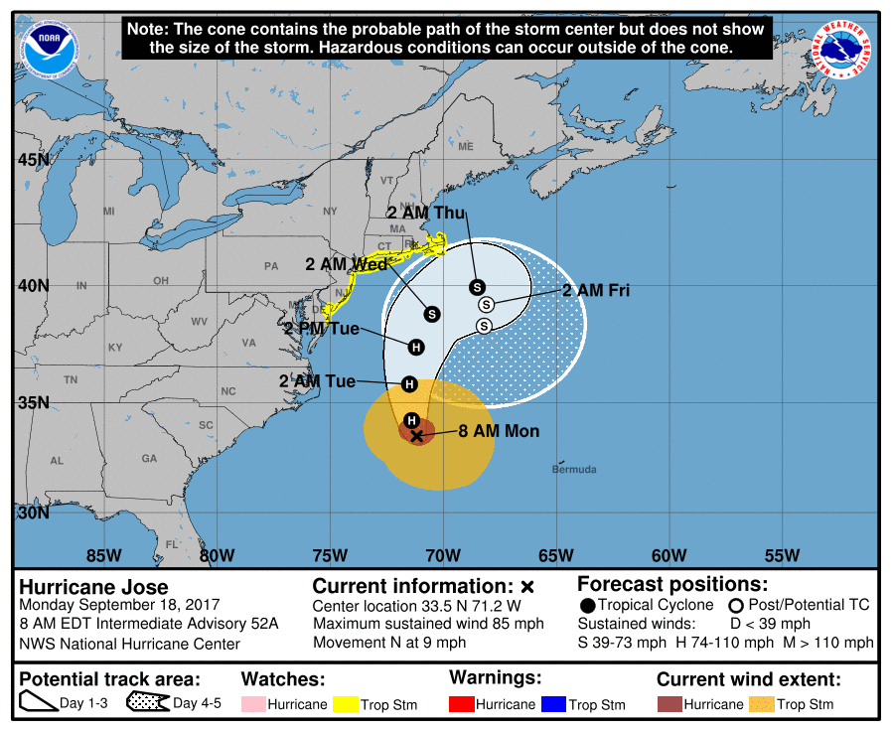
Hurricane Planning
Hurricane Planning– DGM Remarks 9/18/17
Document modeled after snow plan
Developed in coordination with MassDOT resiliency team
Identifies infrastructure impacts to rain, wind and flooding
Plans to protect assets
Integration of Commuter Rail and Ride
Continuous evolving document

Slide 26
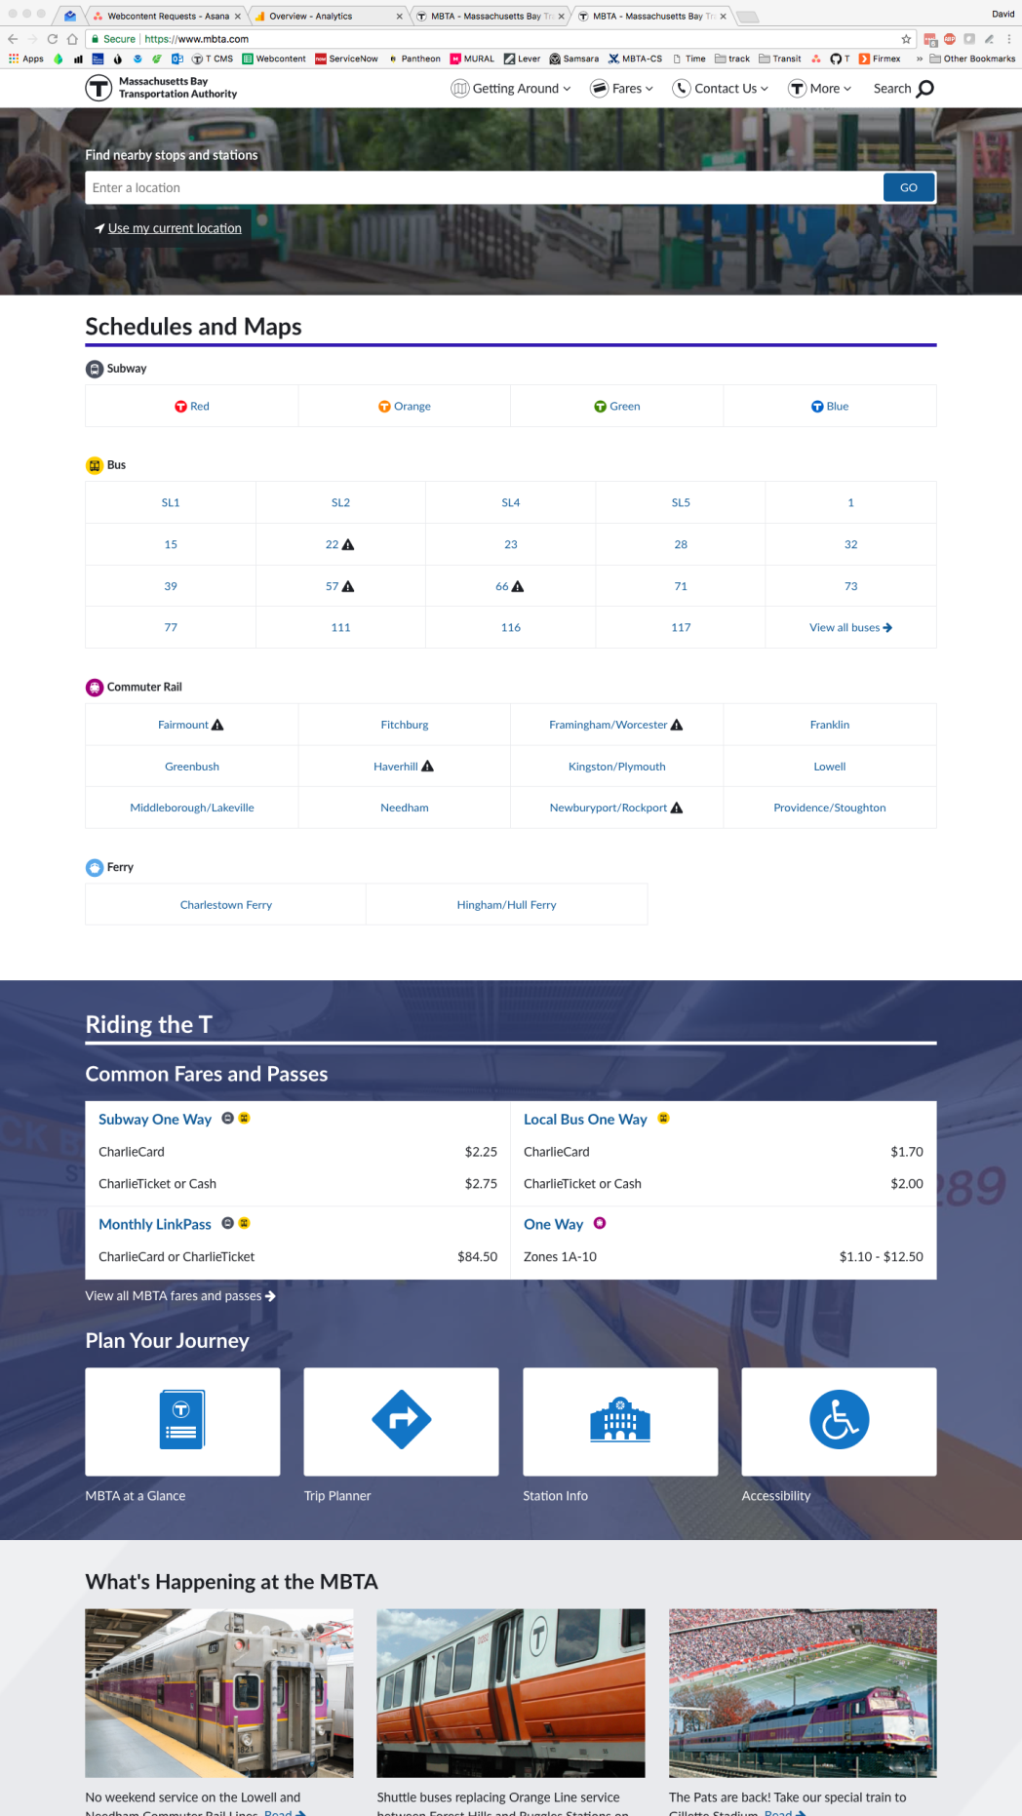
MBTA New Website – DGM Remarks 9/18/17
MBTA Launches New Website

Slide 27
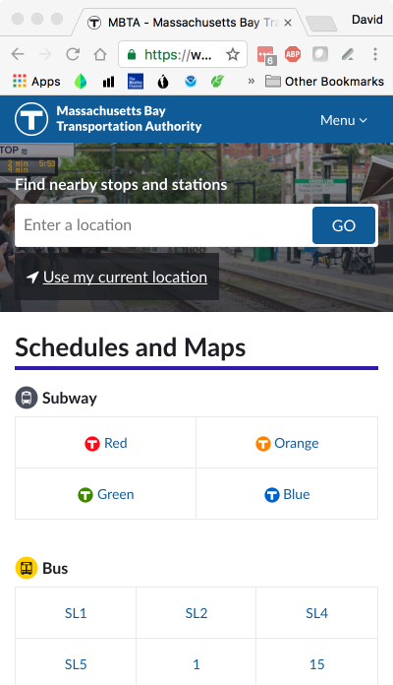
MBTA.com
MBTA New Website– DGM Remarks 9/18/17
MBTA Launches New Website
Launched September 12th
Replacement for 2007 era website, built before first iPhone
80,000+ users each day
>60% of usage is schedules and real time information
>60% of usage on mobile devices, and growing each day
>85% of visitors on mobile during peaks
Now completely accessible

Slide 28
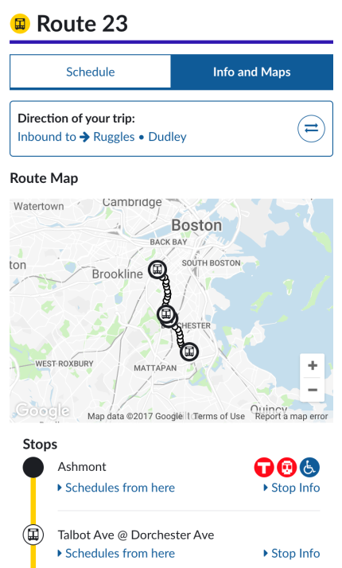
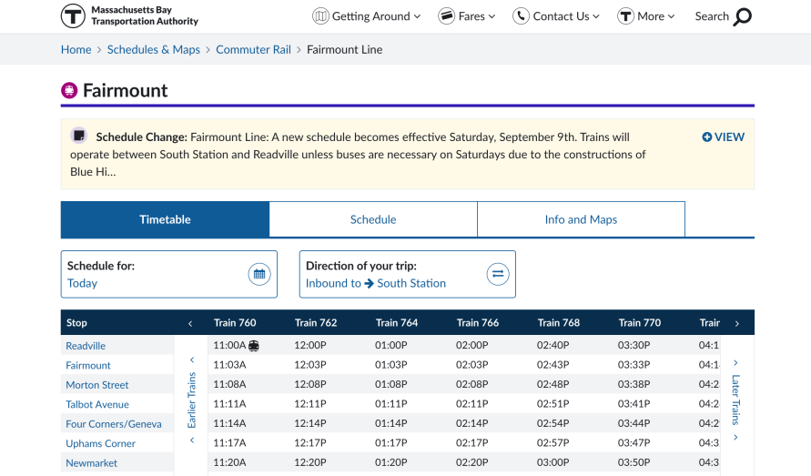
MBTA Launches New Website
MBTA New Website– DGM Remarks 9/18/17
Extensive user research, both online and in person
1,000+ comments received over beta period
Iterative agile process, with daily and weekly releases that continue today
Standards based, technology forward, responsive design
Platform for rapid delivery of user-focused features going forward

