Slide 1
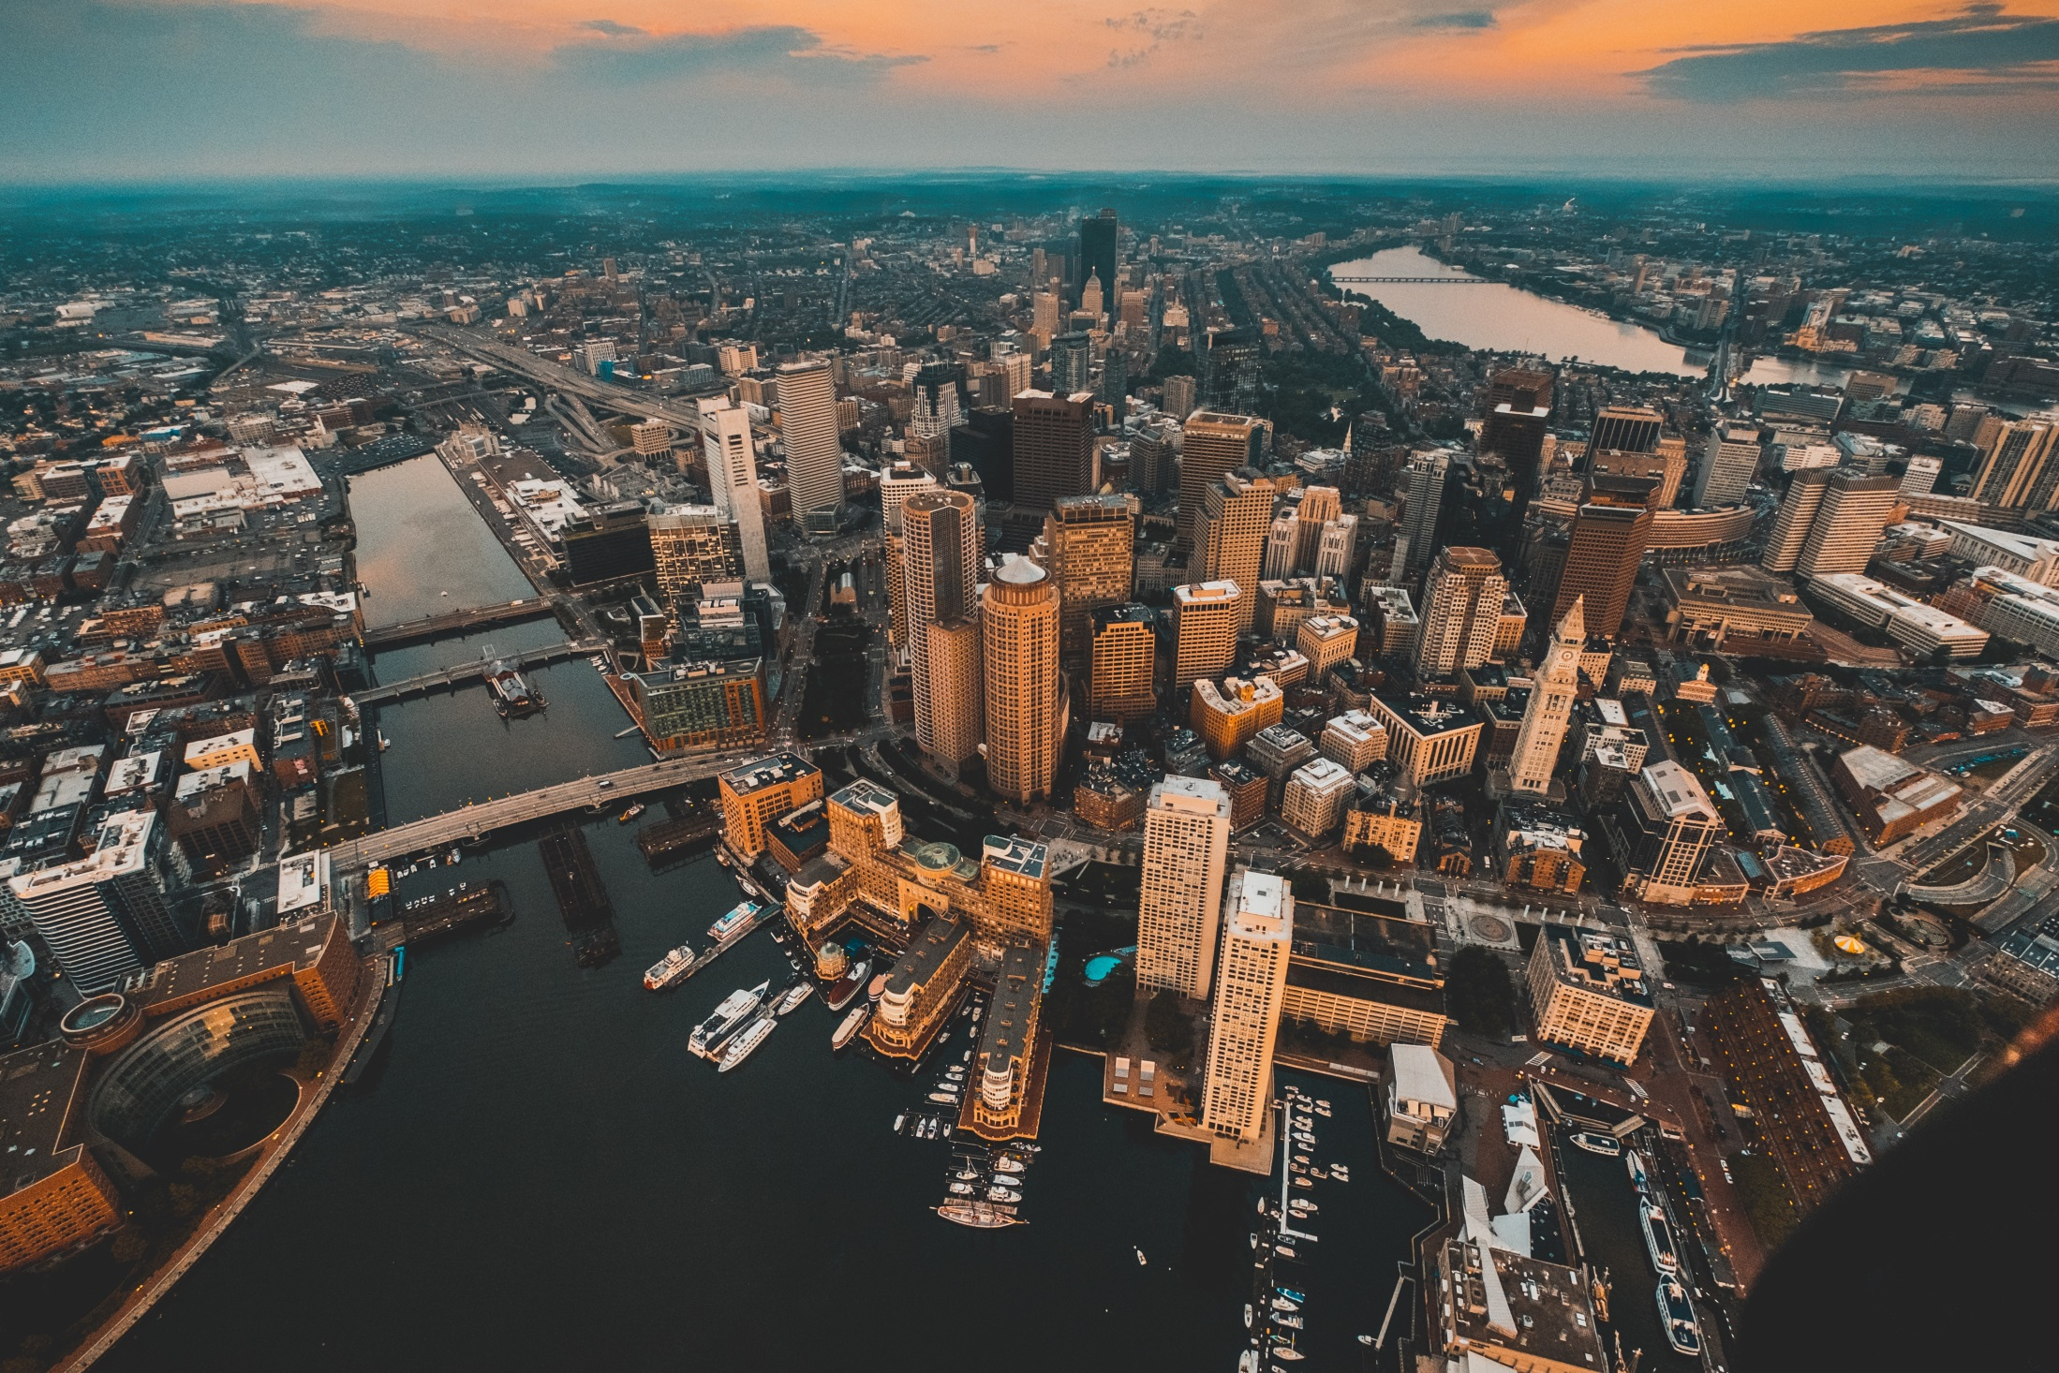
North South Rail Link Feasibility Reassessment
June 2018

Slide 2
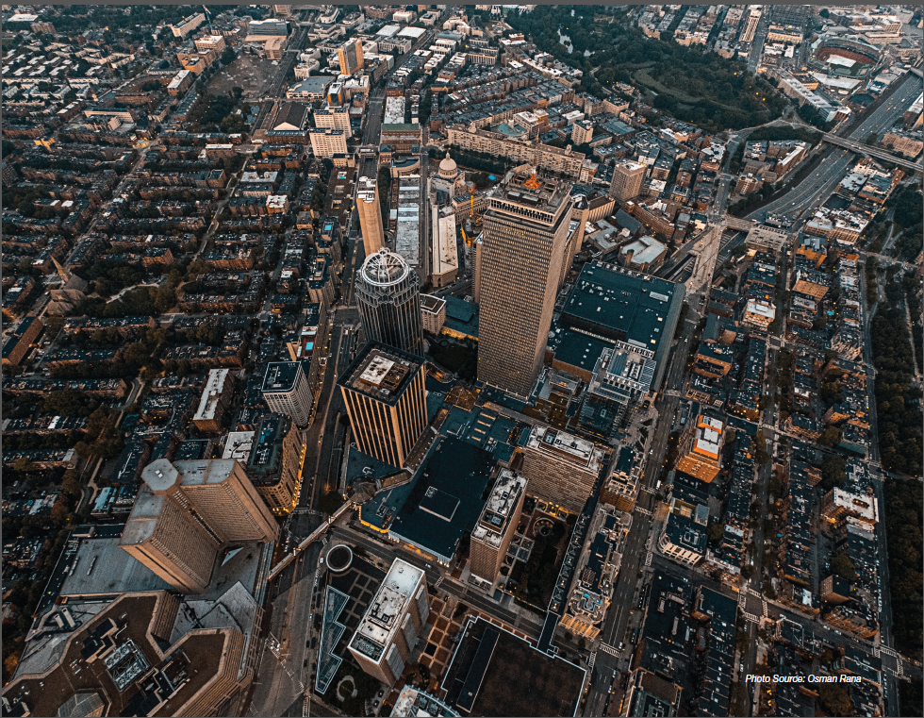
Agenda
Update and present key findings on the North South Rail Link Feasibility Reassessment:
Project Background / Scope
Tunnel Alignments, Portals and Stations
Service Plans
Ridership
Cost Estimates
Questions

Slide 3
Project background + project scope

Slide 4
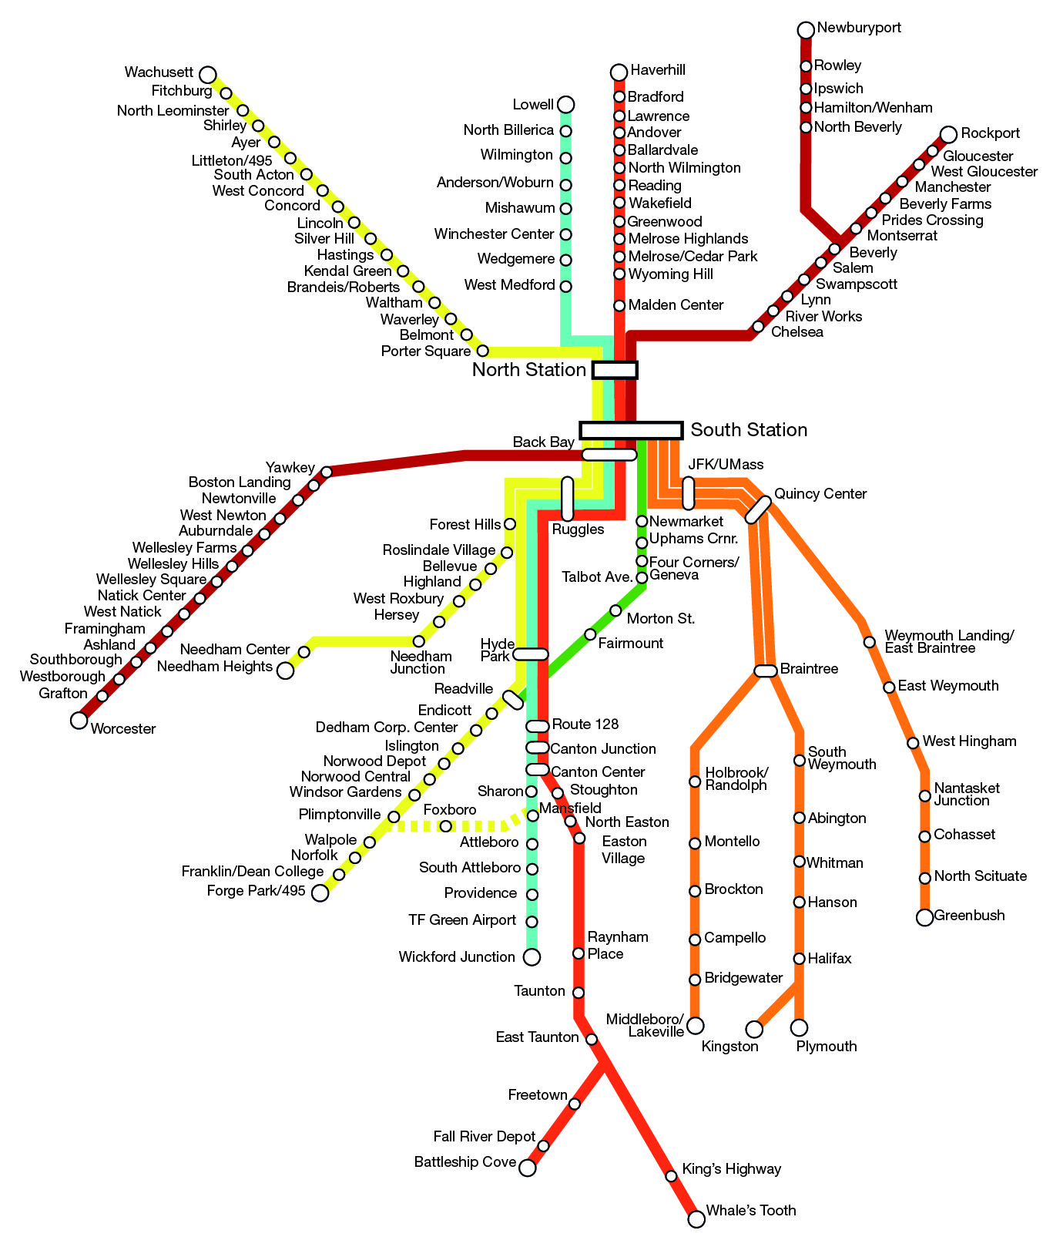
What is the North South Rail Link (NSRL)?
The North South Rail Link is a concept to connect the MBTA’s north and south commuter rail networks through the construction of a rail tunnel under downtown Boston. The potential benefits of such a connection could be:
Increase commuter rail capacity
Improve access to employment
Relieve rapid transit crowding
Improve maintenance flexibility through easier access to facilities
Reduce highway congestion and emissions
Create redevelopment opportunities by repurposing property no longer needed for rail layover

Slide 5
Scope of Feasibility Reassessment
Project is charged with:
Identifying changes in the urban form, demographics, and transportation choices since the DEIR era
Identifying a right of way envelope
Estimating order of magnitude cost
Summarizing high level benefits (ridership, reductions in VMT, air quality benefits, development potential along the project corridor)
Scope does not:
Identify potential financing options
Evaluate impacts on development potential beyond the project corridor
Develop a full operations simulation model
Include a health impact assessment

Slide 6
Tunnel Alignments, Portals and Stations

Slide 7
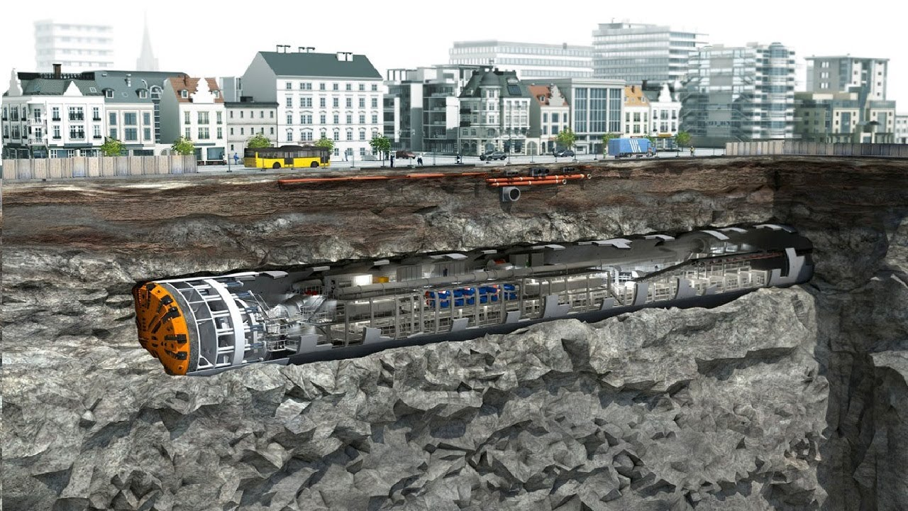
Tunneling – TBM Technology
Given the complexities of tunneling through downtown Boston (underground utilities, existing rail and highway tunnels), the NSRL would be built by a tunnel boring machine (TBM) at a depth below these obstructions.
Photo Source: National Geographic, Tunnel Boring Machine

Slide 8
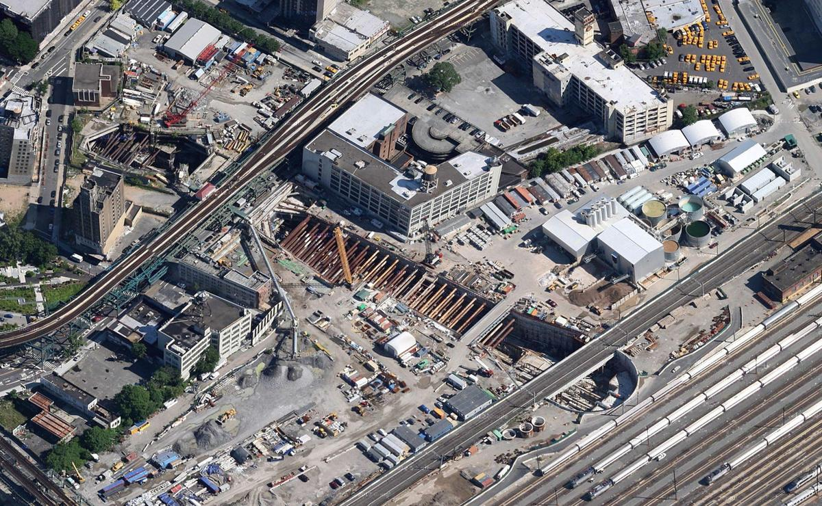
Tunneling – Aerial View of TBM Launch Pit
East Side Access NY

Slide 9
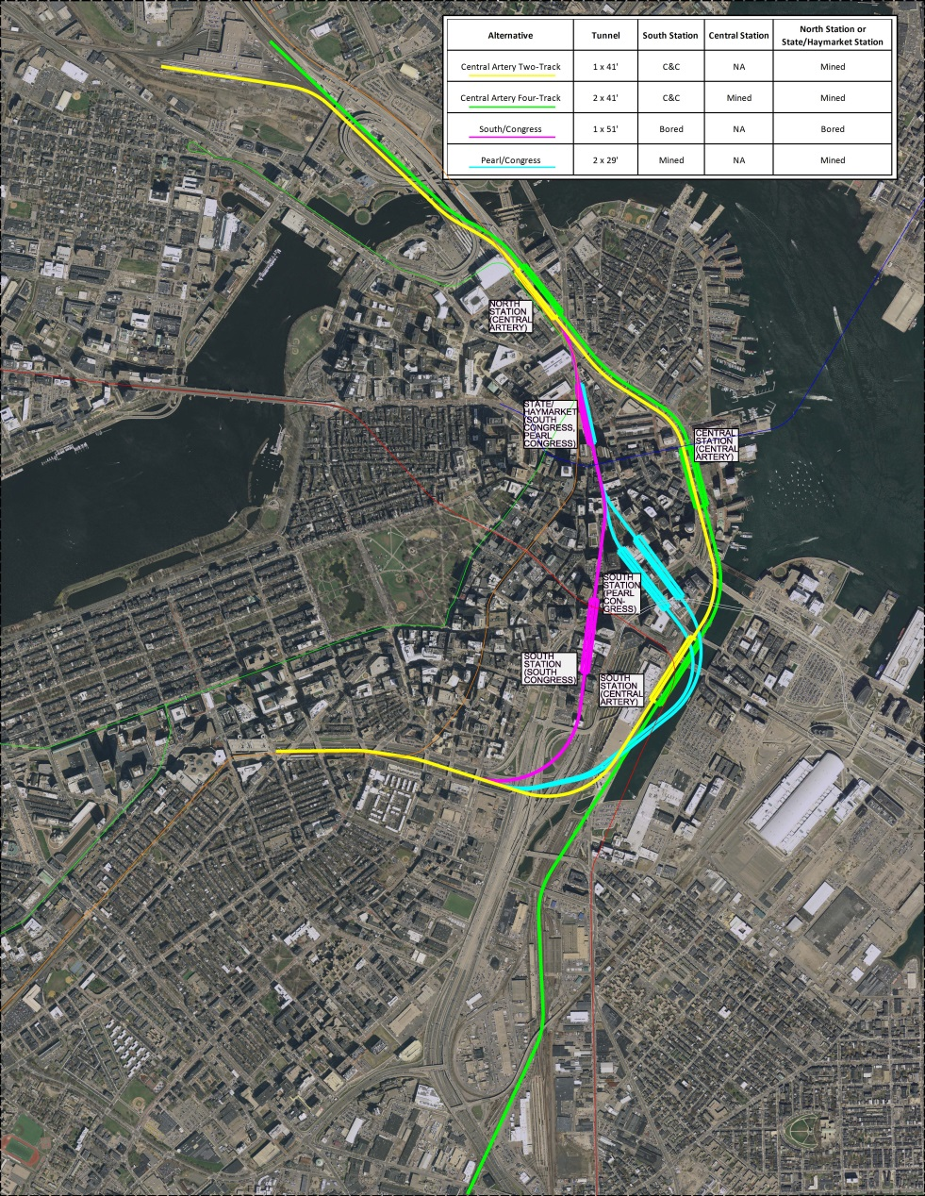
Potential Alignments
More than a dozen potential alignments were examined, with four selected as being the most viable:
Central Artery two-track (yellow)
Central Artery four-track (green AND yellow)
South/Congress (pink)
Pearl/Congress (blue)
South & Congress
Pearl & Congress
Central Artery 2-Track
Central Artery 4-Track

Slide 10
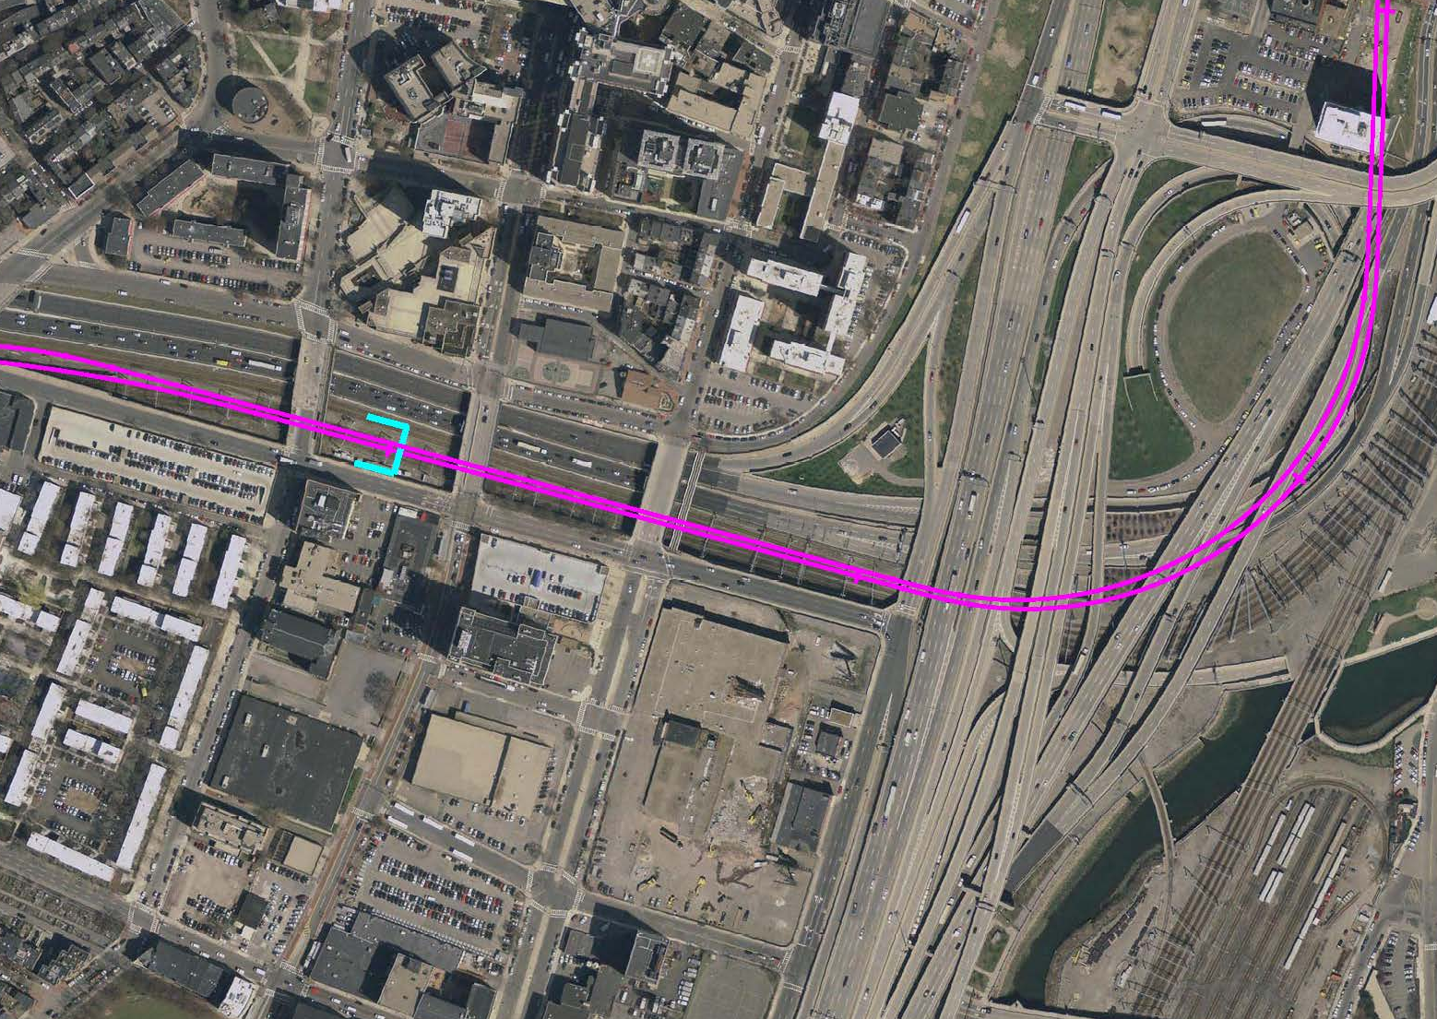
Back Bay Portal
Back Bay Portal utilized in all alternatives.
Location: Maximum allowable 3% grade means approach to portal must begin immediately east of Back Bay station, with portal located between Shawmut Avenue and Washington Street
Method of Construction: Constructed using boat sections and cut-and-cover.
Construction Impacts:
Limited single-tracking from Back Bay into South Station
Temporary rerouting of some or all Amtrak, Providence, Stoughton, and Franklin Line service via the Fairmount Line into South Station (this requires electrification of the Fairmount line to allow electric Amtrak service into South Station during construction)
Termination of the Worcester Line and Amtrak Lakeshore Limited service west of Back Bay unless a viable rerouting (i.e. via the Grand Junction Line into North Station) is identified.

Slide 11
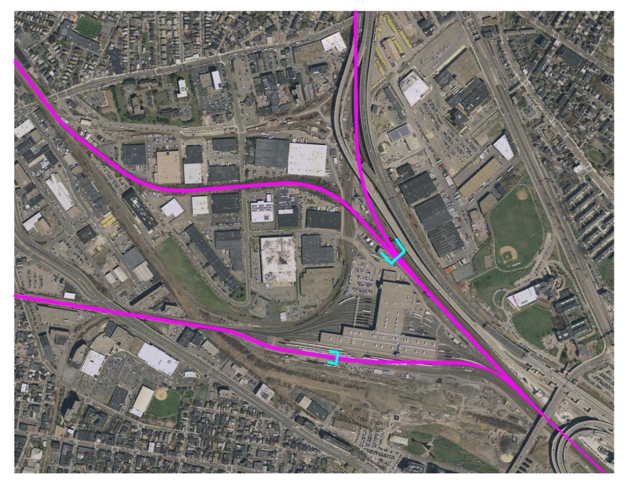
North Portals
The North Portals are utilized in all alternatives. The TBM would be launched from these portals and driven south.
Location: After passing north under the Charles River, the Fitchburg Line tracks climb to reach the surface via a portal directly south of the MBTA Boston Engine Terminal (BET) on the Cambridge/Somerville border. The other tracks (to the Lowell, Haverhill, and Newburyport/Rockport Lines) emerge from a portal due east of BET.
Method of Construction: Constructed using boat sections (a U-shaped section with a continuous base slab and supporting retaining walls) and cut-and-cover.
Construction Impacts: Service delays and interruptions as the north portal grade separations are constructed.

Slide 12
Stations Overview
All NSRL station platforms will be underground and will not be located directly underneath North or South Station due to technical feasibility constraints. All alternatives maintain current connections into today’s South Station headhouse and North Station subway station*
The exact location of platforms will be governed by:
Path and depth of each tunnel alignment in relation to existing North and South Stations
Locations of tangent (straight) track
Ability to preserve connections (both to neighborhoods and other transit) available at today’s North and South Stations
While much of today’s surface tracks and platforms at South Station are preserved (to serve Amtrak and MBTA lines not using the tunnel), there is the potential to shift all of North Station’s commuter rail and Amtrak service below grade to the new NSRL station.
*with the exception of South Congress and Pearl Congress alignments

Slide 13
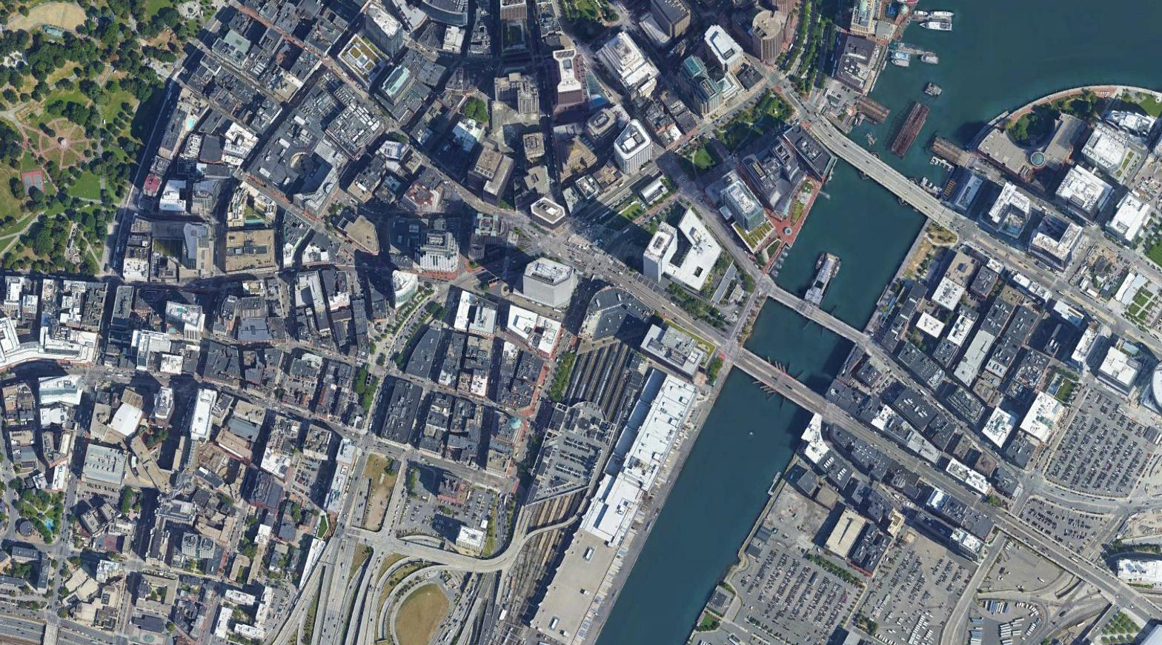
South Station: Platform Alternatives
3 slides: one for each S. Station location/alignment – aerial photo, where today, where going, proposed headhouse locations
Station depth (time to surface), change in walking time to post office square, change in walking time to vertex (seaport), change in walking access to SL + RL
Proposed South Station Platform (South Congress)
Existing South Station
= Indicates potential headhouse locations

Slide 14
South Station: Platform Alternatives
3 slides: one for each S. Station location/alignment – aerial photo, where today, where going, proposed headhouse locations
Station depth (time to surface), change in walking time to post office square, change in walking time to vertex (seaport), change in walking access to SL + RL
Proposed South Station Platform (Pearl Congress)
Existing South Station
= Indicates potential headhouse locations

Slide 15
South Station: Platform Alternatives
3 slides: one for each S. Station location/alignment – aerial photo, where today, where going, proposed headhouse locations
Station depth (time to surface), change in walking time to post office square, change in walking time to vertex (seaport), change in walking access to SL + RL
Existing South Station
= Indicates potential headhouse locations

Slide 16
South Station: Platform Alternatives
3 slides: one for each S. Station location/alignment – aerial photo, where today, where going, proposed headhouse locations
Station depth (time to surface), change in walking time to post office square, change in walking time to vertex (seaport), change in walking access to SL + RL
Proposed South Station Platform (Pearl Congress)
Proposed South Station Platform (South Congress)
Proposed South Station Platform (Central Artery)
Existing South Station
= Indicates potential headhouse locations

Slide 17
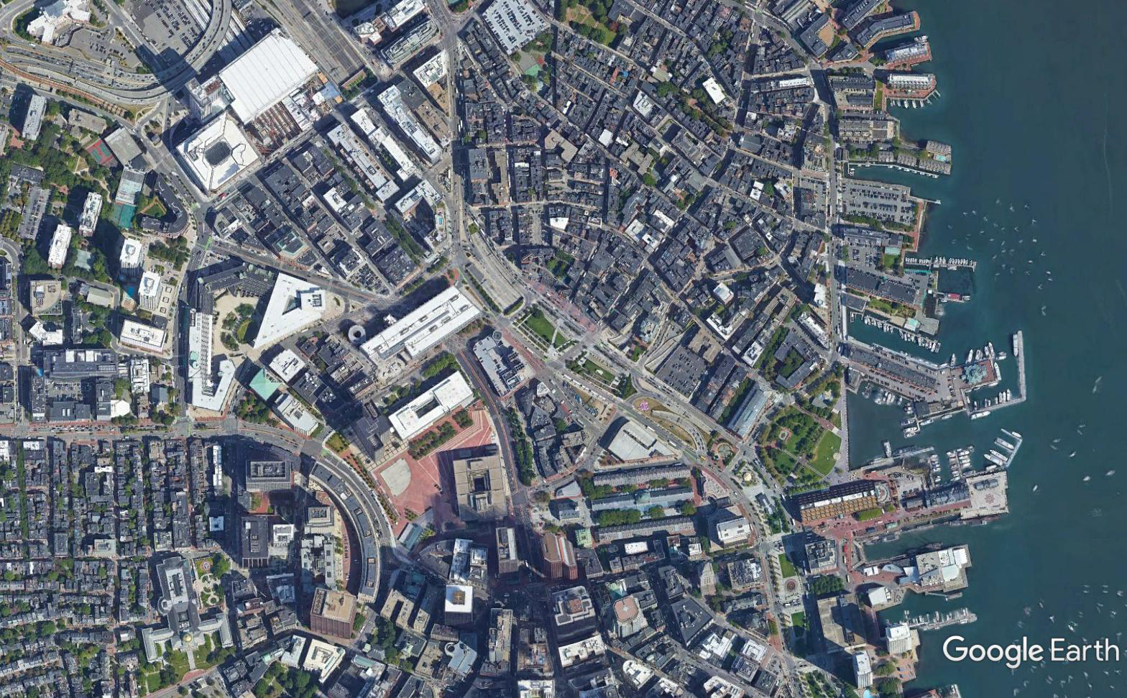
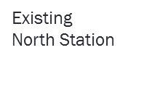
North Station: Platform Alternatives
Proposed North Station Platform (Central Artery)
= Indicates potential headhouse locations

Slide 18
North Station: Platform Alternatives
Proposed State/Haymarket Station (South Congress,
Pearl Congress)
= Indicates potential headhouse locations

Slide 19
North Station: Platform Alternatives
Proposed North Station Platform (Central Artery)
Proposed State/Haymarket Station (South Congress,
Pearl Congress)
= Indicates potential headhouse locations

Slide 20
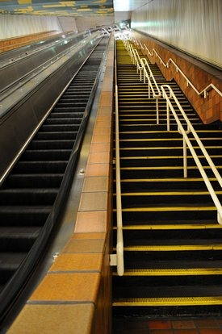
Station Depth Comparison
Station | Station Depth
NSRL Stations | 115 - 195 feet
MBTA Aquarium | 50 feet
MBTA Porter Square | 105 feet
WMATA Dupont | 114 feet
WMATA Bethesda | 165 feet
NYC MTA 191st Street | 180 feet
Portland Washington Pk | 260 feet
NOTE: We are assuming a walk time of 3-4 minutes from the underground platforms to the station entrances
Porter Square escalators/stairway

Slide 21
Service Plans

Slide 22
Service Plans
 | Peak Service Levels | Off-Peak Service Levels | South Coast Rail
No Build 2040 | Current service schedules | Current service schedules | South Coast line via Middleborough
South Station Expansion All-Day Peak Service (No NSRL) | Maximum achievable service levels (trains every 10-30 minutes, depending on the line) | Maximum achievable service levels (trains every 10-30 minutes, depending on the line) | South Coast line via Stoughton (fully electrified)
NSRL Regular Service (2-track) | Maximum achievable service levels (trains every 10-30 minutes, depending on the line) | Hourly Service | South Coast line via Stoughton (fully electrified)
NSRL All-Day Peak Service (2-track and 4-track) | Maximum achievable service levels (trains every 10-30 minutes, depending on the line) | Maximum achievable service levels (trains every 10-30 minutes, depending on the line) | South Coast line via Stoughton (fully electrified)
Note: Unlike typical ridership modeling , all service plans assume no constraints on station parking

Slide 23
Service Assumptions
All trains operating through the tunnel are interlined with another line on the other side of the system
NSRL 2 Track Tunnel can support 17 trains per hour, per direction (for context, this is more frequent service than currently provided on the Red Line); NSRL 4 Track Tunnel can support 21 trains per hour, per direction
Passengers would be able to board and alight through all doors on a train and more quickly than is typical today, similar to rapid transit operations
Service on the individual lines would be managed such that trains would be able to arrive precisely as scheduled for their slot to enter the tunnel and maintain the 17 trains/hour frequency
Significant infrastructure investments beyond those necessary for the tunnel itself are made in order to meet the above assumptions.

Slide 24
Risks in Implementing Service Plans
The following represent some of the biggest concerns MBTA Operations has with the study’s assumptions:
No system has yet operated aspirational level of frequency with Positive Train Control
Service disruptions on one or two tracks in the tunnel will cause ripple effects throughout the entire commuter rail system
Assumptions about train loading/unloading time are much more aggressive than current experience
Depth of stations is a concern during evacuation (and possible negative impact on customer experience due to longer time to exit stations)
Rapid transit stations were not designed to accommodate transfers from commuter rail in the way they would happen now and may lack platform capacity to adequately do so
Locations for additional layover and maintenance capacity have not been identified and are challenging to site

Slide 25
Ridership

Slide 26
CTPS Regional Travel Demand Model
Federally approved tool to project ridership on projects seeking federal funding support – same tool used for all major MBTA/MassDOT investments (example: GLX, South Station Expansion)
Projects how trips are made (drive vs transit; which route or transit service) in horizon year (currently 2040)
Assuming future population/employment across >5,000 zones in Eastern Massachusetts, consistent with regionally adopted land use forecasts developed by MAPC
Model is not dynamic (transportation investments don’t change land use)
Investments (such as NSRL) are compared to a future “No Build” that doesn’t include that investment, but where today’s network is enhanced by other funded or otherwise committed projects in the pipeline (i.e. GLX)
Model does not typically constrain capacity except for parking supply
Since model looks at a 3 hour peak period, transit capacity not typically an issue
For this project, commuter rail parking was treated unconstrained in all model runs

Slide 27
Ridership by Alternative: No Build 2040 All Day Boardings

Slide 28
Ridership by Alternative: NSRL Regular Service (2-track) All Day Boardings

Slide 29
Ridership by Alternative: SSX All-Day Peak Service All Day Boardings

Slide 30
Ridership by Alternative: NSRL All-Day Peak Service (2-track All Day Boardings

Slide 31
Ridership by Alternative: NSRL All-Day Peak Service (4-track) All Day Boardings

Slide 32
Ridership Destinations Northside (Southbound) AM PEAK

Slide 33
Cost Estimates

Slide 34
Cost Estimating Methodology
Escalation to midpoint of construction (2028): Standard practice for construction costs. Aims at simplifying the cost-loading strategy of a project by assuming that 50% of the project cost will be incurred in 50% of the project’s duration.
Every cost estimate includes an annual escalation rate of 3.5% (compounded annually)
Costs include: Alignment lengths, tunnel types, station areas, trackwork, portals, and allowances
Allowances: underpinning works, roadway reconstruction, and utility relocations
Total Design Build Costs: Direct Costs + Indirects + Contractor’s Overhead / Profit + Design Engineering
Total Project Costs: Total Design Build Costs + Owner’s Soft Costs + Project Risk Contingency + Escalation to Midpoint of Construction

Slide 35
Cost Estimating Methodology
Calculation of Project Costs
Use of Arup tunneling experts input
Composite unit rate build-up based on construction technique which was then compared to Arup’s cost databases and cost benchmarks
Use of International Best Practices to assign accuracy ranges and contingencies (AACEi)
Estimating mark-ups applied based on experience on other projects: Green Line Extension Project, Tappan Zee Bridge (The New NY Bridge), Texas Central Rail, Windsor Tunnel
Use of benchmarks:
CHSRL (California) → Similar scope (TBM /SEM and diameter)
London Cross Rail (UK) → Similar scope (TBM / diameter, constructability)
M-30 tunnel (Spain) → Similar scope (TBM / diameter)
I-710 (California) → Similar scope (TBM / diameter)
Pannerdenschkanaal (Netherlands) → Similar scope (TBM / diameter)
San Francisco Central Subway → station construction type
Green Line Extension estimate → trackwork scope

Slide 36
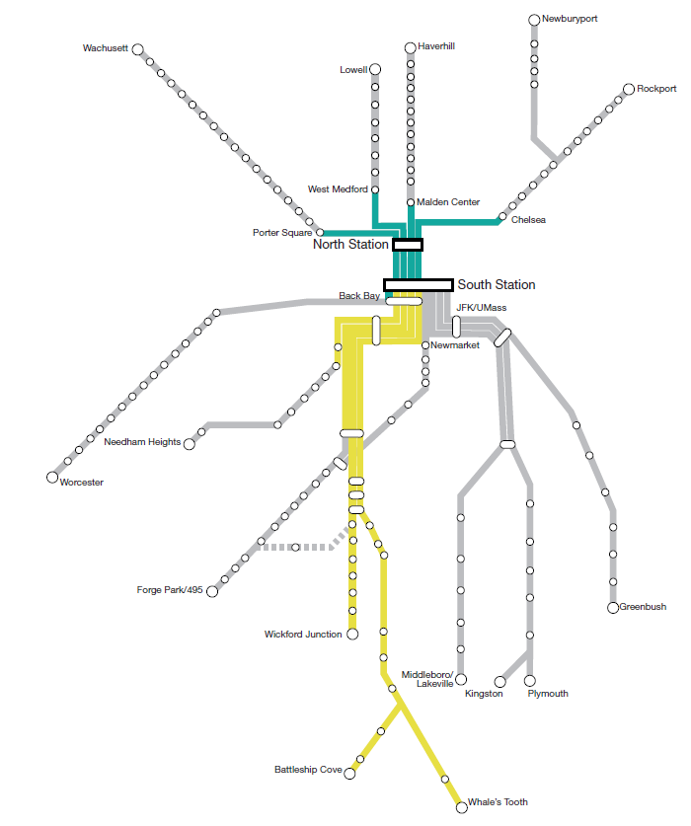
Electrification Proposal
Already electrified (including SCR Phase 2)
Electrified as part of NSRL project

Slide 37
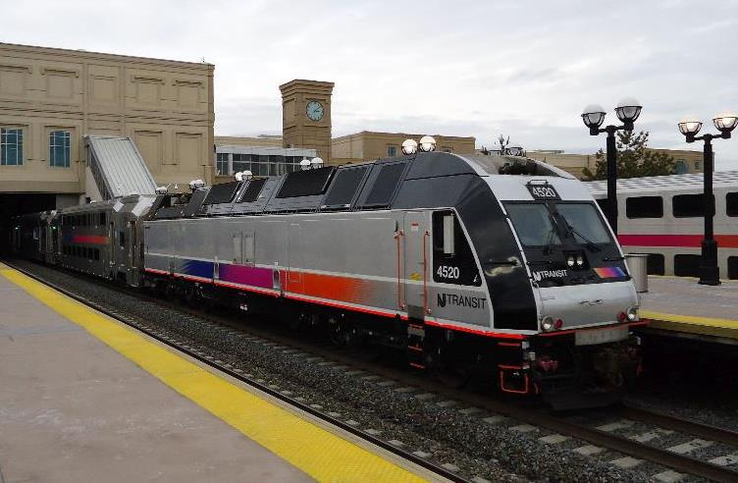
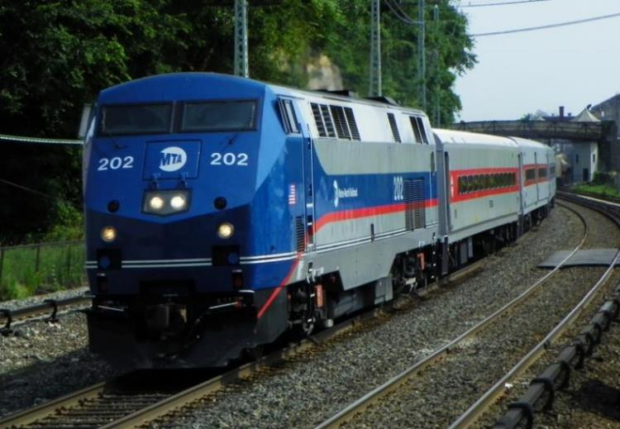
Dual Mode Locomotives + Coaches
Dual-mode locomotives are proposed for the NSRL tunnel alternatives as they are able to travel on both the electrified and non-electrified portions of the commuter rail system, switching between diesel and electric operations as appropriate
Bombardier ALP-45DP Locomotive (NJ Transit) GE P32AC-DM Locomotive (Metro-North Railroad)
The three 2-track alternatives involve replacing 48 diesels with dual-modes, expanding locomotive fleet with 72 dual-modes and 203 coaches
The Central Artery 4-track alternative involves replacing 58 diesels with dual modes, expanding locomotive fleet with 72 dual-modes and 203 coaches

Slide 38
Other Investments Needed to Increase Service
Upstream Improvement
Resignaling | 30 track miles of signaling assumed to support increased service
Double Tracking | Worcester, Fitchburg, Newburyport/Rockport (between McNall & Northey Point Junctions - between Swampscott and Salem stations)
Additional Platforms | Fitchburg, Lowell, Worcester
Grade Separation | Between northbound and southbound services at each tunnel portal
Turnback Crossovers | Fitchburg, Franklin, Fairmount
Crossing and Passing Loops | Needham, Old Colony (passing loop between Abington and Whitman Stations), Haverhill

Slide 39
Cost Estimates – Summary
 | South Station Expansion All-Day Peak Service | Central Artery 2 - track | South Congress | Pearl / Congress | Central Artery 4 - Track
Tunneling | NA | $8,629,000,000 | $9,493,000, 000 | $10,701,000,000 | $17,730,000,000
Vehicles | $1,397,000,000 | $2,380,000,000 | $2,380,000,000 | $2,380,000,000 | $2,439,000,000
Upstream Investments to Support Increased Service | $ 833,000,000 | $1,307,000,100 | $1,307,000,100 | $1,307,000,100 | $1,321,000,000
SSX* | $2,466,000,000 | NA | NA | NA | NA
Total | $4,696,000,000 | $12,317,000,000 | $13,181,000,000 | $14,388,000,000 | $21,491,000,000
All costs escalated to midpoint of construction (2028) and rounded to the nearest Million
*includes only project elements from MassDOT’s South Station Expansion Federal Environmental Filing
NOTE: Additional Vehicles costs are part of increased service in all alternatives
Assumptions:
Every alternative has 2 stations except for the Central Artery 4-track which has 3 stations
All tunnel alternatives replace 66 diesel trains with dual-mode locomotive trains

Slide 40
Comparison of South Station Expansion
Cost Estimates
Element | VJ Associates Cost Estimate: South Station Expansion | Keville Independent Cost Estimate: South Station Expansion | Arup Cost Estimate: South Station Expansion All-Day Peak Service
Dorchester Ave. including USPS Demo | $36,700,391 | $56,623,715 | $28,000,000
South Station Headhouse | $210,533,210 | $331,207,324 | $235,000,000
South Station Track | $157,737,210 | $132,605,815 | $181,000,000
Layover Facilities – Widett | $115,331,637 | $97,360,704 | $130,000,000
Layover Facilities – Readville | $15,156,522 | $18,628,863 | $34,000,000
ROW Acquisition | $348,308,000 | $348,308,000 | $400,000,000
Sub totals w/o contingencies | $883,766,890 | $984,734,421 | $1,008,000,000
Contingencies | $979,058,737 | $935,892,663 | $741,000,000
Totals in Year 2017/2018 dollars | $1,862,825,627 | $1,920,627,084 | $1,749,000,000
Totals in Year 2028 dollars |  |  | $2,466,000,000

Slide 41
NSRL Cost Comparisons
2002 MassDOT Study
Alternative | Infrastructure Cost (2002 USD) | Infrastructure Cost (2028 USD)
Two-Track (Back-Bay)/Two Station | $ 3,368,700,000 | $ 8,240,000,000
Two-Track (South-Bay)/Two Station | $ 3,317,100,000 | $ 8,114,000,000
Four-Track/Three Station | $ 5,748,000,000 | $14,060,000,000
Executive Summary Table ES-7 Summary of Capital Costs (2002 Dollars) escalated to 2028 MP Construction
2017 Harvard Study
Alternative | Total Cost (2025 USD) | Total Cost (2028 USD)
Minimum (Two Track) | $ 3,820,000,000 | $ 4,236,000,000
Maximum (Four Track) | $ 5,940,000,000 | $ 6,586,000,000
Figure 2 and Figure 3 of NSRL White Paper_Silver_Final.PDF escalated to 2028 USD. Note: The Harvard Study did not include cost for the tunnel boring machine launch pit and only accounted for 2.7 miles of tunneling (the MassDOT studies both accounted for 5 miles of tunneling), and no contingency for risk.
2018 MassDOT Study
Alternative |  | Infrastructure Cost (2028 USD)
Central Artery Two-Track / Two Station |  | $ 8,629,000,000
South Congress Alignment / Two Station |  | $ 9,493,000,000
Central Artery Four Track / Three Station |  | $17,730,000,000
Arup analysis (2018 Dollars) escalated to 2028 MP Construction

Slide 42
Operating costs - Estimates
Operating costs have been estimated for the no build (2040), South Station Expansion All-Day Peak Service (No NSRL), and the NSRL All-Day Peak Service (2-track) alternatives
Midpoint cost alignment, 2018 US Dollars
 | No Build 2040 | South Station Expansion All-Day Peak Service | NSRL All-Day Peak Service (2-track)
Vehicle revenue miles/day | 16,420 | 41,550 | 51,470
Operating expenses/year | $400,000,000 | $775,000,000 | $929,000,000

Slide 43
Next Steps
Public Meeting – Thursday, June 21 – 10 Park Plaza, 2nd Floor – 5:30pm to 8:30pm
Release of draft NSRL Feasibility Reassessment – Early July 2018
Comment Period – July/August 2018
Final NSRL Feasibility Reassessment Report – Early Fall 2018
MBTA Rail Vision Study examining electrification and alternative service models - Ongoing

Slide 44
Questions

Slide 45
appendix

Slide 46
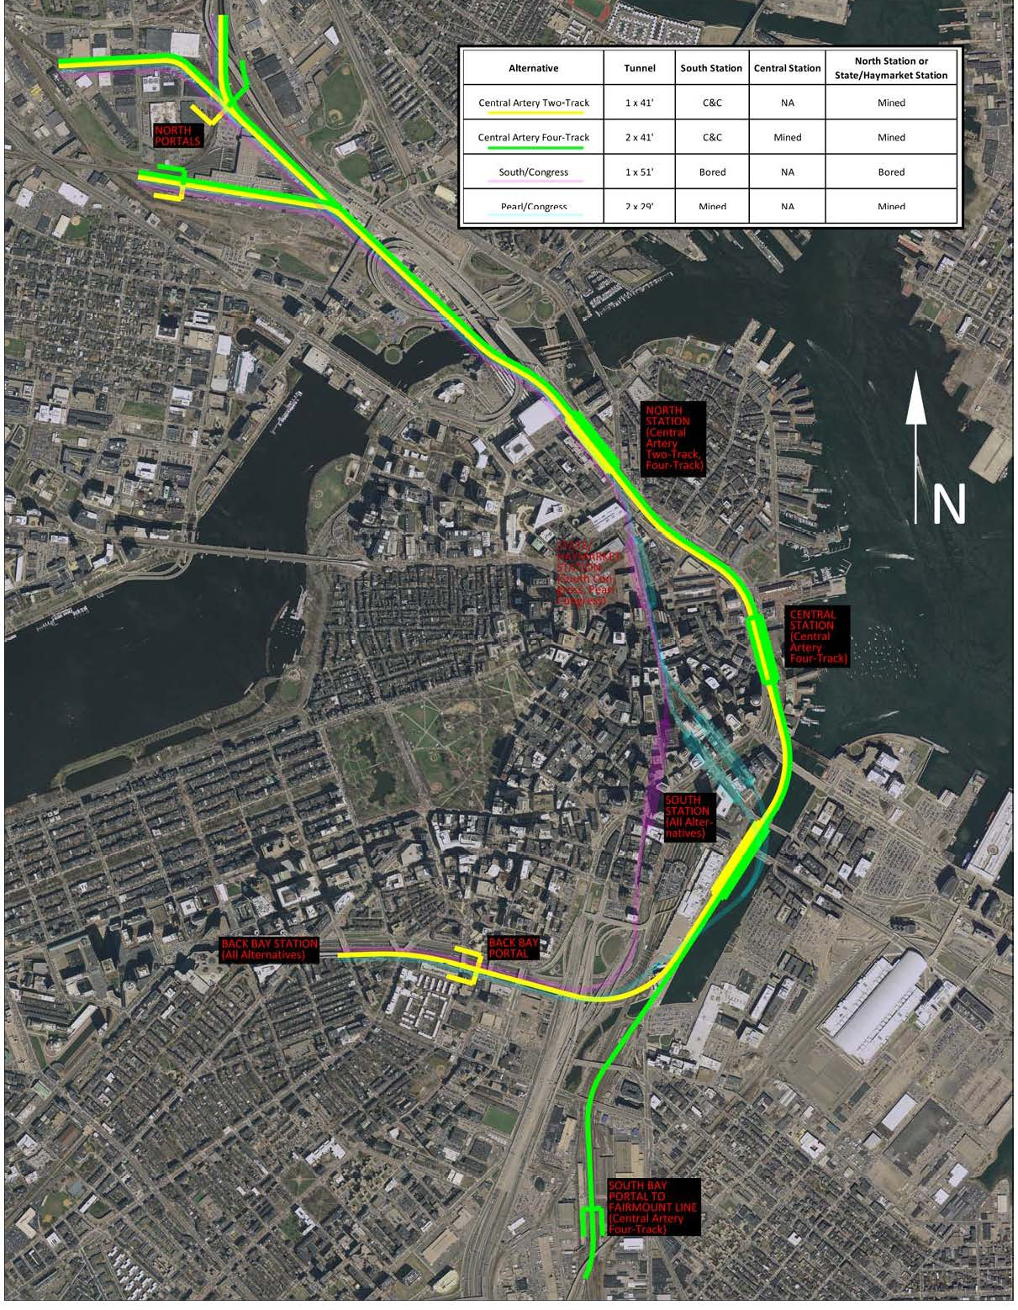
Central Artery Two-Track
Two stations
Cut-and-cover construction in Fort Point Channel, mining around South Bay interchange ramps
Alignment accommodated in a 38-foot internal diameter tunnel built using a 41-foot-diamter TBM.
Tunnels under the Orange Line, I-90 Ramps, the Red, Silver, and Blue Lines.
Fairmount and Old Colony Lines continue to terminate at South Station at grade
Tracks | Tunnel Diameter | Stations | Alignment Depth
2 | 1 x 41ft | 2 | 125ft

Slide 47
Central Artery Four-Track
Three stations – Includes Central Station
Cut-and-cover construction in Fort Point Channel, mining around South Bay interchange ramps
Uses two 41-foot TBMs to form two 38-foot internal dimension tunnels
Tunnels under the Orange Line, I-90 Ramps, the Red, Silver and Blue Lines.
Fairmount Line uses the tunnel. Old Colony Lines continue to terminate at South Station at grade
Tracks | Tunnel Diameter | Stations | Alignment Depth
4 | 2 x 41ft | 3 | 125ft

Slide 48
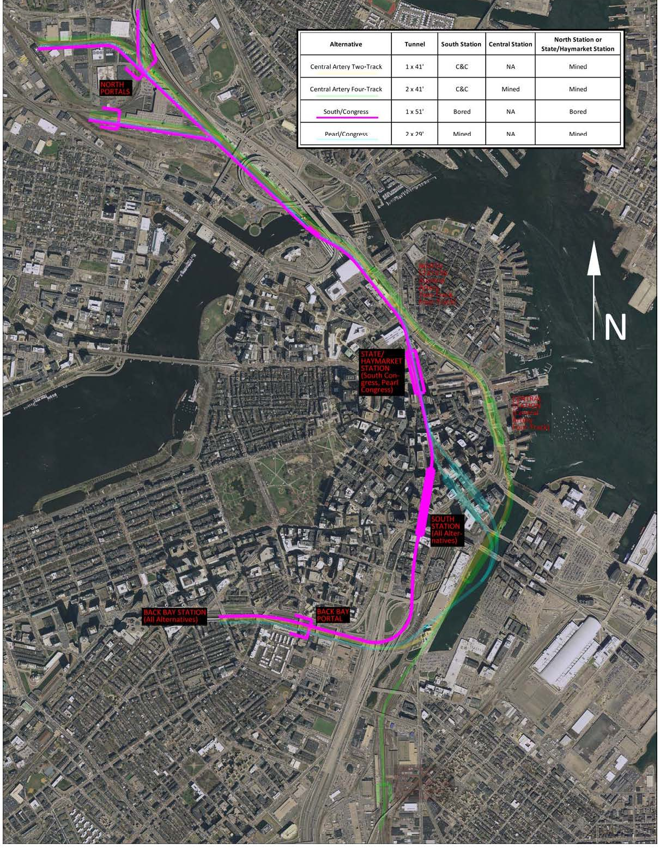
South/Congress Alignment
Two stations
Single 51-foot TMB bored tunnel with stacked tracks and platforms within the tunnel bore
Tunnels under Red, Blue, Orange and Green Lines and the southbound lanes of I-93
Fairmount and Old Colony Lines continue to terminate at South Station at grade
Tracks | Tunnel Diameter | Stations | Alignment Depth
2 | 1 x 51ft | 2 | 115 - 130ft

Slide 49
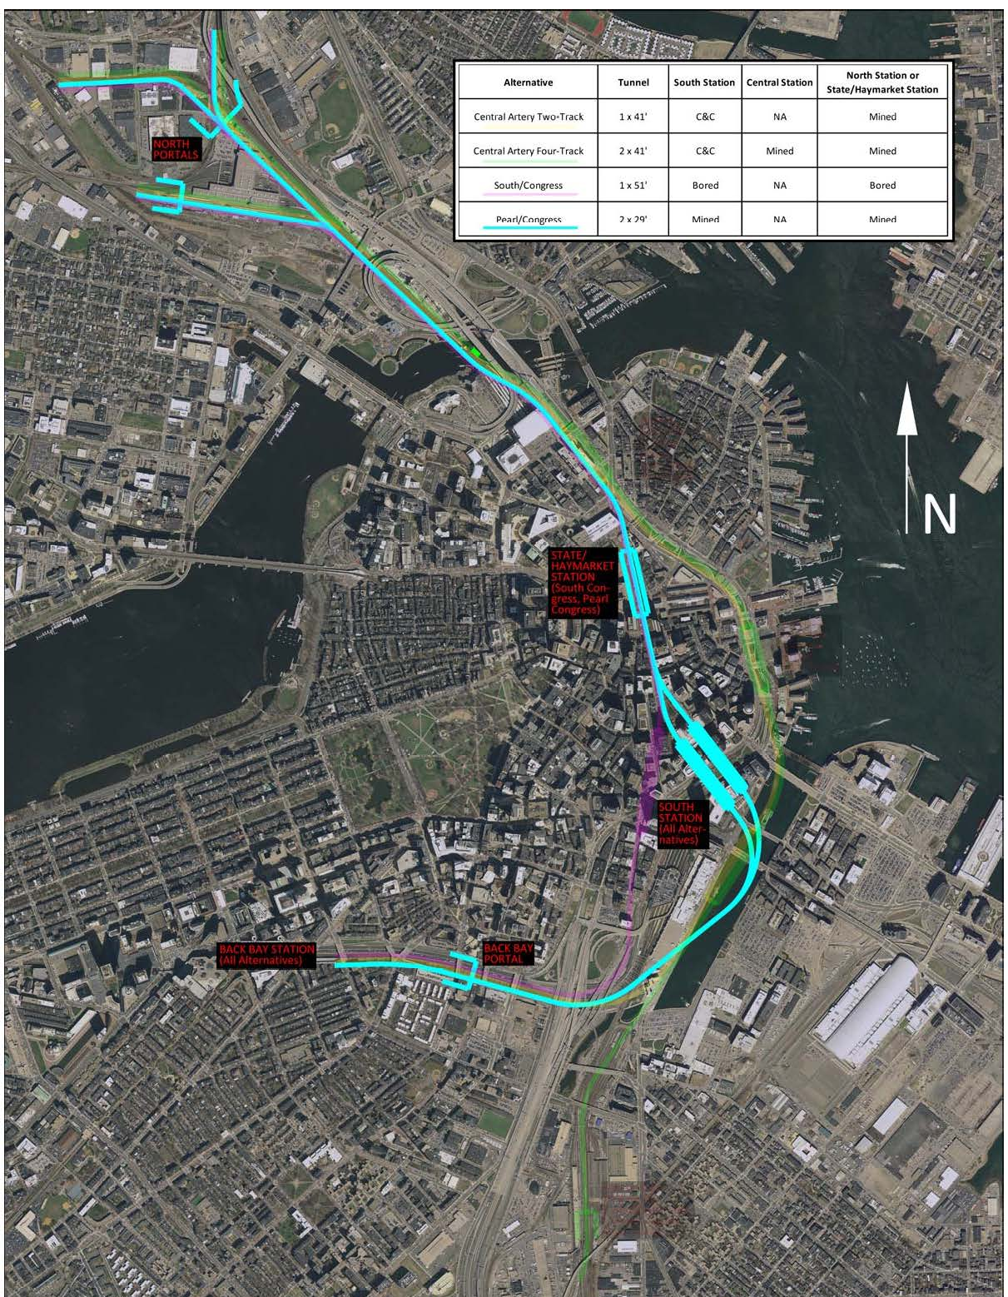
Pearl/Congress Alignment
Two stations
Mining around South Bay interchange ramps
Uses two 29-foot-diameter TBM bored tunnels
Tunnels under Orange Line, I-90 Ramps, the Red and Silver Lines, I-93 northbound lanes, I-93, the Blue and Green Lines
Fairmount and Old Colony Lines continue to terminate at South Station at grade
Tracks | Tunnel Diameter | Stations | Alignment Depth
2 | 2 x 29ft | 2 | 135 - 195ft

Slide 50
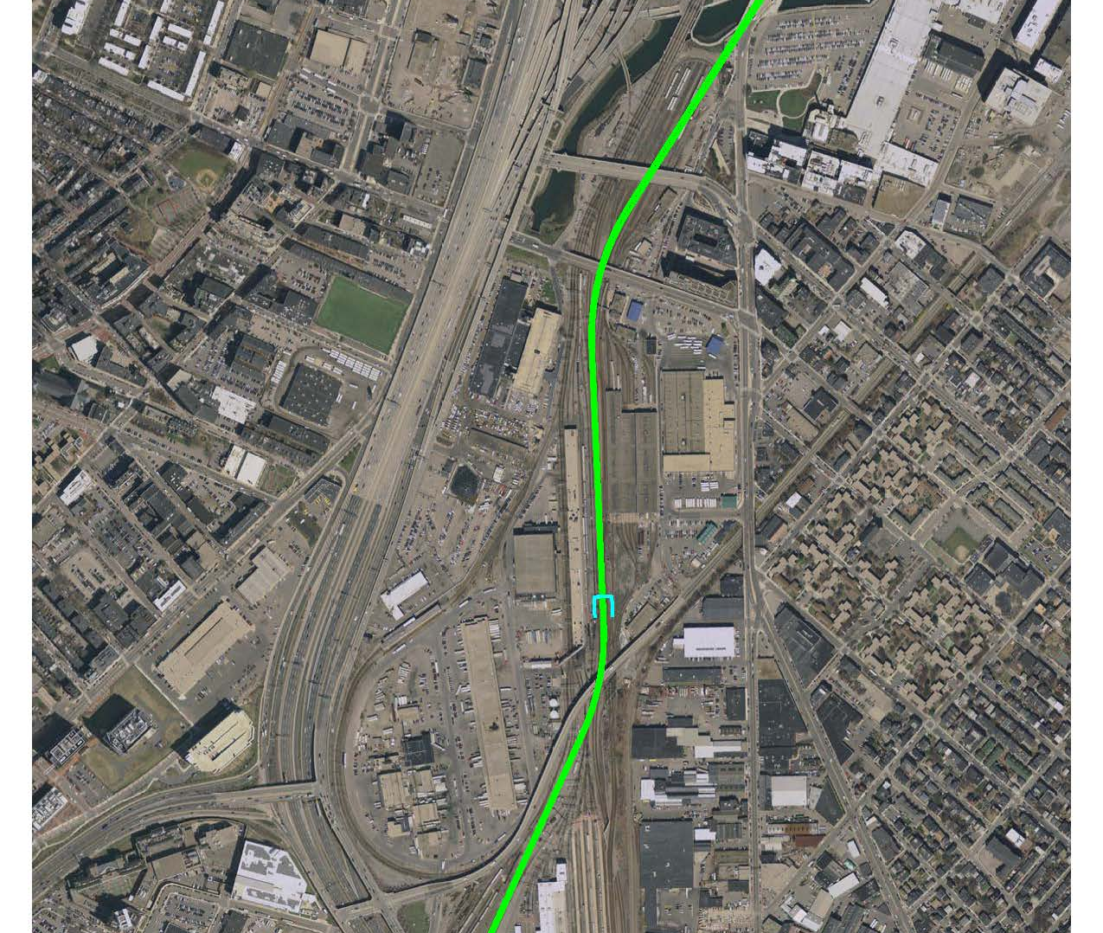
South Bay Portal
South Bay Portal only utilized in Central Artery Four-Track alternative. Necessary to accommodate Fairmount or Old Colony Lines.
Location: On the Fairmount Line, just east of Widett Circle
Method of Construction: Constructed using boat sections and cut-and-cover.
Construction Impacts: Service delays and interruptions.

Slide 51
Cost Estimates – NSRL Tunnel Costs
 | Central Artery 2 - track | South Congress | Pearl / Congress | Central Artery 4 - Track
Tunneling Works | $4,282,000,000 | $5,698,000,000 | $5,046,000,000 | $10,179,000,000
Stations | $1,396,000,000 | $827,000,000 | $2,643,000,000 | $4,214,000,000
Trackwork/Civils | $197,000,000 | $174,000,000 | $189,000,000 | $390,000,000
Portals | $1,723,000,000 | $1,723,000,000 | $1,723,000,000 | $1,770,000,000
Electrification Back Bay Portal to Chelsea, W. Medford, and Malden | $469,000,000 | $456,000,000 | $466,000,000 | $598,000,000
Layover Facilities | $106,000,000 | $106,000,000 | $106,000,000 | $106,000,000
Allowances | $456,000,000 | $508,000,000 | $528,000,000 | $472,000,000
Total | $8,629,000,000 | $9,493,000,000 | $10,701,000,000 | $17,730,000,000
2028 MP Construction USD rounded to the nearest Million
Assumptions:
Every alternative has 2 stations except for the Central Artery 4-track which has 3 stations
All tunnel alternatives replace 66 diesel trains with dual-mode locomotive trains

Slide 52
Cost Estimates – Vehicles
 | South Station Expansion All-Day Peak Service | Central Artery 2 - track | South Congress | Pearl / Congress | Central Artery 4 - Track
Dual Mode Locomotives to support tunnel | $0 | $391,000,000 | $391,000,000 | $391,000,000 | $391,000,000
Additional Dual Locomotives and Coaches to support increased service levels | $1,397,000,000 | $1,989,000,000 | $1,989,000,000 | $1,989,000,000 | $2,048,000,000
Total | $1,397,000,000 | $2,380,000,000 | $2,380,000,000 | $2,380,000,000 | $2,439,000,000
2028 MP Construction USD rounded to the nearest Million
Assumptions:
Every alternative has 2 stations except for the Central Artery 4-track which has 3 stations
All tunnel alternatives replace 66 diesel trains with dual-mode locomotive trains

Slide 53
Cost Estimates – Upstream Investments to Support Increased Service
 | South Station Expansion All-Day Peak Service | Central Artery 2 - track | South Congress | Pearl / Congress | Central Artery 4 - Track
Layover Facilities Widett Circle (Surf. Asp.) | Included in MassDOT’s SSX cost estimate | $405,000,000 | $405,000,000 | $405,000,000 | $405,000,000
Additional Platforms | $53,000,000 | $40,000,000 | $40,000,000 | $40,000,000 | $53,000,000
Double Track | $298,000,000 | $376,000,000 | $376,000,000 | $376,000,000 | $376,000,000
Turnback Crossovers | $9,000,000 | $14,000,000 | $14,000,000 | $14,000,000 | $14,000,000
Resignaling Critical Points | $472,000,000 | $472,000,000 | $472,000,000 | $472,000,000 | $472,000,000
TOTAL | $833,000,000 | $1,307,000,000 | $1,307,000,000 | $1,307,000,000 | $1,321,000,000
2028 MP Construction USD rounded to the nearest Million
Assumptions:
Every alternative has two stations except for the Central Artery 4-track which has three stations
The three 2-track alternatives involve replacing 48 diesels with dual-modes, expanding locomotive fleet with 72 dual-modes and 203 coaches
The Central Artery 4-track alternative involves replacing 58 diesels with dual modes, expanding locomotive fleet with 72 dual-modes and 203 coaches

Slide 54
Operating costs - Methodology
Train miles and hours provide the basis for the estimation of operating costs, including maintenance:
Distances are derived from the current MBTA Commuter Rail track network
Journey times are based on current schedule timings
Non-revenue mileage and train hours are based on assumed trainyard locations. (A high-level assessment of yard capacity has been undertaken)
The calculations do not allow for non-revenue moves between lines during operating hours or any additional movements required for rolling stock maintenance or refueling.
Mileage and hours are based on the whole consist rather than per coach.

Slide 55
Operating costs - Inputs
Train miles and hours per service alternative
 | Weekday Daily Totals
Service Alternative | Revenue Miles | Revenue Hours | Non-revenue Miles | Non-revenue Hours
No Build 2040 | 16,420 | 530 | 800 | 30
South Station Expansion All-Day Peak Service | 41,550 | 1,370 | 1,630 | 60
NSRL Regular Service (2-track) | 28,290 | 950 | 2,300 | 80
NSRL All-Day Peak Service (2-track) | 51,470 | 1,690 | 2,480 | 80
NSRL All-Day Peak Service (4-track) | 55,230 | 1,780 | 2,800 | 90

